Slide 1
Outline
Author

Slide 2
R Markdown
Slide outline template. See http://rmarkdown.rstudio.com.
Click the Knit button to make the slideshow.

Slide 3
Bullets
Bullet 1
Bullet 2
Bullet 3

Slide 4
Table by hand
Item | Number
Apples | 1,000
Oranges | 500

Slide 5
Table from code
Item | Number
Apples | 1,000
Oranges | 500

Slide 6
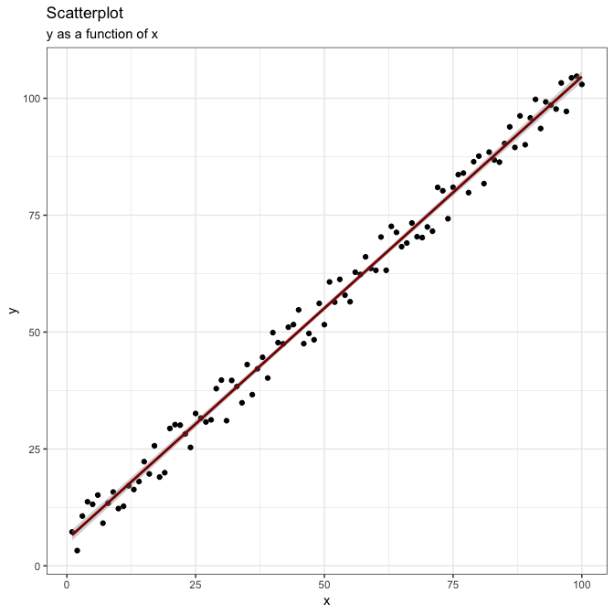
Plot from code

Slide 7

Plot from file

