Slide 1
GOLANG Q. A.
Norbert Bondarczuk
Norbert.Bondarczuk@hp.com

Slide 2

Agenda
GOLANG AS LANGUAGE
DEVELOPMNT PRACTICES
API BUILDING
ENCODERS/DECODERS
DATABASES
CONCURRENCY PATTERNS
MORE COMPLEX PROJECT STRUCTURES
QUESTEIONS & ANSWERS

Slide 3
GOLANG AS LANGUAGE
History
What is this?
What is it for?
Taxonomy
Family tree of Golang
Memory model
Types
Polymorphism: how it is done?
Processing model
Concurrency
Functional programming

Slide 4
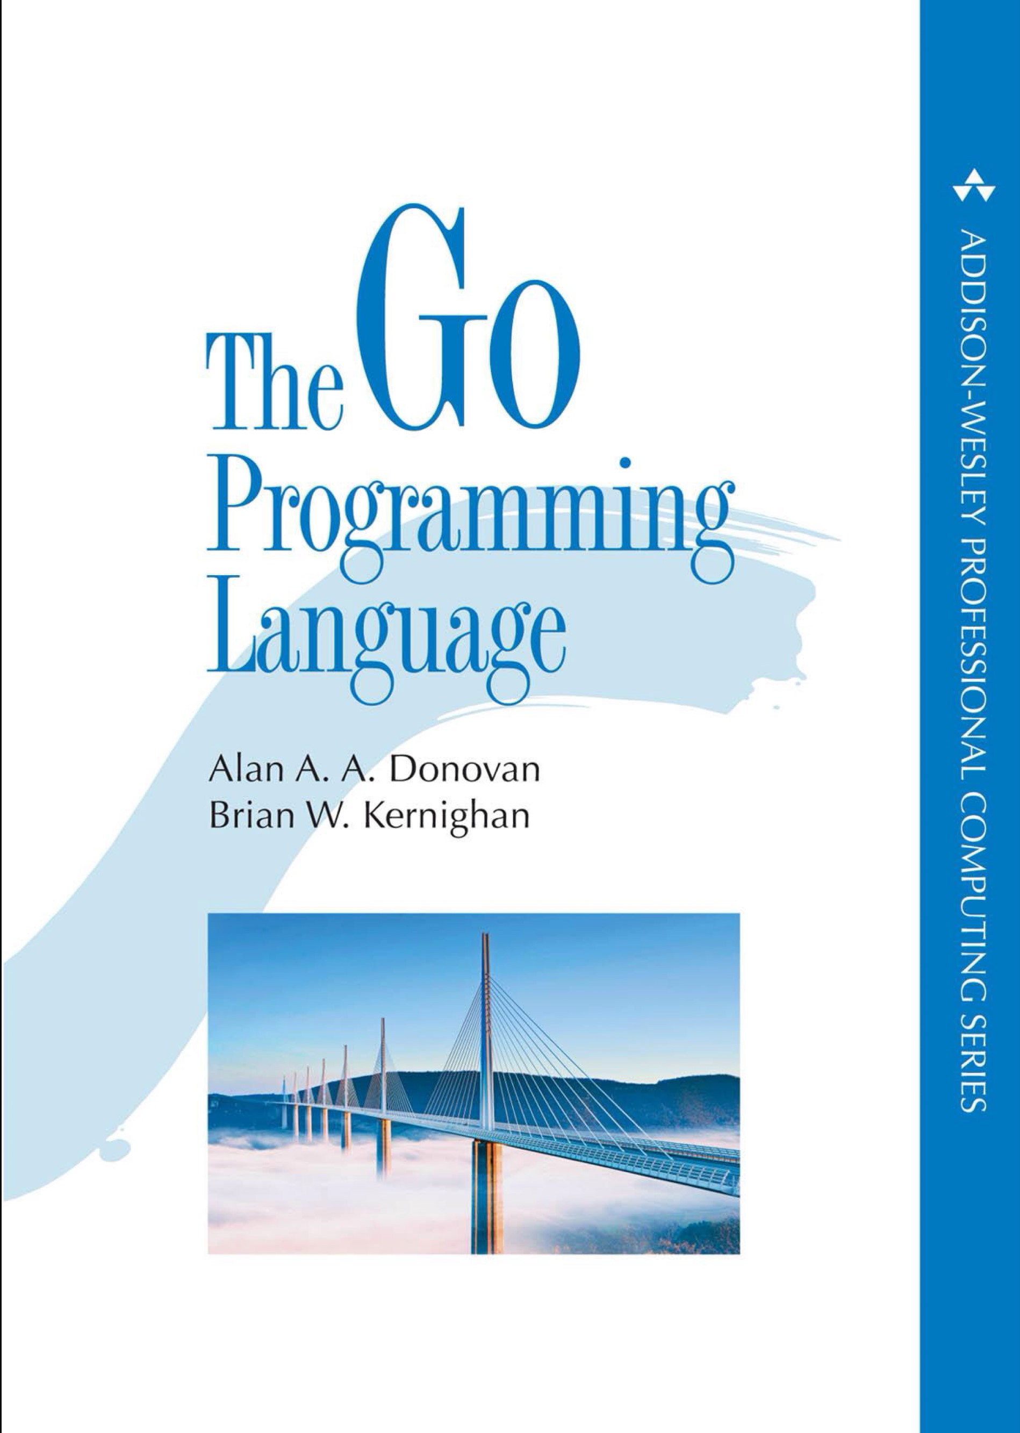
History
It was conceived in 2007 R. Griesemer, R. Pike, K. Thompson all working for Google (at the time).
Recommended reading materials ->

Slide 5
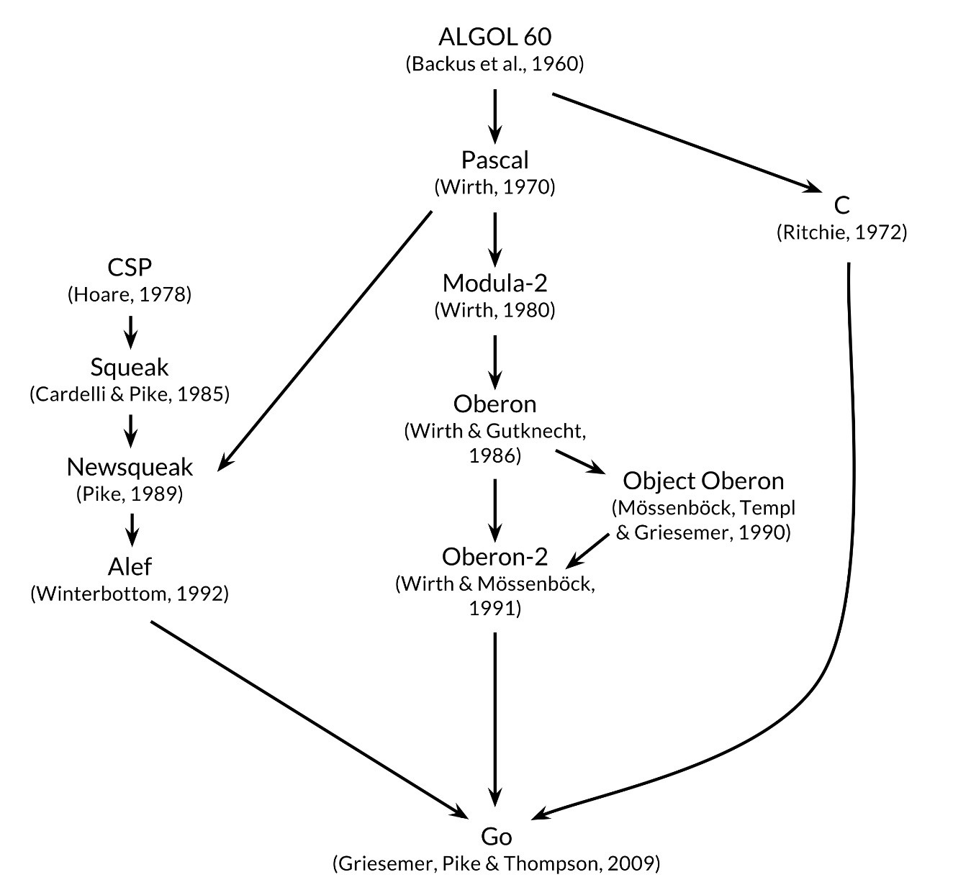
Family tree of Golang

Slide 6
What is this?
“Go is an open source programming language that makes it easy to build simple, reliable and efficient software” (From the Go site at golang.org)
The Go Programming Language
Tutorial: Get started with Go - The Go Programming Language
Documentation - The Go Programming Language

Slide 7
What is it for?
It encourages integration of open-source projects as all resources are publicly available, mostly from Github.
It has become popular as replacement for untyped scripting languages because it balances expressiveness with safety.
It is described as C for 21st century.
Some popular use cases are:
Lower lever system programming (but not the lowest)
Cloud systems (easy to embed in docker, Kubernetes)
API design (rich standard library)
Distributed systems (gRPC, REST)
Low memory systems (low memory footprint, good locality of usage)
Massively multiprocessor systems (cheap go-routine management)

Slide 8
Taxonomy
Golang comes from Pascal, Module, Oberon family of Algol-like languages.
It is used as better C or slimmed down C++.
Its compiler produces executable machine code which is different from Java or Python.
It has objects and a sort of inheritance but no classes.
It provides some recently popular features like “duck type” polymorphism, inheritance.
It provides some super-features like CSP like channels and go-routines.
It gives a lot in terms of development environment (go command).
It encourages “safe”or defensive programming putting clarity over verbosity (short identifiers).
Many features were made to write programs easily (no semicolons, no explicit memory management, no while loops, etc.).
It is easy to learn, hard to master.
Usually the good go code is well documented, written for the user to read.

Slide 9
Memory model
Variables are allocated either on heap or on stack. It can be explicitly (keyword var) or by automatic assignment (operator := instead of =)
Variables are strongly typed. Type conversions must be explicit.
The location of the variable depends on its usage. Local variables are placed on the stack, the ones used by reference or pointers are placed on the heap.
There is a under the hood allocation/deallocation of memory. It is not explicit as in C, using malloc, free library calls.
The memory for the variables are allocated by runtime and deallocated in the background.
The GC – garbage collector cleans unused memory.
The go-routines have their own dynamic stack.
The memory is allocated either implicitly or explicitly with commands like new or make.
The new allocated memory is 0 filled (depending on the type). Each type has zero value.
There is no address arithmetic but pointer are allowed but not so welcome (they cause usage of heap).

Slide 10
Types
Type defines classes of compatibility between objects – what can be assigned to what.
Golang is unlike C, a strong typed language.
There is no implicit type conversions.
Compound types like structures may be assigned but they must be compatible ie. their fields and types must be the same.
Objects can have associated functions. They are “attached” to their “receivers”.
The type as an objects as well. It is a consequence of dynamic typing.
The meta-info about type is available to the program via type checks an/or reflection library.

Slide 11
Polymorphism: how it is done?
It is a way of accessing opaque objects with generic handles.
It is done with interfaces and dynamic method binding, just Python-like duck typing.
They define a set of functions to be called on an objects fulfilling given interface.
The interface determines what an object can do so the common style of calling them with verbs ending on –er, like Stringer, Reader, Writer, etc. They are supposed to do one thing but do it well. That’s why many of them has just one function.
There is also a zero value for all interfaces. It is any or interface{} type. It is a supertype of all interface-like types.
Interface can be nil as well which leads to some corner cases when we try to call a method on a nil object.

Slide 12
Processing model
The runtime provides asyc go-routines mapped to system threads in N to M model.
A go-routine may be started asynchronously with command go.
It operates in common memory so the variable access sharing is necessary.
The runtime manages go-routines unlike pthread models where threads are managed explicitly by a library.
Errors may be handled with exceptions called panic but the recommended ways is to handle errors as values ie. objects having an Error interface.
The defer function can be used to cleanup the allocated resources after function call exit.

Slide 13
Concurrency: how it is done?
Concurrency is not just parallelism ie. many processing threads in one program.
Golang, as practically only one programming language implements Hoare’s model of communicating sequential processes - CSP.
There are go-routines
They communicate each with the other using 1-directional channels.
Channels may be buffered or not.
A process or go-routine or writer sending a message on a unbuffered channel will wait till a reader will pick up the message.
In case of buffered channel (defined with a declared size), if buffer is not full it will not wait but the message will be left for a reader.
Instead of using mutexes we can use channels. However, mutexes are there as well to share the memory in old fashioned way.

Slide 14
Functional programming
Functions are objects.
Functions operate on values. Usage of call can be by reference but it is not considered as good practice as it encourages optimizer to use heap instead of stack for the variable.
They can be treated as values. They may be passed as parameters or returned as values.
They can be closures ie. they can catch references to the local variables and they can work on them, changing their values.
Variadic parameters for functions are quite normal practice. There is a special for range construct to use them (unlike C or C++ where it is done by a library function).

Slide 15
DEVELOPEMNT PRACTICES
Installation
Compilation
Packages
Example of most trivial program
Projects
DDD and hexagonal structures
Unit testing
Benchmarking

Slide 16
Installation
Usually we need to install Golang using system specific package managers
Linux: apt install go
MAC OS X: brew install golang
MS Windows: packman install golang
What we get is a go command installed together with some tools.
The location of the projects shall be given by env variable GOPATH.
The executable go shall be accessible with paths stored in PATH env variable.
Golang development environment is supposed to be used from command line.
It is supposed to be the same on all platforms.

Slide 17
Compilation
Having a project created with some structure the go build command is used to compile the code.
Another command is go run which compiles the objects, builds an executable and runs it in the current shell.
The go build command shall be used in the root of the project.
The code shall be formatted in an uniform waw using tool: go fmt.
It is very easy to do cross-compilation. What we need is just a env variable determining target architecture (ARM, x86_64, etc.) and platform (Linux, Mac OSX, Wintel, etc.).

Slide 18
Packages
The modular structure of a program is made of packages.
Packages may be imported with import command.
Only one function called main() may be placed in package main. This is main entry of the program. This is where the whole processing is initiated.
The init() function of a package, is defined in a module, will be called earlier than that. This allows to initialize things which have to be done before main function is started.
The objects (functions, types, constants, variables) of a module to be exported must have name starting with big capital letter.

Slide 19
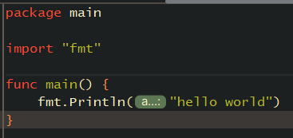
Example of a most trivial program
golang-q-a/examples/1/hello-world.go at main · nbondarczuk/golang-q-a · GitHub

Slide 20
Projects
A more non-trivial program has more complex modular structure than hello world with only one module main.
It is normally composed of several subdirectories where separate packages are stored
It is mandatory to name the packages the same as top current directory.
The go mod init command is used to initialize the project in its root directory.
The go mod tidy command is used to manage dependencies as they are stored in files go.mod, go.sum. They are stored in the main dir of the project.
The go get command is used to download the dependent libraries if they are listed in the import section and were not downloaded yet.
The go compile command builds the executables of some useful tools.
The go install builds some specific command line tools.
There is no specific project structure but there are more or less “good” practices.

Slide 21
DDD and hexagonal structures
The DDD methodology requires that the structure of a project has circular layers.
The lowest, most persistent kernel are business entities stored in packages like model.
The other layers like interfaces are placed around it.
The database and caching is an add-on detail. It may be plugged-in in the later phase. It may be mocked easily.

Slide 22
Unit testing
The TDD is very much encouraged but it is not compulsive.
A package testing is available for building unit tests.
A better one, called testify may be used. It has add-ons like suites and assertions. They make coding more comprehensible.
A unit test may be started with command go test.
The files with unit tests are ended with _test.go.
The tests are in functions starting with Test and one parameter *testing.T.
The package testing shall be imported in the file where tests are stored.
Some flags like –v,-short, -cover are quite useful.
When a specific test case shall be run, it can be done with command go test <PACKAGE> <TEST-FUNCTION-NAME>
The bests tests are table driven so that many cases must be checked.

Slide 23
Benchmarking
Benchmarks are very similar to unit tests. The whole difference is that testing is replaced by benchmarking.
Usually, benchmark run some function in a look with given number of N iterations.
The files with unit tests are ended with _test.go.
The tests are in functions starting with Benchmark and one parameter *testing.B.
The package testing shall be imported in the file where benchmarks are stored.
A unit test may be started with command go test –bench=..

Slide 24
API BUILDING
Standard library package net/http
An example of web client/server

Slide 25
Standard library package net/http
Very rich standard library allows quick & easy creation of web services.
The main notion is a handler. It connects a request with a response.
This happens on a specific path. Some query attributes can be added. The paths may have variable parts which may be used to store the id of resources.
Some other parts may be controller, changing state of some resource.
This is called REST model.
It is easy to mock a service using standard library package net/http/httptest.

Slide 26
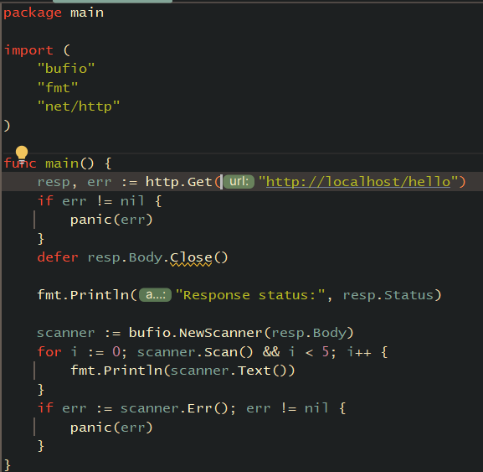
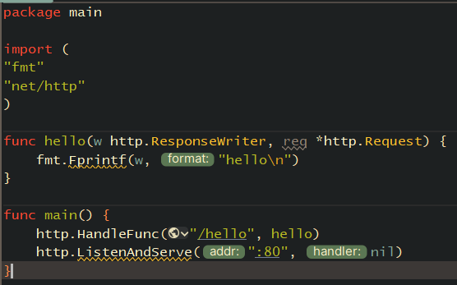
Example of web client/server
golang-q-a/examples/2/client.go at main · nbondarczuk/golang-q-a · GitHub
golang-q-a/examples/2/server.go at main · nbondarczuk/golang-q-a · GitHub

Slide 27
ENCODERS/DECODERS
Structure annotations
JSON encoding/decoding
XML encoding/decoding

Slide 28
Structure annotations
Structure annotations are just comments on the fields of a structure.
With reflection, they can be used to give hints to encoders/decoders in order to build terminal version of a structure – in a certain format, depending on the encoder/decoder.
It can be JSON, XML, YAML, SQL statements covered by GORM, etc.

Slide 29
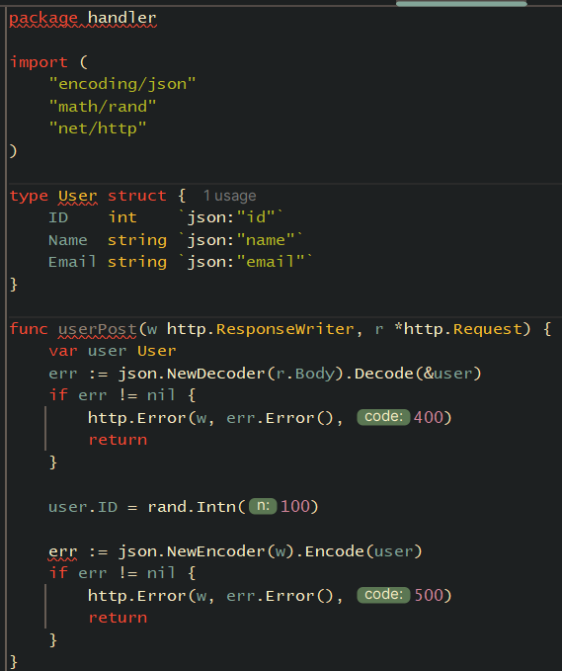
JSON encoding/decoding
JSON annotations in structures are facilitating encoding/decoding of JSON messages.
This is part of standard library.

Slide 30
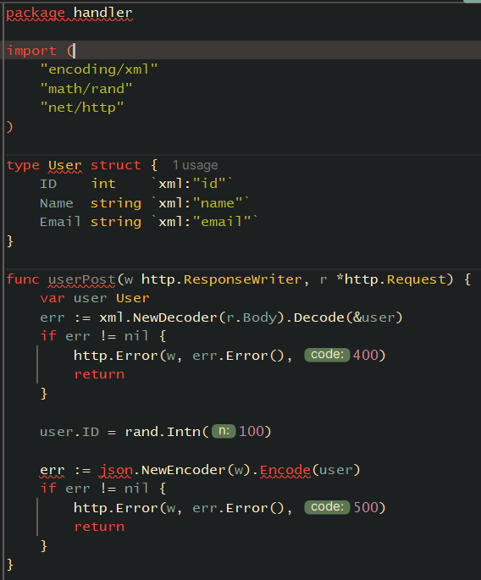
XML encoding/decoding
XML annotations in structures are facilitating encoding/decoding of XML messages.
This is part of standard library.

Slide 31
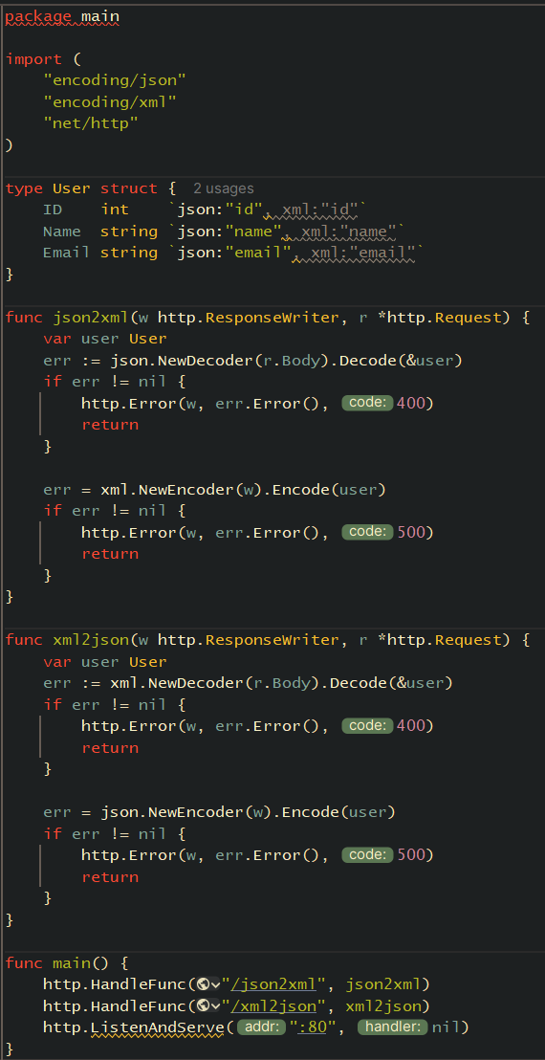
JSON/XML translator
Very simple server translating structure in one format to another.
It is done by adding annotations for both of the formats
The unit test is done with curl
Full example at: golang-q-a/examples/3/server.go at main · nbondarczuk/golang-q-a · GitHub

Slide 32
DATABASES
GORM: How to access a DB?

Slide 33
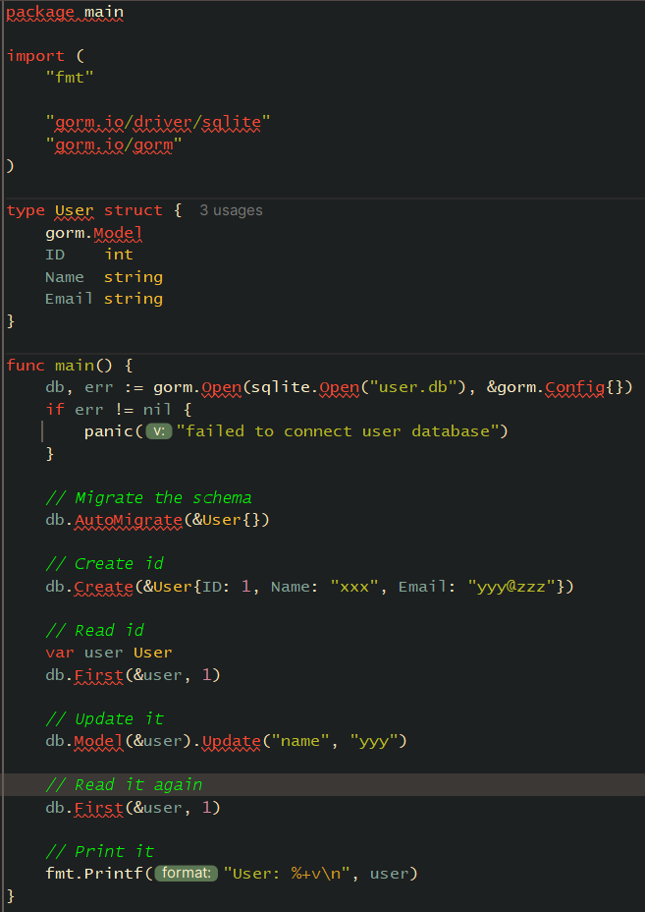
GORM: How to access a DB?
GORM - The fantastic ORM library for Golang, aims to be developer friendly.
go-gorm/gorm: The fantastic ORM library for Golang, aims to be developer friendly (github.com)
golang-q-a/examples/5/gocrur.go at main · nbondarczuk/golang-q-a · GitHub

Slide 34
CONCURRENCY PATTERNS
Workers pool

Slide 35
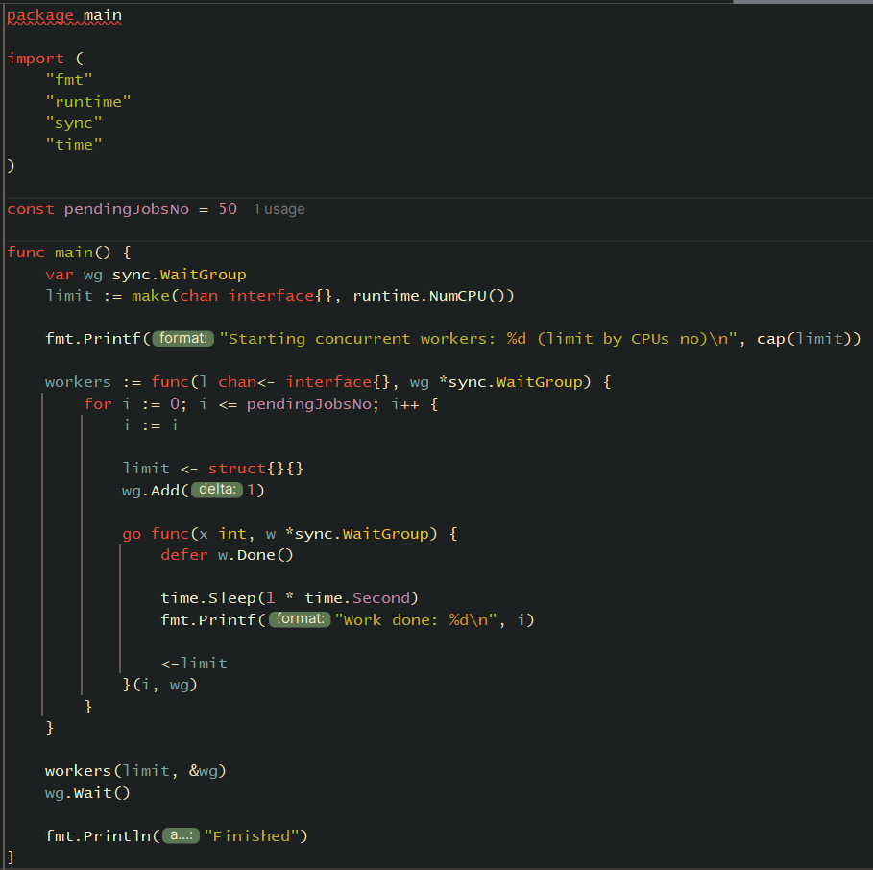
Example of worker pool
This is more complex example of a pool of workers processing fixed number of task concurrently.
golang-q-a/examples/4/workers.go at main · nbondarczuk/golang-q-a · GitHub

Slide 36
MORE COMPLEX PROJECT STRUCTURES
Imaginary Go bank API project

Slide 37
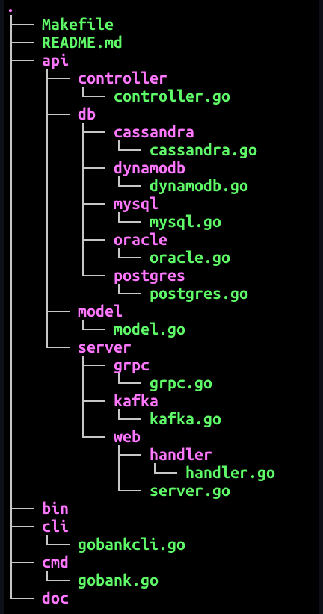
Example of an imaginary bank API
This is an example of more complex project structure
golang-q-a/examples/6 at main · nbondarczuk/golang-q-a · GitHub

Slide 38
QUESTION AND ANSWERS
Go proverbs – quiz
Examples for workshop

Slide 39
Go proverbs - quiz
Errors are values.
Don’t just check errors, handle them gracefully.
Don’t panic.
Make the zero value useful.
The bigger the interface, the weaker the abstraction.
interface{} says nothing.
Gofmt’s style is no one’s favorite, yet gofmt is everyone’s favorite.
Documentation is for users.
A little copying is better than a little dependency.
Clear is better than clever.
Concurrency is not parallelism.
Don’t communicate by sharing memory, share memory by communicating.
Channels orchestrate; mutexes serialize.
Rob Pike, Go Proverbs (see go-proverbs.github.io)”

Slide 40
Code examples for workshop
Available at: golang-q-a/examples at main · nbondarczuk/golang-q-a · GitHub

Slide 41




Thank you
Norbert Bondarczuk
Norbert.Bondarczuk@hp.com

