Slide 1
Solutions- Biz2Credit-DataScientist
By
Neha Bora

Slide 2
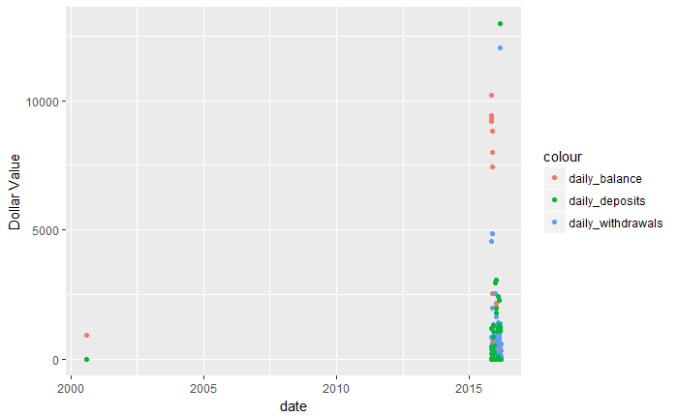
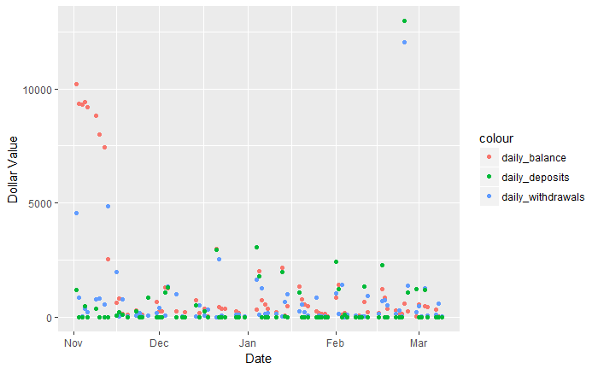
Q2(i) userid: 219154, bank_account_id: 4614 - plot the withdrawals, deposits and daily balance as a daily time series
Zoomed In
15
15
16
16
16

Slide 3
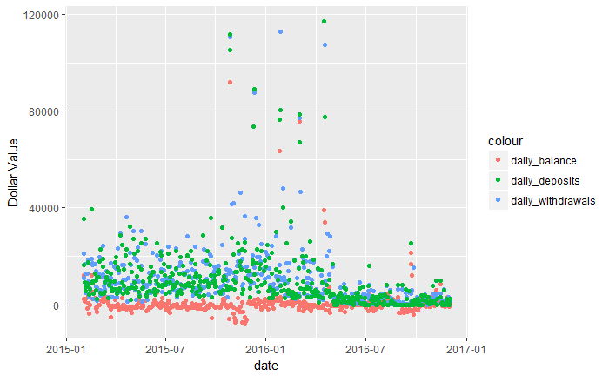
Q2(ii) userid: 217867, bank_account_id : 5420 - plot the withdrawals, deposits and daily balance as a daily time series

Slide 4
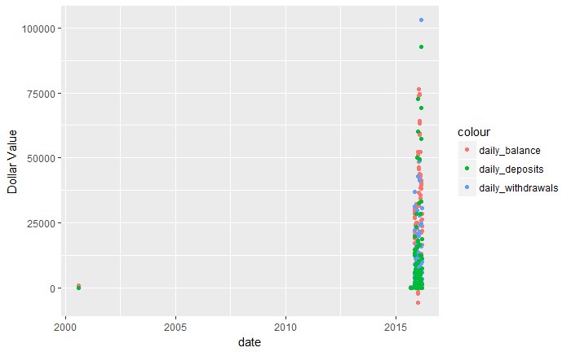
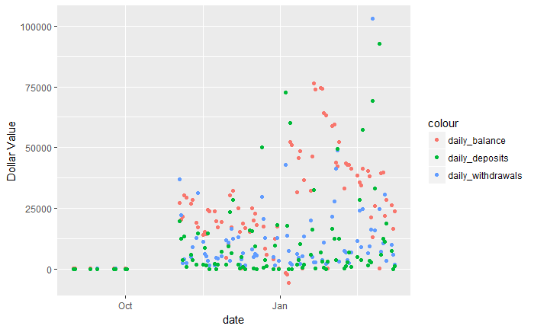
3(i) userid: 219154 - plot the withdrawals, deposits and daily balance as a daily time series (aggregate over all their bank accounts)
Zoomed In
15
16

Slide 5
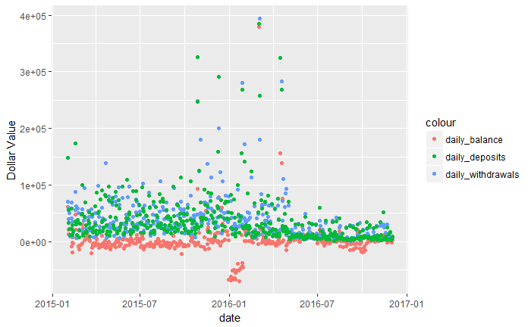
3(ii) userid: 217867 - plot the withdrawals, deposits and daily balance as a daily time series (aggregate over all their bank accounts)

Slide 6
4. Subcategories based on transaction method
ach - Automated Clearing House : Bank to Bank transfers within US
cc - Credit/ Debit Card
direct – Payment made by depositing/withdrawing cash or check
Latefees – Overdraft charges
online_transfers - ONLINE or INTERENT transfers
other – payment by other methods
paymenttechs - payment using third party services like Heartland Payment Systems
Wallet – Payment by VENMO/ PAYPAL/ STRIPE similar apps

Slide 7
5. Other cash flow variables can you hypothesize that could be relevant for predicting customer default?
1. Debit/ Credit ratio
Less than one means lesser deposits than withdrawals which could be used to identify defaulters
2. Percentage of total withdrawals made for loans and insurance w.r.t total deposits or withdrawals
This would give us an idea of what percent of a customer’s income is spent on loans and thus will help in predicting customer default.

Slide 8
4. Ideas to classify transactions into subcategories
Use classification based of expenditure : Travel /Groceries/Shopping/ Services etc.
We could use k-means on amount to cluster transactions

