Slide 1
/home/user0/venv/bin/python example.py
process pid: 100
load
/root/usr/bin/python2.7
execute
/root/usr/bin/python2.7
read
/home/user0/project/example.py
read
/home/user0/data/dataset.xml

Slide 2
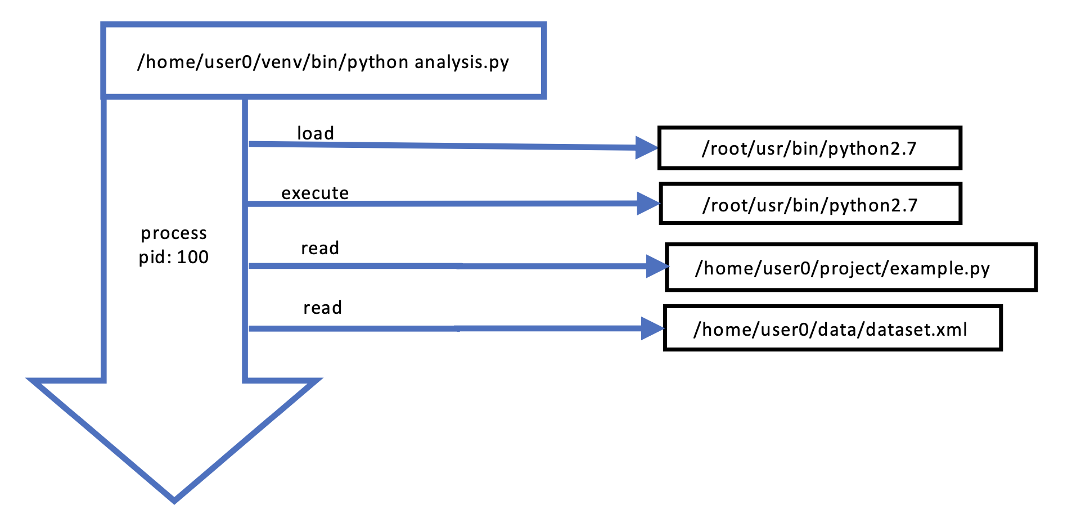
Summary:
The user executed the script "example.py", located in the /home/user0/project/ directory. They executed the script using Python version 2.7. The script accessed a dataset located at /home/user0/data/dataset.xml.

