Slide 1
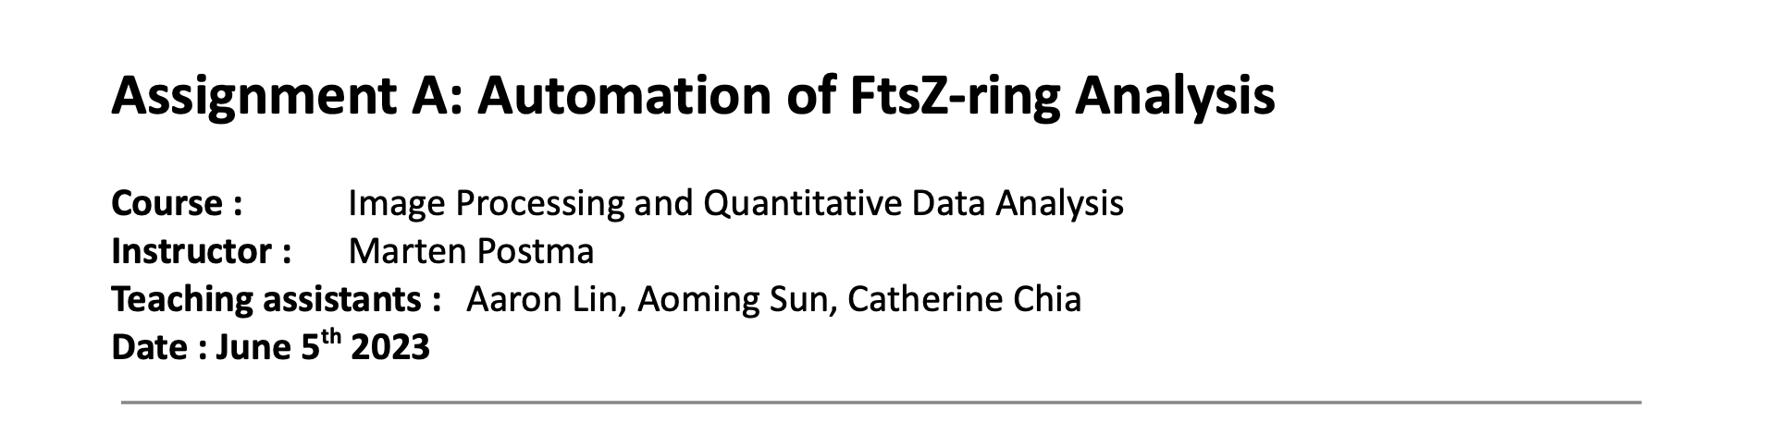
Assignment overview

Slide 2
Mini assignments (30% of total grades. Passing total grade 5.5)
General scopes of question. To demonstrate:
Understanding about the data and workflow
Your methods and the ability to explain them to your readers (hint: use code comments)
Understanding about the results and relations to the biological meaning
Submission:
One PDF for texts, figures and tables (please refer to the provided template)
Single or multiple ImageJ and/or Python scripts
One zipped folder(s) of processed image data

Slide 3
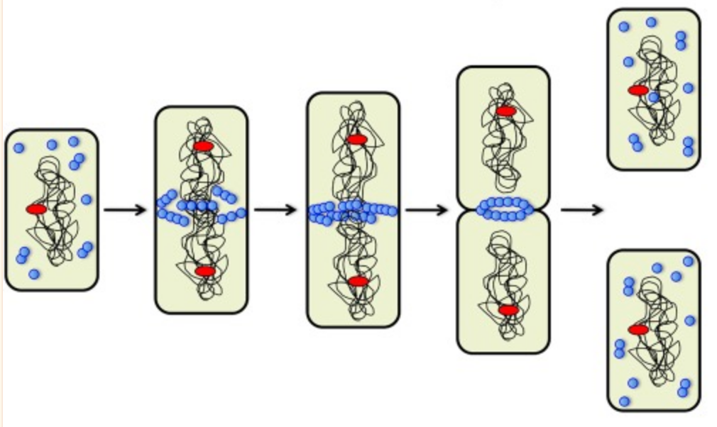
FtsZ-ring and bacterial cell division
(Huang et al., 2013)

Slide 4
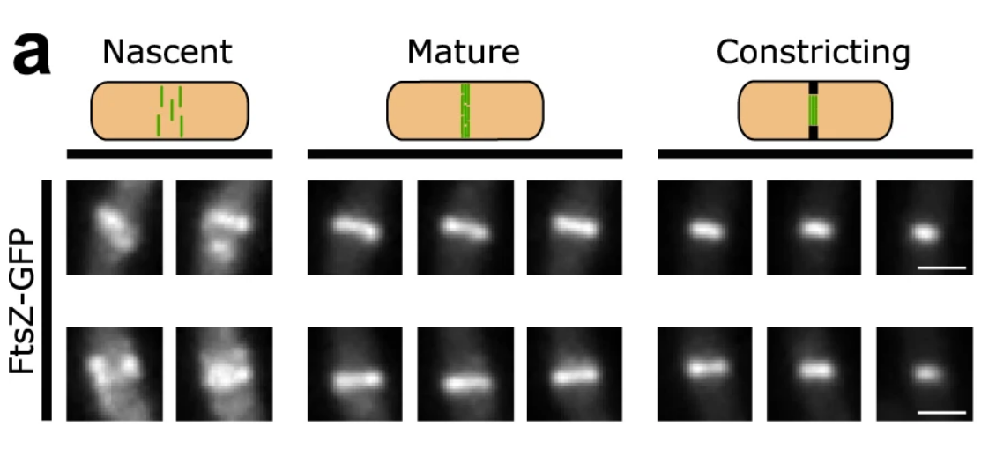
FtsZ-ring diameter changes as the cell approaches division
https://www.nature.com/articles/s41467-021-22526-0/figures/1

Slide 5
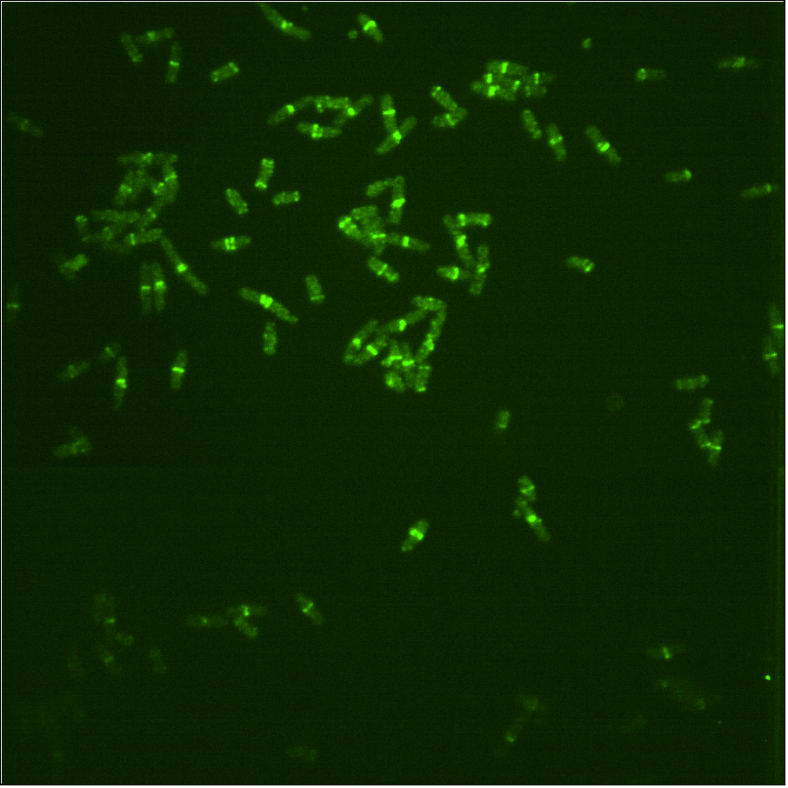
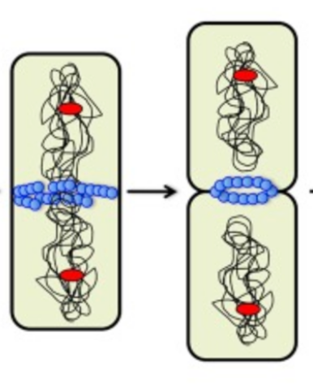
Dataset FTSZ6_1.5x.nd2
Z layers

Slide 6



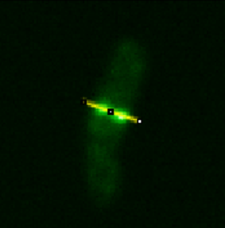
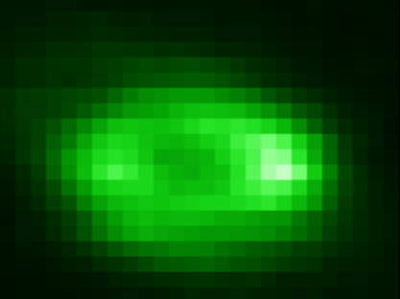
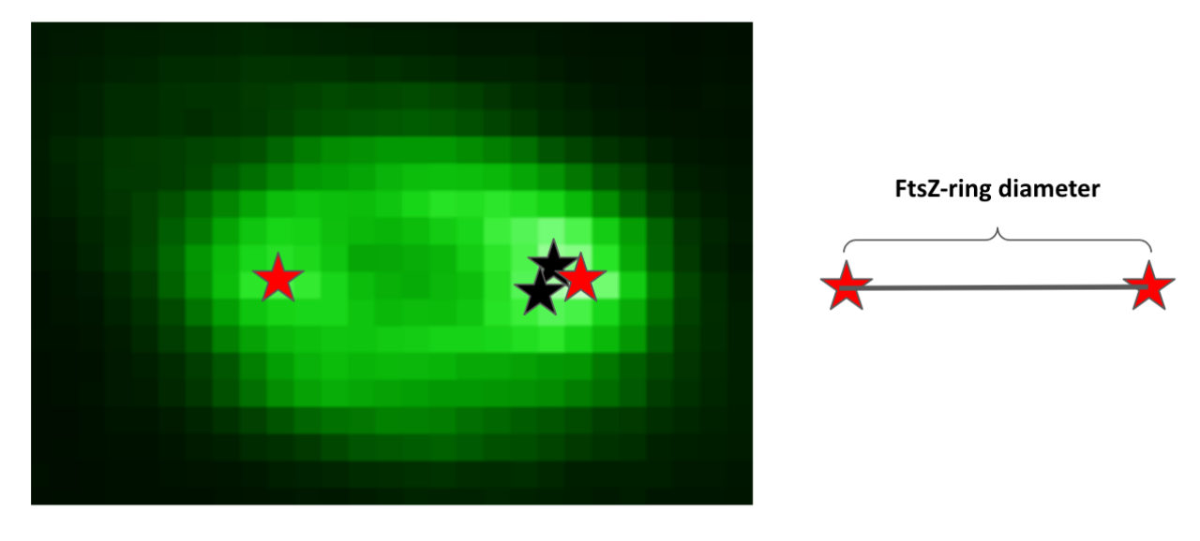
Tasks
Research question:
Are all the cells at the same stage of cell division?
*.nd2
Import *.nd2
Extract cross-section of the cells as images
Import preprocessed images
Compute FtsZ-ring diameter
Present results in plot(s)
(Optional) run statistics
Submission:
ImageJ macro
Python script
ROI lines
Preprocessed images
Report PDF

