Slide 1
Module2
File created on: 7/27/26 1:21:32 PM PDT

Slide 2
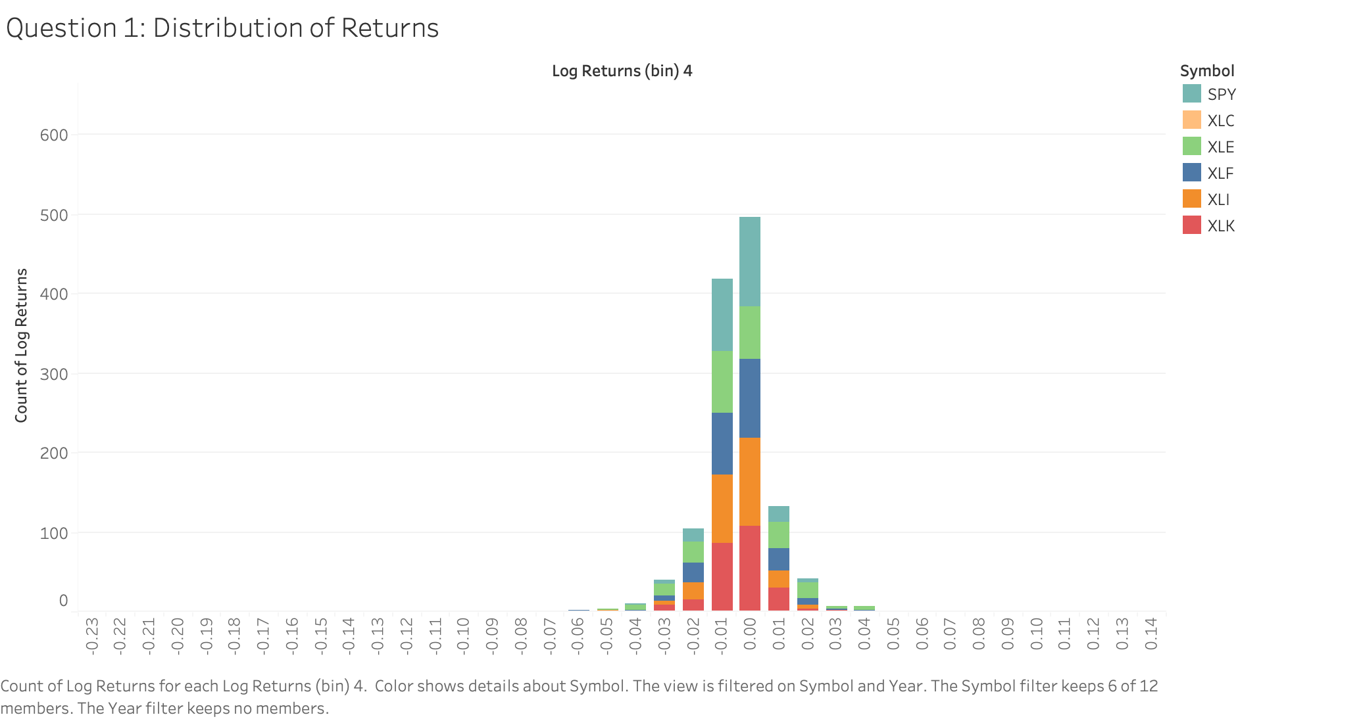

Slide 3
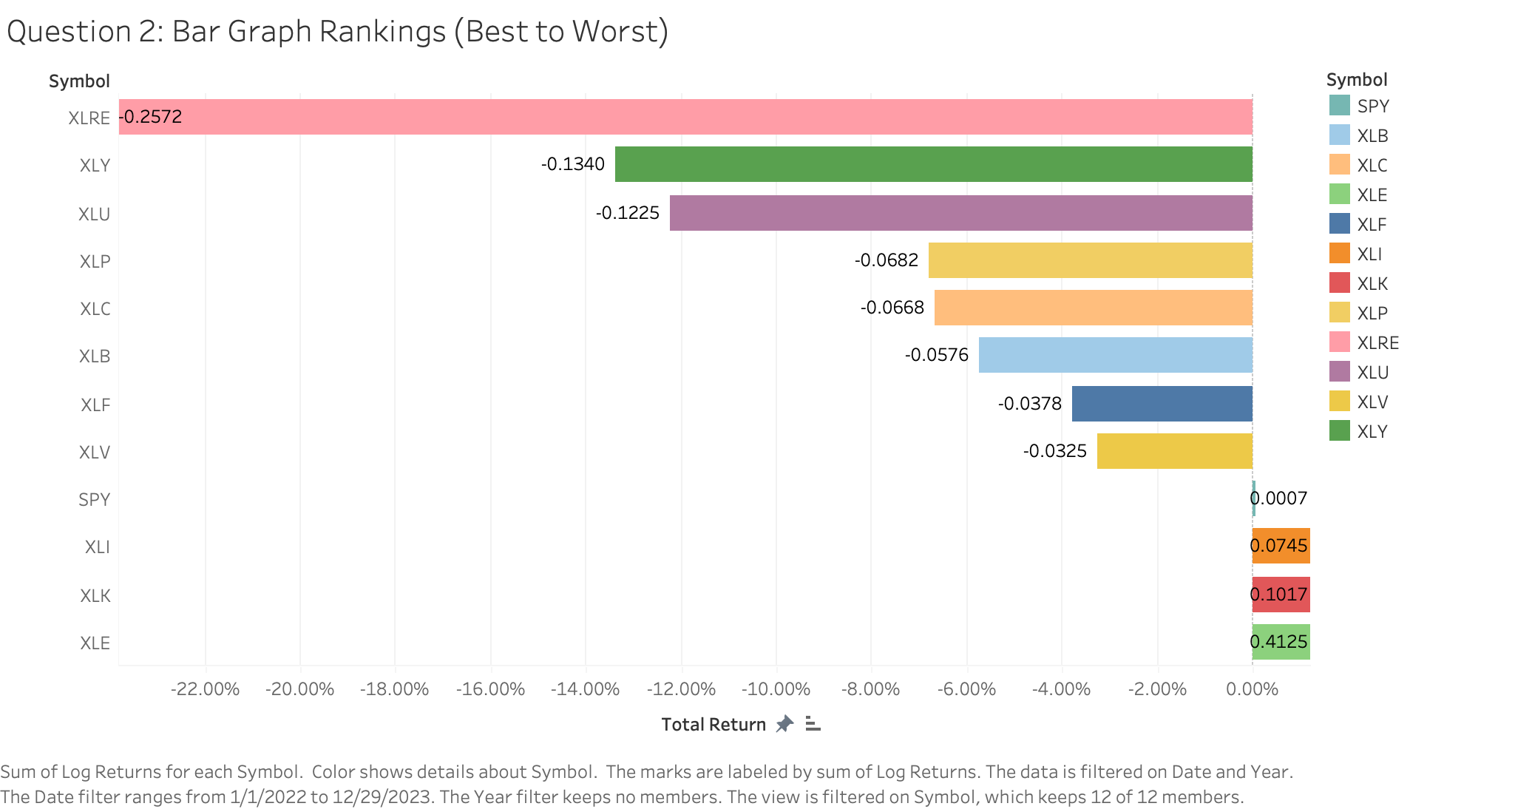

Slide 4
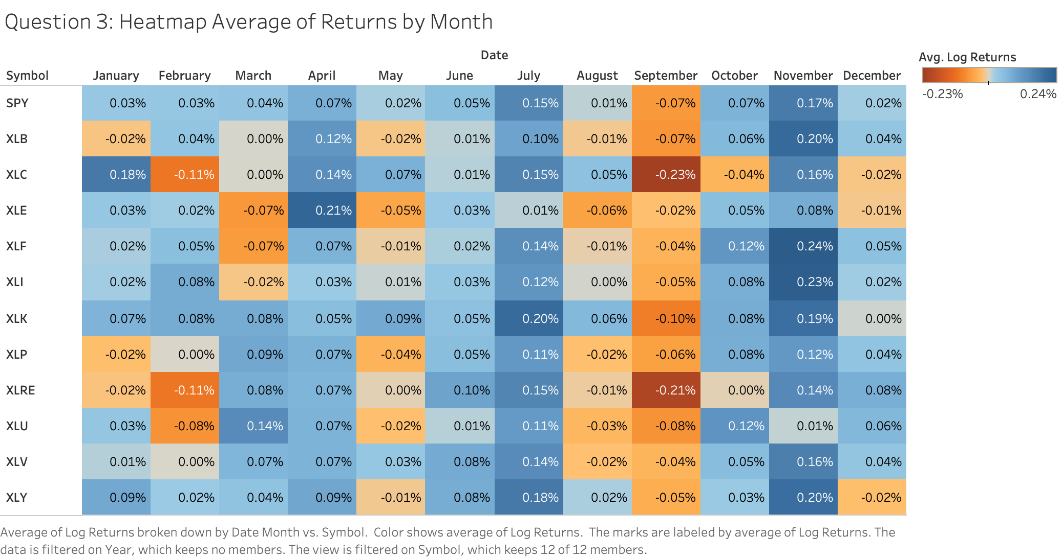

Slide 5
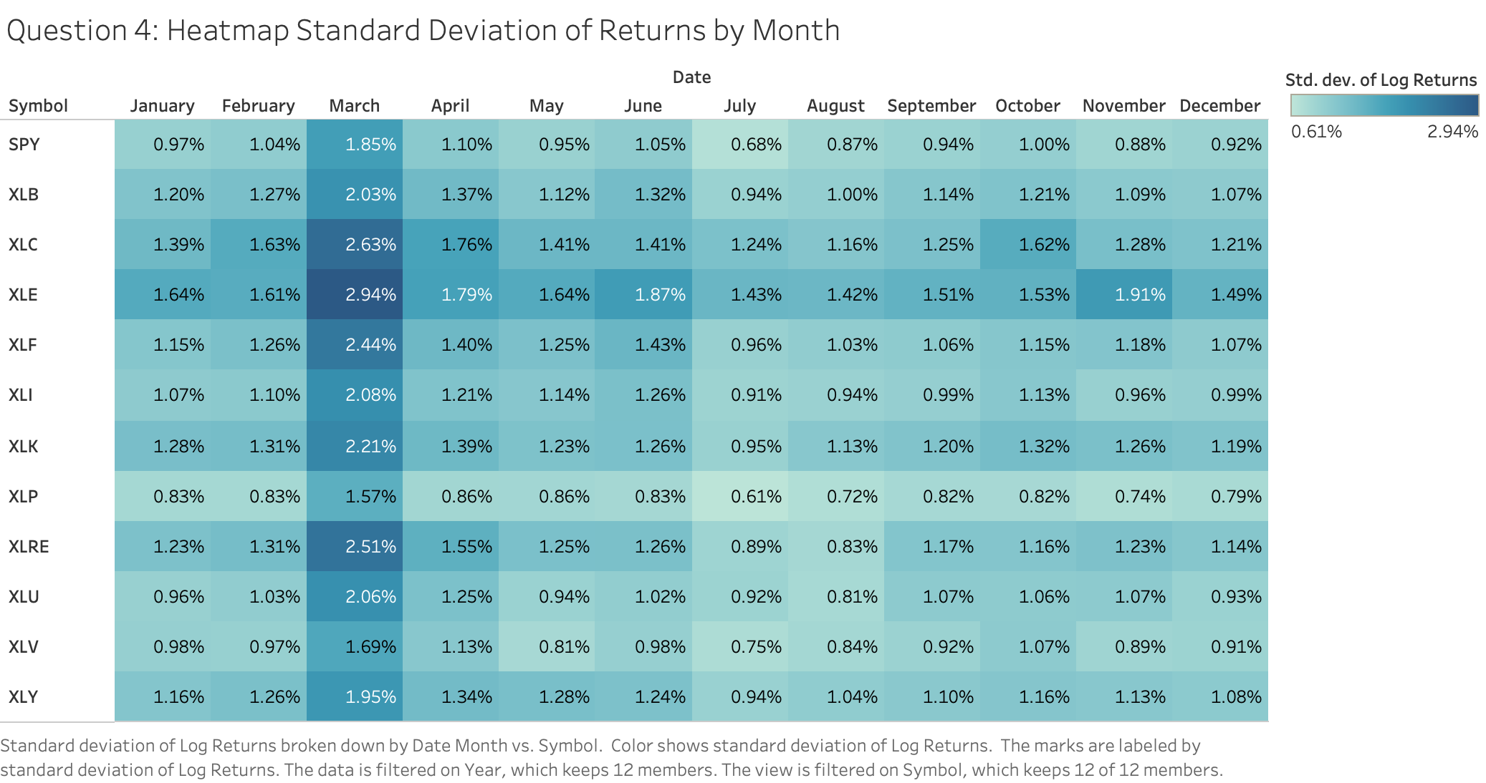

Slide 6
