Slide 1
Module3
File created on: 7/27/26 1:24:01 PM PDT

Slide 2
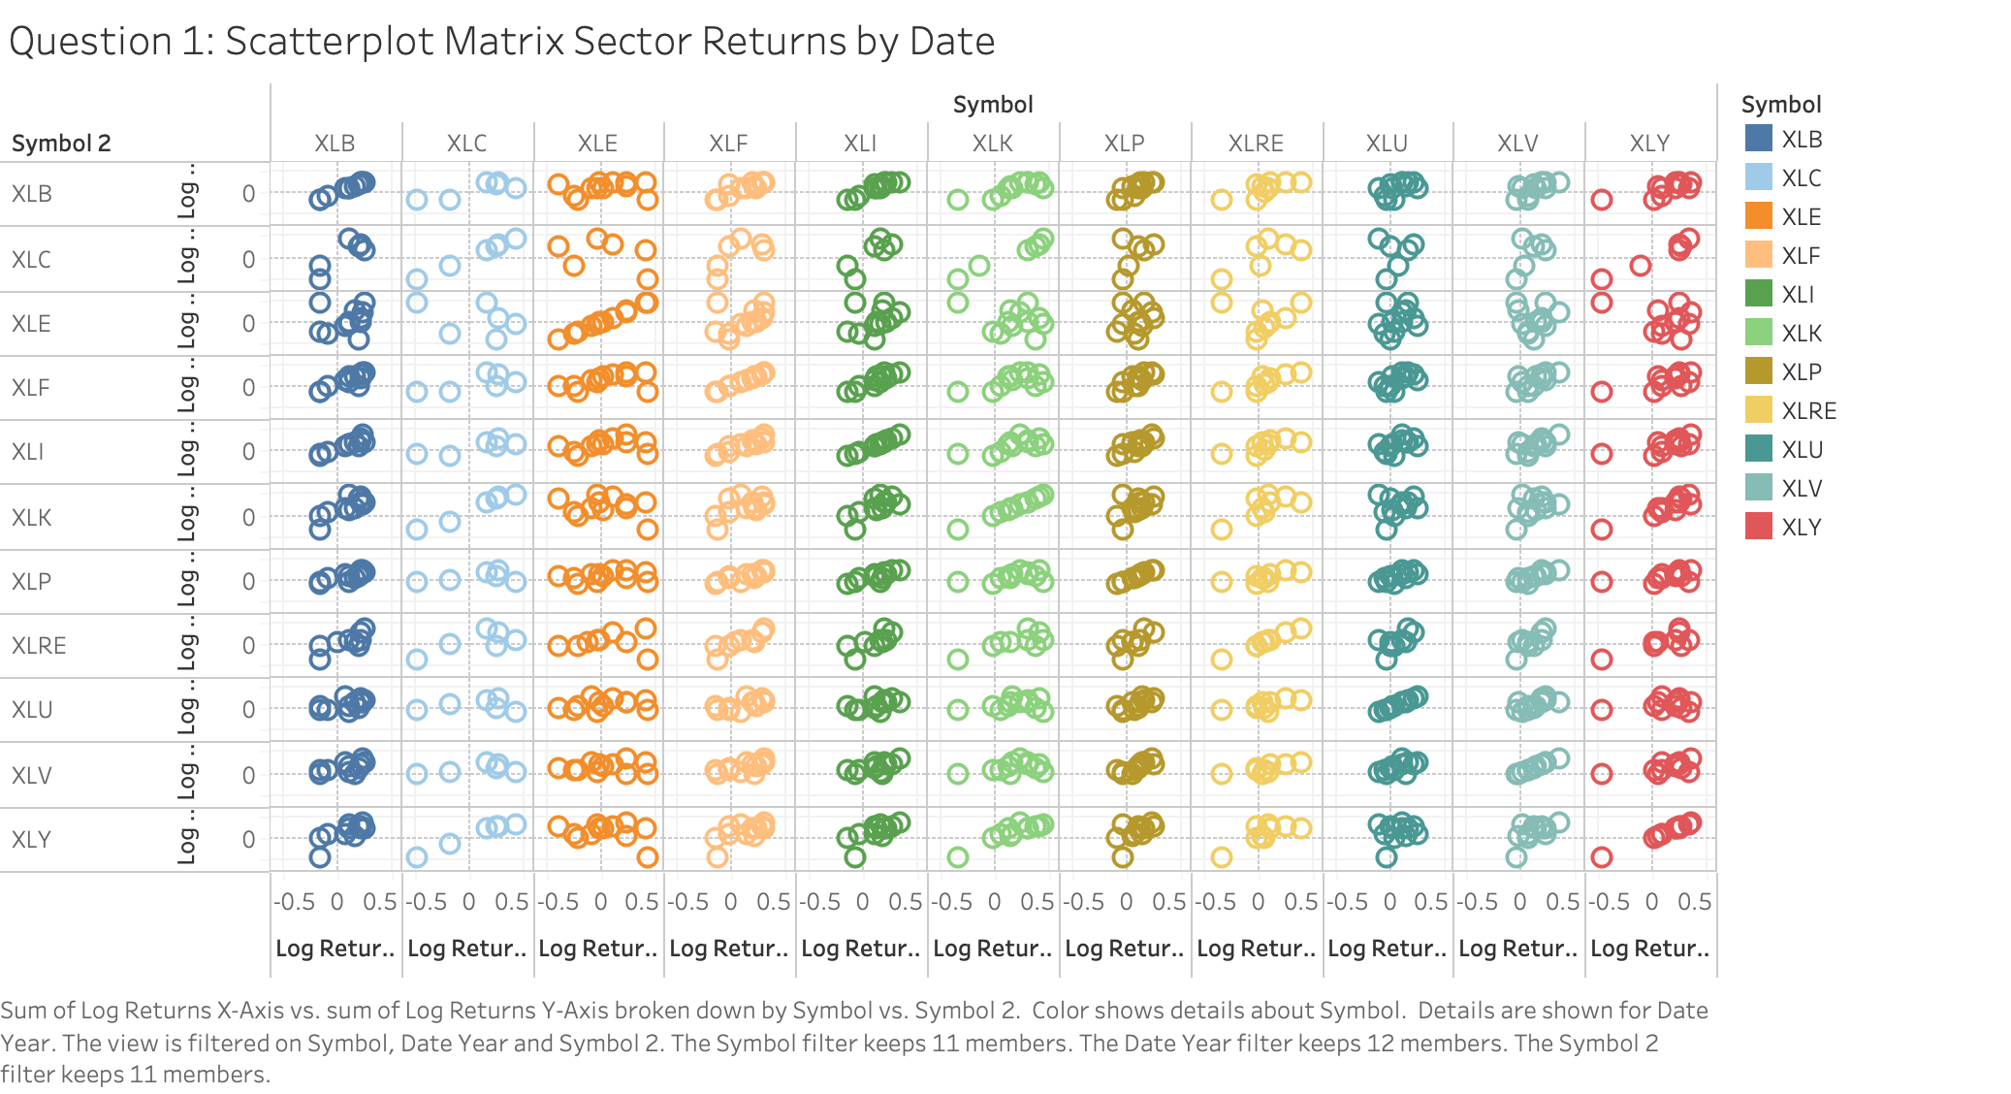

Slide 3
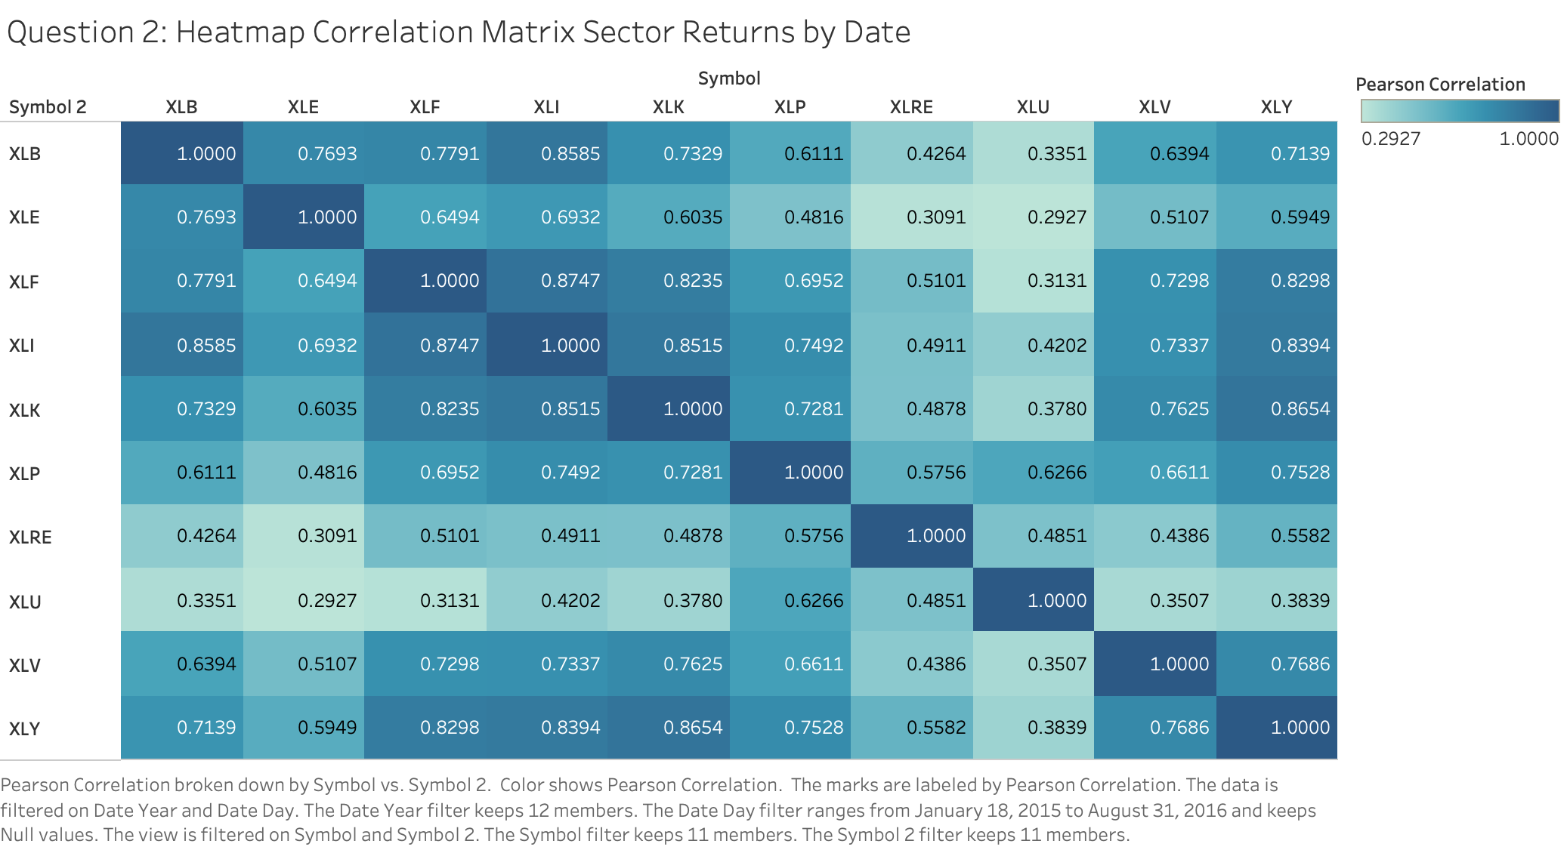

Slide 4
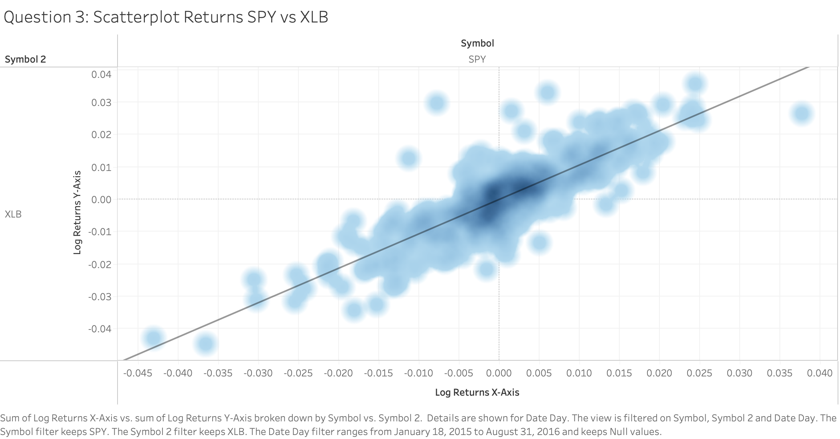

Slide 5
