Slide 1
Community Events and
Participation Database (CEPD)
COMP-4421-1 — Database Organization & Mgmt I
Relational database design, synthetic data generation, SQL analysis, and visualization
Make information easier for people to understand and use.

Slide 2
Problem Definition and Purpose
Why this database matters
How an organizer could use this information
Event sign-ups, check-ins, and memberships can end up in separate places.
1
Are we hosting more or fewer events over time?
2
When members RSVP, how often do we record a check-in?
Collecting information is only part of the job.
3
Are low check-in rates limited to a few events or happening across the organization?
Organizers also need a way to understand what is happening in their communities.
This database keeps related records together so participation can be reviewed in one place.
4
How many people check in without registering first?
Metrics can point to issues, but they do not explain why a community is succeeding or struggling.

Slide 3
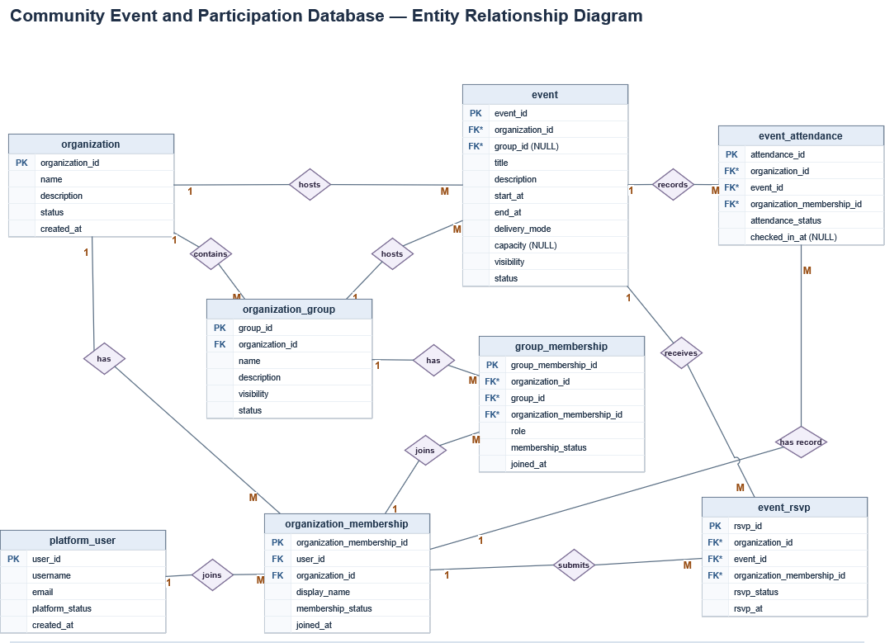
Relational Database Design
The structure follows the path from community
membership to event participation.
platform_user stores one global account per person.
organization and organization_membership connect people to communities.
organization_group and group_membership capture smaller groups inside a community.
event stores organization or group events.
event_rsvp stores event responses.
event_attendance stores attendance results (attended / absent).
Eight related tables organize people, communities, events, RSVPs, and attendance.

Slide 4
Constraints and Integrity
DATABASE CHECK
SQL VALIDATION · QUERY 8
Invalid event time
Group-only membership
The event end must be after its start.
Query 8 checks for missing group memberships.
-- ck_event_times: end_at > start_at
INSERT INTO event
(organization_id, title, start_at, end_at)
SELECT MIN(organization_id),
'Invalid Time Constraint Test',
'2026-06-15 18:00:00',
'2026-06-15 16:00:00'
FROM organization;
-- Core condition (RSVP branch)
WHERE e.visibility = 'group_only'
AND NOT EXISTS (
SELECT 1 FROM group_membership gm
WHERE gm.group_id = e.group_id
AND gm.organization_id = e.organization_id
AND gm.organization_membership_id =
r.organization_membership_id
)
MYSQL RESULT
QUERY 8 RESULT
ERROR 3819 · ck_event_times
0 invalid RSVPs · 0 invalid check-ins
Insert rejected: end time is before start time.
Same membership check applied to attended records.
Notes:
Query 8: Checks for RSVP or check-ins without matching group membership. Does not test if it’s active or can do it.

Slide 5
Composite Foreign Keys
Keeping records in the right community
SCHEMA RULE · event_rsvp
TEST INSERT
The composite foreign key
Cross-organization RSVP
CONSTRAINT fk_rsvp_member_org
FOREIGN KEY (
organization_membership_id,
organization_id
)
REFERENCES organization_membership (
organization_membership_id,
organization_id
);
INSERT INTO event_rsvp
(organization_id, event_id,
organization_membership_id, rsvp_status)
VALUES (1, 1, 6001, 'attending');
Event 1 → Org 1 | Member 6001 → Org 2
MYSQL RESULT
ERROR 1452 · fk_rsvp_member_org
Both IDs must match the same membership record.
RSVP rejected: the organization IDs do not match.
Notes:
Composite foreign make sure events and organization membership belong to the same org

Slide 6
Implementation and Synthetic Data
What was built
Python generator
generator/generate_seed.py
Selected data
Records
Five fictional communities
Platform users
28,080
Eight TSV files
generator/output/
Organization memberships
30,000
One file per database table
Events
378
MySQL import
RSVPs
27,654
sql/schema.sql + sql/seed.sql
UTC session · Foreign keys enabled
Attendance records
17,796
Verified
143,014
records across eight tables

Slide 7
SQL Analysis and Findings
Key findings
209 events were hosted from January through October 2026.
Organization
Events
Below 50%
Share
Gaming hosted the most events: 60.
Gaming
51
31
60.8%
Gaming: 5,112 attending RSVPs; 44.9% had a matching check-in.
Ethical Non-Monogamy
29
0
0.0%
The other four organizations ranged from 76.5% to 83.2%.
Open Source & Tech
32
0
0.0%
Gaming: 31 of 51 qualifying events below 50% follow-through.
Pagan / Nontraditional
21
0
0.0%
Other communities: 0 of 106 qualifying events below 50%.
Rollerblading
24
0
0.0%
Walk-ins: 958 of 9,474 check-ins (10.1%).
Total
157
31
19.7%
Gaming had the highest walk-in share at 14.0%.
Qualifying: at least 20 attending RSVPs
Results show patterns worth investigating, not final explanations.

Slide 8
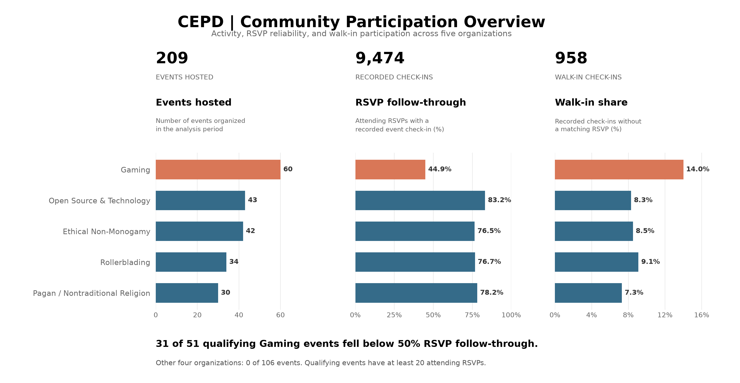
Visualization and Interpretation
Why it helps
The same order across all three charts.
Percentages compare participation rates, not just totals.
Every bar includes its exact value.
Visualization makes the data more interpretable, but people still need context before deciding what action to take.

