Slide 1
Spectra Escape
Niklas Brandtner

Slide 2
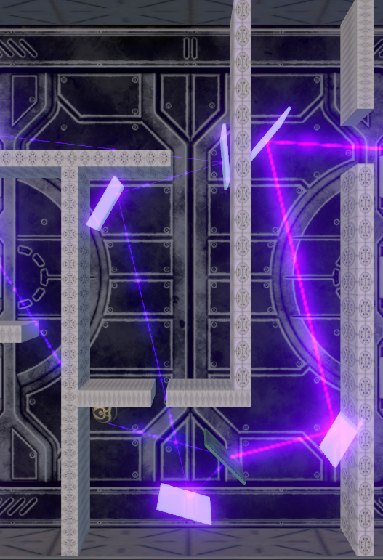
Overview
Concept:
A laser-based puzzle escape game combining logic, reflection, and STEM learning
Target Audience:
Highschool Students and Puzzle Fans
Platform:
WebGL Build
Itch.io

Slide 3
Game Design & Mechanics
Design
Concept
Mechanics
Futuristic Laserbeam Puzzle with Plasma Panels and Laser Splitters
A Puzzle where Players reflect a Laser beam through a maze to reach a Target
Mirrors & Splitters can be moved and rotated
Mirrors reflect the beam
Splitters split the beam in two smaller beams

Slide 4
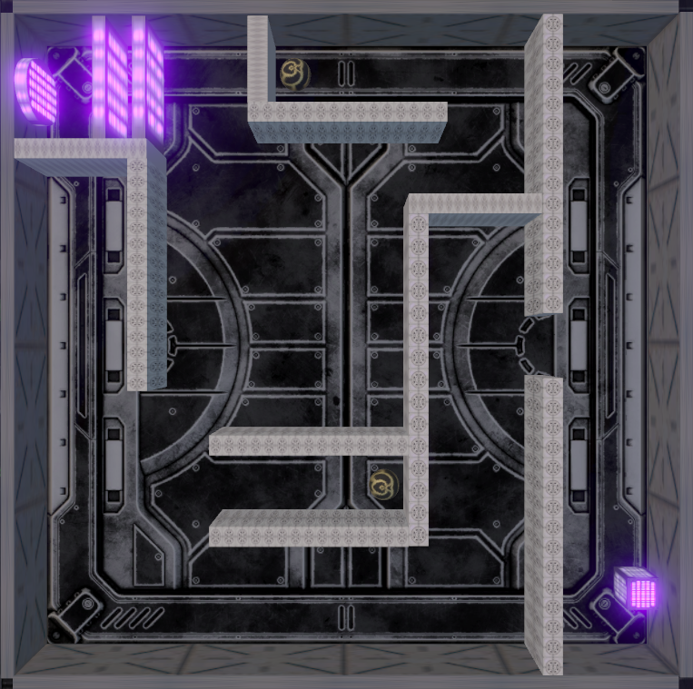
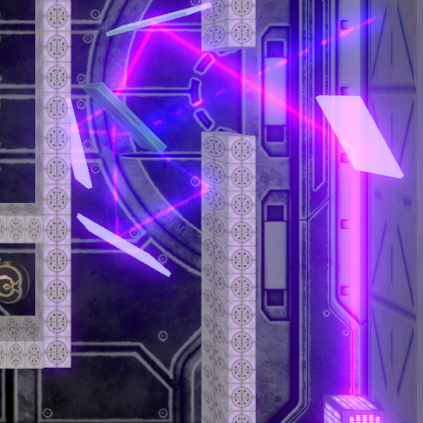
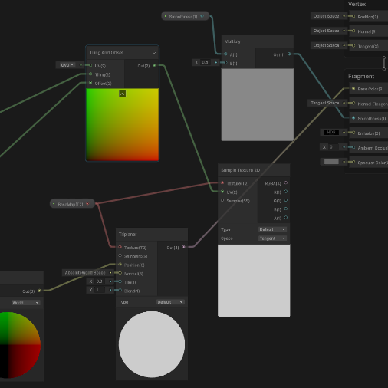
Goals & Challenges
Design short interesting Mechanics and challenging Puzzles
Core Logic of Laser Beams, Mirrors and Splitters
Shaders, Lighting, Volumes and URP

Slide 5
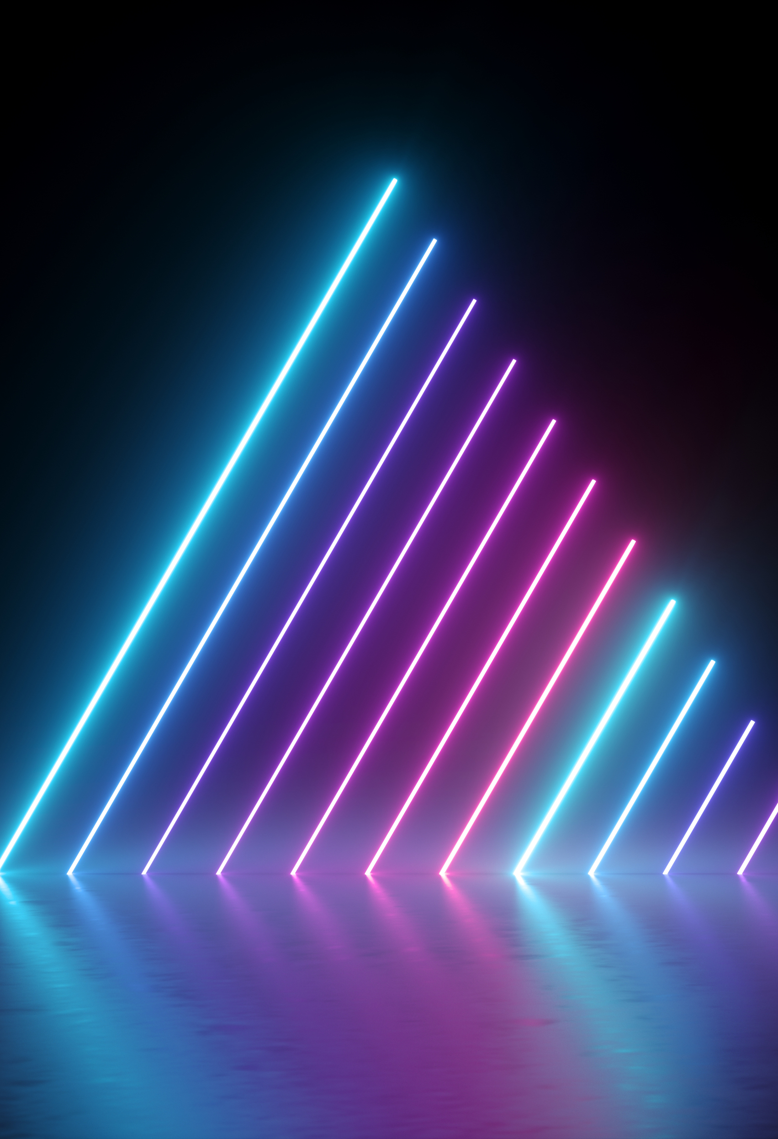
Conclusion & Reflection
Lessons Learned:
Shader Development
C# Logic
How to do it better from the start
Further expand SpectraEscape:
Switch Laser-Logic
More Mechanics like Multicolor Laserbeams

Slide 6
Thanks for listening!

