Slide 1
Electronic Structure of H20 and bulk Si

Slide 2
Login to Midway
Mac or Linux:
Open up a terminal (search terminal in applications)
ssh to midway
ssh yourusername@midway.rcc.uchicago.edu
Enter your password
Widows:
Download putty
http://www.putty.org
Enter the following for host name or ip address
yourusername@midway.rcc.uchicago.edu
Hit open
Enter password

Slide 3
Setup input files on Midway
All operating systems:
Change your directory to the project
cd /project/meng23000
Create your own directory
mkdir yourusername
Go to new directory
cd yourusername
Copy the input files from git repository
git clone https://github.com/nbrawand/dft_tutorials.git

Slide 4
Run H2O on Midway
Navigate to the H2O example :
cd /project/meng23000/yourusername/dft_tutorials/electronic_structure/h2o
Run the example
sbatch runqe
Check status of jobs
squeue -all | grep yourusername
Look at output after job is complete
cat pw.out
Or
vim pw.out

Slide 5
Moving Files to your computer
https://rcc.uchicago.edu/docs/data-transfer/index.html

Slide 6
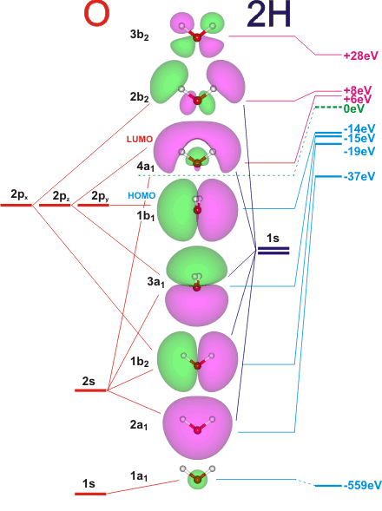
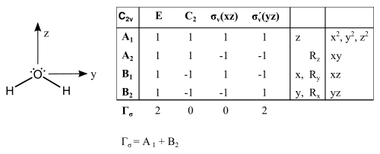
H2O Electronic Structure

Slide 7
Run Si on Midway
Navigate to the H2O example :
cd /project/meng23000/yourusername/dft_tutorials/electronic_structure/si
Run the example
sbatch runqe
Check status of jobs
squeue -all | grep yourusername
Output files
pw_scf.out, pw_bands.out, bands.out, plotband.out, si.ps
si.ps has the band structure

Slide 8
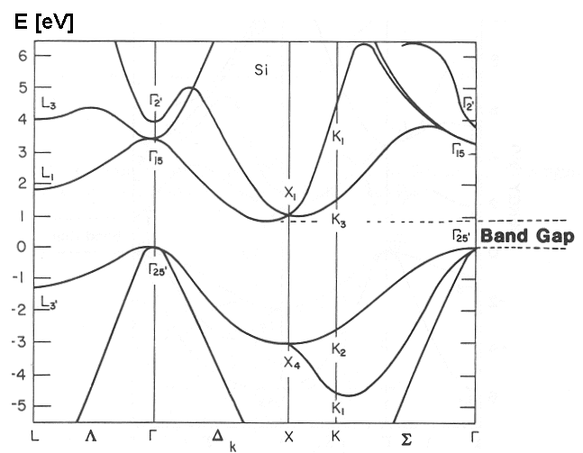
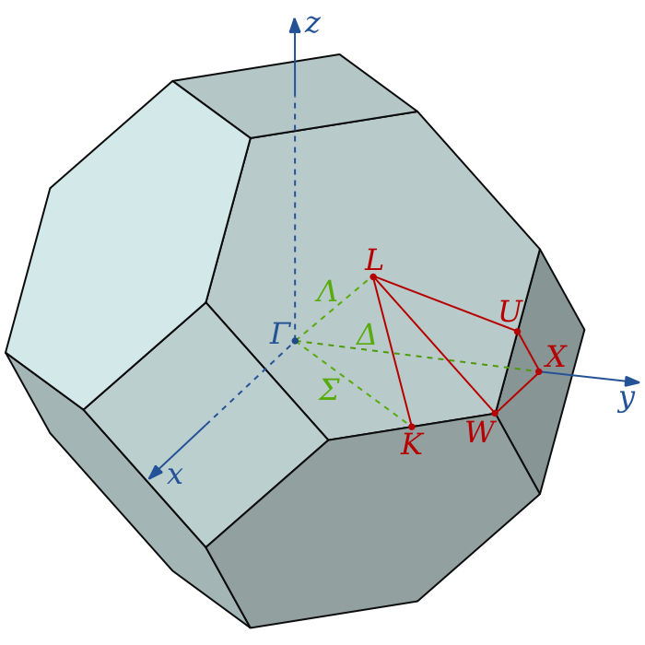
Electronic Structure Si

Slide 9
Helpful links
structures and experimental/computational information at computational chemistry comparison and benchmark database
cccbdb.nist.gov/geometriesx.asp
Quantum espresso software http://www.qe-forge.org/gf/project/q-e/frs/?action=FrsReleaseBrowse&frs_package_id=18
Pseudos
http://www.quantum-espresso.org/pseudopotentials/
Pw.x Input
http://www.quantum-espresso.org/wp-content/uploads/Doc/INPUT_PW.html
Bands.x input
http://www.quantum-espresso.org/wp-content/uploads/Doc/INPUT_BANDS.html
Xcrysden for viewing your structures
http://www.xcrysden.org
My email feel free to ask questions
nicholasbrawand@gmail.com

