Slide 1
Solving the Shallow Water Equations
CFD Final Project
May 12, 2013
Noah Brenowitz

Slide 2
Outline
Finite Volume Methods for Conservation Laws
1st Order
High Resolution
Shallow Water Equations
With Rotation
Results

Slide 3
Conservation Laws
Called hyperbolic if A and B are diagonalizable with real eigenvalues
Examples include (Burger’s Equation, Traffic Flow, Shallow water, Gas Dynamics, etc.)

Slide 4
Finite Volume Methods for Conservation laws
Nodes represent averages over a cell
Solve a Riemann problem on each interface
Upwinding is by characteristic decomposition
Second order accuracy achieved using fully discrete (Lax-Wendroff) scheme
Regularity is enforced using flux-limiters
This is Leveque’s approach
Higher order accuracy can be obtained using WENO
Very costly for higher dimensions. Easier to use finite differencing

Slide 5
First Order Scheme
Diagonalize A
Where

Slide 6
How to find
For linear problems this is easy
For nonlinear problems, we need to solve a Riemann problem on each interface
Impossible analytically and/or computationally costly
Solution: Use an approximate Riemann solver

Slide 7
Roe Averaging
Need to find a diagonalizable matrix with
Simple averaging does not guarantee that A is diagonalizeable
Roe averaging assumption:

Slide 8
Roe Averaging Continued
This implies that
Roe devised some tricks to help find such an A_hat.
Diagonalize A_hat and form the right going and left going fluctuations at each interface
This can violate entropy condition!
Use “entropy” fix

Slide 9
Second Order (1D)
Use fully discrete Lax-Wendroff style scheme with flux limiter
The higher order correction terms are flux limited and depend only on the solution to the Riemann problem at the two neighboring interfaces

Slide 10
2D Higher Order Scheme
Similar flux correction terms
Tricky part is to upwind properly.
Characteristics can be diagonal!
The solution is to split the left and right fluctuations into left-up/left-down and right-up/right-down fluctuations.
“Right-up” from interface (i-1/2,j) is (i,j+1/2)
Draw picture

Slide 11
Shallow Water Equations
Fig 3.1 in Vallis

Slide 12
Shallow Water Equations
Without Rotation
With
Rotation

Slide 13
Derivation (on board)

Slide 14
SWE Conservation Form
Without Rotation
With
Rotation

Slide 15
Roe Averaging for SWE

Slide 16
Roe Averaging for SWE
Eigenvalues and Eigenvectors of the above are easy to calculate
A and B are very similar
Easy to implement and cheap computationally

Slide 17
What about this term?
Just use a Godunov splitting approach
Or Strang Splitting (2nd order in time)
Advance homogenous problem dt/2
Advance source problem dt
Advance homogenous problem dt/2

Slide 18
Results
1D Dam Break
2D Radial Dam Break
2D Smooth Radial Dam Break

Slide 19
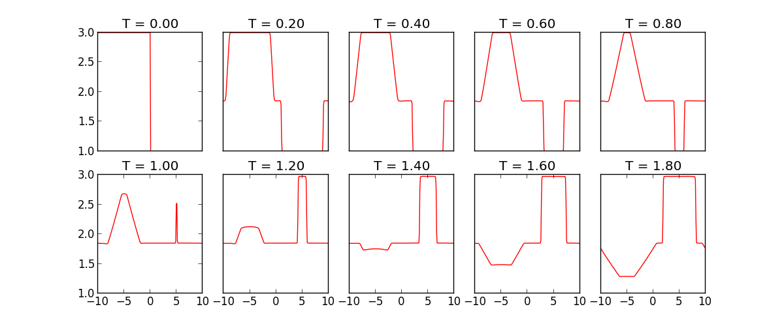
Dam Break Problem in 1D

Slide 20
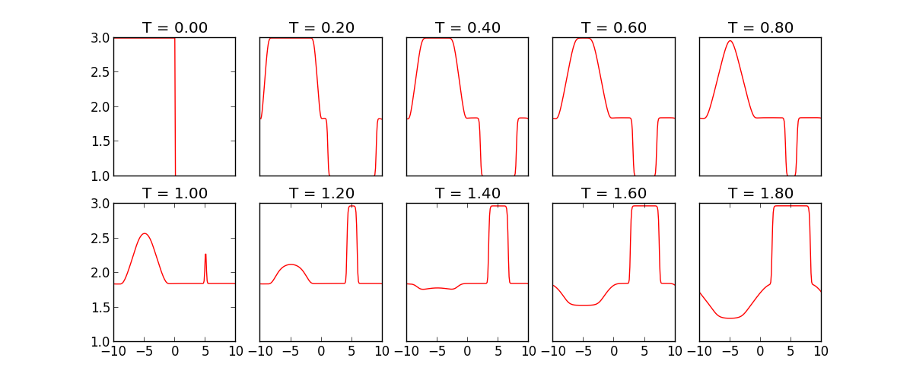
Radial Dam Break Problem

Slide 21
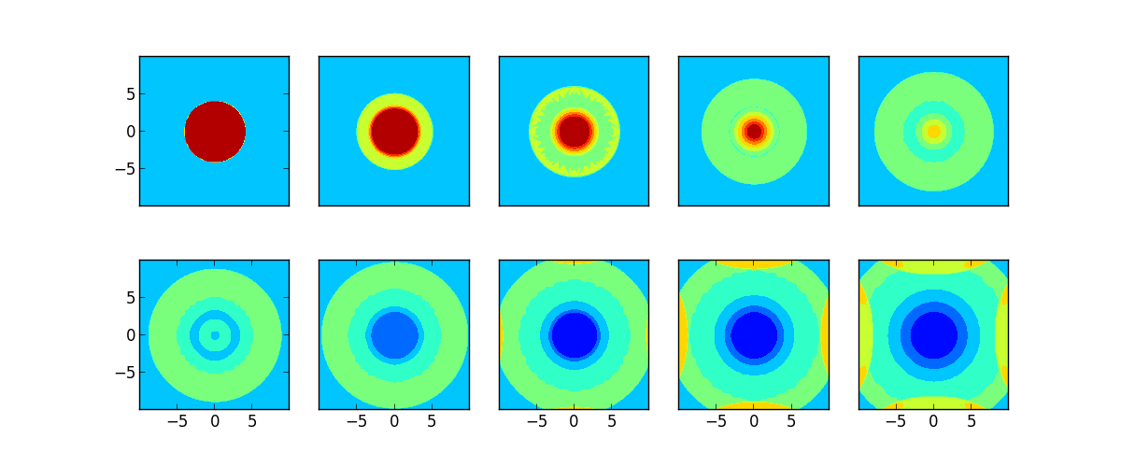
Radial Dam Break Problem

Slide 22
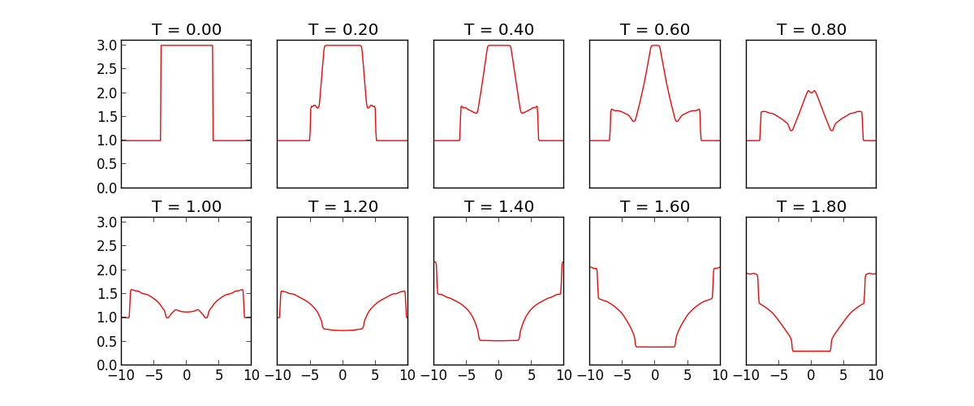
Radial Dam Break Problem

Slide 23
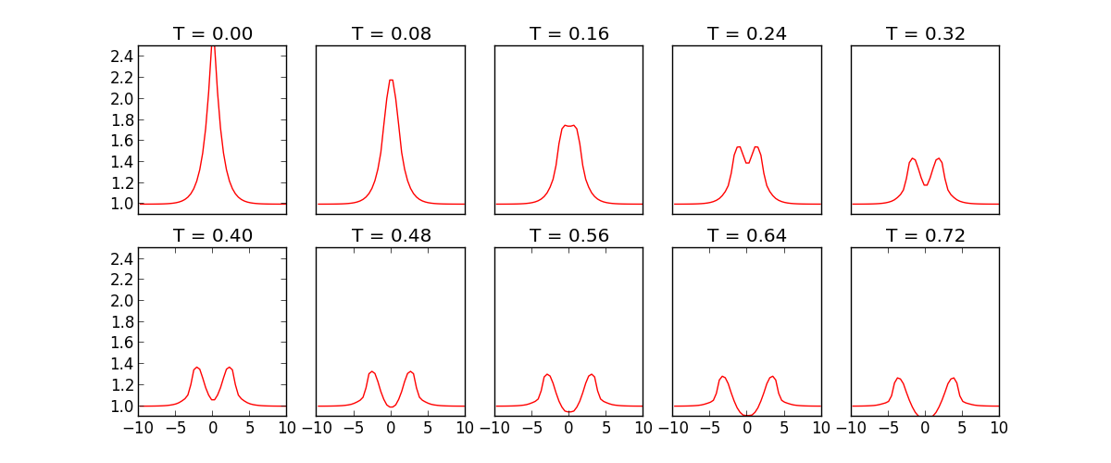
Corner Fixing Helps

Slide 24
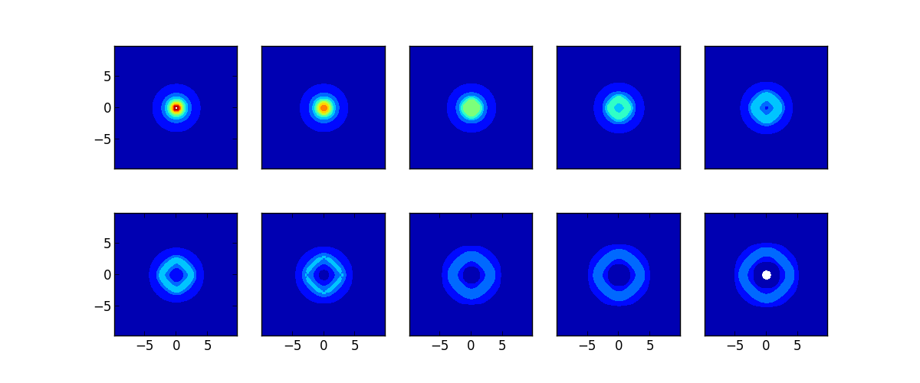
Corner Fixing Helps

Slide 25
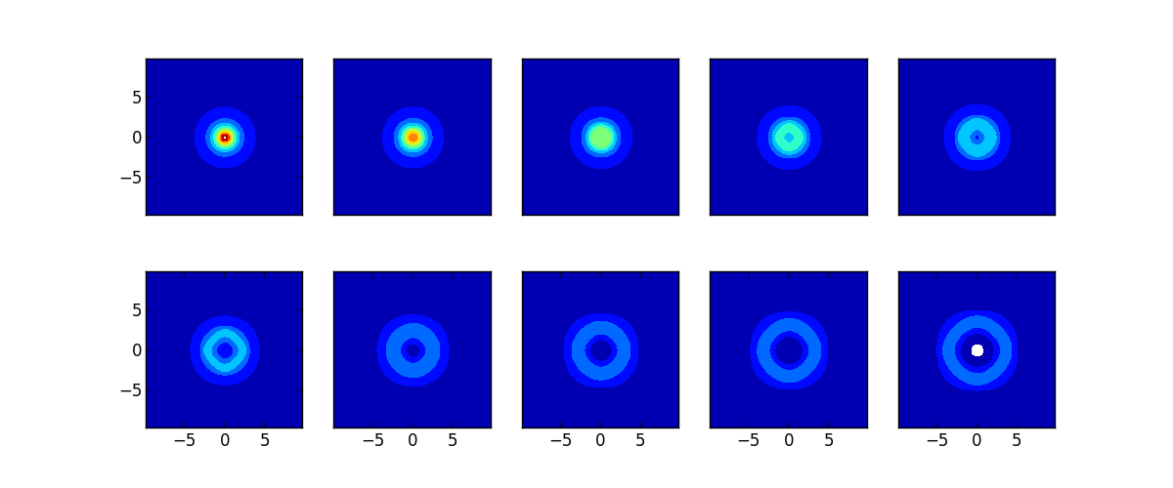
Corner Fixing Helps

Slide 26
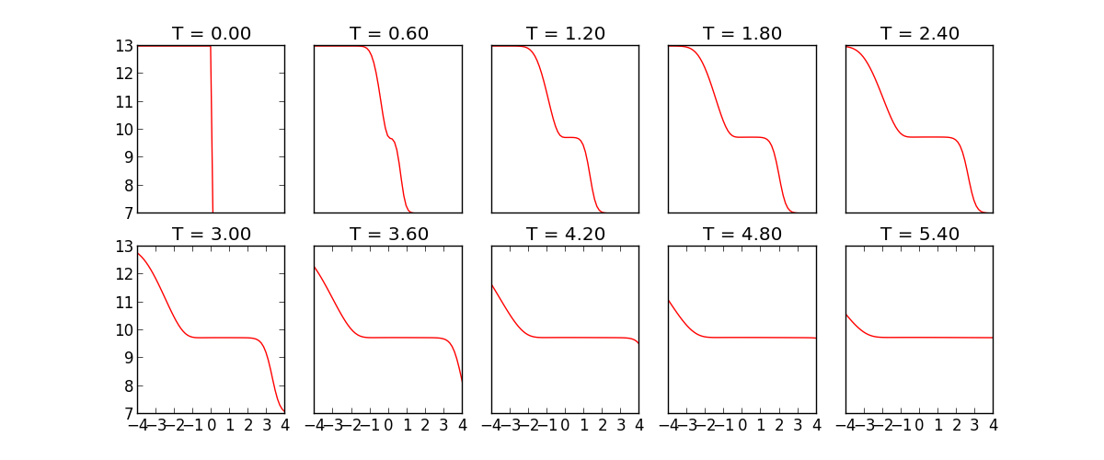
Geostrophic Adjustment: Dam break with f=.01

Slide 27
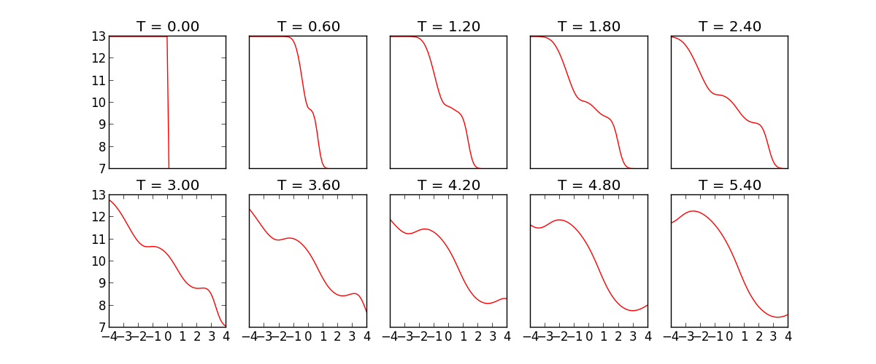
F=.3

Slide 28
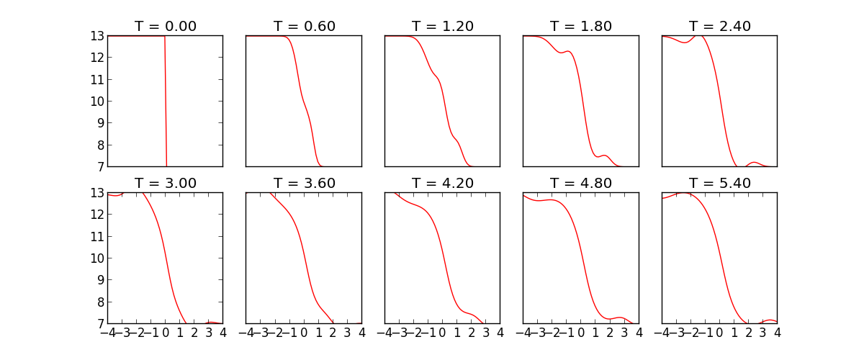
F=1

Slide 29
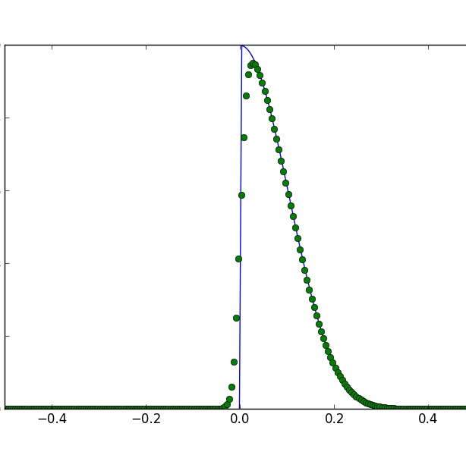
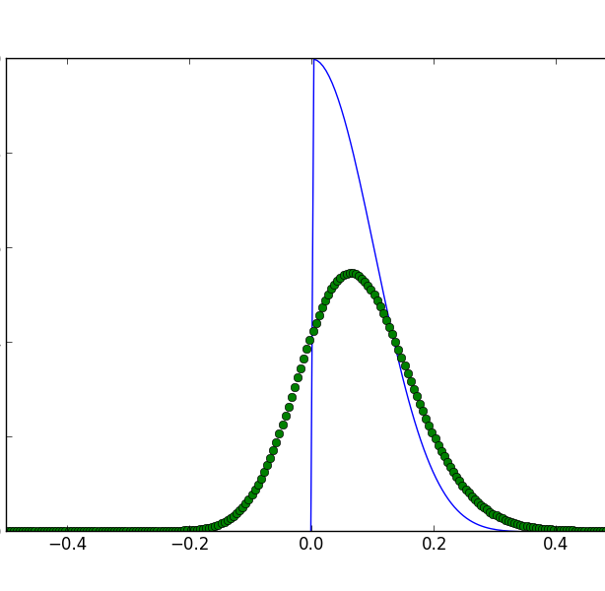
WENO on uniform advection with n=100
WENO r=3 (order 5)
1st order upwind

Slide 30
References
[1] G.-S. Jiang and C.-W. Shu. Efficient Implementation of Weighted ENO Schemes. Journal of Computational Physics, 126(1):202–228, June 1996.
[2] A. Kuo and L. Polvani. Time-dependent fully nonlinear geostrophic adjustment. Journal of physical oceanography, (Stoker 1958):1614–1634, 1997.
[3] R. LeVeque. Finite volume methods for hyperbolic problems, 2002.
[4] C.-W. Shu. High Order Weighted Essentially Nonoscillatory Schemes for Convection Dominated Problems. SIAM Review, 51(1):82–126, Feb. 2009.
[5] C.-W. Shu. WENO methods, May 2011.
[6] G. K. Vallis. Atmospheric and oceanic fluid dynamics: fundamentals and large-scale circulation. Cambridge University Press, Cambridge, 2006.
[7] Y. Xing and C.-W. Shu. High order finite difference WENO schemes with the exact conservation property for the shallow water equations. Journal of Computational Physics, 208(1):206–227, Sept. 2005.
[8] X. Zhang and C.-W. Shu. Maximum-principle-satisfying and positivity-preserving high-order schemes for conservation laws: survey and new developments. Proceedings of the Royal Society A: Mathematical, Physical and Engineering Sciences, 467(2134):2752–2776, May 2011.

Slide 31
Repository
https://github.com/nbren12/cfd-final

