Slide 1
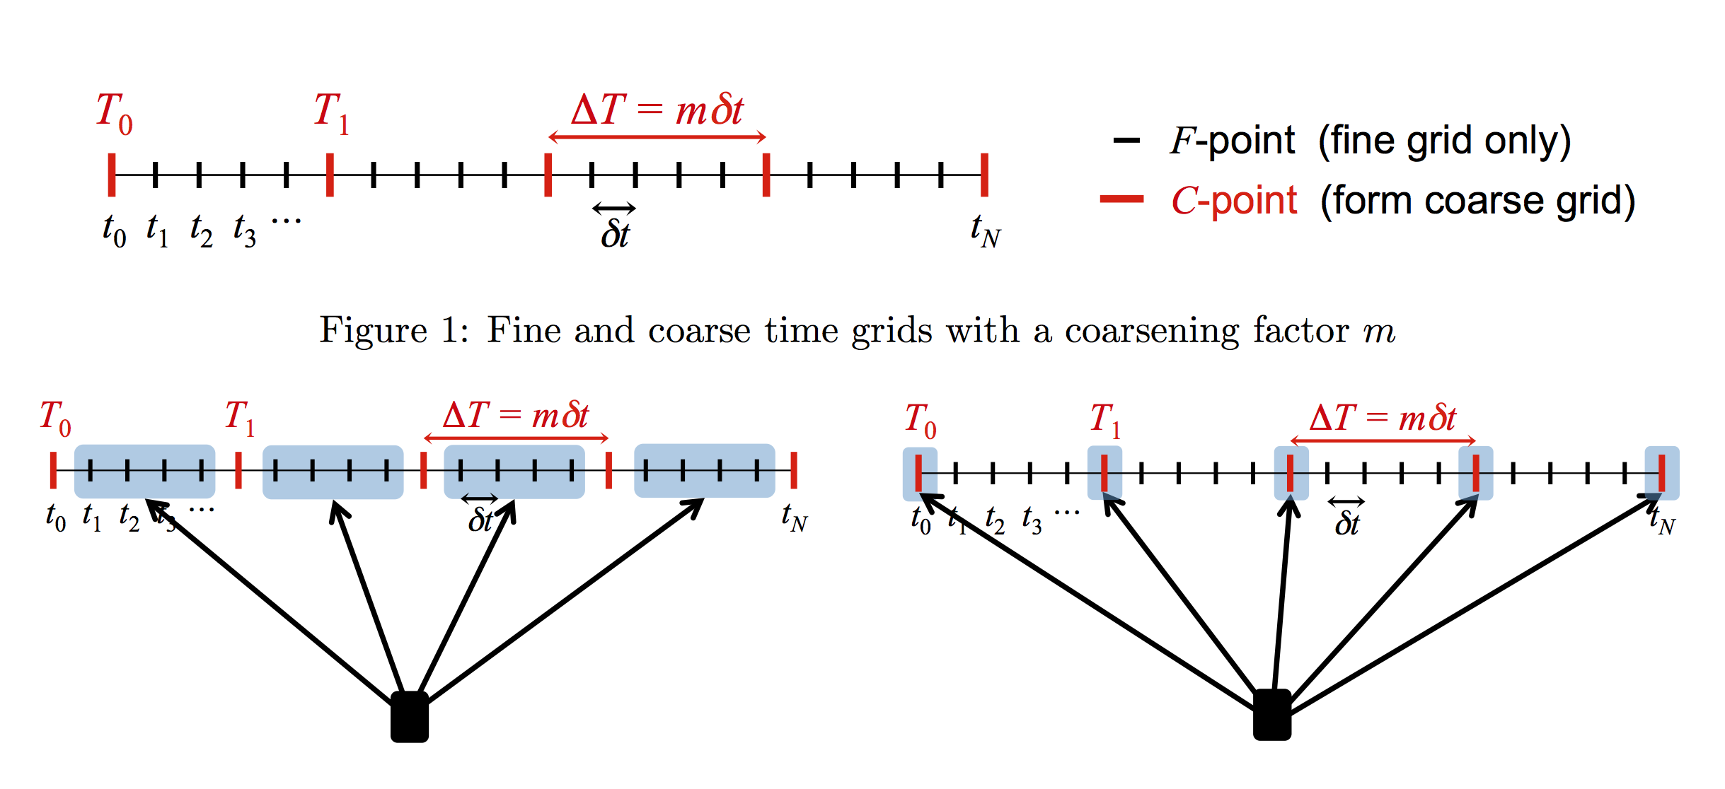
Parallel in time : fine and coarse grid
*Figure from Falgaut etal

Slide 2
Setup
Fixed final time (T = 10)
Fixed spatial grid (nx = ny = 10)
Stopping criterion: 10% relative error
Vary total number of time steps nt
Vary number of cores given nt

Slide 3
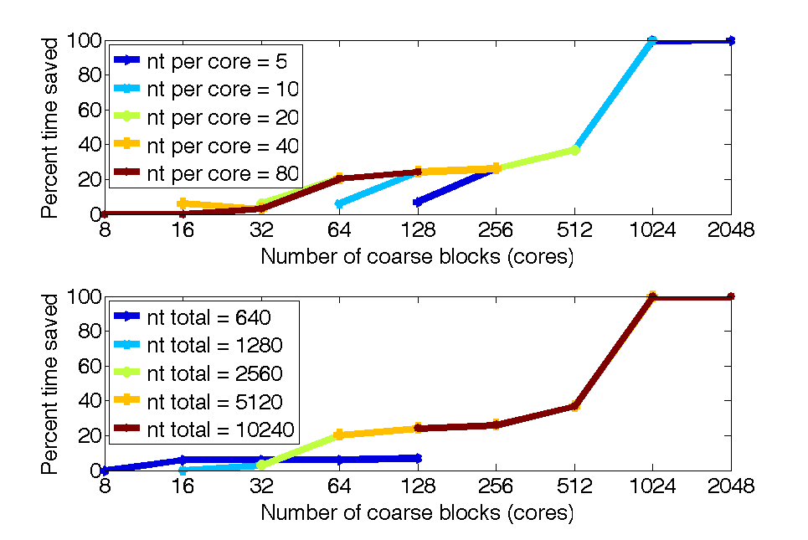
Scalability tests

Slide 4
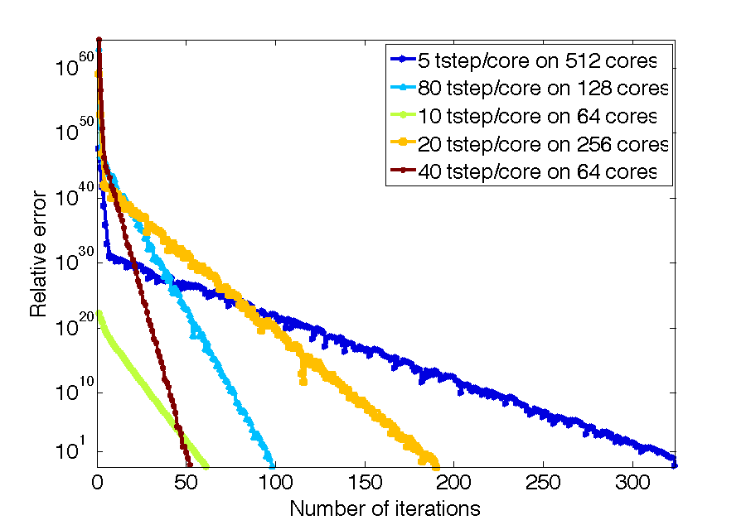
Convergence

Slide 5
References
Falgaut, Katzs, Kolev, Schroder, Wissink Yang. “Parallel Time Integration with Multigrid Reduction for a Compressible Fluid Dynamics Application”. Journal of Computational Physics. October 2014

