Slide 1
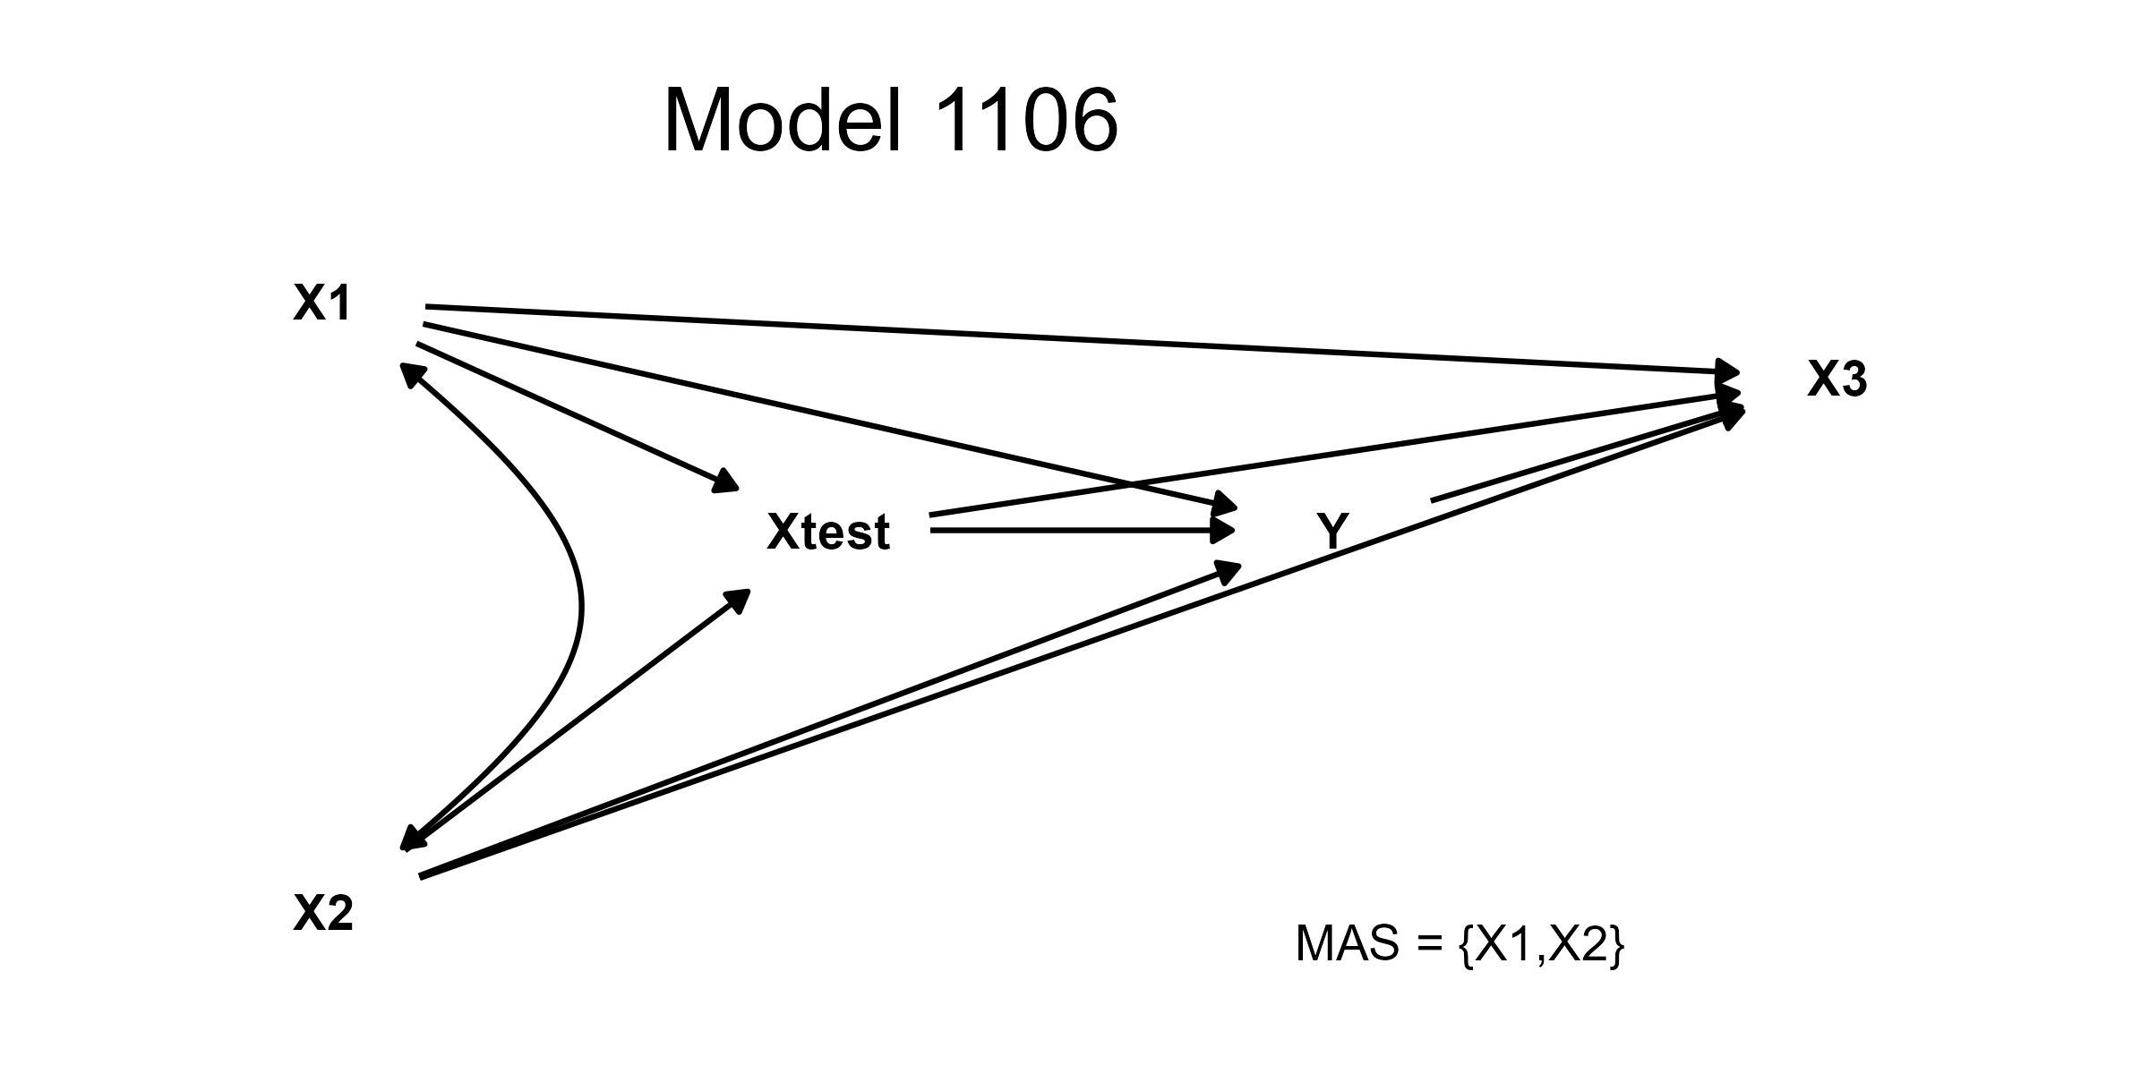
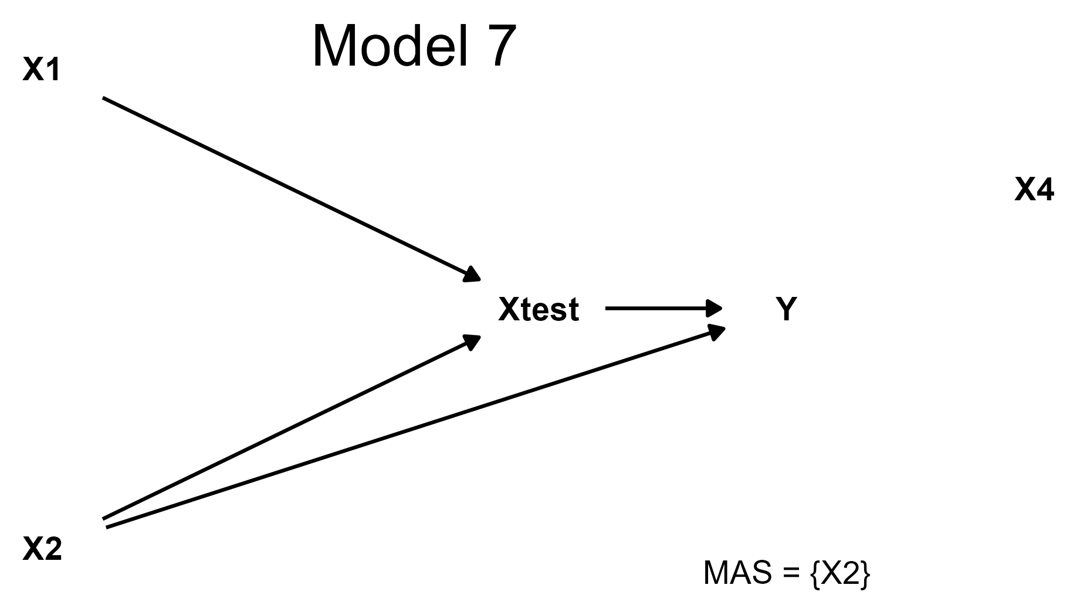
0.25
(0.80)
1.00*
(1.00)
Full model incompatible
Full model incompatible
X1
Multiverse of Theoretical Pathways
0.50*
(0.67)
0.25
(0.57)
X3
X3
Xtest
0.25
(0.57)
0.50*
(0.67)
X2
Y
0.78
(0.82)
X3
Y
Xtest
X1
0.72
(0.80)
Reference Model
0.78
(0.82)
Xtest
0.72
(0.80)
Y
1.00
(1.00)
0.72
(0.91)
Test incompatible
Test incompatible
* Inclusion Necessity = 1.00
Coverage Necessity
(Relevance Necessity)

