Slide 1
A Brief Overview of
***P-Values***
Nate Breznau
Lecture prepared for
“Open Science in Social Sciences”
BA Blockseminar
University of Zurich, Fall 2021

Slide 2
The data and code to generate the figures in this lecture are available at
https://github.com/nbreznau/p_values

Slide 3
What is a p-value?
1.4. P-Values
Quick survey: link

Slide 4
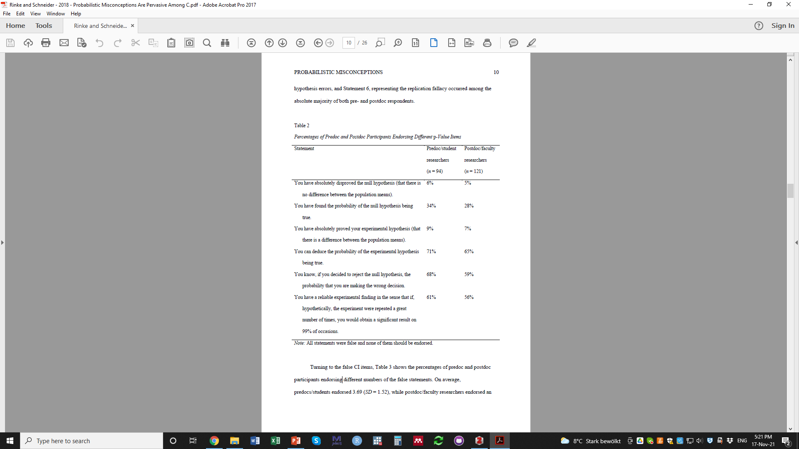
What is a p-value?
1.4. P-Values
Rinke and
Schneider 2018

Slide 5
What is p ≤ 0.01?
1.4. P-Values
}
significance tests provide probabilistic information and therefore can never prove (or disprove) hypotheses
}
significance tests do not allow assignment of
probabilities to a hypothesis, but to data only
}
significance tests provide probabilistic information and therefore can never prove (or disprove) hypotheses
Rinke and
Schneider 2018
}
significance tests do not allow assignment of
probabilities to a hypothesis, but to data only
}
significance tests do not allow assignment of
probabilities to a hypothesis, but to data only
}
replication fallacy. The correct statement would be: “The probability of the available data, given that the null hypothesis is true, is 1%.”

Slide 6
What is a p-value?
Almost always: A statistical test result commonly used to evaluate the null hypothesis

Slide 7
What is a p-value?
Almost always: A statistical test result commonly used to evaluate the null hypothesis
But: Can be used to evaluate any hypothesis test (must not be null)
Short for “probability”-value
A test to determine if statistics calculated for a given dataset are likely different from some hypothesized value
“different” = based on sampling probability
‘what is the likelihood of observing data that produces this statistic if the hypothesized value is true’

Slide 8
What is a null hypothesis?
The claim that something measured in the world is equal to zero
For example:
That a vaccine has zero impact on infection rates (a controlled experiment)
That the average height difference of boys and girls at age 5 is zero (population observation)
That there is zero difference in intelligence between immigrants and natives (population observation)
That income has zero effect on happiness after adjusting for religious beliefs (population observation, w/ adjustment)

Slide 9
What is a p-value?
A statistical test result used to evaluate the null hypothesis
It is based entirely on probability

Slide 10
What is a p-value?
A statistical test result used to evaluate the null hypothesis
It is based entirely on probability
It is the probability of observing the data assuming the null hypothesis is correct

Slide 11
What is a p-value?
A statistical test result used to evaluate the null hypothesis
It is based entirely on probability
It is the probability of observing the data assuming the null hypothesis is correct
Assumes that the data were randomly sampled from a population
Assumes that the test is properly modeled (e.g., improper: testing if getting sick or not makes one more likely to get a vaccine)
Assumes a normal distribution of observing the null hypothesis if it were true

Slide 12
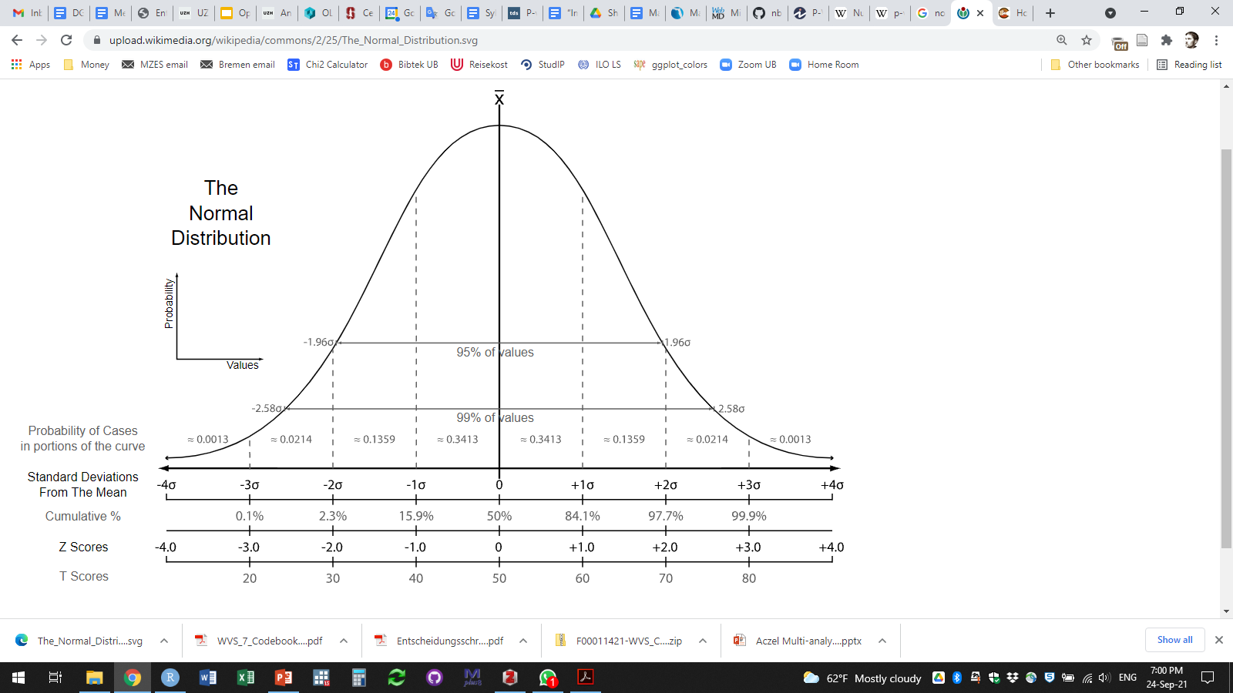
What is a normal distribution?
Credit:
Heds 1

Slide 13
What is a p-value?
A statistical test result used to evaluate the null hypothesis
It is based entirely on probability
It is the probability of observing the data assuming the null hypothesis is correct
Assumes that the data were randomly sampled from a population
Assumes that the test is properly modeled (e.g., improper: testing if getting sick or not makes one more likely to get a vaccine)
Assumes a normal distribution of observing the null hypothesis if it were true
Also known as “NHST”
(Null Hypothesis
Significance Testing)

Slide 14
What is a normal distribution?
P-Values
(if all assumptions are true)
P > 0.68
P < 0.002
0.68 < P > 0.05
P < 0.002
0.05 < P > 0.002
Credit:
Heds 1

Slide 15
What is a normal distribution?
P-Values
(if all assumptions are true)
Only 5 % of Null Hypothesis tests would be outside these lines (~ 95% confidence)
P > 0.68
P < 0.002
0.68 < P > 0.05
P < 0.002
0.05 < P > 0.002
Credit:
Heds 1

Slide 16
Can Money Buy Happiness? Example 1. NHST – Comparing Means
Comparing means
Experiment (randomized controlled trial)
Zero difference in infection rates between vaccine and placebo groups
Zero difference in employer call-back rates for job candidates with ethnic versus native surnames
Experiment (intervention)
Zero difference in adolescent test scores between schools with the introduction of different teaching techniques

Slide 17
Can Money Buy Happiness? Example 1. NHST – Comparing Means
Comparing means
Experiment (randomized controlled trial)
Zero difference in infection rates between vaccine and placebo groups
Zero difference in employer call-back rates for job candidates with ethnic versus native surnames
Experiment (intervention)
Zero difference between adolescent test scores between schools with the introduction of different teaching techniques
Demographic/population properties (non-experimental)
Zero difference between height of girls and boys at age five
Zero difference between happiness between those with high incomes and those with low incomes

Slide 18
Can Money Buy Happiness? Example 1. NHST – Comparing Means
How would you test this?

Slide 19
Can Money Buy Happiness? Example 1. NHST – Comparing Means
One idea:
Sample from the populations of different countries
Ask questions about happiness and income
Compare the average happiness of those with high to those with low incomes

Slide 20
Can Money Buy Happiness? Example 1. NHST – Comparing Means
World Values Survey
Up to 80 countries
1985-2021 (7 waves)
Basis for studies of societal values and change
Roughly 1,000 or more respondents per country
Haerpfer, C., Inglehart, R., Moreno, A., Welzel, C., Kizilova, K., Diez-Medrano J., M. Lagos, P. Norris, E. Ponarin & B. Puranen et al. (eds.). 2020. World Values Survey: Round Seven - Country-Pooled Datafile. Madrid, Spain & Vienna, Austria: JD Systems Institute & WVSA Secretariat. doi.org/10.14281/18241.13

Slide 21
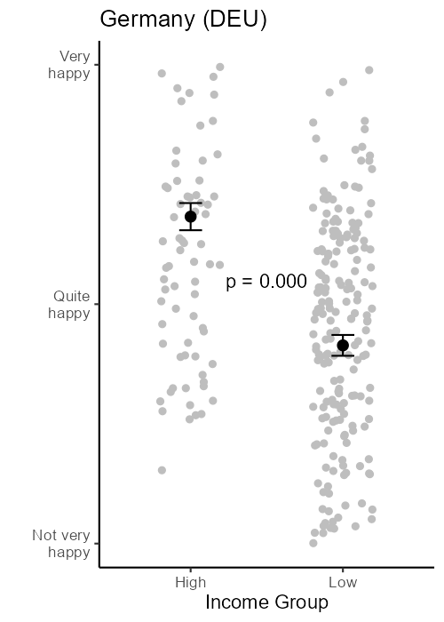
Can Money Buy Happiness? Example 2. NHST – Test of Linear Association
Group average
or mean
Individual survey respondent
(data point)

Slide 22
Can Money Buy Happiness? Example 2. NHST – Test of Linear Association
Standard error
=
Standard deviation / square root of sample size

Slide 23
Can Money Buy Happiness? Example 2. NHST – Test of Linear Association
We can see this based on the standard error bars, they do not overlap

Slide 24
Can Money Buy Happiness? Example 2. NHST – Test of Linear Association
NHST that the difference in happiness between high and low income groups is zero

Slide 25
Remember, normal distribution!
P-Values
(if all assumptions are true)
P > 0.68
P < 0.002
0.68 < P > 0.05
P < 0.002
0.05 < P > 0.002
Credit:
Heds 1

Slide 26
Can Money Buy Happiness? Example 1. NHST – Comparing Means
Group Task
1) Look at different country comparisons in the folder “…results/means_p” at
https://github.com/nbreznau/p_values
2) Select two countries to compare, save the two figures on a slide or document
3) Be prepared to meaning of the p-values for each country

Slide 27
Can Money Buy Happiness? Example 2. NHST – Linear Association
Compare income and happiness as continuous measures.
WVS has an 8-category income scale (quasi-continuous)
WVS asks ‘how happy are you’ and ‘how satisfied are you with your life’. Using these two questions we can construct a scale.

Slide 28
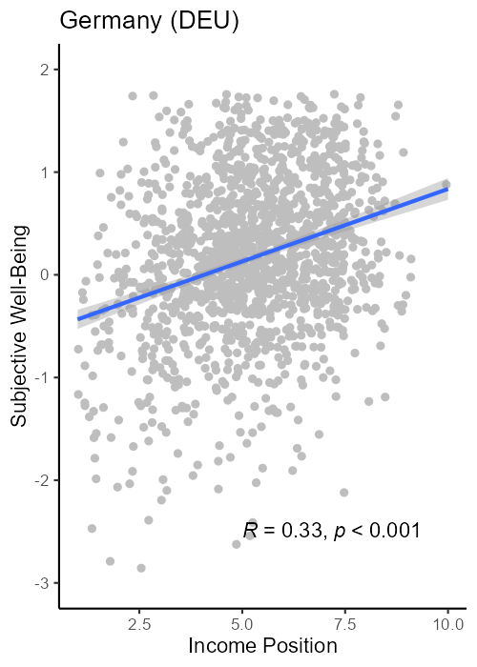
Can Money Buy Happiness? Example 2. NHST – Linear Association

Slide 29
Can Money Buy Happiness? Example 2. NHST – Linear Association
NHST is that the line of best fit has a slope of zero

Slide 30
Can Money Buy Happiness? Example 2. NHST – Linear Association
Line of best fit
(minimizes sum of squared error)
Individual survey respondent
(data point)
Correlation, P-Value

Slide 31
Can Money Buy Happiness? Example 2. NHST – Linear Association, adjusted
Sometimes we want to adjust for other variables that might explain a linear association.
With the income-happiness association for example, maybe people who are higher educated are happier, or people who have stronger religious beliefs.
Other variables may explain a linear association better, or in part

Slide 32
Can Money Buy Happiness? Example 2. NHST – Linear Association, adjusted
Education* and well-being linear association.
*Note that ISCED is not intended as a linear measure, but we will use it that way for now just for the purposes of example (and we removed 9 for ‘other’).

Slide 33
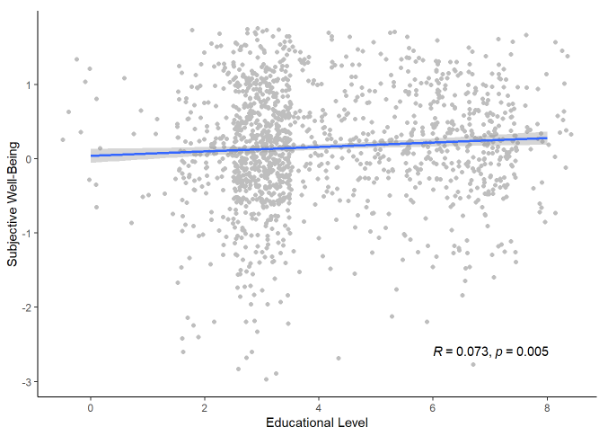
Can Money Buy Happiness? Example 2. NHST – Linear Association, adjusted
Education* and well-being linear association.
*Note that ISCED is not intended as a linear measure, but we will use it that way for now just for the purposes of example (and we removed 9 for ‘other’).

Slide 34
Can Money Buy Happiness? Example 3. NHST – Linear Association, adjusted
One option is a partial correlation
This procedure:
Compute residuals for x (dependent) ~ z (independent) model
Compute residuals for y (dependent) ~ z (independent) model
Compute correlation between the residuals
In other words:
A partial correlation is what remains of a linear association after removing the portion of that association that can be explained by a third variable

Slide 35
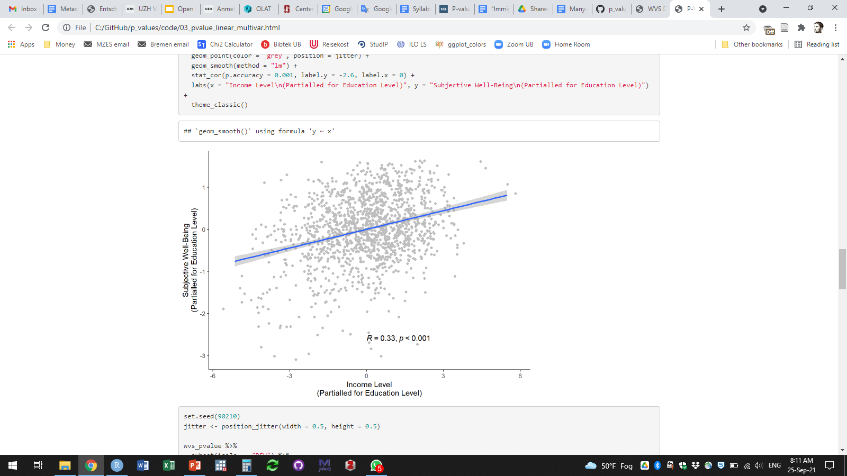
Does Education affect the income-happiness association in Germany?
Adjusted Linear Association
Unadjusted Linear Association

Slide 36
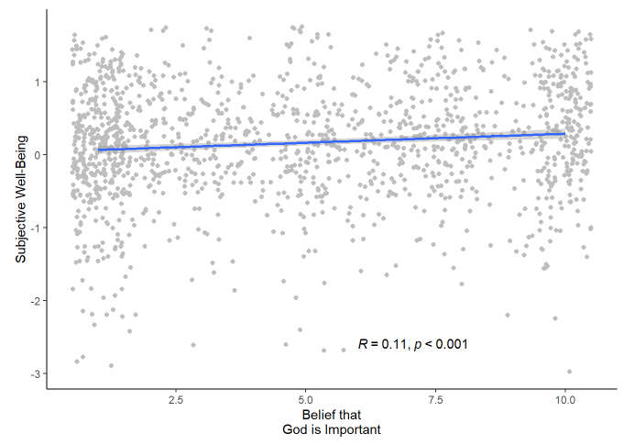
Importance of God and Happiness?

Slide 37
Can Money Buy Happiness? Example 3. NHST – Linear Association, adjusted
One option is a partial correlation
Another option is a linear regression
Advantage is that it can adjust for many variables
Computer does the work
Statistical software provides results/p-values

Slide 38
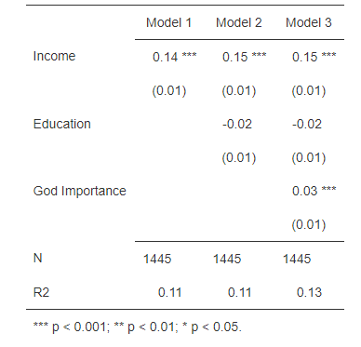
Can Money Buy Happiness? Example 3. NHST – Linear Association, adjusted
Germany – 3 regressions

Slide 39
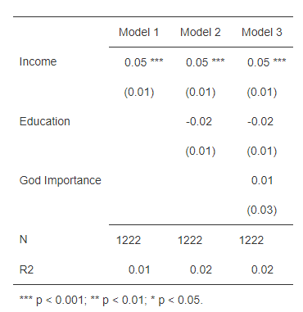
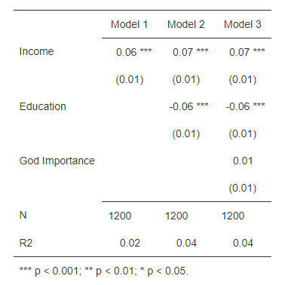
Can Money Buy Happiness? Example 3. NHST – Linear Association, adjusted
Compare: Ethiopia Vietnam

Slide 40
References
Rinke, Eike Mark, and Frank M. Schneider. 2018. “Probabilistic Misconceptions Are Pervasive Among Communication Researchers.” SocArXiv. doi: 10.31235/osf.io/h8zbe.

