Slide 1
CHIRTS-Daily
For Nina

Slide 2
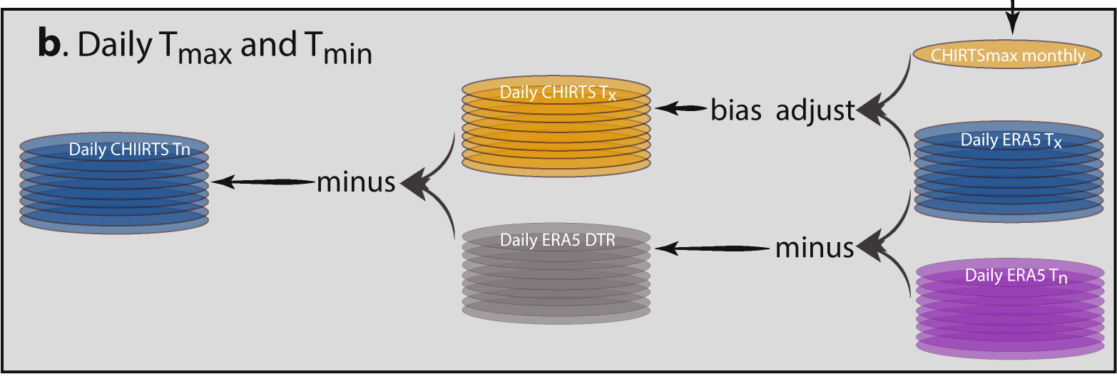
Data Development: CHIRTS-daily Tmax
Verdin, A., Funk, C., Peterson, P., Landsfeld, M., Tuholske, C., & Grace, K. (2020). Development and validation of the CHIRTS-daily quasi-global high-resolution daily temperature data set. Scientific Data, 7(1), 1-14.
CHIRTSmax: Monthly average maximum temperatures (Tmax) 1983 – 2016 constructed with cloud- screen thermal data + station data (Funk et al. 2019) at 0.05° resolution.
Down-scale ERA5 daily Tmax to 0.05° and convert to daily anomalies based on ERA5 monthly averages.
Add CHIRTS-max and to ERA5 daily anomalies to produce CHIRTS-daily.
In other words, down-scale and bias correct ERA5 daily based on CHIRTS-max monthly climatology.
Notes:
From paper “To produce the CHIRTS-daily T_{max} (CHIRTS_{X}) values, the downscaled ERA5 T_{max} are first translated into anomalies from the monthly ERA5 T_{max} average. These daily T_{max} anomalies are then added to each month’s CHIRTS_{max} value. The resulting CHIRTS_{X} product thus varies on monthly timescales with the CHIRTS_{max} while tracking the day-to-day variations of the ERA5 reanalysis. The ERA5 T_{max} and T_{min} are then used to determine the daily diurnal temperature range (DTR) at each 0.05° pixel. DTR is then used to produce CHIRTS-daily T_{min}(CHIRTS_{N}) by subtracting the DTR from CHIRTS_{X}.”

Slide 3
Data Development: CHIRTS-daily Tmax
CHIRTS-max monthly is comprised of both satellite data and station data.
Leverages spatial coverage of satellite data to create high-resolution mean temperature fields fields in data sparce regions (e.g. Ghana has 1 weather station with a robust, longitudinal reporting record).
Advantage of stations to improve temporal accuracy that satellites cannot provide due to cloud coverage.
Notes:
From paper “To produce the CHIRTS-daily T_{max} (CHIRTS_{X}) values, the downscaled ERA5 T_{max} are first translated into anomalies from the monthly ERA5 T_{max} average. These daily T_{max} anomalies are then added to each month’s CHIRTS_{max} value. The resulting CHIRTS_{X} product thus varies on monthly timescales with the CHIRTS_{max} while tracking the day-to-day variations of the ERA5 reanalysis. The ERA5 T_{max} and T_{min} are then used to determine the daily diurnal temperature range (DTR) at each 0.05° pixel. DTR is then used to produce CHIRTS-daily T_{min}(CHIRTS_{N}) by subtracting the DTR from CHIRTS_{X}.”

Slide 4
Data Development: CHIRTS-daily Minimum Relative Humidity (RHmin)
To calculate RH, first we calculated specific humidity using, q = (0.622 * e)/(p - (0.378 * e)) (EQ 1)
where,
e = 6.112*exp((17.67*Td)/(Td + 243.5)) and,
e = vapor pressure in mb
Td = dew point in deg C [ERA5]
p = surface pressure in mb [MERRA2]
q = specific humidity in kg/kg. [what we want for next eq.]
from this we made RH using,
RH = 0.263 * P * q / (exp((17.67(T-T0)/T-29.65)) (EQ 2) where, P = surface pressure [MERRA2] q = specific humidity calculated above Tmax (CHIRTS-daily) T0 = 273.15 convert Kelvin to Celcius.
The Computation of Equivalent Potential Temperature. Mon. Weather Rev. 108, 1046–1053 (1980).
Notes:
From paper “To produce the CHIRTS-daily T_{max} (CHIRTS_{X}) values, the downscaled ERA5 T_{max} are first translated into anomalies from the monthly ERA5 T_{max} average. These daily T_{max} anomalies are then added to each month’s CHIRTS_{max} value. The resulting CHIRTS_{X} product thus varies on monthly timescales with the CHIRTS_{max} while tracking the day-to-day variations of the ERA5 reanalysis. The ERA5 T_{max} and T_{min} are then used to determine the daily diurnal temperature range (DTR) at each 0.05° pixel. DTR is then used to produce CHIRTS-daily T_{min}(CHIRTS_{N}) by subtracting the DTR from CHIRTS_{X}.”

Slide 5
Data Development: CHIRTS-daily Minimum Relative Humidity (RHmin)
To calculate RH, first we calculated specific humidity using, q = (0.622 * e)/(p - (0.378 * e)) (EQ 1)
where,
e = 6.112*exp((17.67*Td)/(Td + 243.5)) and,
e = vapor pressure in mb
Td = dew point in deg C [ERA5]
p = surface pressure in mb [MERRA2]
q = specific humidity in kg/kg. [what we want for next eq.]
from this we made RH using,
RH = 0.263 * P * q / (exp((17.67(T-T0)/T-29.65)) (EQ 2) where, P = surface pressure [MERRA2] q = specific humidity calculated above Tmax (CHIRTS-daily) T0 = 273.15 convert Kelvin to Celcius.
The Computation of Equivalent Potential Temperature. Mon. Weather Rev. 108, 1046–1053 (1980).
Notes:
From paper “To produce the CHIRTS-daily T_{max} (CHIRTS_{X}) values, the downscaled ERA5 T_{max} are first translated into anomalies from the monthly ERA5 T_{max} average. These daily T_{max} anomalies are then added to each month’s CHIRTS_{max} value. The resulting CHIRTS_{X} product thus varies on monthly timescales with the CHIRTS_{max} while tracking the day-to-day variations of the ERA5 reanalysis. The ERA5 T_{max} and T_{min} are then used to determine the daily diurnal temperature range (DTR) at each 0.05° pixel. DTR is then used to produce CHIRTS-daily T_{min}(CHIRTS_{N}) by subtracting the DTR from CHIRTS_{X}.”

Slide 6
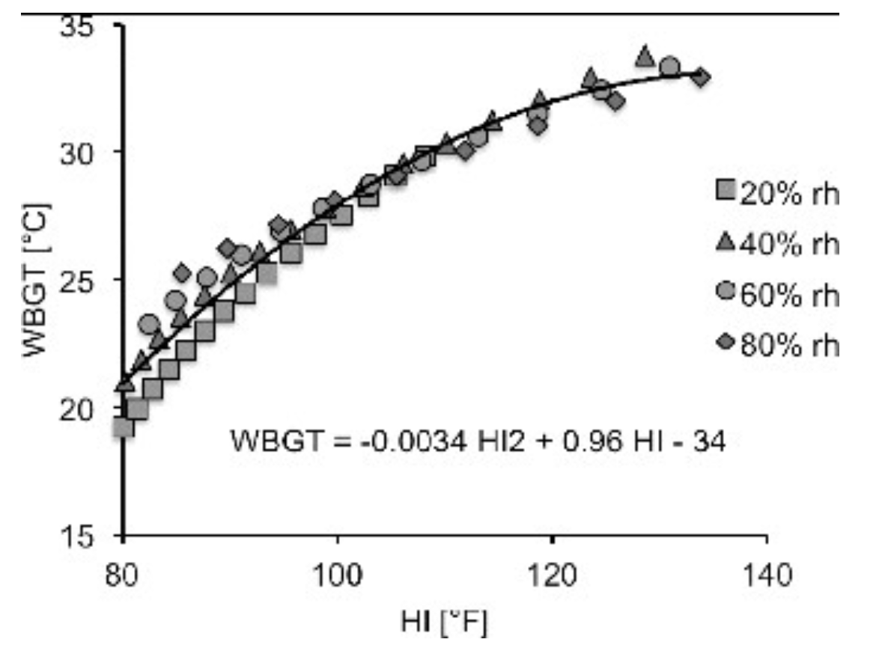
Data Development: CHIRTS-daily maximum heat index (HImax) and wet bulb globe temperature (WBGTmax)
Use CHIRTSdaily Tmax and RHmin generate HImax following National Weather Service procedure.
Covert HImax to WBGTmax following Bernard & Iheanacho 2015.
WBGTmax assumes a fixed wind speed and no radiation.
Bernard, T. E., & Iheanacho, I. (2015). Heat index and adjusted temperature as surrogates for wet bulb globe temperature to screen for occupational heat stress. Journal of Occupational and Environmental Hygiene, 12(5), 323-333.

