Slide 1
Knowledge of a Second Language Influences Auditory Word Recognition in the Native Language
**Note: This is NOT a template.
This is simply an example of what a QALMRI presentation might look like.
Refer to the assignment instructions for info on content.

Slide 2

Introduction
Big Question: How are languages represented in bilinguals?

Slide 3


Introduction
Research on bilingual word recognition has mainly focused on the visual modality (i.e., reading)
The current study investigated bilingual word recognition in the auditory modality (i.e., hearing spoken language)

Slide 4
Introduction
Mental Lexicon: a mental dictionary that contains information regarding a word's meaning, pronunciation, & syntactic characteristics.
Research on bilingual lexical access focuses on how language is accessed and/or retrieved from the ”mental lexicons” of people who can speak two languages

Slide 5
Introduction
Specific Question: Is lexical access in auditory word recognition by bilinguals language specific?
That is: Is lexical access “Selective” or ”Non-selective”

Slide 6


Introduction
Hypothesis 1: Bilinguals, when listening to speech, can only access the the language system that is currently task-relevant (i.e., lexical access is selective)
Hypothesis 2: Bilinguals, when listening to speech, access language systems in parallel (e.g., lexical access is non-selective)
Notes:
For ex., when the Dutch word “vork” is activated, the English word “pork” is NOT activated despite sounding the same
For ex., when the Dutch word “vork” is activated, the English word “pork” is NOT activated despite sounding the same

Slide 7
Methods
Bilinguals performed a lexical decision task in one of their two languages (Dutch-English)
Task: indicate whether a spoken word was a “word” or “non-word”
In order to make this decision, you must activate the mental lexicon
Words were either “interlingual homophones” or control words
Interlingual homophones are words that sound like both an english and dutch word
e.g., “Lief” [sweet] sounds the same as “Leaf”

Slide 8
Methods
Some examples of stimuli used:

Slide 9
Methods
Experiment 1A: English lexical decision task with Dutch native speakers
Experiment 1B: English lexical decision task with English native speakers
Experiment 2A & B: English monolinguals (control experiments with different accent speakers)
Experiment 3A: Dutch lexical decision task with Dutch native speakers
Experiment 3B: Dutch lexical decision task with English native speakers

Slide 10
Methods
Logic:
If H1 (selective), then… hearing an interlingual homophone should only activate the task-relevant language and the lexical decision should take the same amount of time for homophones and control words.
If H2 (non-selective), then… hearing an interlingual homophone will co-activate both languages and will make the lexical decision more difficult. Therefore, it should take longer to respond to homophones than the control words.

Slide 11
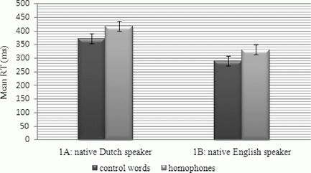
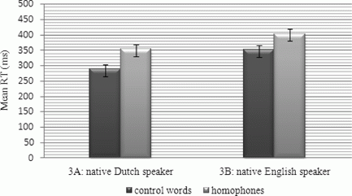
Results
Experiments 1A& 1B (English lexical decision task)
Experiments 3A & 3B (Dutch lexical decision task)

Slide 12
Discussion
Reaction time of homophones was longer than the control words in both experiments.
This provides basis for a language non-selective access for auditory recognition.
When words from two languages are activated, the bilingual listener needs additional information time.

Slide 13
Discussion
Critical thinking / Future Directions / Additional thoughts:
What is physiologically occurring in a language non-selective vs. selective access with bilinguals? How are languages represented in the brain?
What about individuals who aren’t completely fluent in their L2, but can read/understand and can somewhat participate in the study? Would the results have been different?
How does similarity between languages impact their lexical representations?
Would testing people who are bilingual in romance languages (Spanish, French, Italian, Portuguese, etc.) yield a faster RT than someone who is bilingual in a romance language and a non-romance languages?

