Slide 1
Contents:
What is a unit test?
Types of testing
Desirable properties
TDD
Testing Framework
Fixtures, runner, AAA, naming, assertions
Parameterizing tests
Before/after
Factory Methods
Exceptions
Return values, vs state,
Mocks stubs and dependency injection
Black box testing vs white box testing vs interface testing

Slide 2



Before we begin…
Make sure you’re sitting next to at least one other person
Get sticky notes and pen
Pull the latest commit from git
Install Kahoot! app on your phone
Coffee, restroom, etc.

Slide 3
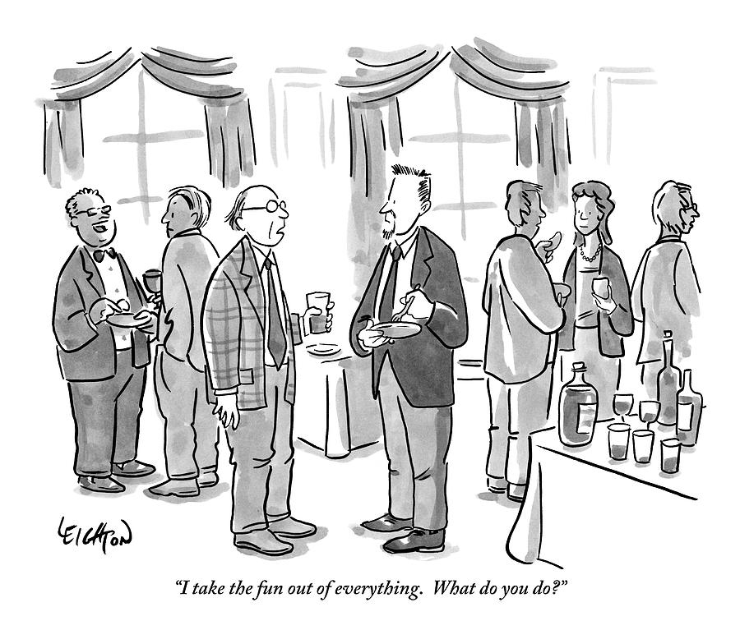
Introductions
Name
Experience with testing
One interesting fact

Slide 4
Green
Refactor
Red
Test Driven Development
Clean Code that Works – Ron Jeffries
Monday, February 5, 2017

Slide 5
What is your ideal approach to developing clean, tested code? (take 3 minutes to discuss)

Slide 6
Learning Objectives & Agenda
Introductions
Testing/Development Strategies
What is TDD?
The TDD Rules
Common Life Cycles
Why should you use TDD?
The benefits of testing first
The benefits of testing often
Shuhari: stages of mastery
How can you implement TDD?
Review: Kahoot
Practice: Bowling!
Lecture, Activities
What should you take away and how will we get there?

Slide 7

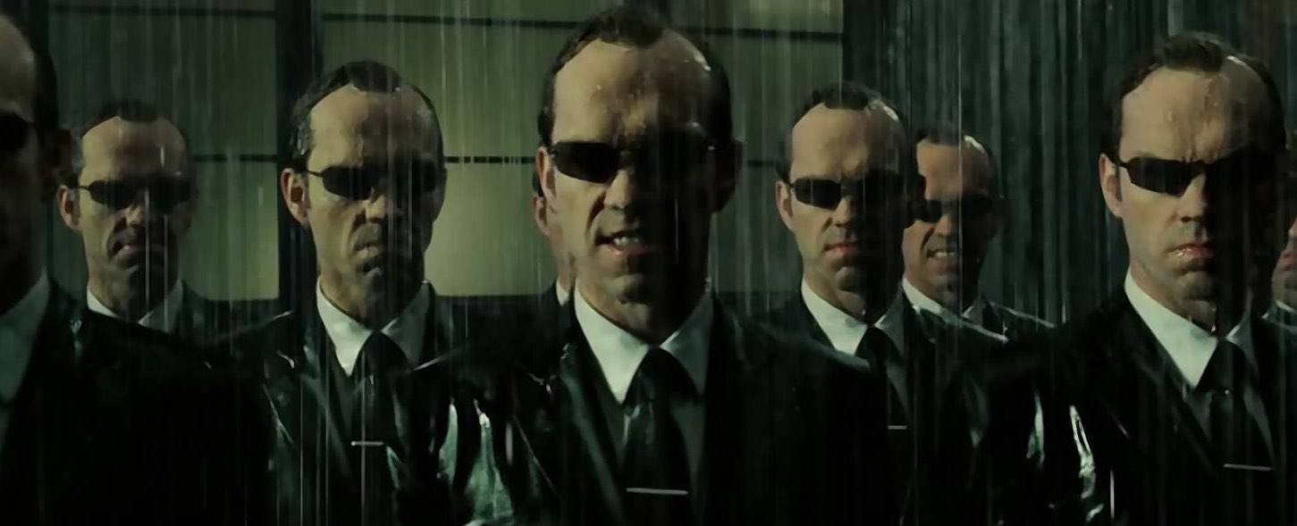
Write new code only if a test fails
Two Simple Rules
Design comes first
Verify tests can fail
That are not so simple to code by
Eliminate duplication
Simplify logic
Identify patterns

Slide 8
The TDD Rhythm: Red, Green, Refactor
Red:
Write a little test that fails
Compilation errors count
Green:
Make the test work quickly
Dirty is okay
Refactor:
Insert favorite improvement methodology here:
KISS
DRY
Design Patterns
SOLID principles
Applies to tests too
Red
Green
Refactor

Slide 9
The Three Laws and Micro Cycle of TDD
First Law:
You may not write production code until you have written a failing unit test.
Second Law:
You may not write more of a unit test than is sufficient to fail, and not compiling is failing.
Third Law:
You may not write more production code than is sufficient to pass the currently failing test.
Green
Refactor
Red
Green
Refactor
Red
Green
Refactor
Red

Slide 10
How is TDD advantageous?

Slide 11

Benefits of Testing First
Design over implementation
Implementation based tests are fragile
Value is derived from use cases and API
Keeps units manageable and testable

Slide 12

Benefits of Testing Often
Build with confidence
Tests fail as intended
Solutions pass for the right reasons
Bugs are simpler to fix

Slide 13

ShuHaRi: Three stages to mastery
Shu (Obey)
Follow the rules
If they conflict, choose one
Concentrate on what, not why
Ha (Detach)
Begin to question the rules
Discover the fundamentals
Ri (Transcend)
Innovate and break tradition
Freely follow rules as circumstances permit

Slide 14
Review of TDD Fundamentals (Kahoot Quiz)

Slide 15
Practice Time / Demo

Slide 16

Exercise Instructions:
TDD with Bowling
Building up to self guided practice
Overview of Exercises
Gutter Game: Instructor Led
All Ones: Groups of Four
One Spare: Individual
One Strike: Pair Up
Perfect Game: Your choice

Slide 17
Further Reading/References
Test Driven Development: By Example (Primary Resource) https://www.safaribooksonline.com/library/view/test-driven-development/0321146530/
Growing Object-Oriented Software, Guided by Tests https://www.safaribooksonline.com/library/view/growing-object-oriented-software/9780321574442/
Clean Code: Ch. 9 Unit Tests (Three Laws) https://www.safaribooksonline.com/library/view/clean-code/9780136083238/chapter09.html
XUnit Testing Patterns http://xunitpatterns.com/
Pragmatic Unit Testing in Java 8 with Junit https://www.safaribooksonline.com/library/view/pragmatic-unit-testing/9781680500769/

Slide 18
Feedback:
The Good, Bad, and Better

