Slide 1
Bathymetry Machine Learning
Nicholas Brown (Team Lead)
David Cedrone(Scrum Master)
Luis Reyes-Ayala (Back End Developer)
Cole Escobar (Front End Developer)
Oliver Suares (Back End Developer)
Client: Dr. Eric Maillard
Affiliation: EdgeTech

Slide 2
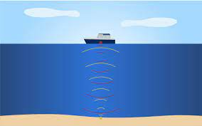

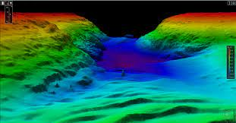
Project Abstract
Machine Learning for Bathymetry: The creation of bathymetric (topography) maps from sonar messages using a machine learning algorithm to lessen energy cost. In the end, the project will be able to take raw sonar message data, and create a bathymetric map of the ocean floor using this data.
Notes:
Speaker: Nicholas Brown
Bathymetry: Depth of the Ocean Floor
The creation of ocean floor topography maps

Slide 3
MVP Abstract
Deliverables
Functioning GUI (web-based)
Fully functioning data cleaning script (Python)
Semi-Functioning Machine Model (not yet coupled with GUI)
Notes:
Speaker: Oliver Suares
GUI: Our GUI primarily would be used for advanced testing and ease of use of the individual model.
Cleaning Script: The crutch of any machine learning algorithm is the process in which the data is stored and presented within. Being that we are working with A few different data sets, this will require a few different methods in order to contain and direct each individual data.
Machine learning model: The Machine learning model is the primary section that operates with the data. As of now, our model is capable of intaking data, but it still requires a large amount of refinement in order to ensure that their output is optimal.

Slide 4



Tools
Flask
HTML/CSS
JavaScript
JSF File Viewer (by Edgetech)
VSCode
Python (numpy, pandas)
Keras
Notes:
Speaker: Cole Escobar
Flask: A web application framework that we used to run our GUI. It is dependent on Werkzeug, which is a collection of libraries that can be used to create a web server gateway interface, and Jinja2 which is a web templating software created for Python
HTML: Used for our basic GUI functions
CSS: Used to make the website look unique with different fonts
JavaScript: Used to submit forms to flask so that each button will bring you to a separate page of the GUI
JSF File Viewer: This was used to look at the files sent by our client. STAVE files contained sonar message data, while BINNED files contained the output
VSCode: A text editor we used for all of our programming, specifically the Jupyter notebook
Python: This was used to create our machine learning framework and data cleaning
Keras: This contains the machine learning library. This makes machine learning user friendly as we are novices in the subject.

Slide 5
GUI
File Selection
Input
Output
Data Cleaning
Sonar message Data Input
Two-Delay and Angle Output
Generate Output
Image from training and input of more data
Notes:
Speaker: David
Gui consists of major parts such as HTML
CSS JS and FLASK
So currently flask is being used as backend to run certain python scripts in our website.
There is 4 different pages of HTML each one containing a different part of the project
Doing all the specific

Slide 6

Back End
Data Cleaning
Numpy, Pandas
GUI
Flask
Machine Model
LSTM (Long Short Term Memory)
Notes:
Speaker: Luis
Flask; Is like the server, Flask is the backend, it is a python library that lets you create applications, our front end
Flask is the glue that holds all our functions together, it is like the pipes that connect the water to your home plumbing. Except is a pipeline for our data.
LSTM: It is a type of artificial neural network used for deep learning, and we use LSTM because it has the great ability to consider data from the far “past”, which we need since we are dealing with a data set of millions of rows.

Slide 7
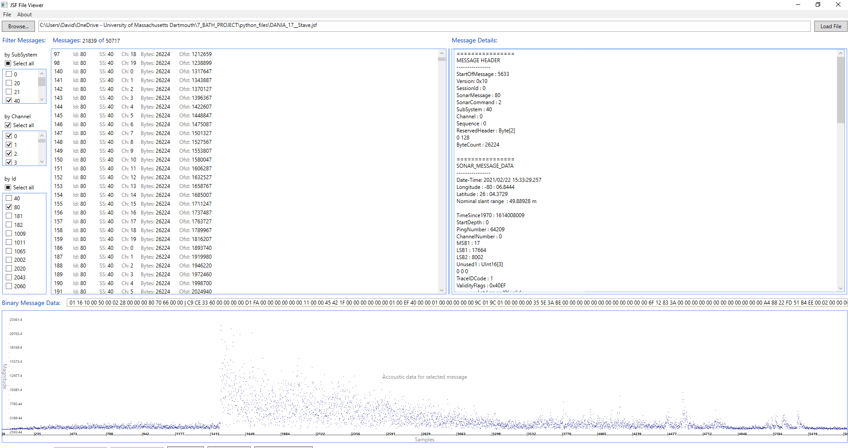
Notes:
Speaker: N/A
All those dots represents the all the signals a single sonar device on the AUV,
All these dots represent all the pings a single sonar device sent out in a specific time frame.

Slide 8
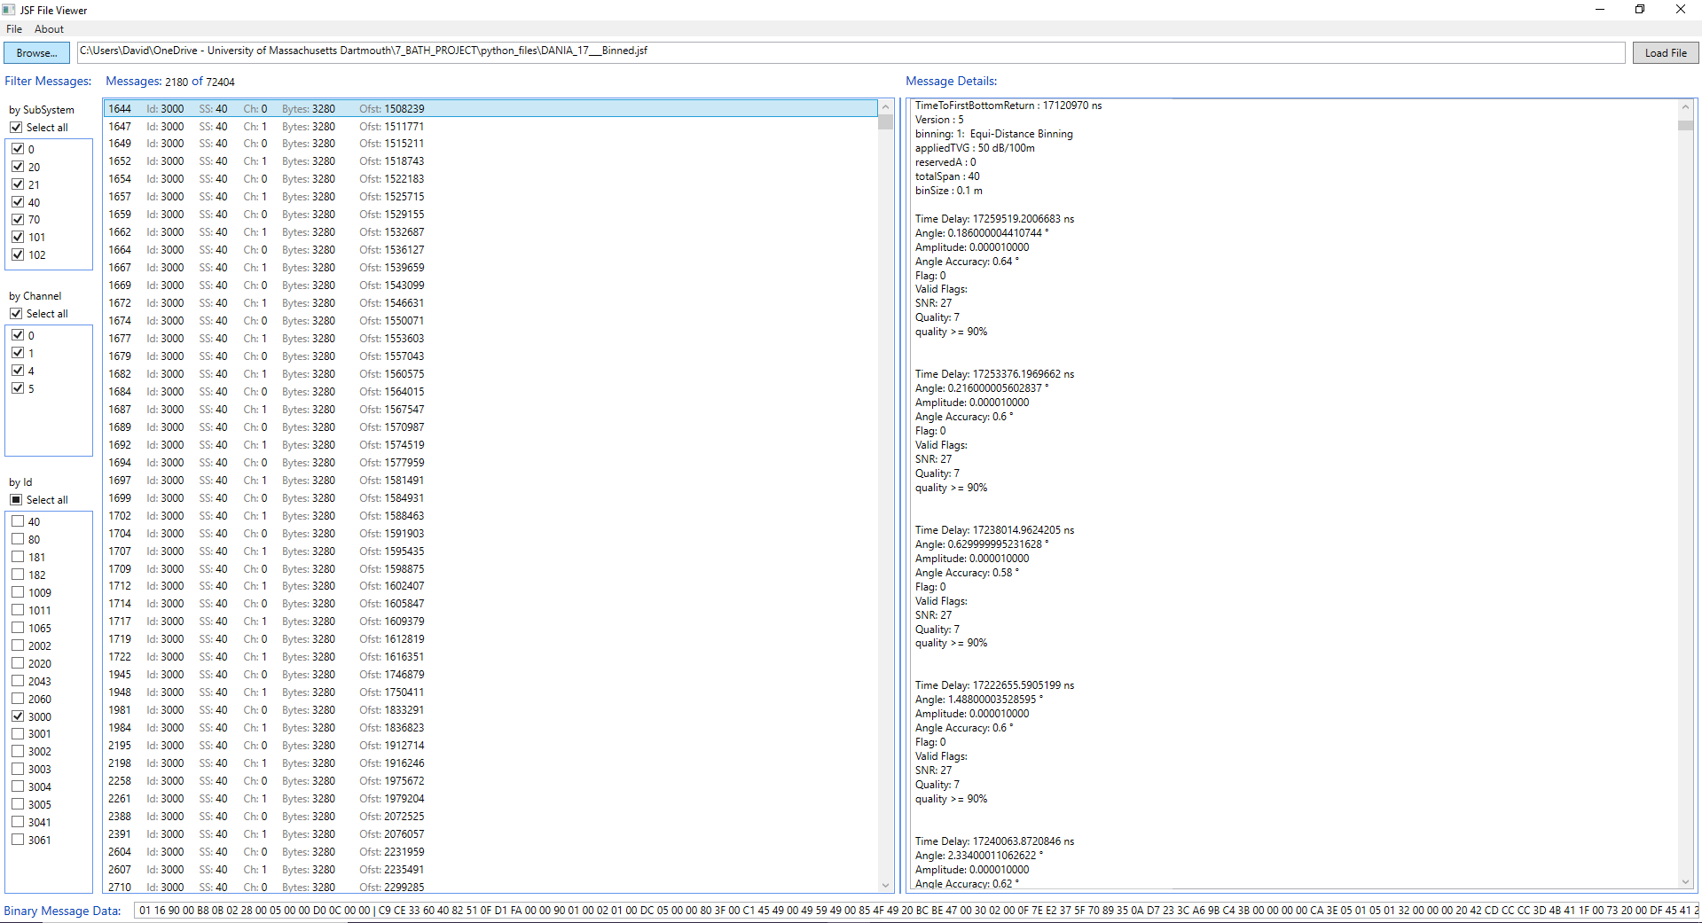
Notes:
Speaker: David
Series of time delay
And angle
Each sample of the 400 used by modeling software to make bathymetric output
Our goal is to do the math without doing the math.
Using the current the edge tech algorithm they do this manually
More on the data

Slide 9
DEMO
Start Demo Here
Notes:
Speaker: N/A

