Slide 1
MS Excel 2007 Basics
Distance Learning
mxccdistance@mxcc.commnet.edu
(860)343 – 5756
Chapman 633/632
Middlesex Community College
http://www.mxcc.commnet.edu/Content/Educational_Technology_Training.asp

Slide 2
MS Excel 2007 Basics
Explanation of key terms in MS Excel
Navigation of Excel Window and Basic Tools
Creation of a Workbook
Workbook - Data Entry, Formatting
Calculations: total, average, simple formula
Graphs/Charts

Slide 3
Key Terms in MS-Excel
A spreadsheet (worksheet): a piece of paper in which data can be manipulated by the computer stored in rows and columns.
A workbook (Excel file) has multiple sheets.
  Each sheet may have multiple pages.
  Record and organize information in a row (record)-and-column (field) format.
  Make calculations and simple statistical analyses across a row or a column.
  Create charts based on the data displayed in a spreadsheet.
Notes:
Excel is a spreadsheet application. With Excel, we can record information in a row-and-column format. We can make simple calculations or statistical analysis across a row or a column. Create charts on the basis of the recorded data. Records of family expenses, Travel log with calculation of the mileage and reimbursement, student grade book with calculation of the final grades and making charts.

Slide 4
Workbook vs Sheets
A workbook refers to an Excel document. You will sometimes hear it called a “spreadsheet.”
In Default, each workbook has 3 “sheets” associated with it. You can rename these sheets to something more fitting to your purpose(e.g. Fall Term, Summer Term, Spring Term…)
You can add sheets if you’d like to.
Your workbook is the ENTIRE file and the file name should reflect the function the file serves.
  Friends_Address.xlsx
  Inventory.xlsx

Slide 5
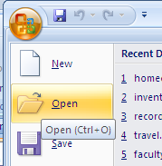
Excel Workbook Window
Open the MS-Excel
  Start-All Programs-Microsoft Office – Microsoft Office Excel 2007
  This creates a new workbook.
Open an Excel workbook – double-click on the practice file named “homeexpense.xlsx”
Open an Excel workbook in Excel
  Click on Office Button and select Open.
  Locate the file via file folders.
  Double-click on the file.

Slide 6
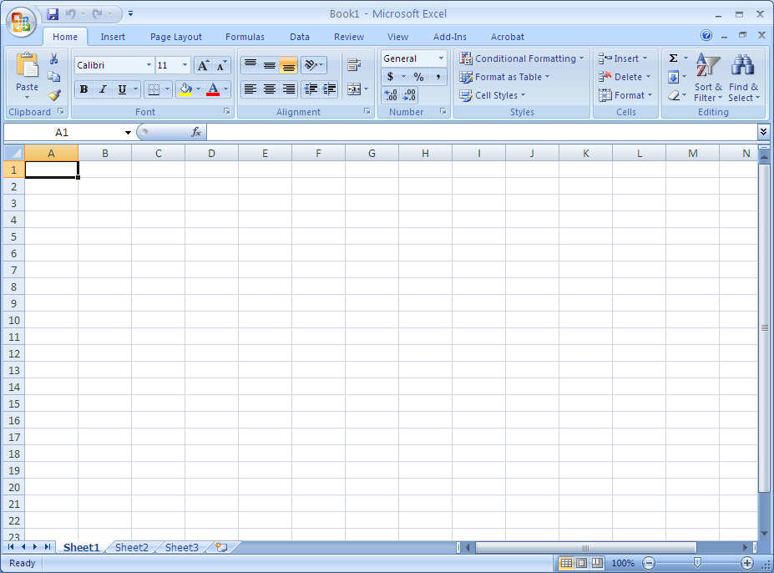
Excel Window
MS Office Button
Quick Access Toolbar
Tab Bar
Ribbon
Worksheet Area
Sheet Tabs
Status Bar
Help: F1

Slide 7
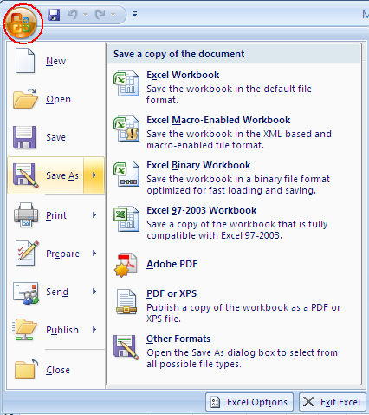
Microsoft Office Button
Performs many of the functions that were located in the File menu of older (or Excel 2010) versions.
  New, Open, Save, Save As, Print, Send, Close, etc.
File Format
  Save As
    Excel Workbook, .xlsx
      Smaller size with new Office 2007 features.
    Excel 97 – 2003 Workbook
    Other Formats: web page, .csv
Notes:
-20 minutes
Open MS Word. File/Edit Menus are grouped to Office Button.
Office Button: common commands: new, open, save, print, email, etc. Prepare-Details to describe or identify a document.
Practice: type in formation, save it as a file. open a file. Print, print-preview, send as an email attachment.

Slide 8
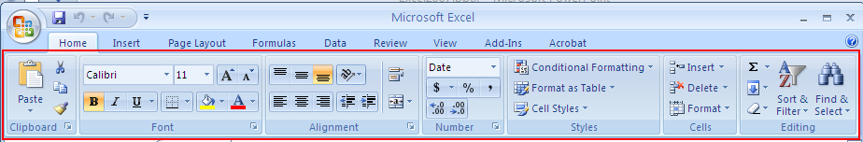
Ribbon
Font grouping
Paragraph grouping
Styles grouping
Each “tab” (such as “Home”, “Insert”…) will open a ribbon with several command items each in similar groupings.
Home: has the common formatting tools, clipboard, fonts, paragraphs, number, Styles, Cells, and Editing.
Notes:
Introduced a term as Ribbon. The command icons are grouped in each of the tabs. Each tab opens a ribbon, a group of commands.
Practice: Explore the tabs with commonly used commands.
Home: formatting – font, size, bold, italic, find/replace, copy/paste

Slide 9
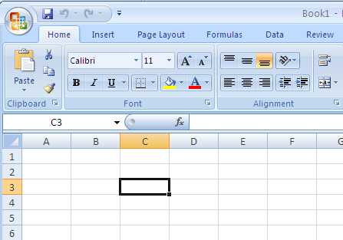
The Workbook
The workbook is comprised of:
  Rows (labeled numerically)
  Columns (labeled alphabetically)
  Cells
A cell is labeled with both a numerical and alphabetical value.
  Naming convention:
  C3 is active as
  Indicated by the
Tab Key: navigate cells.
Notes:
The first 26 columns have the letters from A through Z. Each worksheet contains 256 columns in all, so after Z the letters begin again in pairs, AA through AZ. See Figure 2.
After AZ, the letter pairs start again with columns BA through BZ, and so on, continuing through IA to IV, until all 256 columns have alphabetical headings.
Each row also has a heading. Row headings are numbers, from 1 through 65,536.
There are 16,777,216 cells to work in on each worksheet. You could get lost without the cell reference to tell you where you are.

Slide 10
Steps - Creation of a Workbook
Create a new workbook.
Save it with a file name.
Enter data: column headings, row headings, and data.
Format data: column headings, row headings, and data.
Save the file.

Slide 11
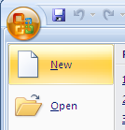
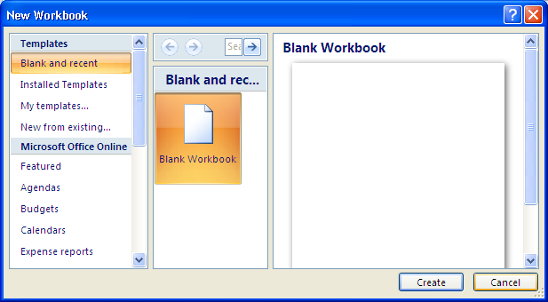
A New Workbook
You have a blank workbook when you open Excel.
  Or click on Office Button and select New.
  Click on Create button.

Slide 12
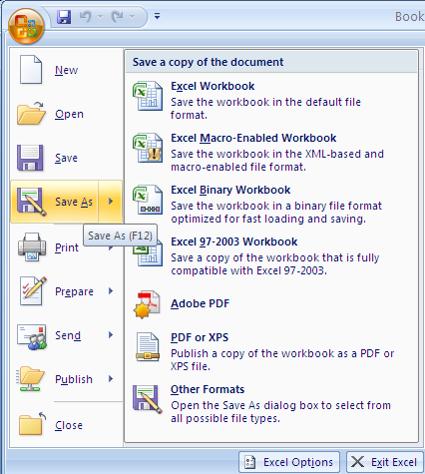
Save a Workbook
Click on Office Button and select Save or Save As.
  Save: save the workbook as .xlsx. This format is Excel 2007 compatible. It cannot be opened in previous version of Excel unless you have an Office 2007 converter installed.
  Save As:
    Excel Workbook - .xlsx
    Excel 97 – 2003 Workbook - .xls
    Other Formats - .CSV and others.

Slide 13
Creation of a Workbook
You should always enter headings to columns and rows to identify what the numbers represent.
Practice: make a workbook of home expenses.
Items | January | February | March | Total | Average
Clothing
Grocery
Gas
Utilities
Total

Slide 14
Data Entry
Place your mouse in a cell and click once. This will allow you to enter data in that cell.
To move HORIZONTALLY across cells, hit TAB.
To move VERTICALLY, hit ENTER.
Practice:
  Enter column heading and row heading.
  Enter data.

Slide 15
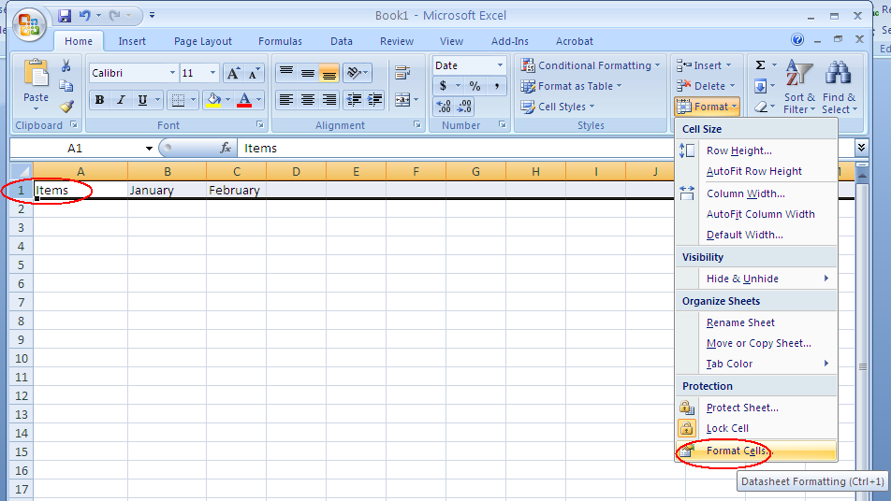
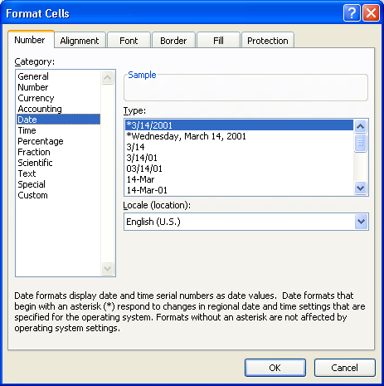

Autofill – Fill in Months
AutoFill Enter the months of the year, the days of the week, multiples of 2 or 3, or other data in a series. You type one or more entries, and then extend the series.
Fill in the months of the year
  Type in the first 2 months.
  Change the cell type to Date type.
    Select the row of the months by clicking on the row tab such as “1”. Go to Format and select Format Cells… (bottom).
    Select Date and click on OK.
  Highlight the cells of the two months and drag the bottom right corner to expand the cells with the rest of the months.
Notes:
Fill activity:
Select cell A15. Type 3, and then press ENTER.
In cell A16, type 6, and then press ENTER. By typing two numbers, you've established a pattern for Excel.
Select A15, press SHIFT, select A16, and then release the SHIFT button. Both cell A15 and cell A16 are selected. Position the pointer over the lower-right corner of cell A16 until a black cross (+) appears. Drag the fill handle down the column.
Release the mouse button when the ScreenTip says "18" in cell A20. Excel fills in the rest of the numbers from the three-times table.

Slide 16

Types of Data
You can enter numerical or text data in a cell.
Enter numbers in cells. You may need to change the cell format to numbers.
  Highlight number cells in the practice file, go to Format and select Cell Format. Select Number and click on OK.
If you see ######, you need to expand your column so the data fits.
  Double click on the line between the two column headings to auto-fit.
  Drag the border between two columns.
Change numbers to Currency with $ sign.
  Highlight all number cells and click on $ icon.
To enter fractions, leave a space between the whole number and the fraction. For example, 1 1/8.
To enter a fraction only, enter a zero first. For example, 0 1/4. If you enter 1/4 without the zero, Excel will interpret the number as a date, January 4.

Slide 17
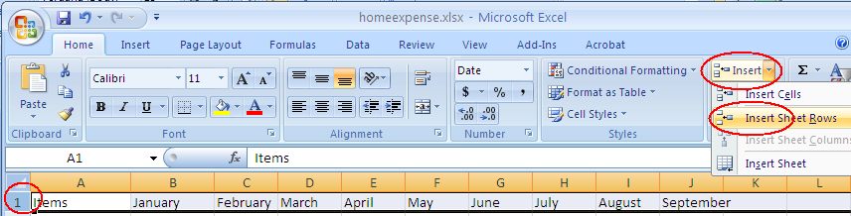
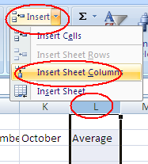
Insert a Row/Column
Insert a row:
  Select the row you would like to insert above
    Clicking on the row number tab.
  In Home tab, go to Insert and select Insert Sheet Rows.
Insert a column:
  Select the column you would like to insert next to it
    Clicking on the column letter tab such as L.
  In Home tab, go to Insert and select Insert Sheet Column.

Slide 18
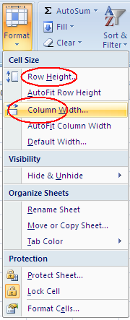
Change Column Width or Row Height
Column Width
  Drag the border between two columns to adjust a column width.
  Adjust column width for a group of columns
    Highlight the columns you want to adjust their width.
    In Home tab, go to Format and select Column Width...
    Enter a number of characters for column width. Click on OK.
Row Height
  Drag the border between two rows to adjust a row width.
  Adjust row width for a group of rows
    Highlight the rows you would like to change their height.
    In Home tab, go to Format and select Row Height.
    Enter a number of the row height and click on OK.
      One point=.035 cm

Slide 19
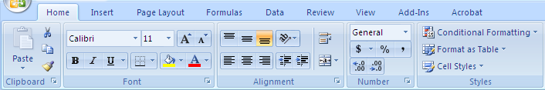
Format a Worksheet
Change the font size, color, and the background of a cell or group of cells.
Select the cells you’d like to change. Then select a formatting tool.
To show cell borders, highlight the cells and select a border.

Slide 20
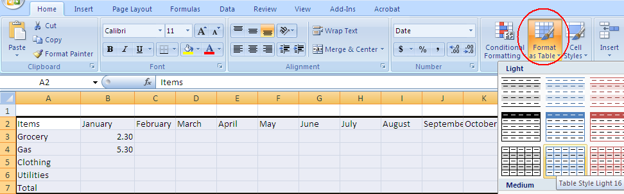
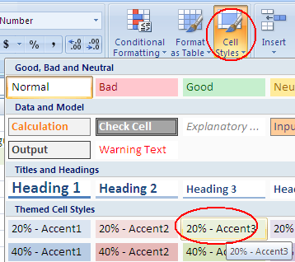
Table Styles and Cell Styles
Table Styles
  Highlight the Excel table (all cells), go to Format as Table icon. Select a table style.
Cell Styles
  Highlight cells, go to Cell Styles, select a cell style.
Notes:
Excel has built-in cell styles you can apply or modify.

Slide 21
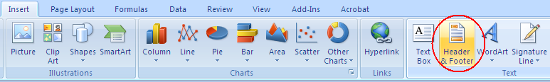
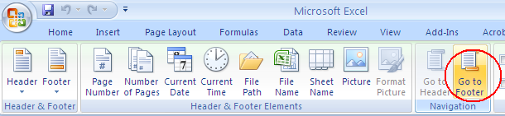
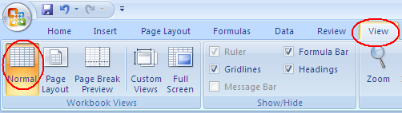
Excel - Header and Footer
In Insert tab, click on Header & Footer icon.
Type in a header in the Header box.
Click on Go to Footer icon. Click on File Name icon to insert the file name in the Footer box.
To go back to the Normal view of the spreadsheet, click on View tab and select Normal.

Slide 22
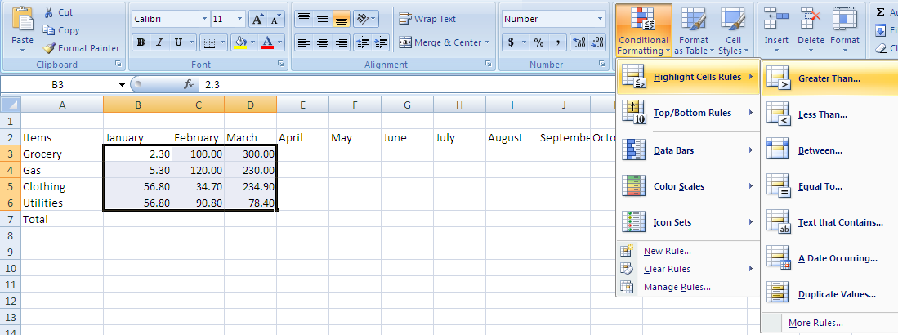
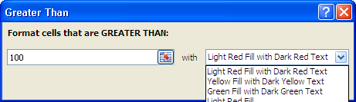
Conditional Formatting
Format cells based on a condition
  Red font for expenses that exceed $100.
  Highlight the cells you would like to apply a conditional formatting rule.
  In Home tab, select Conditional Formatting. Select Highlight Cell Rules and Greater Than.
  Select a cut point number (100) and a style of text.

Slide 23
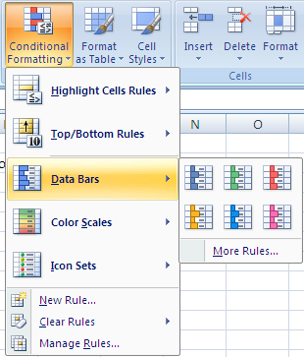
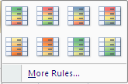
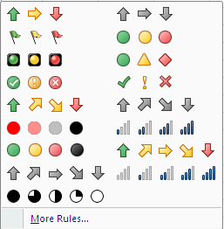
Conditional Formatting
Explore more conditions
  Top/Bottom Rules: Top 10, Above Average
  Data columns
  Formatting Styles
  Color Scale
  Data Set

Slide 24
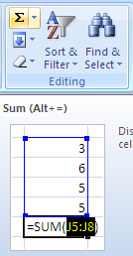
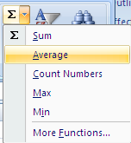
Basic Calculating Functions – Total, Average
Excel has mathematical functions for you to use.
  Total
    Click on the Cell that displays a total.
    In Home tab, click on the sum function icon.
    Highlight the cells included in the total and hit Enter key.
  Average
    Click on the cell that displays an average.
    In Home tab, click on the little down arrow in the sum function icon and select Average.
    Highlight the cells included in the average and hit Enter key.

Slide 25
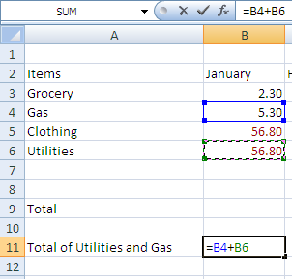
Creating Basic Formula
You conduct a mathematical calculation in Excel by typing a simple formula into a cell. An Excel formula always begins with an equal sign (=).
Math operators
  Addition: +
  Subtraction:-
  Multiplication:*
  Division:/
Example: Gas + Utilities
  Click on the cell that displays the expense of Gas and Utilities.
  Enter =.
  Click on the Gas cell for January.
  Enter +.
  Click on the Utilities cell for January
  Hit Enter key.

Slide 26
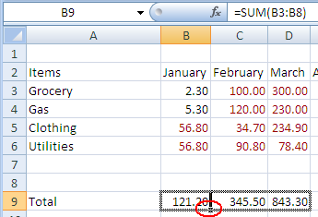
Copy a Formula
You may copy the same formula onto a series of cells.
  Example, a total expense in each of all 12 months.
  Select the total cell for January.
  Drag the bottom right corner of the cell to expand to the December total cell.
  The total expense is then calculated for all 12 months.
  Practice
  Total for each of the categories

Slide 27
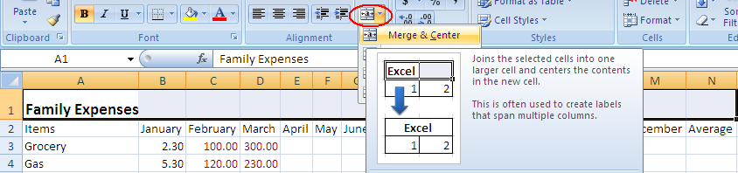
Merge and Center
You may want to add a title for an Excel table.
Insert a row above the column heading row.
Type the title in the first cell of the title row.
Highlight the cells you would like to display the table title.
Click on Merge and Center icon.

Slide 28
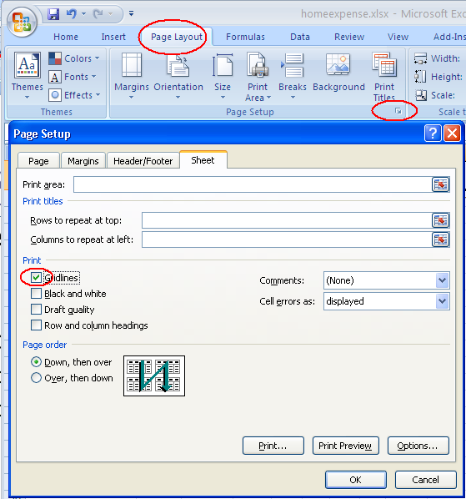
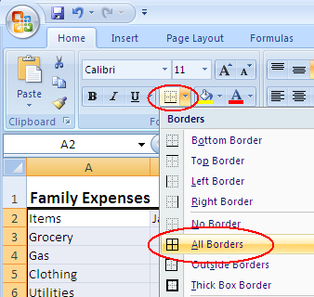
Print an Excel Sheet
As default, there are no borders around cells.
For printing, there are two ways to print boarders around cells.
  Gridlines: This way adds gridlines around the cells in the table.
    Click on Page Layout tab.
    Click on Page Setup group.
    Click on Sheet tab.
    Check Gridlines. Click on OK.
  Add borders: This way adds borders around the cells you selected.
    Highlight the cells you want to have borders.
    In Home tab, click on the down arrow next to the border icon and select a choice of borders.
    You have flexibility of selecting a variety of borders.

Slide 29
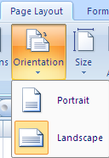
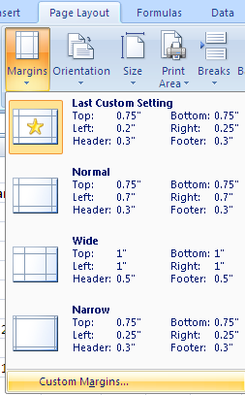
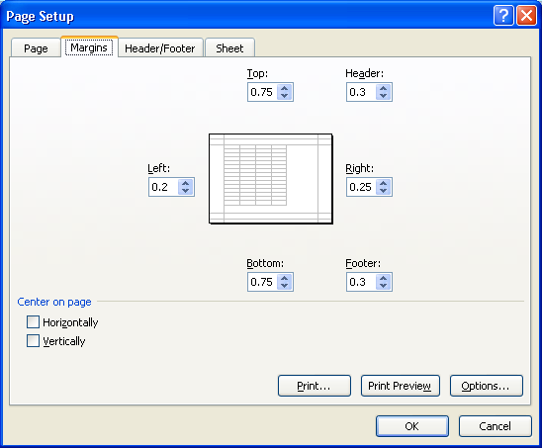
Page Layout
Orientation
  The vertical dotted line specifies the right border of a page in a spreadsheet.
  You may change the page orientation from Portrait to Landscape. Go to Page Layout tab, click on the Orientation icon and select Landscape.
  You may adjust the width of columns to fit the columns into a page.
    Double click on the border between the titles of two columns to automatically adjust the column width.
    Drag the border between the titles of two columns to adjust the column width.
Margins
  To adjust the margins of a page, in Page Layout tab, click on Margins icon and select Custom Margins. Change margins and click on OK.
Sheet Name
  To give a name of a sheet, double-click on the sheet tab and enter the name.

Slide 30
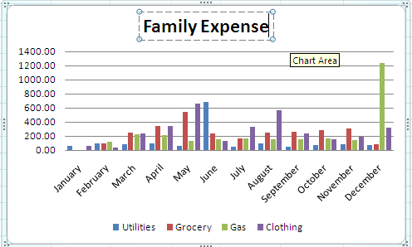
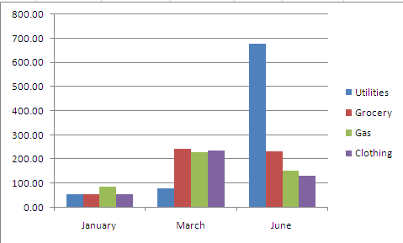
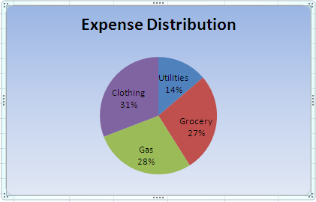
Column and Pie Chart
A column chart to show monthly expenses.
A column chart to show the comparison of expenses in selected months.
A pie chart to see the percentage/amount of each expense category.

Slide 31

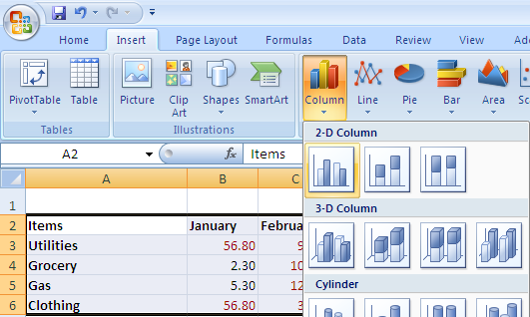
Column Chart -Monthly Expense
Highlight the expenses with the headings of 12 months.
Click on Insert tab.
Click on the arrow in Columns icon in Charts group.
Select a column chart.
To enter a title for the chart, choose a chart layout in Chart Layouts group. click on the Title Box and type a title.
You may change a layout or a style of the chart by selecting a style or a layout.

Slide 32

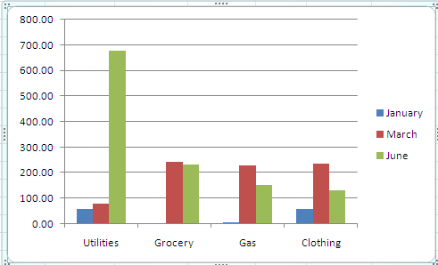
Column Chart - Expense Comparison
Display expense comparisons among January, March, and June.
Four columns: Items, January, March, and June. Use “ctrl” key to select multiple columns.
Go to Insert tab and select a column chart under Column chart icon.
Click on Switch Row/Column icon to change the comparison: comparison among months’ categories.

Slide 33
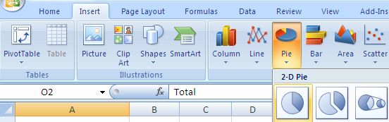

Pie Chart - Expense Distribution
Highlight the Items column and the Total Expense Column (ctrl).
Go to Insert tab.
Select a Pie chart in Pie icon.
To show a percentage, click on the first icon in Chart Layouts group.

Slide 34
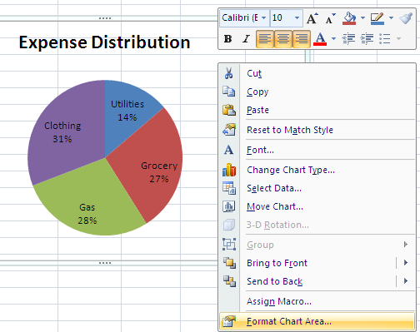
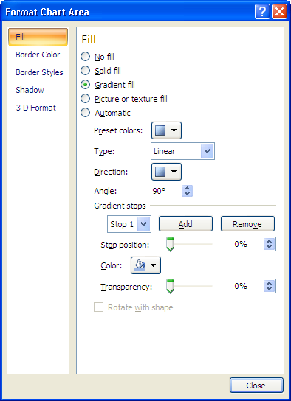
Pie Chart - Format
To add a title for the pie chart, choose a layout with a title box, click on the title box, and type the title.
Add background for the chart: Right-click on the chart and select Format Chart Area….
  Select a Fill style, border color, border style, etc. Click on Close.

Slide 35
Key Steps in Charting
Create the columns/rows that have the data you need to draw a chart.
Select the columns/rows needed.
  Hold “ctrl” key to select non-continuous columns.
  Hold “shift” key to select continuous columns.
Select a chart type in Insert tab.
Enter Chart title.
Select a style of a chart.

