Slide 1

Exploring the Relationship Between Smoking and Lung Cancer
Nick Scarth
Nick Mincucci
George Achie

Slide 2
The Dataset
We used a dataset from Kaggle titled “Lung Cancer Prediction.”
It was sufficiently large with 38 columns and nearly 24,000 rows of data.
It was a synthetic dataset that provided detailed information on lung cancer patients, covering demographic attributes, medical history, treatment specifics, and survival outcomes.
Mammadov, Rashad. “Lung Cancer Prediction.” Kaggle, 29 May 2024, www.kaggle.com/datasets/rashadrmammadov/lung-cancer-prediction.

Slide 3
Our Objectives
Determine the distribution of demographics such as age and gender within our dataset
Evaluate how smoking affects the onset and outcome of lung cancer.
Assess factors that contribute to length of survival after treatment such as treatment type.

Slide 4
Question 1
Are there any demographics within the dataset that demonstrate higher risk of lung cancer?

Slide 5
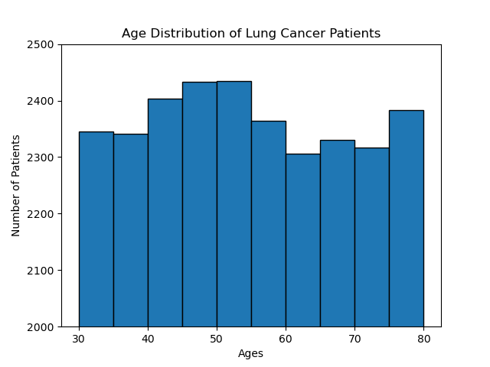

Slide 6
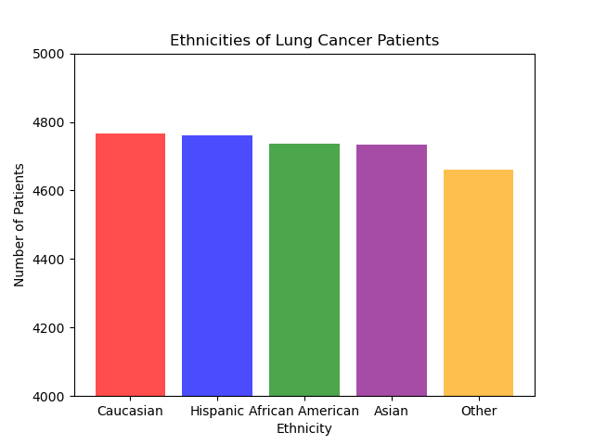

Slide 7
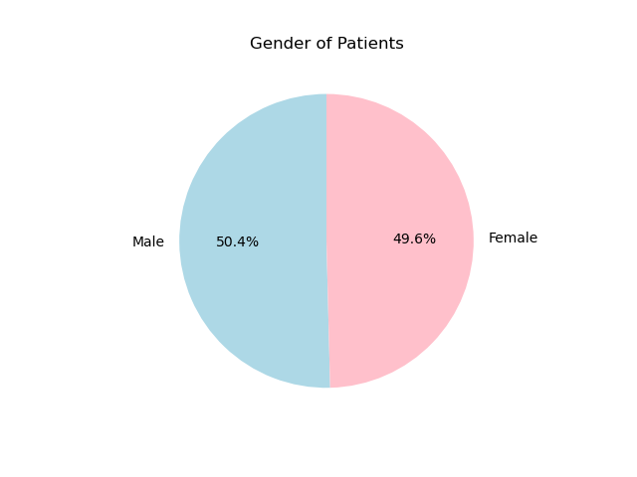
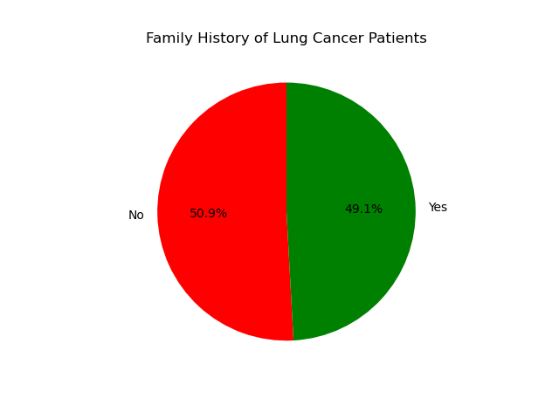

Slide 8
Question 2
What impact does smoking have on the onset of lung cancer?

Slide 9
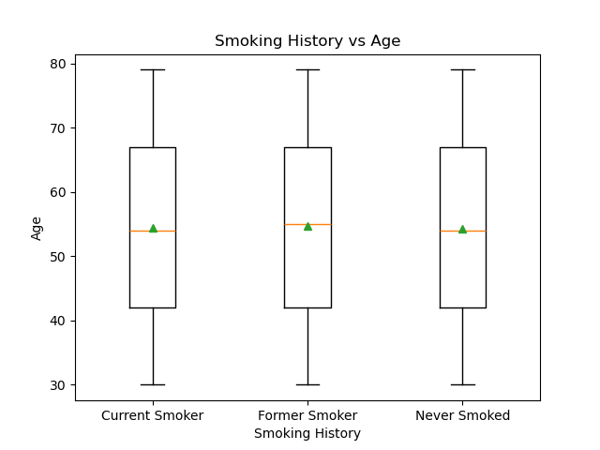
Current smoker
mean: 54.479
median: 54.0
std dev: 14.418
Former smoker
mean: 54.634
median: 55.0
std dev: 14.433
Never smoked
mean: 54.201
median: 54.0
std dev: 14.335

Slide 10
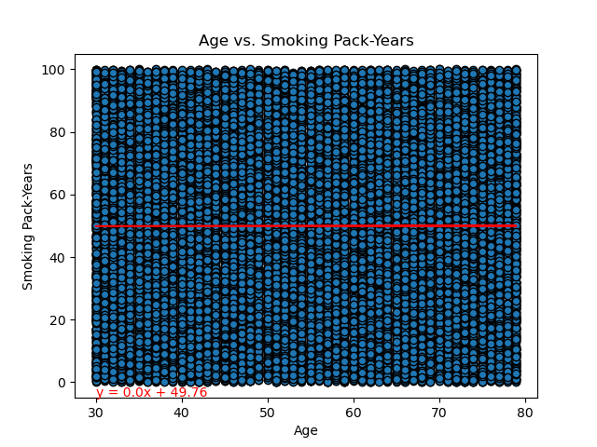
r^2 value: 1.9215548355196506e-06

Slide 11
Question 3
Does smoking affect tumor size?

Slide 12
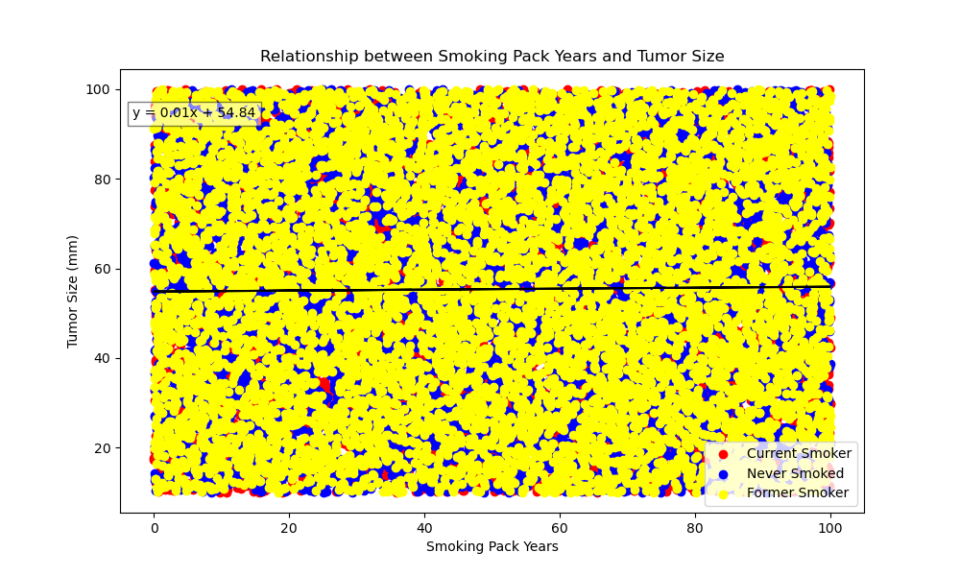
r^2 value is : 0.012042315910243592

Slide 13
Question 4
Does smoking affect tumor location?

Slide 14
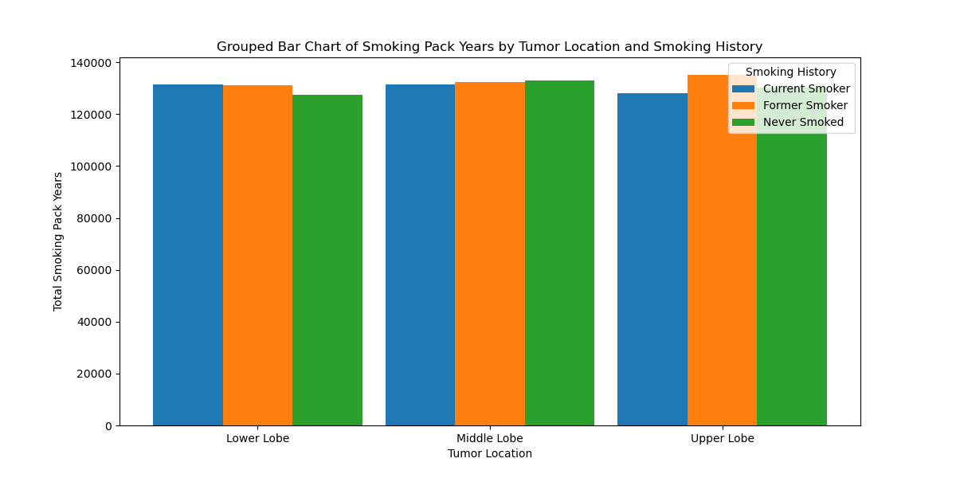

Slide 15
Question 5
Does smoking affect the stage of cancer?

Slide 16
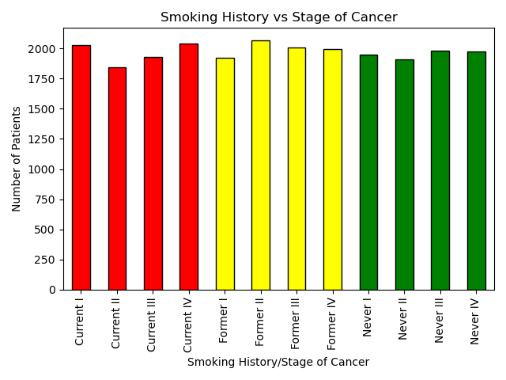

Slide 17
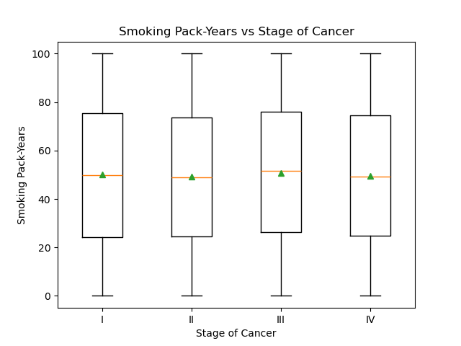
Stage I
mean: 50.010
median: 49.944
std dev: 29.242
Stage II
mean: 49.185
median: 48.812
std dev: 28.542
Stage III
mean: 50.788
median: 51.640
std dev: 28.905
Stage IV
mean: 49.663
median: 49.362
std dev: 28.771

Slide 18
Question 6
What is the average length (in months) of survival after treatment?
Mean: 59.864
Median: 60
Std dev: 34.246

Slide 19
Question 7
Which treatment has a higher survival rate?

Slide 20
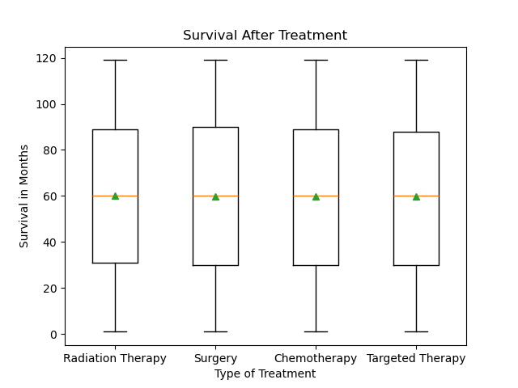
Radiation therapy
mean: 60.097
median: 60.0
std dev:34.002
Surgery therapy
mean: 59.915
median: 60.0
std dev:34.506
Chemotherapy therapy
mean: 59.820
median: 60.0
Std dev:34.389
Targeted therapy
mean: 59.618
median: 60.0
std dev:34.090

Slide 21
Question 8
Does smoking affect survival rate?

Slide 22
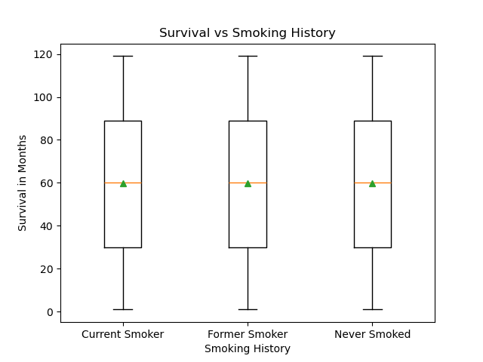
Current smoker
mean: 59.930
median: 60.0
std dev: 34.284
Former smoker
mean: 59.749
median: 60.0
std dev: 34.341
Never smoked
mean: 59.914
median: 60.0
std dev: 34.114

Slide 23
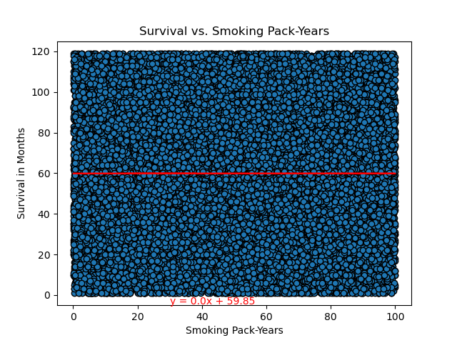
r^2 value: 3.36070175723838e-08

Slide 24
Conclusions
The demographics of the dataset are extremely evenly divided.
Within our dataset, smoking had no impact on when lung cancer developed, how lung cancer developed, or on the length of survival after treatment.
The synthetic nature of the dataset may be responsible for the evenness of the data.

