Slide 1

OpenCores - Nand Controller Integration with DE1-SoC Computer
Nicholas Strong

Slide 2
Goals
Integrate the OpenCores ONFI Compliant Nand Controller into the DE1-SoC Computer Development Board to allow reading and writing with NAND component connected to TSOP extender card. This will help facilitate ongoing research into NAND Memory done at UAH.
Resources:
System available at https://github.com/nbstrong/DE1_SoC_Computer
Original core sourced from: https://opencores.org/projects/nand_controller
Memory model used from: https://www.micron.com/products/nand-flash/mlc-nand/part-catalog

Slide 3
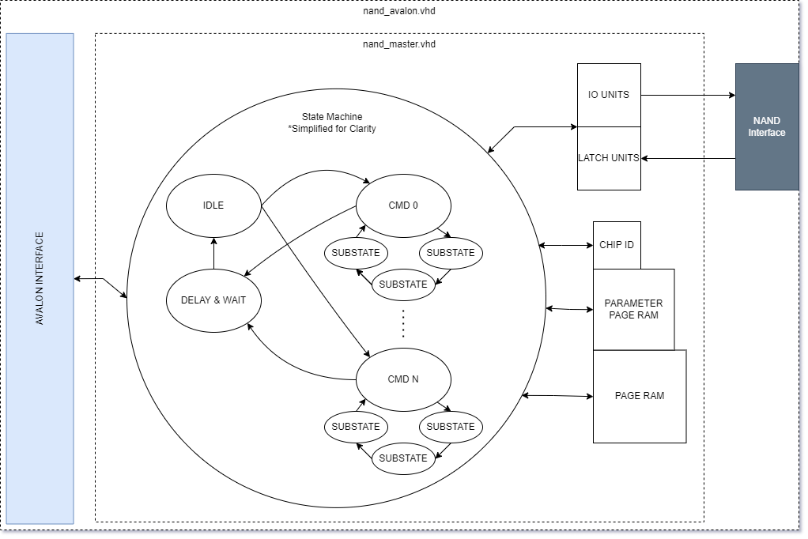
Architecture

Slide 4
Software Interface
Controller execution is started by writing to the COMMAND register.
Required data must be written to the DATA register before command execution.
Status register must be polled between commands to verify both controller and NAND flash are ready.
For full list of commands, see: https://opencores.org/usercontent/doc/1467239607
Data – 8-bit* data value to be written
Cmd – 8-bit command to be executed
RB – 1-bit value reflecting NAND rnb* signal.
1 – Ready
0 – Busy
B – 1-bit value reflecting Controller busy status.
1 – Busy
0 - Ready
* Whereas Opencores documentation states data is 32-bits and Avalon interface is 32 bits, it is truncated to 8 upon entering the controller.
* Adjustment was made to original controller to add rnb polling capabilities to the controller.

Slide 5
Simulation and Hardware Testing – Functional Coverage
Tested and Working up to address 100
Commands:
INTERNAL_RESET
CTRL_CHIP_ENABLE
CTRL_CHIP_DISABLE
CTRL_RESET_INDEX
CTRL_GET_STATUS
CTRL_GET_DATA_PAGE_BYTE
CTRL_SET_DATA_PAGE_BYTE
NAND_RESET
NAND_READ_ID
NAND_READ_PARAMATER_PAGE
NAND_READ_PAGE_CMD
NAND_PAGE_PROGRAM
NAND_BLOCK_ERASE
Untested
Commands:
NAND_READ_STATUS
NAND_BYPASS_ADDRESS
NAND_BYPASS_COMMAND
NAND_BYPASS_DATA_WR
NAND_BYPASS_DATA_RD
CTRL_GET_CURRENT_ADDRESS_BYTE
CTRL_SET_CURRENT_ADDRESS_BYTE
Need to expand addressing and test memory bounds.
Remaining Issues
Have not discovered how to read and write from a starting address other than 0. Suspected to be related to the untested CURRENT_ADDRESS_BYTE commands above, but not as straightforward as I’d have hoped.
Controller seems to think the NAND chip is a x16 wide bus model according to the controller’s status register. This does not make any tests fail but is likely an underlying issue that will need to be resolved.

Slide 6
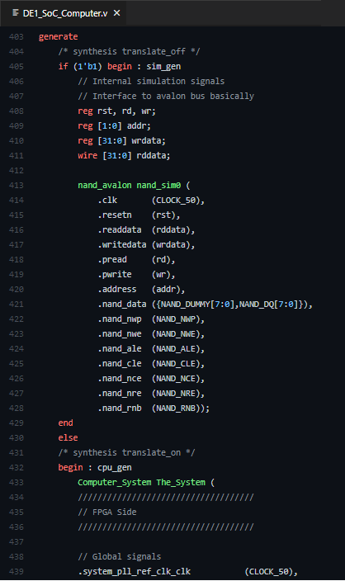
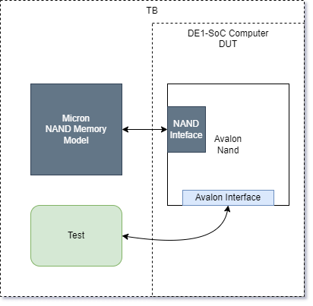
Testbench
Testbench utilized a Micron Memory Model supporting MLC MT29F256G08CBCBB family.
Avalon interface is modeled via timing tasks in SystemVerilog. Avalon signals driven from testbench without adding ports to DUT.
Testbench is self testing, compares 400 values and reports failed compares upon completion.

Slide 7
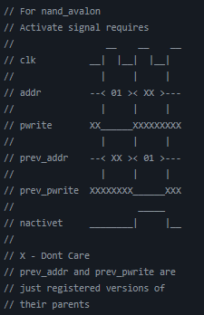
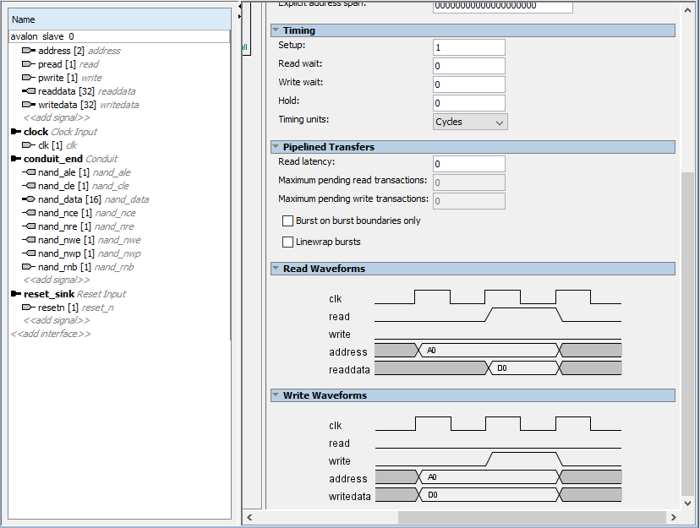
Changes made: Reverse Engineering the Avalon Interface
Without documentation as to the settings for the Avalon component, Avalon interfacing logic had to be reverse-engineered…
A bit of trial and error and some head scratching over logic tables, interface was determined to require a setup of 1

Slide 8
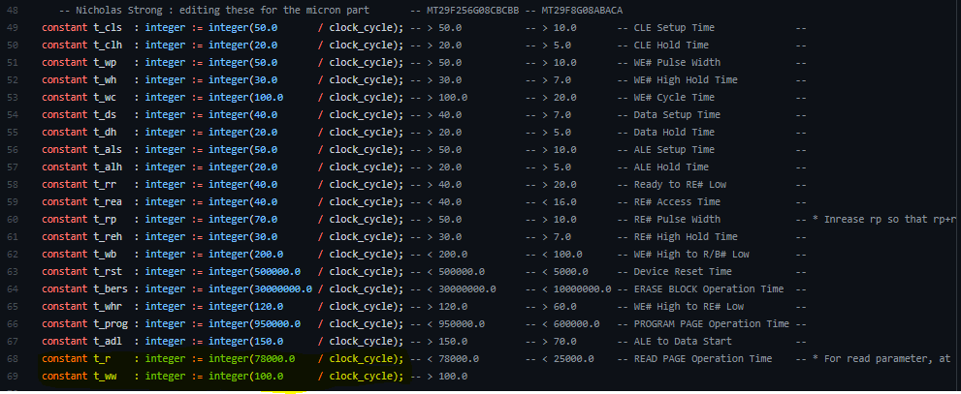
Changes made: Timing Adjustments
Once commands were being output to the model, timing violations started to occur.
Updating the timing in the controller per the datasheet and inserting extra delays that weren’t included in the state machine resolved these…

Slide 9

Changes made: More Timing Adjustments
Finally, the IO Unit storing the data from the NAND was clearing data too early. An extra case in its latching behavior so that it didn’t clear the data until later in its state machine fixed this.
I honestly don’t know how it ever worked with this logic.

Slide 10

Drivers
Testbench was designed to make porting to C for driver code simple.
Like Testbench, performs 400 compares and reports failures upon completion.

Slide 11
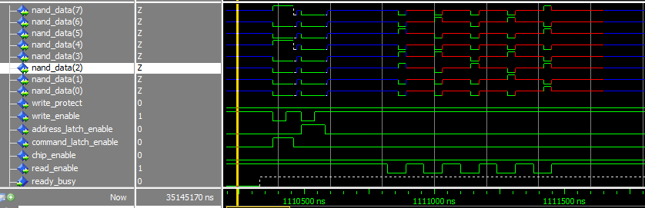
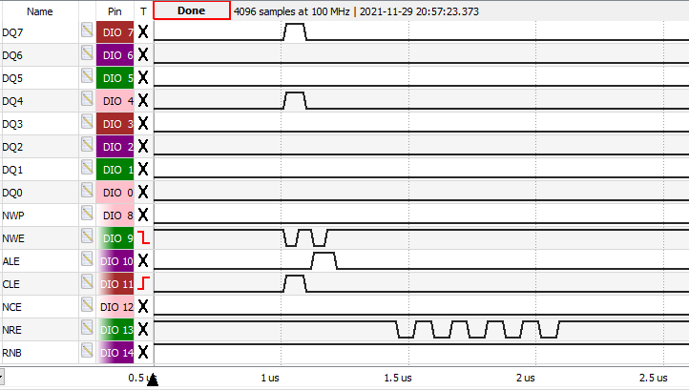
Simulation vs Hardware (no NAND)

Slide 12
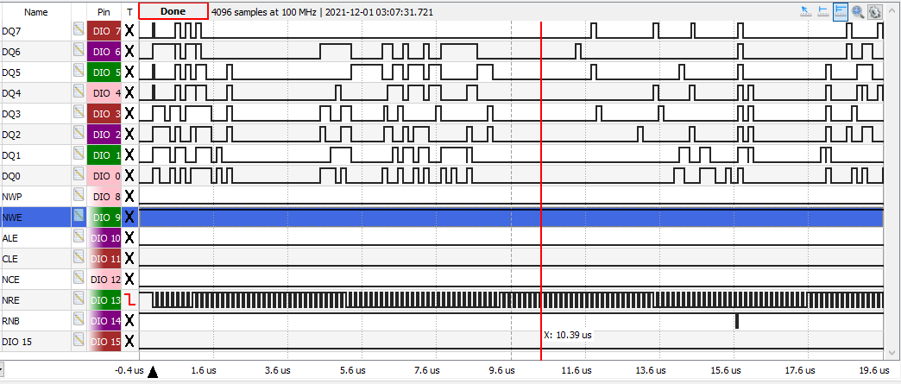
Hardware (with NAND) Read Parameter Page

Slide 13
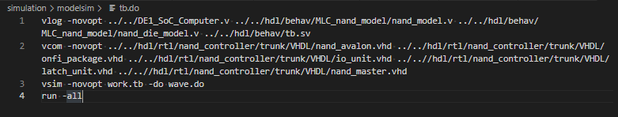
Extra: Running Simulation
Open Modelsim
In Modelsim TCL Console run:
do tb.do

Slide 14
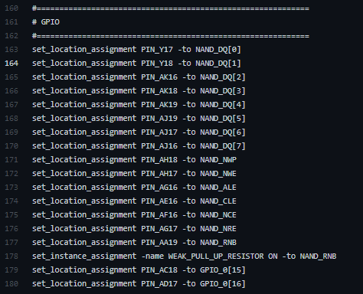
Extra: Be sure to add pull-up resistor on RNB!

