Slide 1
jQuery – Class 2
API
Selectors
Traversing
Attributes
Utilities

Slide 2
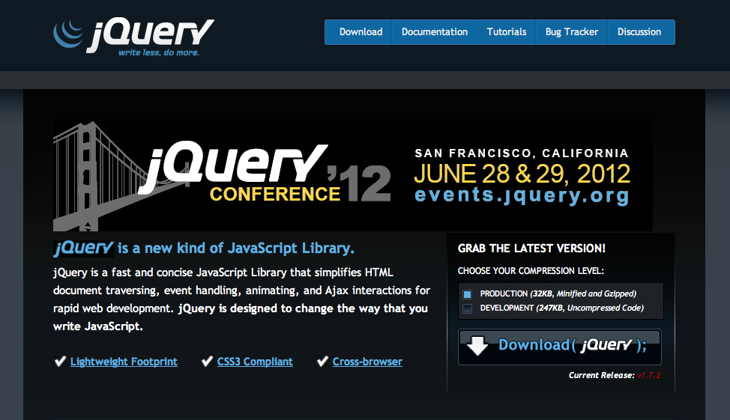
http://jquery.com/

Slide 3
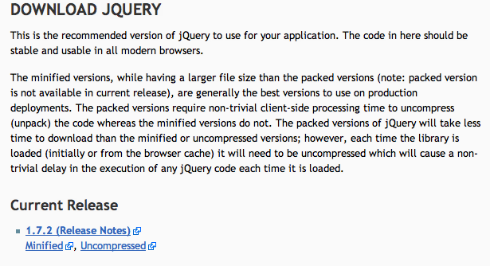

Slide 4
Loading jQuery from Google
<script src=‘https://ajax.googleapis.com/ajax/libs/jquery/1.7.2/jquery.min.js’ type=‘text/javascript’></script>

Slide 5
HTML
<body>
<h1>Hello World</h1>
<div class=‘plan’></div>
<div id=‘hello’></div>
</body>
HTML Tag
Class
ID

Slide 6
jQuery Selectors
<body>
<h1>Hello World</h1>
<div class=‘hello’></div>
<div id=‘hello’></div>
</body>
$(“h1”);
$(“div”);
$(“div.hello”);
$(“div#hello”);

Slide 7
Selectors – Results Explained
<body>
<h1>Hello World</h1>
<div class=‘hello’></div>
<div id=‘world’></div>
</body>
$(“div”);
[“<div class=‘hello’></div>”,
“<div id=‘world’></div>” ]

Slide 8
Selectors – Nothing Found
<body>
<h1>Hello World</h1>
<div class=‘hello’></div>
<div id=‘world’></div>
</body>
$(“p”);
[ ]

Slide 9
Selectors – Multiple Requests
<body>
<h1>Hello World</h1>
<div class=‘hello’></div>
<div id=‘world’></div>
</body>
$(“h1, div.hello”);
$(“h1”, “div.hello”);
[“<h1>Hello World</h1>”,
“<div class=‘hello’></div>” ]

Slide 10
Selectors – Whitespace
<body>
<h1>Hello World</h1>
<div class=‘hello’></div>
<div id=‘world’></div>
</body>
A) $(“div.hello”);
B) $( “div .hello”);
[“<div class=‘hello’></div>” ]
[ ]

Slide 11
Selectors – Pseudo Classes
:first
:last
> - Direct Descendant
:hidden
:visible
Many many more: http://api.jquery.com/category/selectors/

Slide 12
Selectors – Pseudo Classes
<body>
<h1>Hello World</h1>
<div class=‘hello’>
<h1> This is some text </h1>
</div>
<div id=‘world’></div>
</body>
$(“div:first”);
B) $(“div:last”);
B) $(“body > h1”);
[“<div class=‘hello’><h1> This is some text </h1> </div>” ]
[“<div id=‘world’></div>”]
[“<h1>Hello World</h1>”]

Slide 13
jQuery Utilities
$.each( selector, function(index, element) { })
$(html_element).data()
$(html_element).attr()
Many many more: http://api.jquery.com/category/utilities/

Slide 14
jQuery - $.each
<body>
<h1>Hello World</h1>
<div class=‘hello’></div>
<div id=‘world’></div>
</body>
$.each( $(“div”), function(index, element) {
console.log(element);
console.log(index);
});
<div class=‘hello’></div>
0
<div id=‘world’></div>
1

Slide 15
jQuery - .data()
<body>
<h1>Hello World</h1>
<div class=‘hello’></div>
<div id=‘world’></div>
</body>
$(‘div.hello’).data( ‘numPeople’, 100);
$(‘div.hello’).data(‘numPeople’);
$(‘div#world’).attr(‘id’);
$(‘div#hello’).attr(‘numPeople’, 100);

