Slide 1


JavaScript & jQuery
Charleston CODEcamp

Slide 2
Contact
Nick Bucciarelli
nick@jackrussellsoftware.com
@n_bucciarelli / @chscodes_jq
https://github.com/nbucciarelli

Slide 3




JavaScript

Slide 4
JavaScript
Created in 1995 to make Netscape Navigator’s Java support more accessible to non-Java programmers
Originally titled “LiveScript”
Sun and Netscape jointly released the language as a compliment to HTML and Java and renamed it “JavaScript” (oops)
NOT JAVA!

Slide 5
JavaScript
Scripting language to tie into page elements (Document Object Model - DOM)
Easy language, lots of potential
Security flaws, no IDE, books aimed at non-programmers caused many programmers to overlook JavaScript
Microsoft included a version of it in their IE browsers and it’s become a web standard ever since

Slide 6
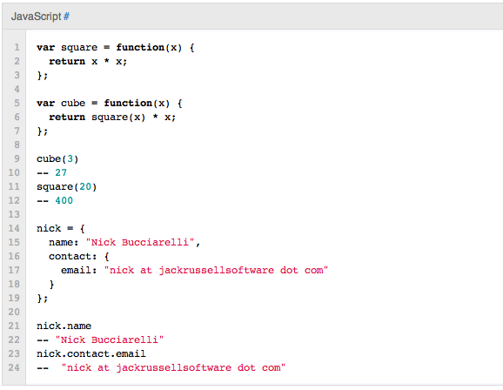
JavaScript – Example Code

Slide 7
jQuery
Released on January 2006
Designed to simplify client-side scripting of HTML
Most popular JavaScript library in use today
http://www.jquery.com/
Makes writing JavaScript easy
Best thing since sliced bread

Slide 8
jQuery
jQuery makes it easier to:
Navigate a document
Select DOM elements
Create animations
Handle events
AJAX
Etc.. Etc..

Slide 9
jQuery in Action
Google
Amazon
IBM
Microsoft
Twitter
Of the top 17,000 most visited web sites, 48% of them use jQuery

Slide 10
jQuery – Set up
Set up is easy as pie
<html>
<head>
<script src="jquery.js” type='text/javascript'></script>
</head>
<body>
</body>
</html>
All you do is include the library in the header

Slide 11
window.onload = function(){ alert("welcome"); }

Slide 12
jQuery(document).ready(function(){ // Code goes here! }); jQuery == $

Slide 13
More stuff!
http://www.codecademy.com/#!/exercises/0
http://gitimmersion.com/

