Slide 1
jQuery – Class 9
jQuery Mobile

Slide 2
jQuery Mobile
UI (user interface) system
Meant to work across all popular mobile device platforms

Slide 3
jQuery Mobile
Animated page transitions
Dialogs
Toolbars
List views
Buttons with icons
Form elements
Accordions
Collapsibles
Much more.
http://jquerymobile.com/test/

Slide 4
Basic HTML Document Outline
<html>
<head>
</head>
<body>
</body>
</html>

Slide 5
Including jQuery Mobile - Head
<meta name="viewport" content="width=device-width, initial-scale=1">
<link rel="stylesheet" href="http://code.jquery.com/mobile/1.1.0/jquery.mobile-1.1.0.min.css" />
<script src="http://code.jquery.com/jquery-1.7.1.min.js"></script>
<script src="http://code.jquery.com/mobile/1.1.0/jquery.mobile-1.1.0.min.js"></script>
Meta viewport tag
Sets the screen width to the pixel width of the device
jQuery mobile CSS
jQuery javascript
jQuery mobile javascript

Slide 6
Including jQuery Mobile – Body Single page template
<body>
<div data-role=“page”>
<div data-role=”header">
Header here!
</div>
<div data-role="content">
Html markup goes in here!
</div>
<div data-role="content">
Footer here
</div>
</div>
</body>
Data role = page
jQuery mobile wrapper.
Used to delineate a page
Data role = content
Used to delineate your content
Data role = header
Used to delineate your header
Data role = footer
Used to delineate your footer

Slide 7
Adding jQuery Mobile Elements
Inside your data-role=“content” div you can add any HTML element.
jQuery mobile supports basically any basic HTML tag and styles it to look very mobile-like
Adding data-role=“type” to basic HTML tags
There is a LOOOOOOOOT of stuff!
http://jquerymobile.com/demos/1.1.1/

Slide 8
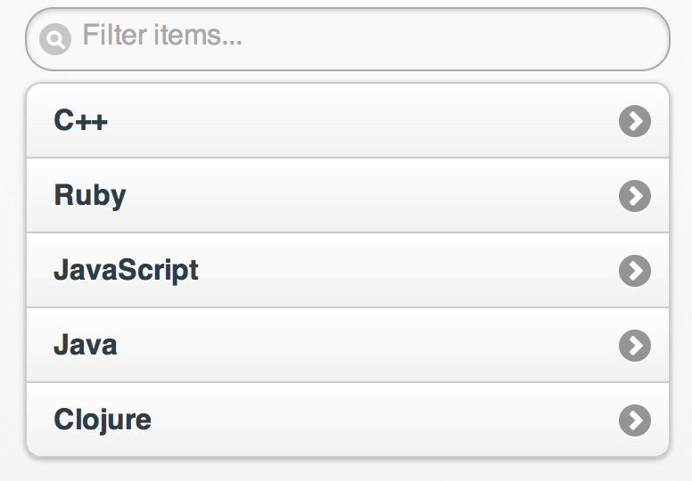
List View
http://jquerymobile.com/test/docs/lists/docs-lists.html
<ul data-role="listview" data-inset="true" data-filter="true">
<li><a href="#”>C++</a></li>
<li><a href="#”>Ruby</a></li>
<li><a href="#”>JavaScript</a></li>
<li><a href="#”>Java</a></li>
<li><a href="#”>Clojure</a></li>
</ul>

Slide 9
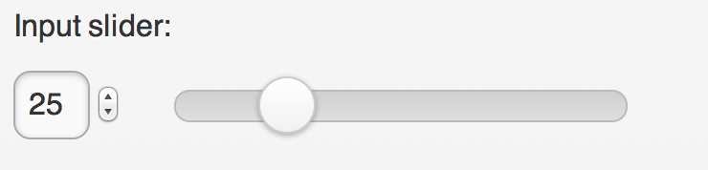
Slider
<form>
<label for="slider-0">Input slider:</label>
<input type="range" name="slider" id="slider-0" value="25" min="0" max="100" />
</form>

Slide 10

Button – Star Icon
<a href="#" data-role="button" data-icon="star">Star button</a>

Slide 11
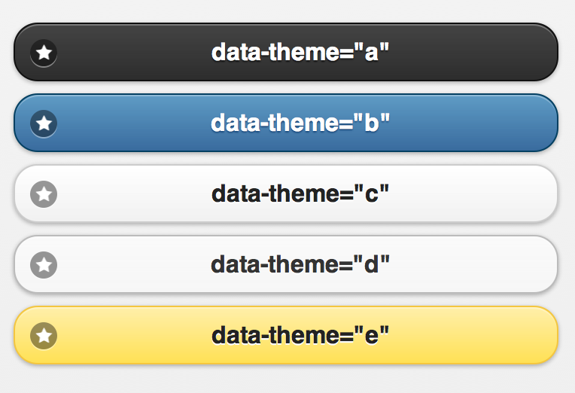
Theme framework – Button Style!
<a href="#" data-role="button" data-icon="star”
data-theme="a">Button</a>
http://jquerymobile.com/demos/1.1.1/docs/api/themes.html

Slide 12
Linking Pages
All pages by default are loaded with Ajax
Parses the link and runs the ajax request when clicked
If success, it will render the page
If failure, it will show a little error window
Can NOT link to a multipage document with Ajax navigation active!
Potential hash collisions
jQuery mobile defaults to AJAX when switching pages
Keeps a hash to track page history
http://jquerymobile.com/demos/1.1.1/docs/pages/page-links.html

Slide 13
jQuery Mobile Page – Multiple Pages
<body>
<div data-role=“page” id=“#one”>
Header/Content/Footer
</div>
<div data-role=“page” id=“#two”>
Header/Content/Footer
</div>
</body>
Give the page div’s ID’s
These ID’s need to be unique across the entire website
<a href=“#two”>Link to Page Two</a>

Slide 14
jQuery Mobile Page – Multiple Pages
<body>
<div data-role=“page” id=“#one”>
<a href=“#two”>Page Two</a>
</div>
<div data-role=“page” id=“#two”>
<a data-rel=“back” >Back</a>
</div>
</body>
<a data-rel=“back”>Back</a>
jQuery mobile keeps a hash of visited pages in order, so it automatically makes a back button work

Slide 15
Page Transitions
<a data-transition=“pop” >Link</a>
<a data-direction=“reverse”>Reverse</a>
fade (default)
pop
flip
turn
flow
slidefade
slide
slideup
slidedown
none

Slide 16
Dialogs
<div data-role=“page”>
<div data-role=“content”>
<a href=“#dialog” data-rel=“dialog”>Open Dialog</a>
</div>
</div>
<div id=“dialog” data-role=“dialog”>
<div data-role=“header”>
<h1>Header!</h1>
</div>
<div data-role=“content”>
Content goes here
</div>
</div>
To close
data-rel=“back”
$(select).dialog(‘close’)

Slide 17
Changing Default Configurations
Before $(document).ready( function() {})
We will be extending the $.mobile object
$(document).bind("mobileinit", function(){
//apply overrides here
});
mobileinit event is triggered immediately by jQuery mobile, so load your code in before jQuery mobile
<script src="jquery.js"></script>
<script src="custom-scripting.js"></script>
<script src="jquery-mobile.js"></script>

Slide 18
Configuration Options
$.mobile. defaultDialogTransition = "fade”
Default “pop”
$.mobile. defaultPageTransition = ”slide”
Default “fade”
$.mobile.loadingMessage = “Loading!”
Default “loading”
http://jquerymobile.com/test/docs/api/globalconfig.html
http://jquerymobile.com/test/docs/config/index.html - test

Slide 19
Events
Work the same as the normal ones!
$(selector).tap( function{ /* code here */ });
tap
swipe
taphold
swipeleft
swiperight
http://jquerymobile.com/test/docs/api/events.html

Slide 20
Extra Stuff
http://jquerymobile.com/test/docs/api/data-attributes.html

