Slide 1
Min 15-30:
Moodle Quiz

Slide 2
Min 30-60: Bias-Correcting Meteorological Forecasts with simple ML
Group activities (Wilks Ch7, Géron Ch3+4):
(Theme 2)Model output statistics (MOS) learn to correct the output of knowledge-based models based on past observations. Why can this be useful? Can you come up with a scenario in which it might fail?​
​
(Theme 3) : Explain forward (sequential) feature selection and backward feature elimination using simple drawings/schematics. Can you think of alternative methods to select a model's features?​
Why (think of examples in your field of interest) and how (in Python) can you regularize a linear regression model? ​
(Theme 5) : Come up with two presentations: One to convince the class that they should use confidence intervals for their project, and one to explain why you should never use confidence intervals. ​

Slide 3

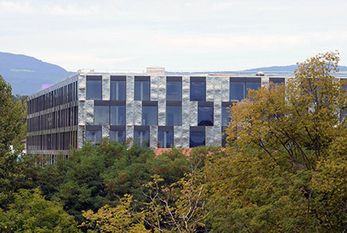
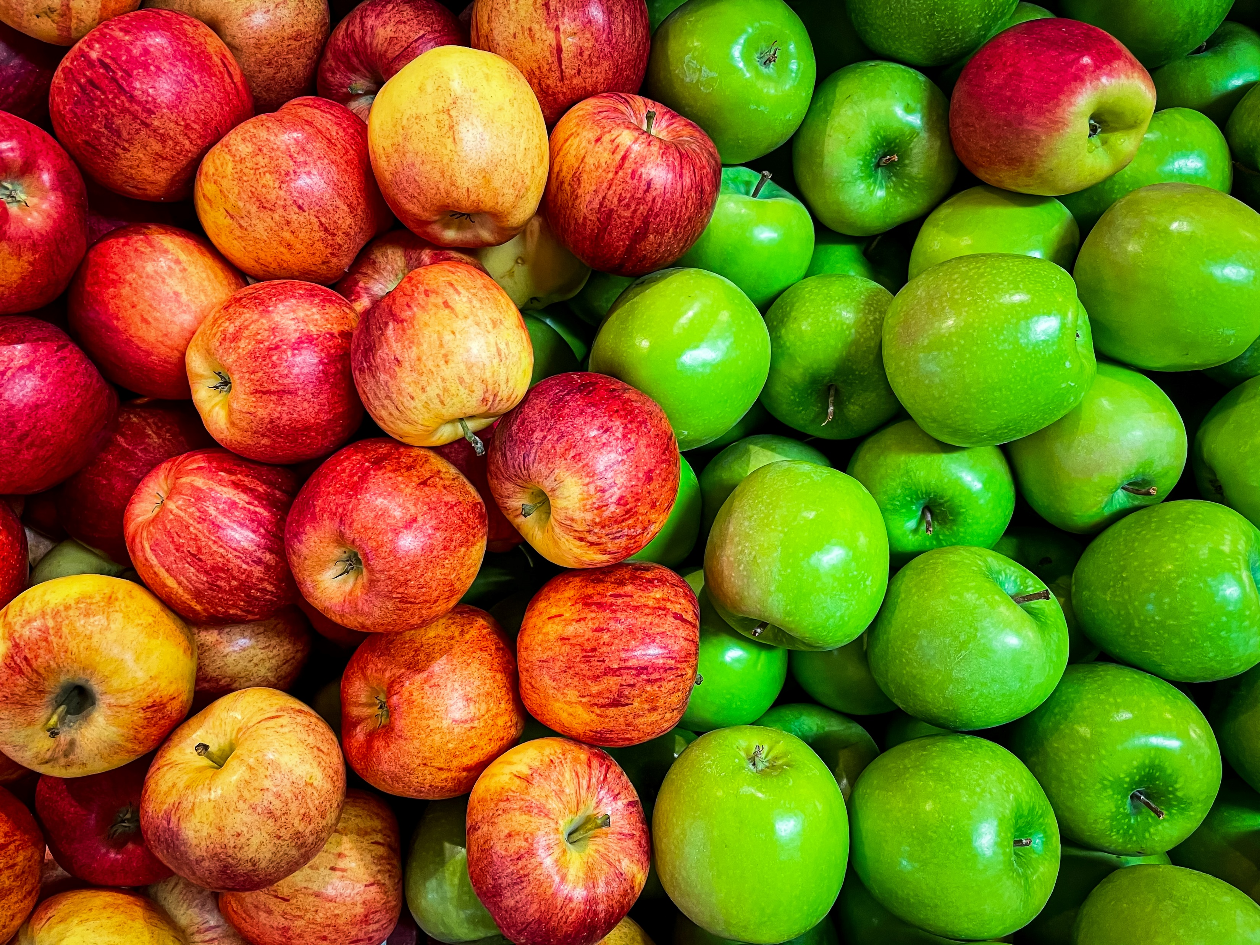
Min 60-75: Break

Slide 4



Welcome back!
ML for Earth & Env Sci (Week 2, SP2022)
Learning Objectives:
Name Support Vector Machines & understand their applicability
Know how to train & interpret a decision tree
Understand how to choose a regularization hyperparameter
Define a random forest
Know some advantages/drawbacks of ensemble modeling
Understand feature importance
Book a 1-1 meeting with me to discuss the final projects:
Notes:
Thank you:
For coming today
To all of you who did the guided readings
For persevering

Slide 5
Min 75-85: Support Vector Machines for Classification on Small Datasets
Learning Objectives (Géron Ch5):
Name Support Vector Machines & understand their applicability
Understand how to choose a regularization hyperparameter

Slide 6
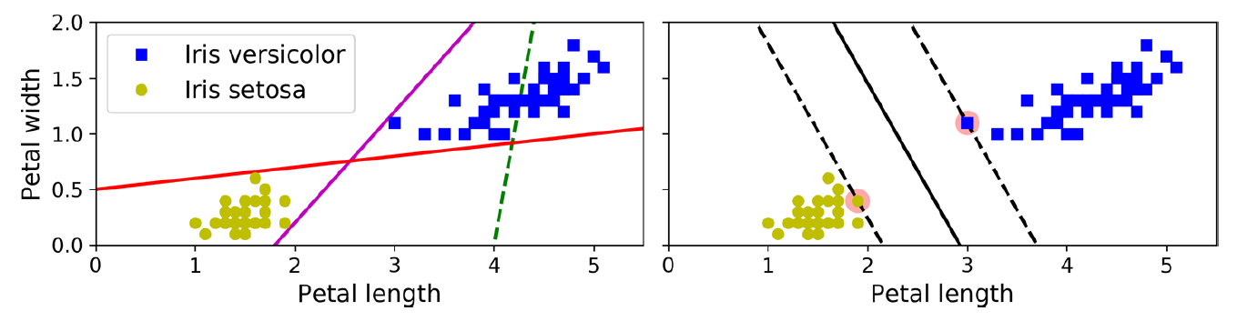
What is a Support Vector Machine (SVM)?
Goal = Widest Possible Street
How to choose the best decision boundary?
“Support Vectors”
Notes:
Supervised ML algorithm that learn a boundary, more generally a “street” from data for regression or classification

Slide 7


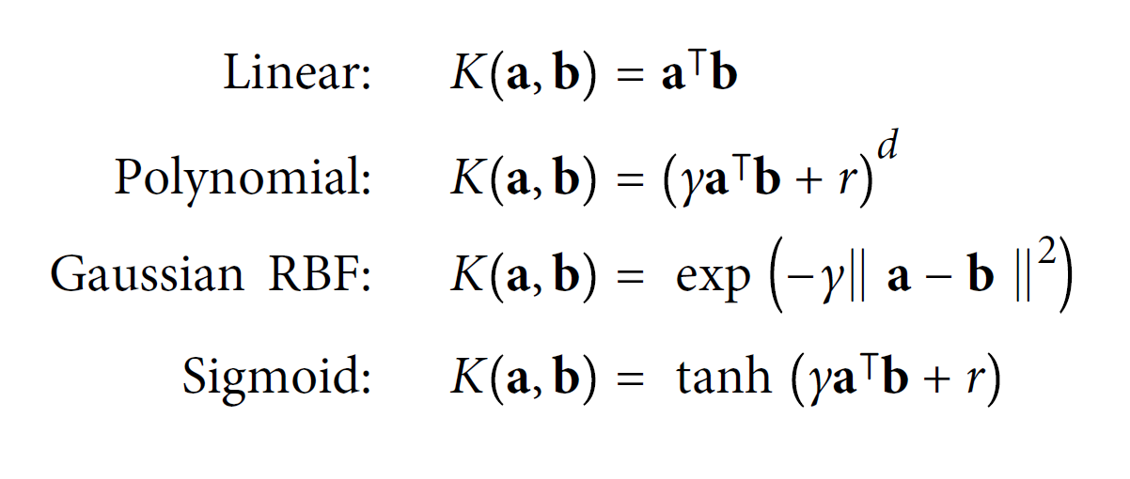

Can you elaborate on kernels?
Source: SVM with polynomial kernel visualization (Udiprod, Youtube)
Notes:
Point of the RBF

Slide 8
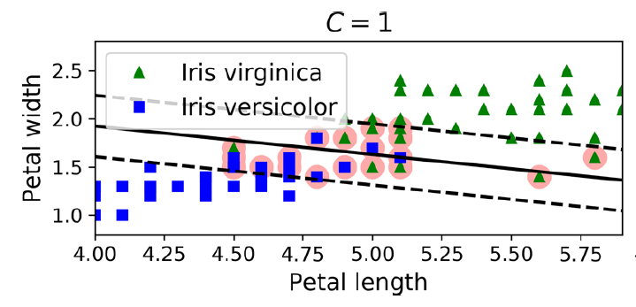
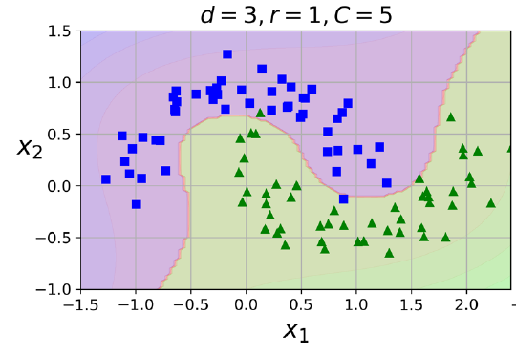
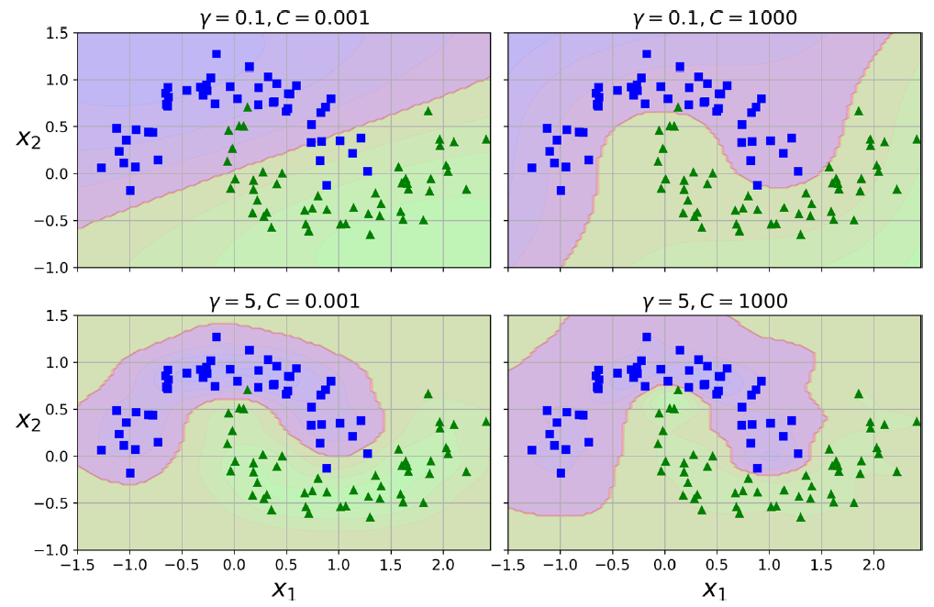
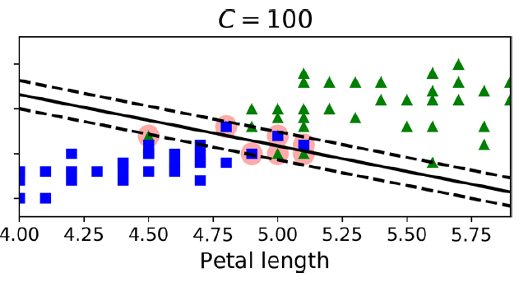
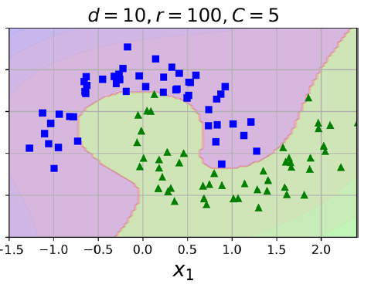
SVMs sorted by complexity/representation power
SVM with RBF kernel
Linear SVM
(with soft margin)
SVM with polynomial kernel
Representation power/Complexity
Notes:
Why would RBF kernel be useful?

Slide 9
Which complexity to choose for env. applications?
An example would be classifying water and vegetation pixels based on NDVI.
determining forest cover from its surrounding, only based on longitude and latitude.
When there is a clear difference between two groups, for exemple tree population over/under a decided altitude
Asses species environment (biomes, coordinates) based on many features such as physical characteristics, alimentation, behavior, ect..
differentiating cloudy and non-cloudy satellite imagery pixels in the open oceans
differentiate convective storms that produce hail and those that do not
Classifying linearly separable values e.g species differentiation by physiological characteristic
SVM with polynomial kernel
SVM with RBF kernel
Linear SVM
(with soft margin)
Representation power/Complexity
Notes:
For Intro to quadratic programming & online SVMs, see Géron Ch5

Slide 10
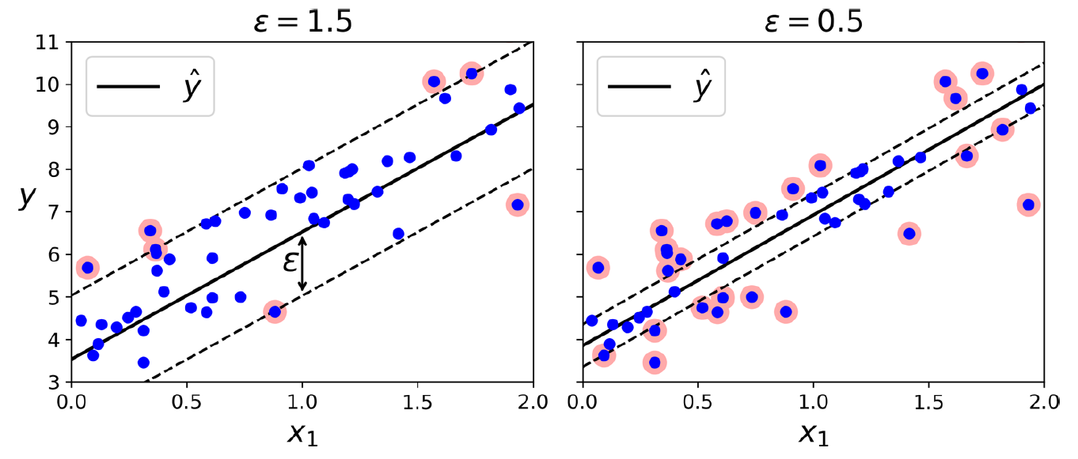
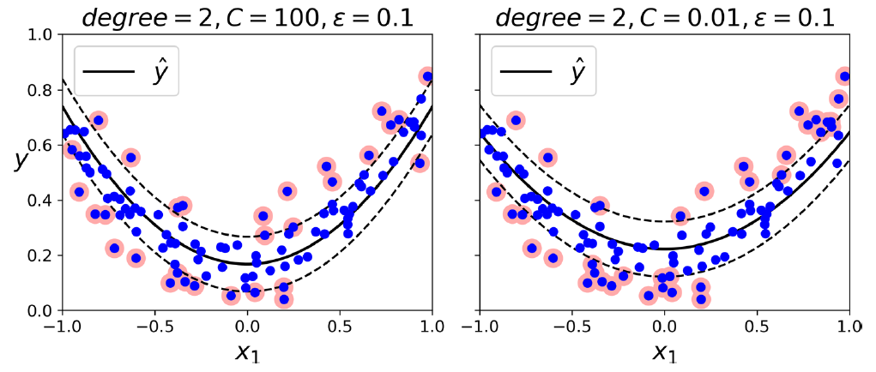
SVM Regression: Are wide margins a good thing of not?
Reverse the objective:
Try to fit as many instances on the street while limiting instances off the street
Possible to use nonlinear kernels
Useful for detecting outliers
Problem for applications: Does not scale well with data size

Slide 11
Min 85-95: Decision Trees for Interpretable Classification/Regression
Learning Objectives (Géron Ch6):
Know how to train & interpret a decision tree
Understand how to choose a regularization hyperparameter

Slide 12
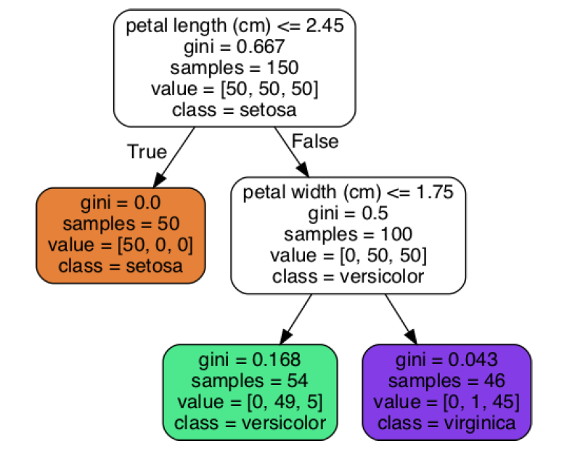
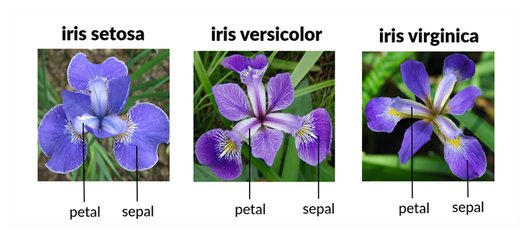

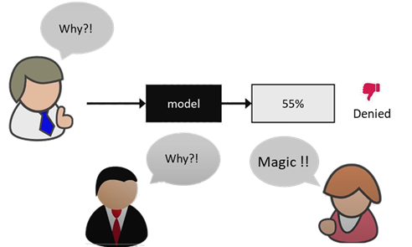
The advantages of a Transparent Model
Parents
Children

Slide 13
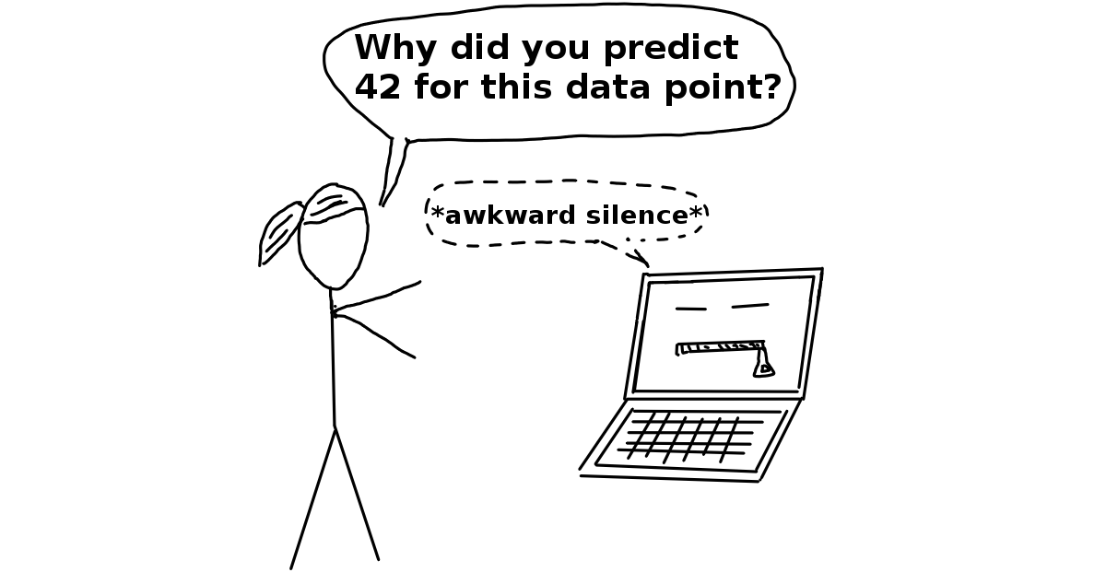
When do we need transparent models in env. sci.?
When we need interpretability
← ← ← ← ← ← ← ← ←
Environmental policy making
When the goal is to understand rather than to predict, for example classify sediment samples into groups of different origin with the goal to understand the influence of the different variables.
a phenomenon which requires clear comprehension after the prediction process. For instance, the application of a type of decision tree on a specific pixel type in satellite image to distinguish between vegetation and no vegetation.
Source: Interpretable ML (C. Molnar)

Slide 14


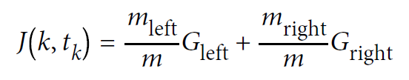
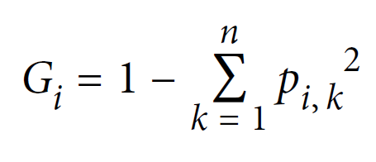
How can we train or “grow” a decision tree?
+
= ?
CART algorithm
Decision tree
min_samples_split
min_samples_leaf
max_leaf_nodes
max_features
Gini impurity:
Photos by: Bruno Kelzer, Johann Siemens
Notes:
Classification and Regression Tree
min_samples_split (the minimum number of samples a node must have before it can be split),
min_samples_leaf (the minimum number of samples a leaf node must have),
max_leaf_nodes (the maximum number of leaf nodes)
max_features (the maximum number of features that are evaluated for splitting at each node)

Slide 15
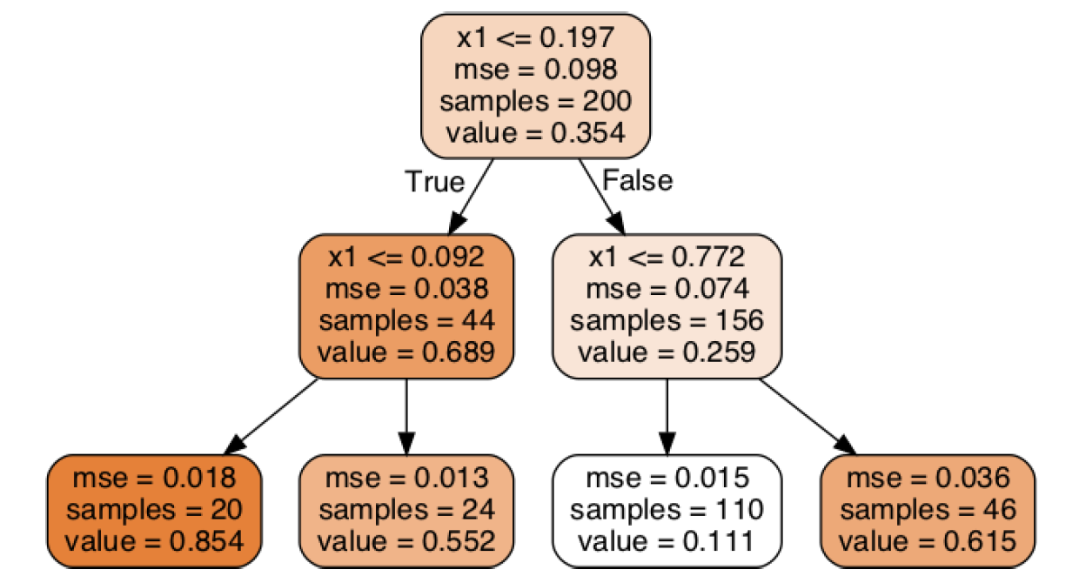
How can we train or “grow” a decision tree?
x1=0.7
+
=
Regression ≈ Nearest neighbor
CART algorithm
Decision tree
min_samples_split
min_samples_leaf
max_leaf_nodes
max_features
Gini impurity:
Supervised
Photos by: Bruno Kelzer, Johann Siemens
Notes:
m = Number of instances; QUICK VOTE
min_samples_split (the minimum number of samples a node must have before it can be split),
min_samples_leaf (the minimum number of samples a leaf node must have),
max_leaf_nodes (the maximum number of leaf nodes)
max_features (the maximum number of features that are evaluated for splitting at each node)

Slide 16

How long does it take? Computational Complexity
Fast prediction ☺
At each node, compare:
All features
on All samples
Much slower training ☹
Photos by: Bruno Kelzer, Johann Siemens
Notes:
min_samples_split (the minimum number of samples a node must have before it can be split),
min_samples_leaf (the minimum number of samples a leaf node must have),
max_leaf_nodes (the maximum number of leaf nodes)
max_features (the maximum number of features that are evaluated for splitting at each node)

Slide 17
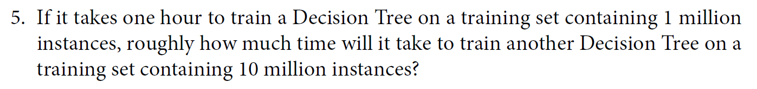
How long does it take: Computational Complexity
Notes:
min_samples_split (the minimum number of samples a node must have before it can be split),
min_samples_leaf (the minimum number of samples a leaf node must have),
max_leaf_nodes (the maximum number of leaf nodes)
max_features (the maximum number of features that are evaluated for splitting at each node)
Vote

Slide 18
Min 95-105: Random Forests & Ensembles: The power of teamwork
Learning Objectives (Géron Ch7):
Define a random forest
Know some advantages/drawbacks of ensemble modeling
Understand feature importance

Slide 19
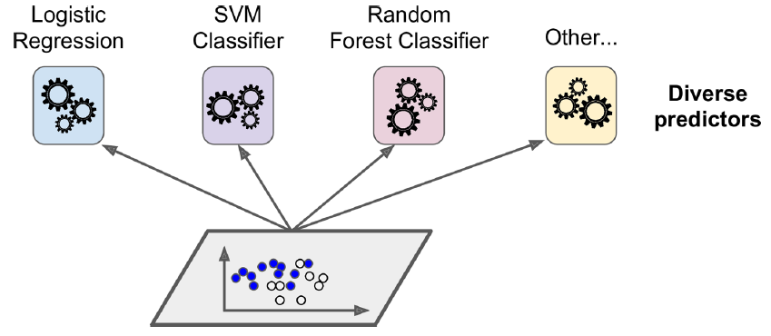
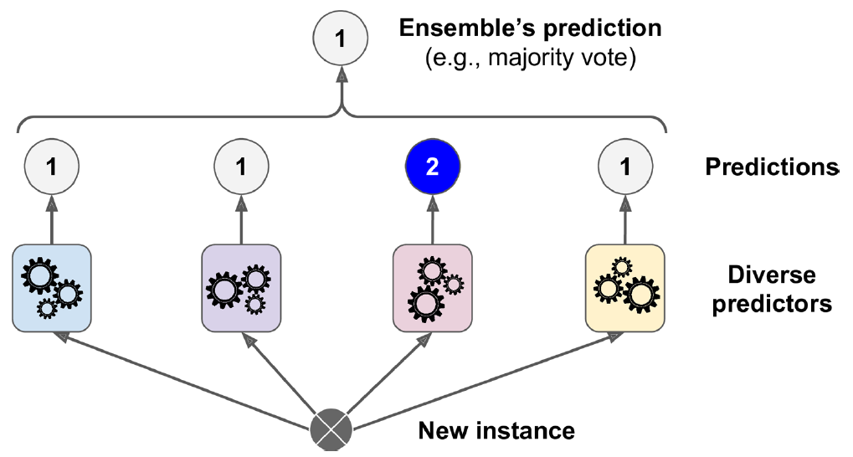
A random forest is an ensemble of decision trees
Step 1: Train an ensemble of different models
Many ways of creating ensembles
Step 2: Make the ensemble vote
Hard voting ≠ Soft voting

Slide 20
Advantages of ensemble modeling
Q) Why choose random forests over decision trees?
Pros:
If models make different types of errors, ensemble usually more accurate
More representation power than individual models
Smoother predictions (less spread) → Increase in robustness
Uncertainty quantification
Probabilistic predictions
Cons (Q = Why not always train ensemble models?):
(1) Computationally expensive; (2) Less interpretable; (3) Can increase bias

Slide 21
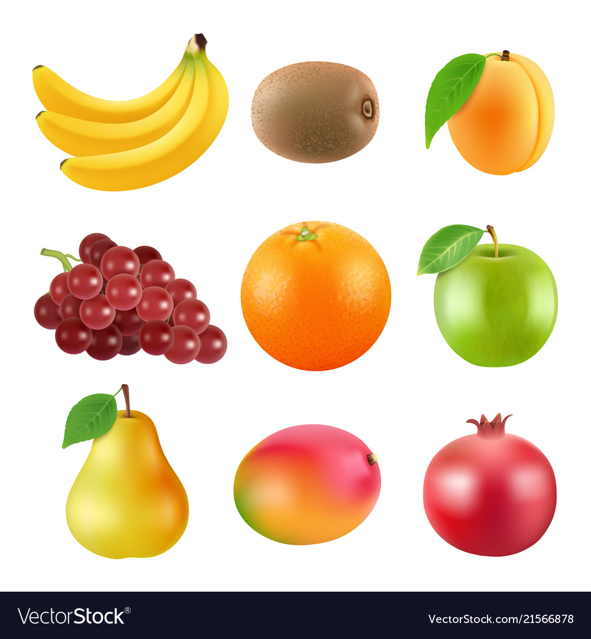
Bagging = Sampling with replacement
Pasting = Sampling without replacement
Original Training Set
?→?

Slide 22
Bagging = Sampling with replacement
Pasting = Sampling without replacement
Original Training Set
→
Notes:
Quick vote

Slide 23
Bagging = Sampling with replacement
Pasting = Sampling without replacement
Original Training Set
→
Notes:
Quick vote

Slide 24
Bagging = Sampling with replacement (small data)
Pasting = Sampling without replacement
Original Training Set
→
Notes:
Quick vote

Slide 25
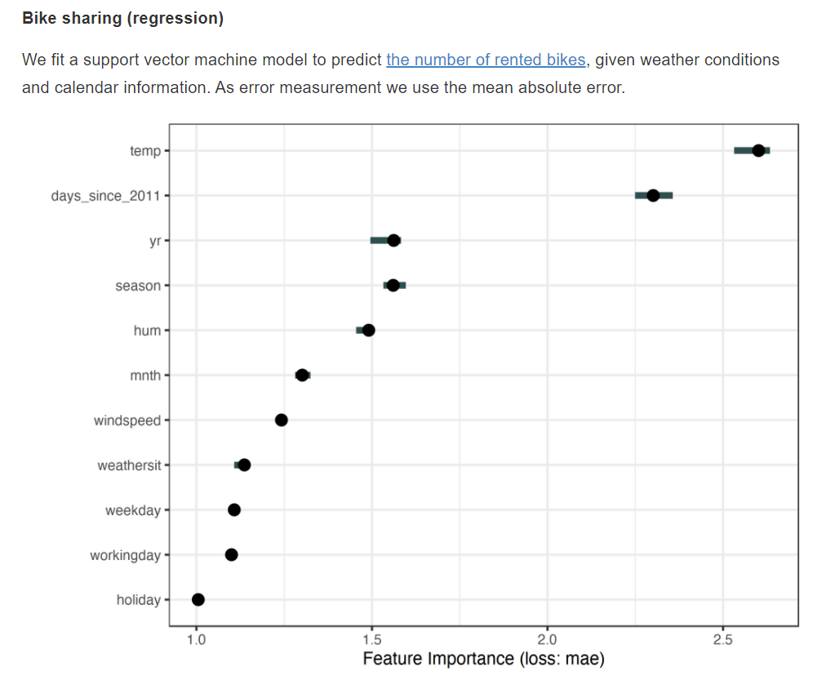
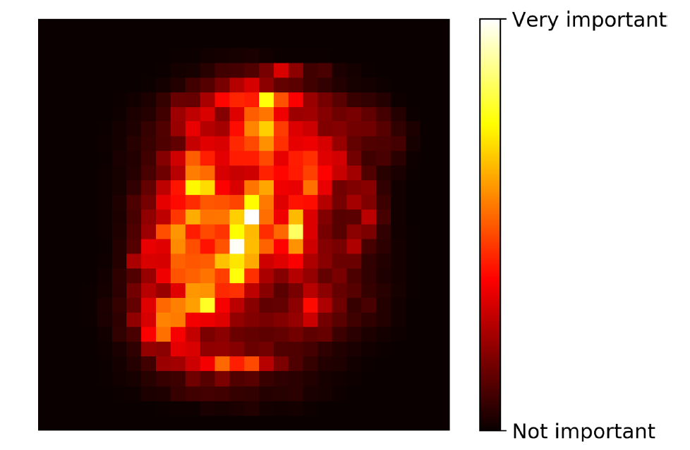
Feature Importance: Towards Interpretable Models
Random Forest: Sample-averaged decreased Gini impurity
Source: HOML2 (Géron), Interpretable ML (Molnar)

Slide 26
How to use feature importance in environmental Science?
When the computational or measurement cost is high, or when deciding what features to put in a model.
When predicting air pollution levels, knowing how the feature importance of different features (wind speed, wind direction, temperature) have on the prediction outcome.
How and which environmental factors influence vegetation dynamics in a particular context?
Finding which features are important/relevant to explain the widening of a river (large wood accumulation, precipitations, erosion, riparian vegetation ,etc, )
It would be useful if we try to quantify the impact of more than two pollutant. So we can see which one will be more dangerous.
The feature importance can give a better understanding of an environmental problem which can lead to improve the modeling process by focusing on those important features
Determining which morphological aspects influence species classification, or which considerations influence the danger class of a natural hazard.
When developing a rainfall generator for cities for which many features are available and you want to know which ones will modify most the precipitation e.g. heat island, pollution sources, building geometry…
When we want to reduce the number of features.

Slide 27
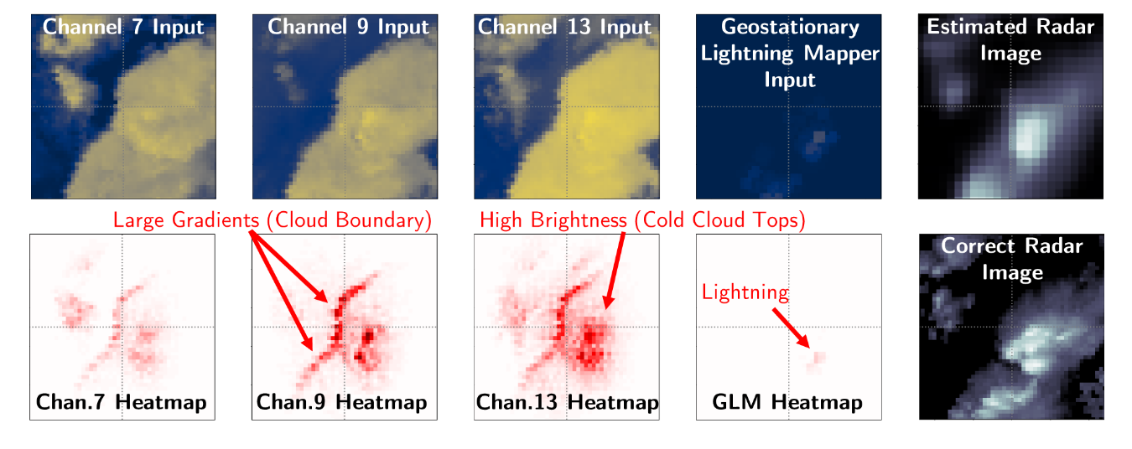
How to use feature importance in environmental Science?
Source: Ebert-Uphoff and Hilburn (2020)
Notes:
Use of an attribution method, namely Layer-Wise Relevance Propagation (LRP),to analyze a neural network model that seeks to translate imagery from the Geostationary Op-erational Environmental Satellite into Multi-Radar Multi-Sensor (MRMS) imagery. LRP results(bottom row) showwherein the input channels the neural network is focusing when predict-ing the MRMS value for a single (central) pixel. Using LRP indicated for various samples threestrategies for the neural network to trigger large MRMS values, namely i) cloud boundaries, ii)cold cloud tops, and iii) presence of lightning in the Geostationary Lightning Mapper channel.

Slide 28
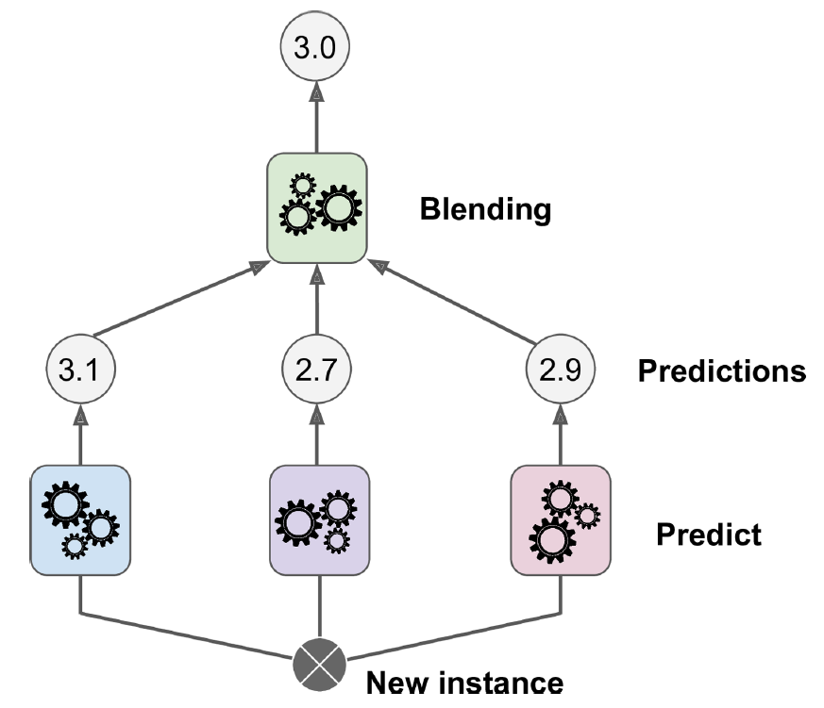
Stacking (Stacked Generalization) and Blending
What if model 2 is always bad in situation X?
And model 3 is always bad in situation Y?

Slide 29
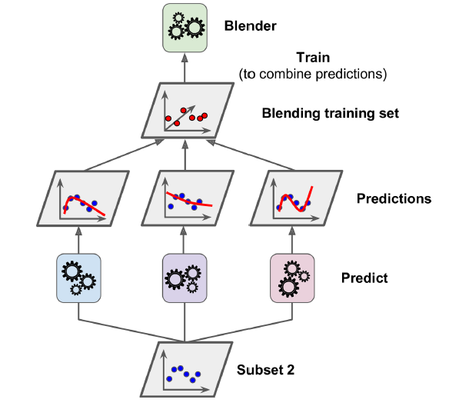
Stacking and Blending

Slide 30
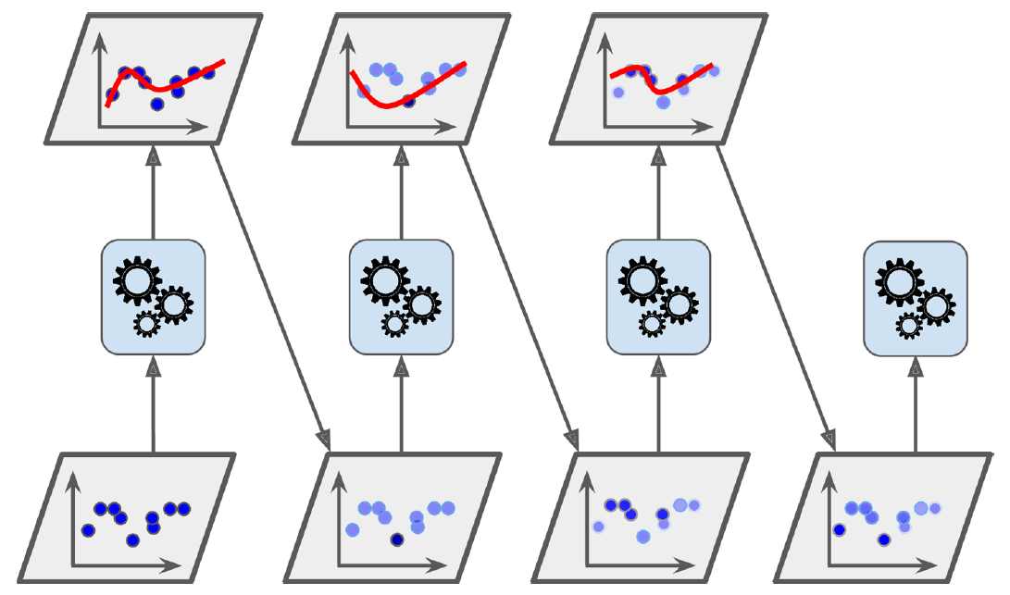

Boosting = Combining weak learners into strong one by sequentially correcting preceding predictions
AdaBoost: Increase weights (misclassified)
Grad. Boosting: Train on resid.

Slide 31
Min 105-120:
Moodle Quiz Review

Slide 32
Workload and schedule
Thu. Oct 1st
In class:
- Activities
- Ch. 5+6+7
At home:
- Read Ch. 5+6+7
- Read wildfires paper
Wed. Oct 7th
In class:
Quiz
Lab Ch. 3
1-1 project meetings
At home:
- Finish Lab Ch. 3
- Think about final project
Thu. Oct 8th
In class:
- Activities
- Ch. 8+9
At home:
- Read Ch. 8+9
- Read ocean paper

Slide 33
Legacy slides

Slide 34
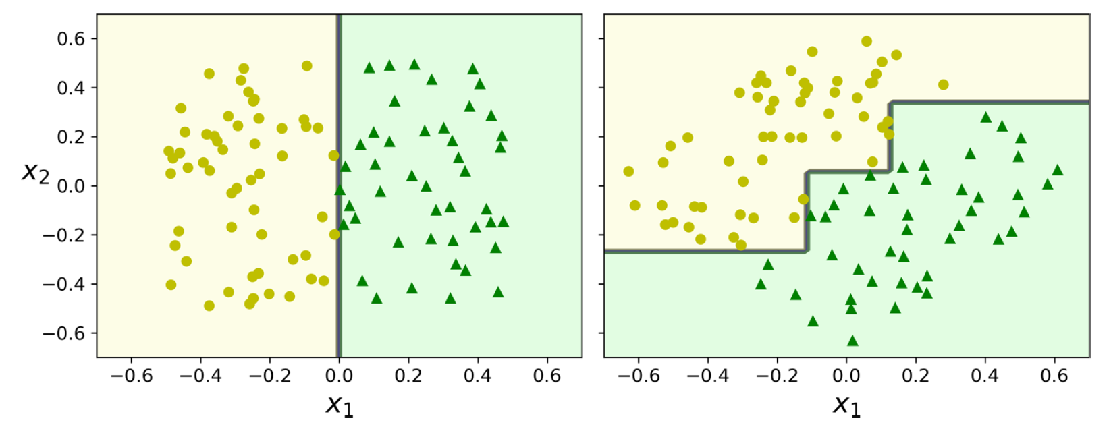
What are the steps to choose one ML method over another? how do we know whether a model will generalize well?
Use domain knowledge (how complex is the method vs env. problem?)
& Characteristic of the datasets (data size ↔ complexity)
Pick a model and train it on the training set
UNDERFITTING? Try a more complex model ☺
(Optional) Adjust its hyperparameters on the validation set
Evaluate on the test set (ideally a generalization set)
OVERFITTING?
Regularize your model or try a (simpler) model ☺
→ Workflow from lecture 1 slides or Géron Ch2/Appendix B for more

Slide 35
SVMs sorted by complexity/representation power
Reducing the hyperparameter C means that we tolerate more margin violations. This will bring about a smoother decision boundary, i.e., regularization of SVM model.
By reducing the C value, the model increases the street and accepts more margin violations. This means that it is less sensitive to outliers.
The hyperparameter C set up the margin violation, so the number of instances that end up on the wrong side of the classification. If we reduce C, there are more margin violations, but it will genaralise better and have less overfitting.
Linear SVM
(with soft margin)
Representation power/Complexity

Slide 36
Min 30-60: Bias-Correcting Meteorological Forecasts with simple ML
Learning Objectives (Wilks Ch7, Géron Ch3+4):
Distinguish dynamical from statistical forecasting
Understand Model Output Statistics
Be aware of forward/backward selection to choose inputs for your ML model
Know how to regularize a linear model
Define prediction intervals and think about uncertainty

Slide 37
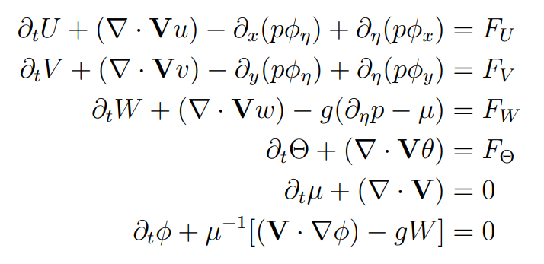
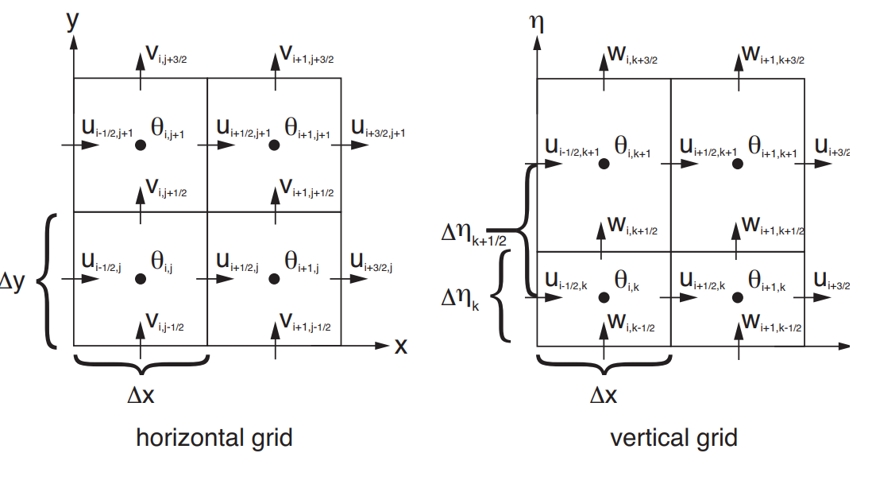


Dynamical Forecasting
Statistical Forecasting
Data
Past
Present
Training
Prediction
Notes:
Distinguish dynamical from statistical forecasting

Slide 38
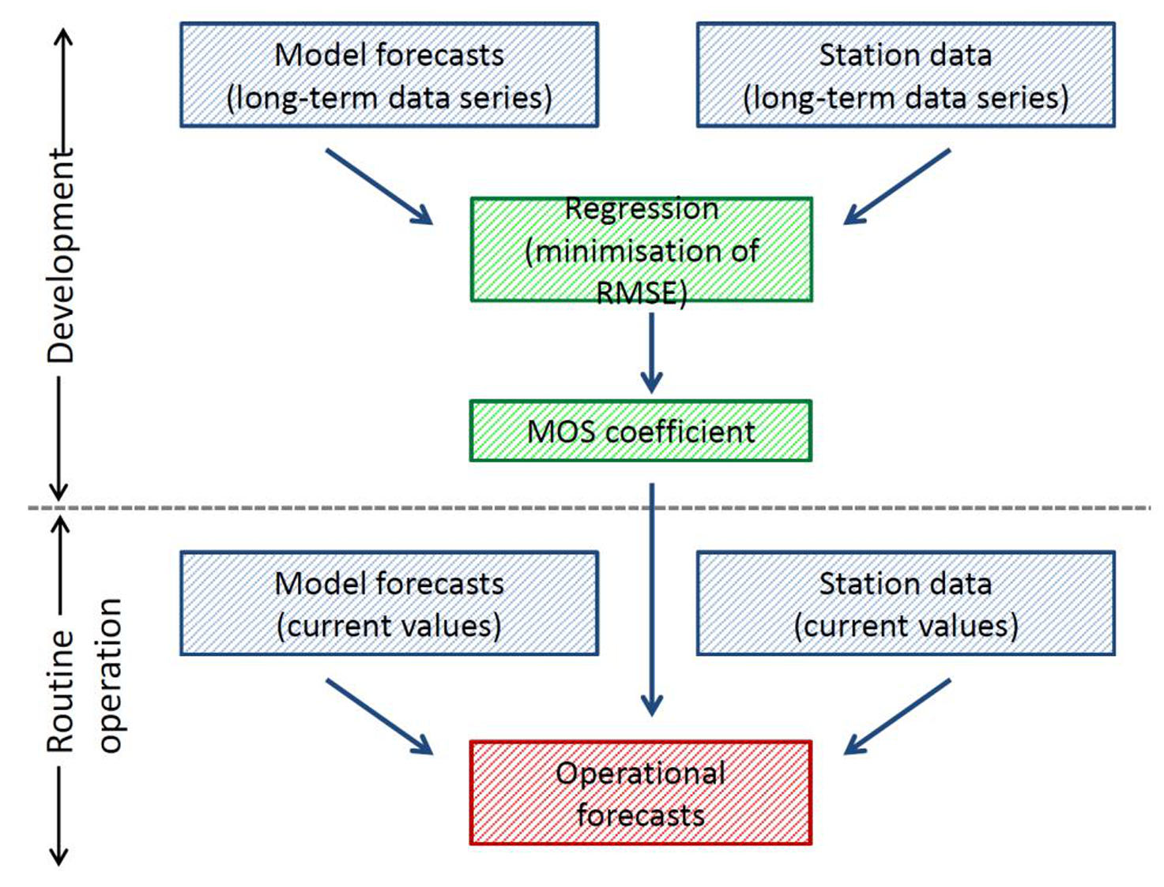
Model Output Statistics
(MOS)
MOS is machine learning applied to:
Past observations
Past forecasts
To statistically correct future forecasts
Source: DWD

Slide 39
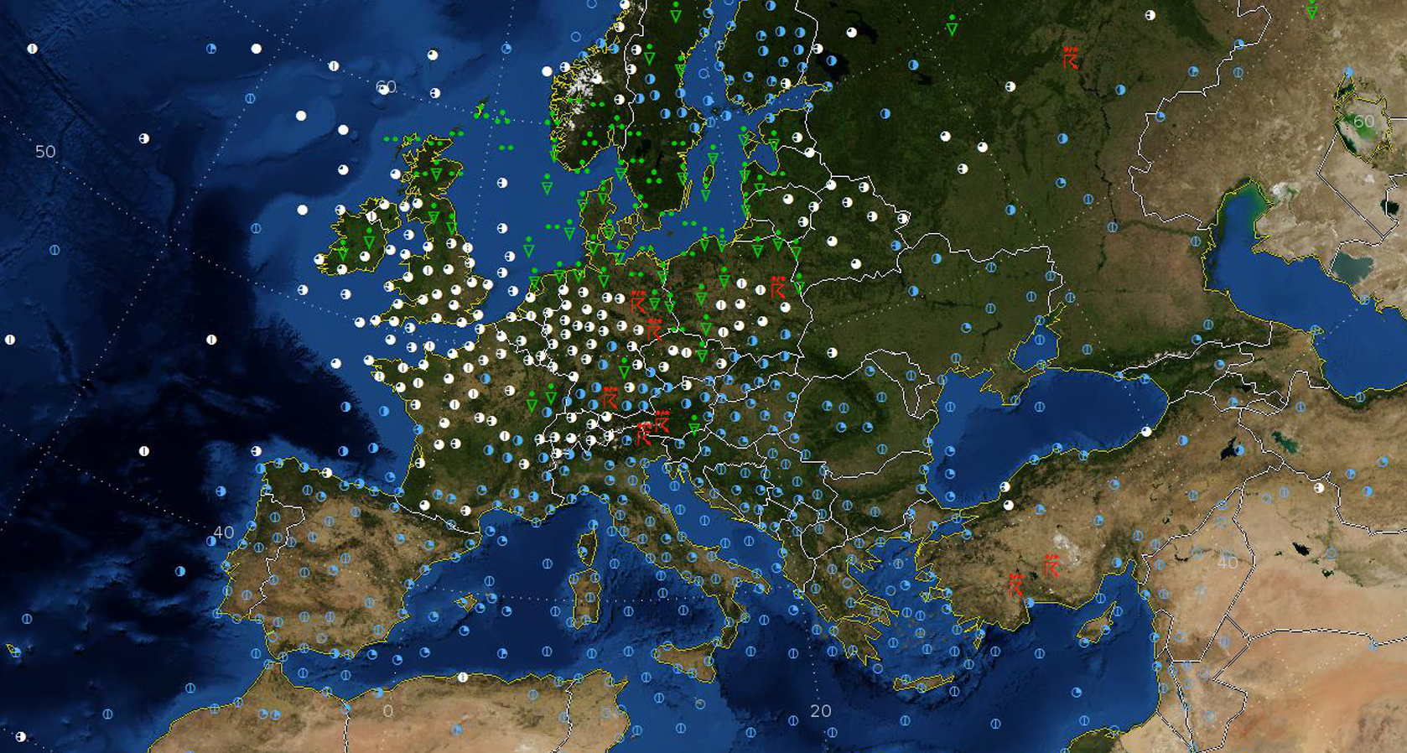
MOS (Model Output Statistics) is a statistical postprocessing method that helps correct the systematic errors of the raw dynamical forecast outputs. The MOS approach modifies the classical statistical forecastings (large multiple regression equations) by considering dynamical forecasts available at the time the forecast must be issued, related to the future time being forecast.
MOS extends classical statistical forecasting by including dynamical forecasts available at the time the forecast must be issued, but which apply yo the future time being forecast. The influences of dynamical models can be included directly in the regression equations.
MOS: The statistical relationships between deterministic forecast outputs and observations
We can use MOS to figure out the systematic biases of a particular weather model. Then we should presumably get more accurate predictions by removing this bias.

Slide 40
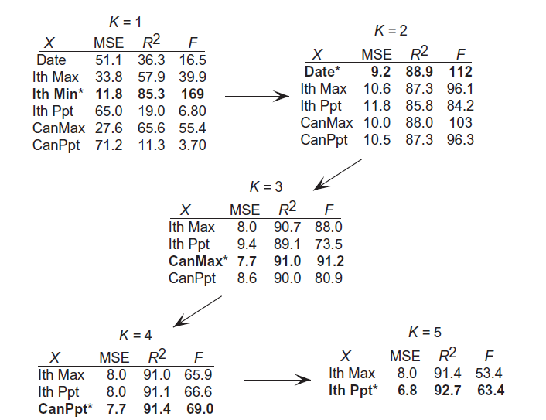
Forward Selection
Backwards Elimination
Starts by fitting with all inputs
Eliminate the least important input
(e.g., based on its weight)
Fit with all inputs minus eliminated
Repeat
In both cases, this can be done using
Sequential Feature Selector
in scikit-learn

Slide 41
Alternative methods to select inputs/predictors
Domain knowledge: You may already know which inputs are most informative, and which inputs are redundant.
As an example, for the case of land-use regression (which aims to predict the concentration of certain pollutants, like NOx), it is known or expected that variables such as emission by factories (if exist in the study area), traffic data, vegetation, population, and meteorological variables such as wind speed, precipitation, and temperature have an impact on the concentration of the pollutant under study. However, as an example, the price of a certain stock, or the number of patients in hospitals (which may be impacted by the pollutant concentration, and will not affect it) do not seem to be suitable predictors.
Direct knowledge of the phenomenon one wishes to study through these methods enables one to choose the most consistent predictors, based on which factors most influence the phenomenon. For example, environmental predictors such as altitude, exposure, temperature, etc. can be used for permafrost detection.

Slide 42
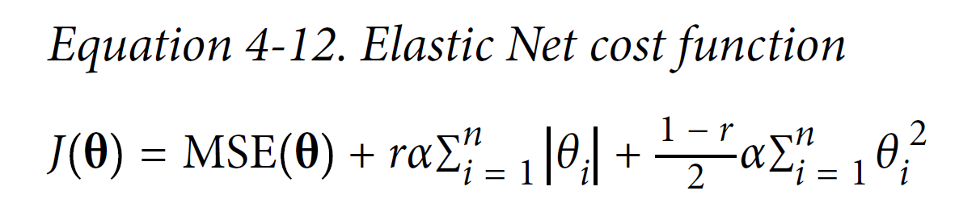

Alternative methods to select inputs/predictors
Domain knowledge: You may already know which inputs are most informative, and which inputs are redundant.
Regularization: Elastic Net
Scale the inputs before regularizing the coefficients!
Performance
L1 Norm
(Lasso)
L2 Norm
(Ridge)

Slide 43

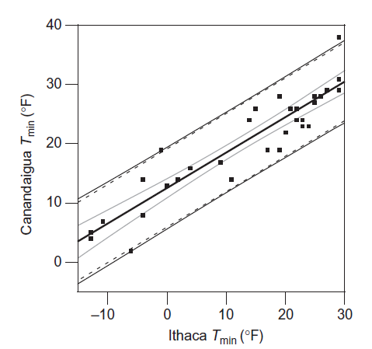
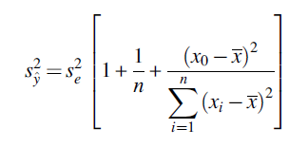
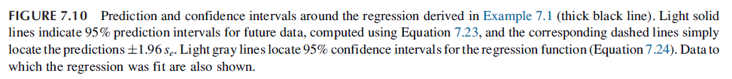
Adding uncertainty to your model: Confidence Intervals
Glacier_Mass_Loss = 0,258315864 x (Scaled_Insolation)
In practice, confidence intervals are implemented as part of the classification/regression model
class you will be using

