Slide 1
Spatial Data Production In Ruby
Keyhole markup language and geocoding

Slide 2
Keyhole Markup Language (KML)
KML is a structured textual markup language for spatial data.
An open standard promoted by Google.
Will look instantly familiar to anyone who’s seen HTML.

Slide 3
KML Structure
KML files require a standard header and footer, just like HTML.
The header simply references the KML specification, as is customary for XML text.
There’s plenty of room for complexity and customization, but you can make a valid KML file using just these lines.
<?xml version="1.0" encoding="UTF-8"?>
<kml xmlns="http://www.opengis.net/kml/2.2">
<Document>
*body goes here*
</Document>
</kml>

Slide 4
Placemarks
<?xml version="1.0" encoding="UTF-8"?>
<kml xmlns="http://www.opengis.net/kml/2.2">
<Document>
<Placemark>
<name>
Simple placemark
</name>
<description>
A simple placemark description.
</description>
<Point>
<coordinates>
-77.03394,38.90485,0
</coordinates>
</Point>
</Placemark>
</Document>
</kml>
The code to the right is a complete, valid KML document that can be displayed by Google Earth and other software.
A placemark is the simplest possible KML feature, consisting of a name and a pair of coordinates.
It represents a point with an attached popup balloon.
More complex features such as polygons are equally simple to write, and consist of an array of coordinates.
Descriptions can contain HTML for extra pizazz, features can be animated, they can have special styles, they can stream from a network, they can only show up at different zoom levels, and so on and so on. But none of that is required.

Slide 5
Placemarks
If we had a list of items with coordinates, such as this list of WDI locations, it would be very simple to write some Ruby to generate the KML.
You just need to split the text and insert the various attributes where they belong in the text template.
Keep appending the text to itself, then add the KML header and footer to the result when you’re finished.
GA Wash. DC 38.90485,-77.03394
GA New York 40.73930,-73.98942
GA Chicago 41.89061,-87.62688

Slide 6
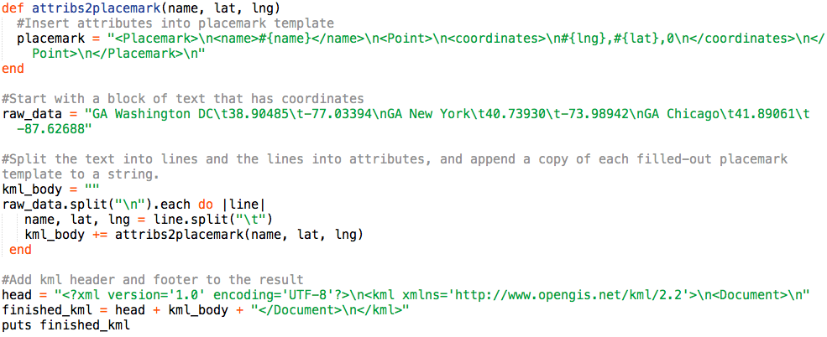
Placemarks- Make KML with Ruby
This snippet will take the 3 General Assembly location coordinates and print out a complete KML document:

Slide 7
But but I don’t have coordinate data
All I have is this list of addresses!
GA Washington DC 1133 15th Street NW, 8th Floor Washington, DC 20005 GA New York 902 Broadway, 4th Floor New York, NY 10010
GA Chicago 444 N Wabash Ave, 5th Floor Chicago, IL 60611

Slide 8
Geocoding, my friend!
We can search for text strings in an engine called a geocoder, in order to find their associated coordinates.
Google provides a web API for this.

Slide 9
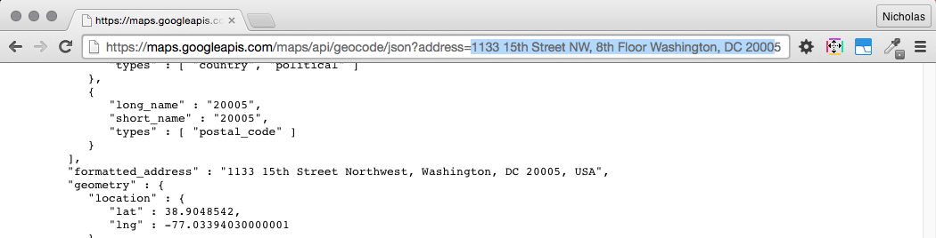
Geocoding with Google’s API
If we add an address to the end of https://maps.googleapis.com/maps/api/geocode/json?address=
We get a whole bunch of JSON about the address returned to us.
It looks like the coordinates are in the ["results"] ["geometry"]["location"] portion of the return.

Slide 10
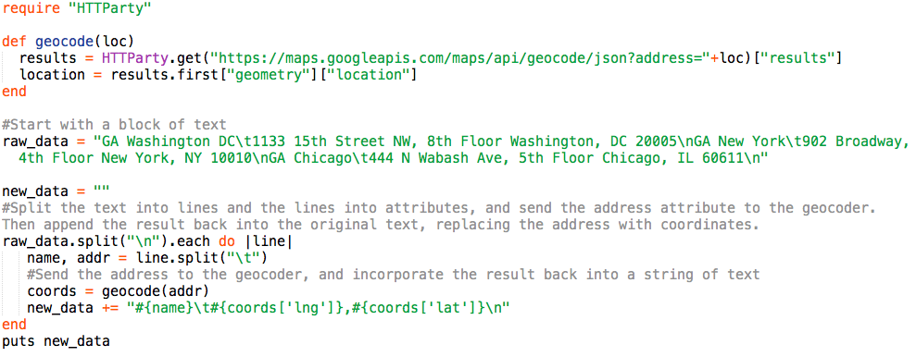
Geocoding with Ruby and Google
We can use the snippet below to hit Google’s API for each of our addresses, and print out the coordinates we want:

Slide 11
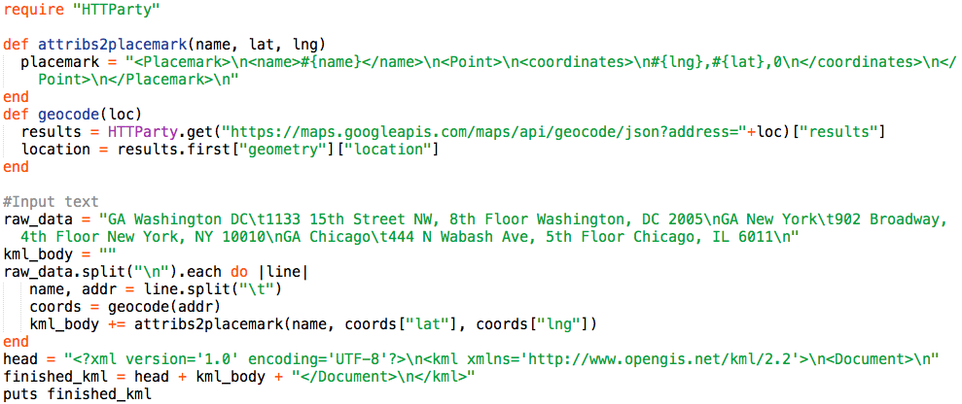
Putting it together
Say, that snippet looked kind of like the first one… let’s just combine the geocoder with the KML maker:

Slide 12
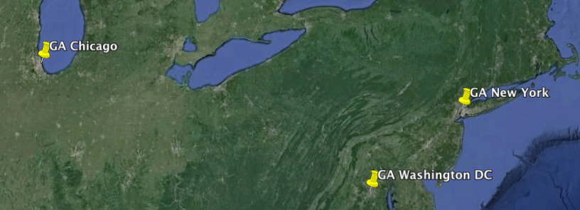
And there you have it: a map
Questions?

