Slide 1
Features
Offline Storage
File Access
Native Video and Audio Streaming
Geolocation
Smart Forms
Performance
Semantics
Connectivity/Web Sockets

Slide 2
http://html5readiness.com/
http://html5test.com/

Slide 3
Canvas
WebGL
Javascript 2D and 3D graphics library (2011)
Base on OpenGL (1992)
WebGL programming is hard
C3DL, CopperLicht, Curve3D, CubicVR, EnergizeGL, GammaJS, GLGE, GTW, JS3D, Kuda, O3D, OSG.JS, PhiloGL, Pre3d, SceneJS, SpiderGL, TDL, Three.js, X3DOM, StormEngineC.

Slide 4
Whats Possible
http://threejs.org/examples/webgl_animation_cloth.html
http://threejs.org/examples/webgl_loader_ctm_materials.html
http://threejs.org/examples/webgl_materials_bumpmap_skin.html

Slide 5
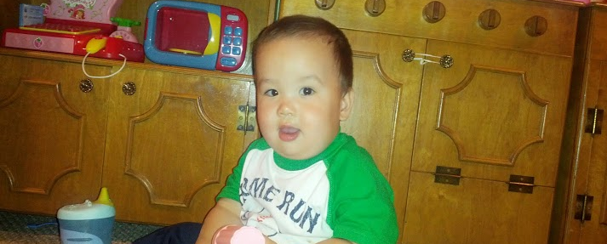
http://html5demo-nburana.appspot.com/

Slide 6
https://github.com/nburana/html5demo

Slide 7
Unnecessary technologies
Necessary
AppEngine
$
_
Backbone.js
Blender
Three.js
Ammo.js (Bullet C++ API)
Physi.js

Slide 8
Basic Pieces
Renderer
Scene
Camera
Lighting
Optional
Geometries
Physics
Audio

Slide 9
Renderer
this.renderer = new THREE.WebGLRenderer();
this.renderer.setSize(width,height);
this.$('#maincanvas').append(this.renderer.domElement);

Slide 10
Scene
this.scene = new Physijs.Scene;

Slide 11
Camera
this.camera = new THREE.PerspectiveCamera(
45, //field of view
width / height, //aspect ratio
.1, //near
3000); //far
this.camera.position.set(0, 110, 600);

Slide 12
Lighting
var ambientLight = new THREE.AmbientLight(new THREE.Color("#424242"));
this.scene.add(ambientLight);
var directionalLight = new THREE.DirectionalLight(0xffffff);
directionalLight.position.set(1, 1, 1).normalize();
this.scene.add(directionalLight);

Slide 13
Geometries
var material = Physijs.createMaterial(
new THREE.MeshLambertMaterial({
map: THREE.ImageUtils.loadTexture('/static/crate.jpg', {}, function() {
self.render();
})
}),
.8, //friction
.2 //restitution
);

Slide 14
Continued…
var crate = new Physijs.BoxMesh(new THREE.CubeGeometry(30, 30, 30), material, 100);
crate.name = "crate";
crate.castShadow = true;
crate.receiveShadow = true;
crate.position.x = this.generateRandomPosition();
crate.position.y = 300;
crate.position.z = this.generateRandomPosition();
this.scene.add(crate);

Slide 15
Audio (mp3, wav, ogg)
<audio id=“sound">
<source src="/static/sound.mp3" type="audio/mpeg">
Your browser does not support the audio element.
</audio>
$('#sound').load();
$('#sound').get(0).play();

Slide 16
Animation
animate: function() {
this.scene.simulate(); // run physics
this.renderer.render(this.scene, this.camera);
requestAnimationFrame(function() {
self.animate();
});
}

