Slide 1
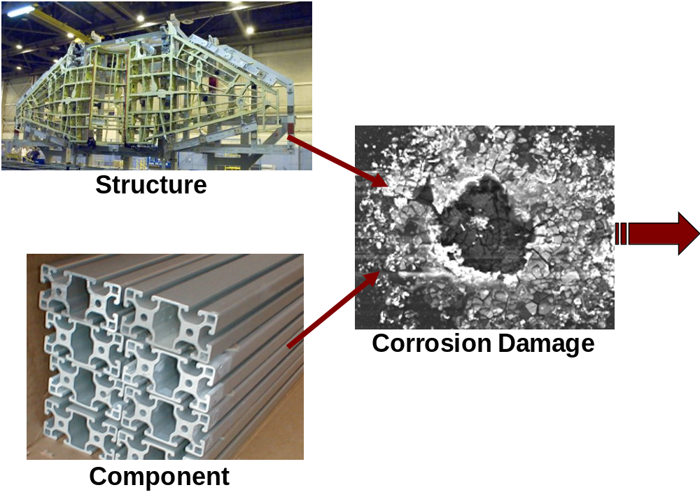
Material parameters
Geometric parameters
Environmental parameters
Temporal and Spatial Model of Corrosion
Evolutionary Algorithms
RISK Index
Parameter Sensitivity Analysis

Slide 2
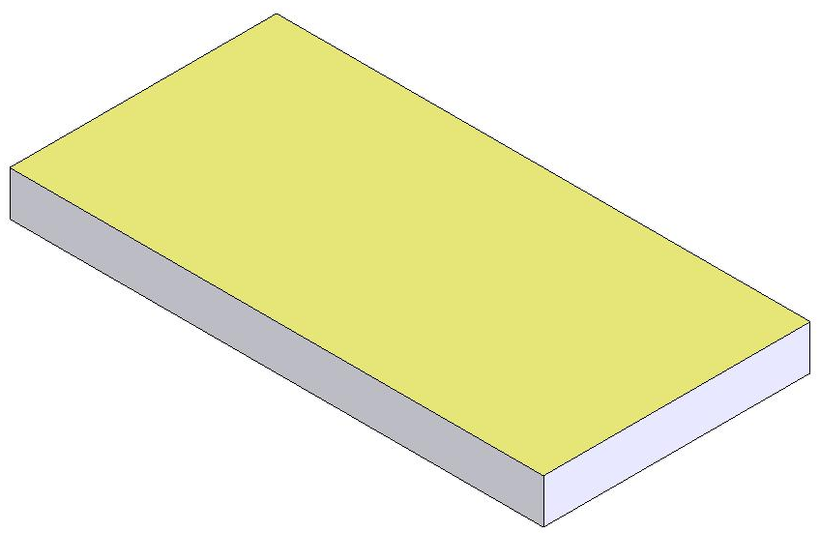
Electro-chemical, Stress, Age, Current Metal State, time
Corrosion Metrics – corrosion rate, pit distributions & stresses, micro-crack length
CA model - Grid
Metal substrate

