Slide 1
MLib Regression Testing
30th November 2015
Andreas Stirnemann, Tell Consulting

Slide 2
Overview
Introduction
Data Loader
Call Capture
Usage Example
Internals
Cheat Sheet

Slide 3
Testing is Good For You!
Why never enough?
The tedium of it!
Especially cumbersome: regression tests.
Two months ago precisely one active test…

Slide 4
Regression Test
Old Style

Slide 5
A Spoonful of Sugar…
Aim: take the pain out of regression testing
Test Data Loader
Call Capture

Slide 6
Regression Test (cont.)
New Style

Slide 7
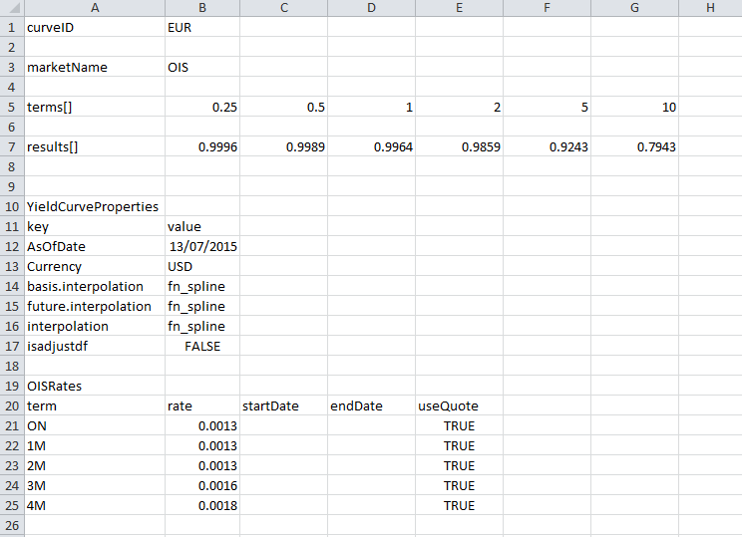
Data Loader
CSV Input Layout

Slide 8
Data Loader (cont.)
A Spoonful of Syntactic Sugar

Slide 9
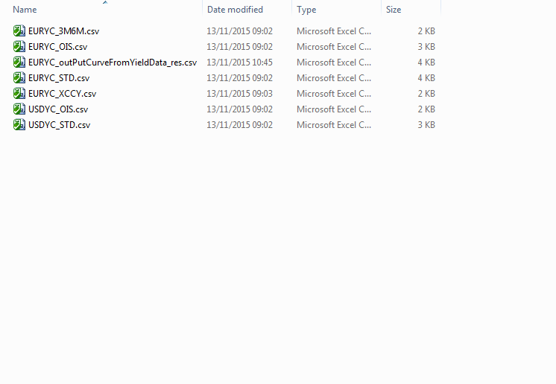
Call Capture
Idea: generate the CSV files

Slide 10
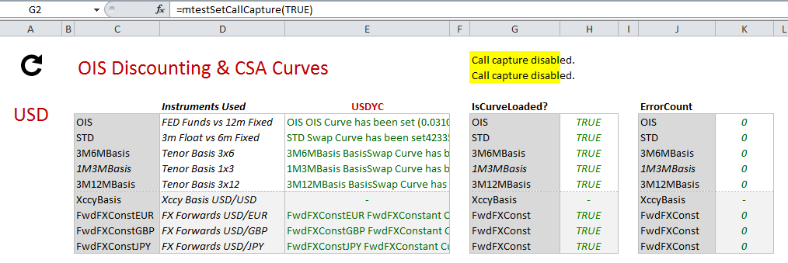
Call Capture (cont.)
Enabling in Excel

Slide 11

Call Capture (cont.)
Enabling in regression executable

Slide 12
Call Capture (cont.)
Enabling at compile time
Instrumentation

Slide 13
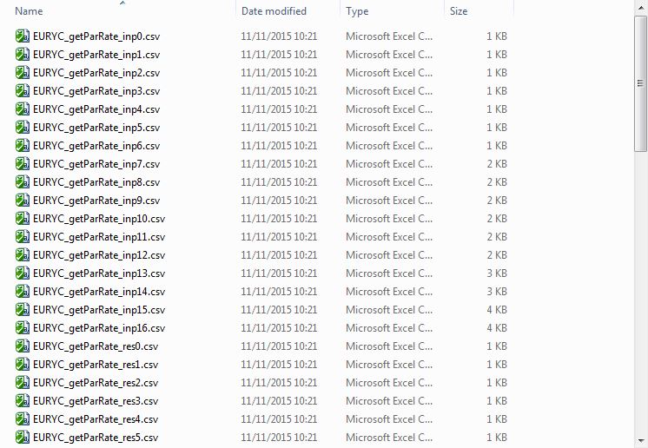
Call Capture (cont.)
Array Output

Slide 14
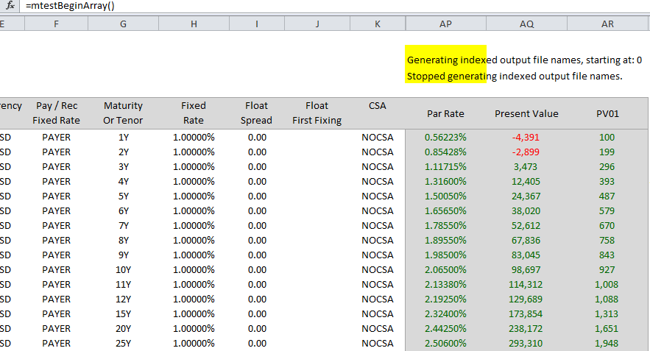
Call Capture (cont.)
Enabling Array Output

Slide 15
Usage Example
Swap Par PV

Slide 16
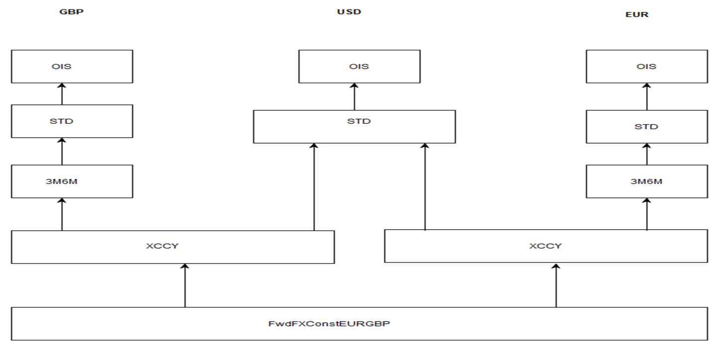
Internals
Curve Dependencies

Slide 17
Internals (cont.)
Compile-Time Dependency Graph

Slide 18
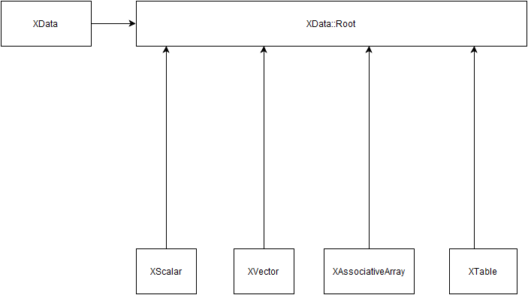
Internals (cont)
Pimpl Idiom, Type Erasure

Slide 19
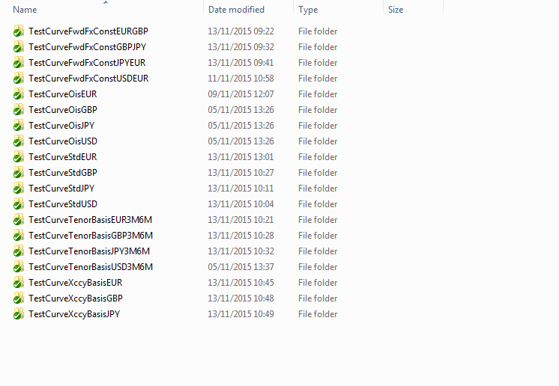
Curve Coverage
List of current curve tests

Slide 20
Cheat Sheet
Un-comment #define in MBPrinterCSV.h.
Create debug build.
Start Excel, loading debug build.
Calculate pricing sheet.
Delete temp/mlib/*.*
Call mtestSetCallCapture(true).
Re-calculate cells to be captured.
Copy files in temp/mlib to new folder underneath APPL/tests/inputs.
Create new test by copying and modifying existing test.

