Slide 1
MLIB Quant Analytics
Nicholas Burgess
Mizuho International plc
February 2017

Slide 2
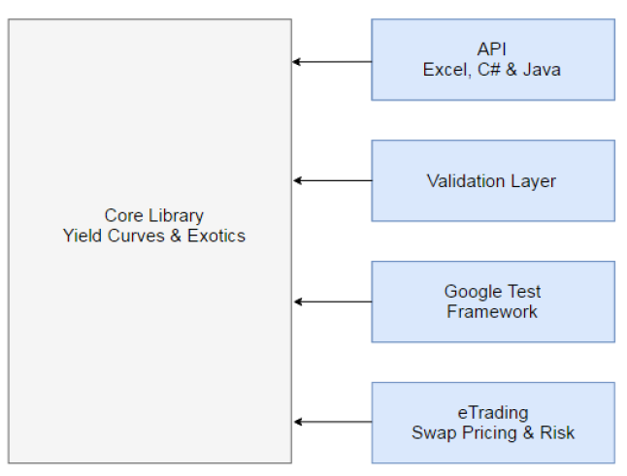
Mlib – Library Structure and Roadmap
Modular Library Structure
Allows for Collegiate, Organized & Independent Working
Plug & Play: New Components Easy to Add
Addition of an Existing XVA Module under Discussion
Quant Roadmap
2015
Library On-boarded
Curve Enhancements
2016
Major Yield Curve Enhancements
Extend Vanilla Product Offering, Pricing & Risk
Major Infrastructure Modernization & Refactoring
Added API Support for C#, Java, R & Python
Added Test Harness: 2,000+ Test Cases
2017
Major Restructuring of Library for Global Co-Development
Extended Curve Coverage from 4 to 14 Currencies
Extended Risk Capabilities
Adding Bond Pricing Functionality

Slide 3
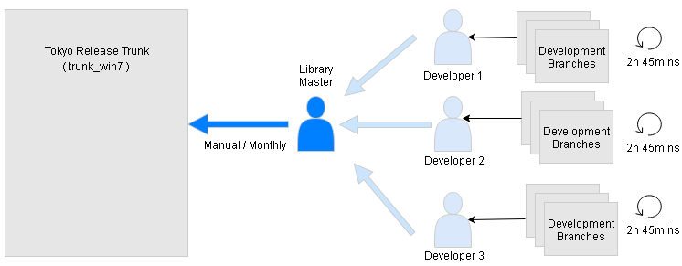
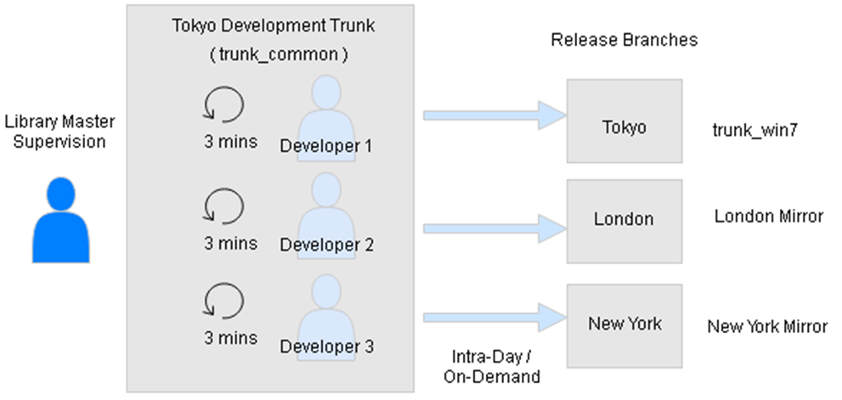
MLIB Development Model
Initial Development Model
Stable trunk – always in a good state
Branch based development
Manual merge & release process
Monthly release cycle
Current Development Model
Fast continuous development on trunk
  Incredibuild speeds up compilation time from hours to minutes
Intra-day / on-demand release cycles (automated)
Developers are responsible to ensure no trunk breakages – good test coverage key to this
  Must immediately revert code causing test breaks
Modular nature of library reduces scenario where developers are simultaneously working on same code

Slide 4
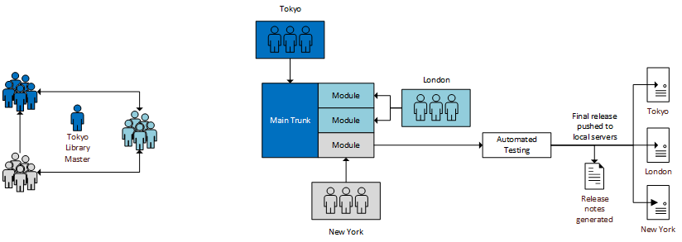
MLIB Collaboration and Governance
Governance
Quant strategy/direction and releases are discussed at a bi-weekly VC
Tokyo library master acts as an arbitrator in the event of a dispute and makes final decisions
Costs for MLIB development are currently borne independently by each region
Development
Regional teams develop remotely on common server
Development activities are concentrated within each teams own modules
  Changes to library modules owned by other teams require notification/approval from the owning team
Code causing test breaks at this stage is immediately reverted
Release
Common development location means no merging is required prior to release
Release notes auto-generated from committed code
Automated pre-release testing tool currently covers ~15% of code base
  Progressing towards aim for coverage of over 70%
Stable releases pushed from common repository to local serves

