Slide 1

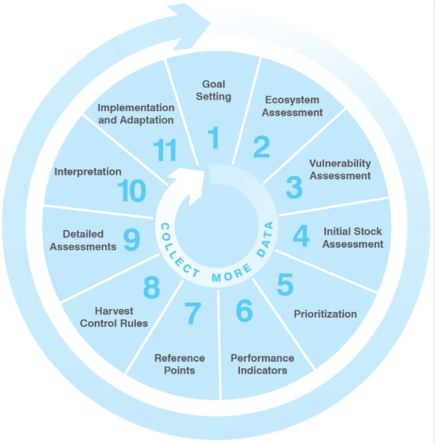
Evaluating Adaptive Management Strategies for Climate-Resilient Fisheries
Introduction
Mapping Vulnerabilities
Comparing Trade-Offs
Biomass Over Time
About the Project (Background)
What is EDF and what are they doing with data-limited fisheries management?
How is climate change accounted for in the FISHE framework?
Which parts of FISHE are most likely going to be affected by climate change?
How was data created?
Was the data collected or was it all simulated by model runs?
What type of model are you running (generic that can be applied to all vs specific that can only be applied to a few)?
Variable glossary (defined variables
What are the variables that are going to be defined and utilized in this Shiny App:
Growth rates (slow, medium, and fast)
Harvest Control Rules (HCRs)
Error reduction
Assessment intervals
Climate severity (moderate → severe)
About FISHE framework (What is the FISHE Framework?)
What is the Framework for Integrated Stock and Habitat Evaluation (FISHE)?
What 11 steps are there in this circular process?
How is FISHE utilized throughout the world?
What case studies can we utilize to show the efficiency of FISHE in other countries?

Slide 2
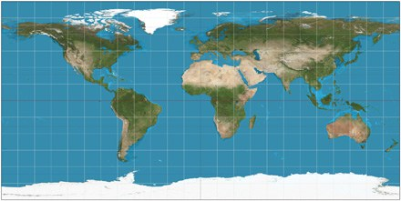

Evaluating Adaptive Management Strategies for Climate-Resilient Fisheries
Introduction
Mapping Vulnerabilities
Comparing Trade-Offs
Biomass Over Time
Latitude Slider Range
Longitude Slider Range
Climate Severity Legend
Moderate
Severe
Extreme
Mapping Vulnerabilities: What To Expect From Climate Change
Mapping longitude and latitude points connected to sliders which map different points on the world map showing how vulnerable countries are to climate change depending on their longitude and latitude points by a pin.
Pins would come in different colors reflecting the severity of the climate impact around the world.

Slide 3
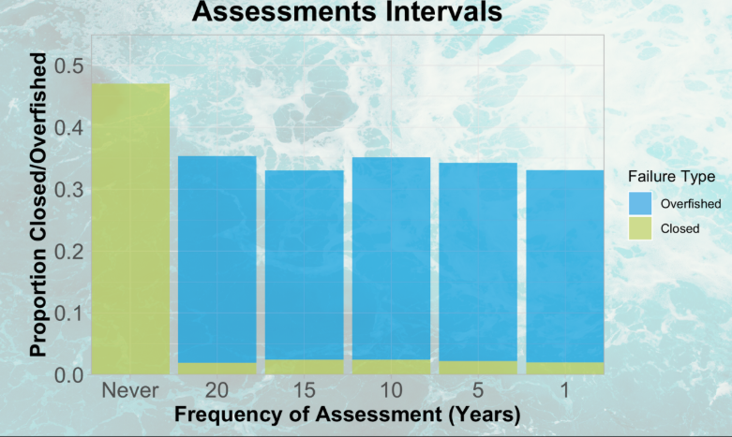

Evaluating Adaptive Management Strategies for Climate-Resilient Fisheries
Introduction
Mapping Vulnerabilities
Comparing Trade-Offs
Biomass Over Time
Checkbox Group
Growth rates
Error reduction
Harvest Control Rule (HCR)
Assessment Interval
Climate severity
Select Box
Comparing Trade-Offs
Comparing the proportion of bad outcomes in the form of stacked bar graphs showing how outcomes vary over time by different factors (i.e. growth rates, error reduction, Harvest Control Rule, etc)

Slide 4
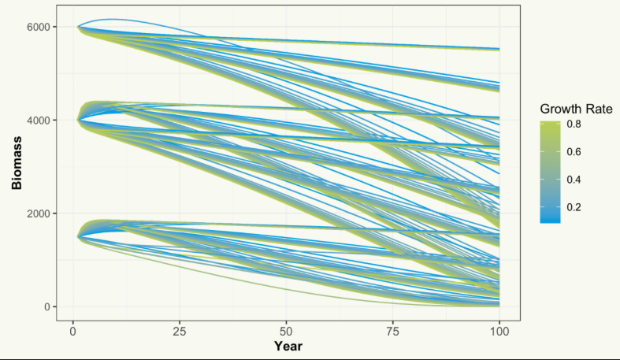
Evaluating Adaptive Management Strategies for Climate-Resilient Fisheries
Introduction
Mapping Vulnerabilities
Comparing Trade-Offs
Biomass Over Time
Checkbox Group
Growth rates
Error reduction
Harvest Control Rule (HCR)
Assessment Interval
Climate severity
Select Box
Plotting Biomass Over Time
Comparing the proportion of biomass and how it changes over time in the form of a scatterplot and how it changes over time by different factors (i.e. growth rates, error reduction, Harvest Control Rule, etc)

Slide 5



FISHE APP draft
FISHE icon
First tab
It extends when clicked
Main
Data
Results
Main
Data
Results
Welcome!
Welcome!
About the Project
About the Project
About FISHE framework
A Master’s Project with the Bren School of Environmental Science & Management and the Environmental Defense Fund (EDF). The goal is to inform better fisheries management practices in the face of uncertain future environmental conditions.
How was the data created?
Variable glossary
Developers

Slide 6
FISHE APP draft
Second tab
Third tab
Main
Data
Results
Main
Data
Results
Main
Data
Results
2. Tradeoffs
1. Graph: Biomass over time
Select the parameters
1. Map climate vulnerabilities (latitude and longitude)
Latitude Slider Range
Longitude Slider Range
2.1 Growth rate
2.2 Error reduction
2.3 Harvest control rule
2.4 Assessment interval
2.5 Climate severity
Choice 1
2. Table: Biomass over time
Choice 1
Choice 2
Year | Growth rate | Biomass Ton.
0 | 0.2 | 2000
1 | 0.2 | 1900
2 | 0.2 | 1850
Choice 1
Choice 1

