Slide 1

TEAM MEMBERS Lynn Orr, Tom Laverty, Nathon Burwick, Wen Chiou, Brandy Bowden, Sam Gantman, Lorena Egea, Ratima Chowadee, Leslie Trejo

Slide 2
Music Recommendation System Using Machine Learning
Objective: Create an app that recommends song(s) to users based on their inputs. In the background the app would take in the user inputs and utilize a machine learning algorithm to identify songs that most closely match what the user is looking for.
Using Kaggle and Spotify, the team used a dataset that contained over 114,000 songs.

Slide 3
The user can input data suggestions such as Artist, Songs, and number of song suggestions it would like returned into our interactive web page.
Song Choice
Artist
# Of Songs Returned
Song Recommendation
The “SongVue” App will provide recommendations based on the user input

Slide 4
Tasks at Hand…
Importing Libraries & Dataset/ ETL
Flask API used to access data hosted on MongoDB Cluster
Create data clusters based on the different musical traits
Use Python to write script that creates, trains and provides the suggestions from the ML algorithm
Create web dashboard to accept user input, then ML outputs songs of similar musical traits as suggestions
Task 1: Data Cleaning/ ETL
Task 2: Analysis/ Visualizations
Task 3: Machine Learning
Task 4: Building of the App/ GUI

Slide 5
Dataset Example
Includes columns with artists’ names, album names, track names, popularity, etc.
Part of the ETL process was to remove eronious columns such as time_signature, mode & speechiness
Artists | Track Name | Popularity
Beyoncè | CUFF IT | 93
Sam Smith | ﻿Diamonds | 3
Sanchez | ﻿Pasiones & Adicciones - Gav Easby Remix | 0

Slide 6
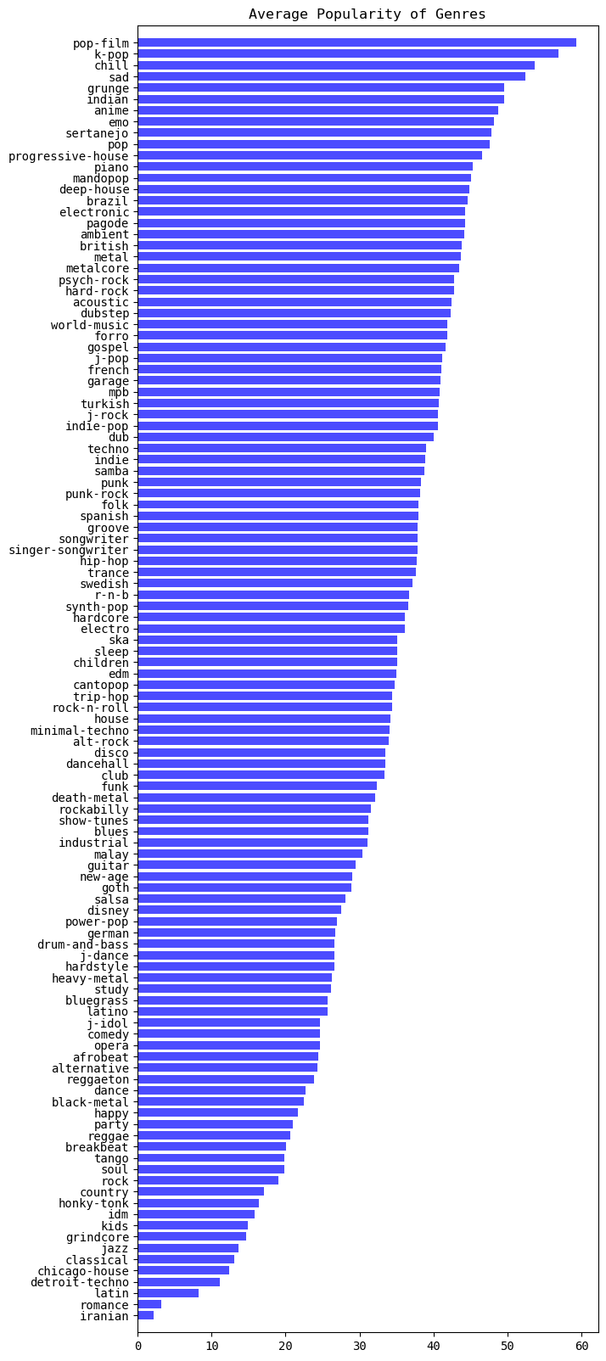
Genre by Average Popularity

Slide 7
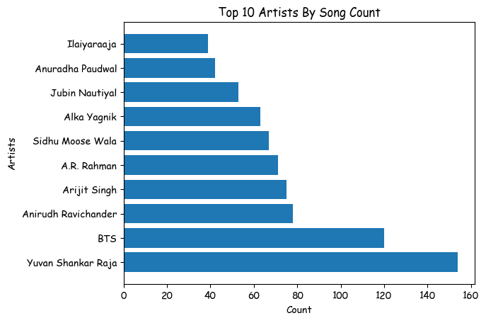
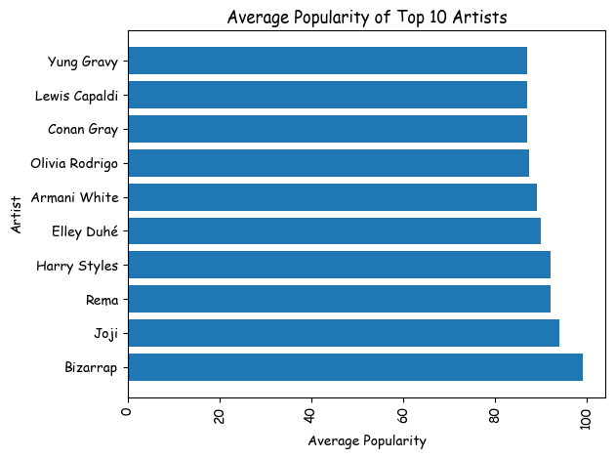
Graph Visualizations from MatPlotLib

Slide 8
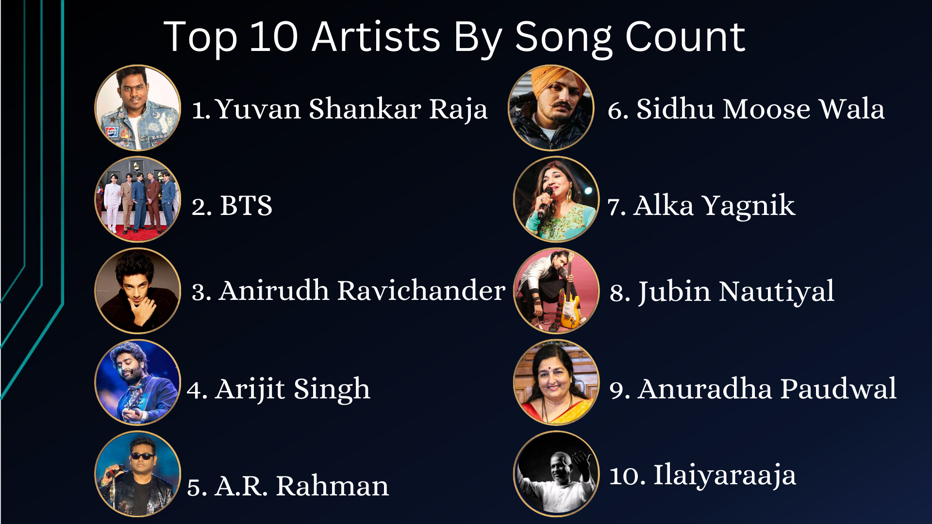

Slide 9
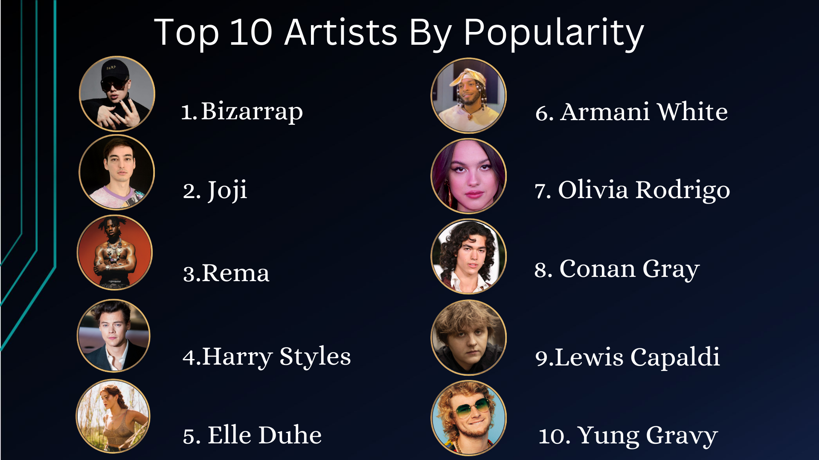

Slide 10
Analysis of Traits as Clusters using
K-Nearest Neighbors
Input Song
Energy
Danceability
Key
Loudness
Mode

Slide 11
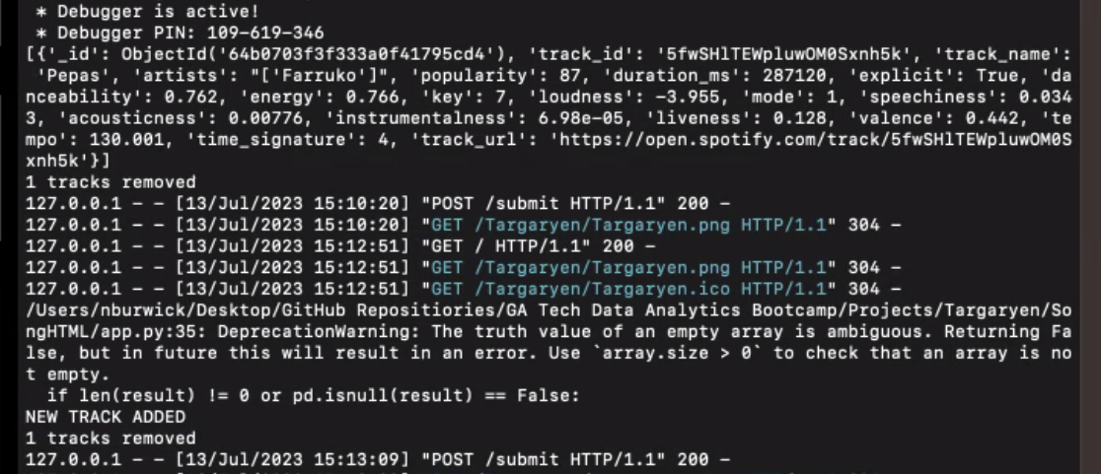
Track Adds: The model looks to Spotify and compares if the suggested song is currently in our MongoDB. If not, the model will add the new track automatically.

Slide 12

Questions?

