Slide 1
Incentivizing Optimal Forecasting Groups in Prediction Markets
Nicholas von Turkovich
CS 590

Slide 2
Outline
Motivation
Wisdom of Crowds
Background
What constitutes an optimal crowd?
Lamberson and Page, 2012
Extension to Prediction Markets
Adjusted payment functions
Limitations
Future Work
References

Slide 3
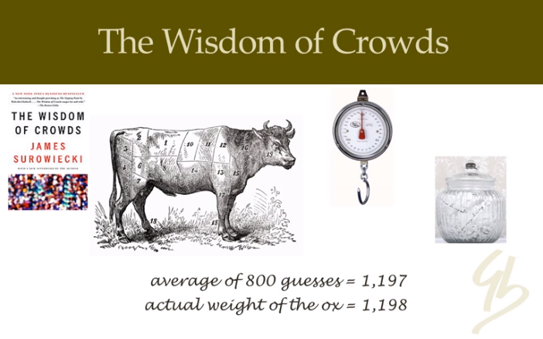
Wisdom of the Crowds
https://vivifychangecatalyst.wordpress.com/2014/07/25/wisdom-of-crowd-crowdsourcing-performance-appraisal/

Slide 4
Background – Lamberson and Page (LP), 2012
What makes a group forecast more (or less) accurate?
Model and Assumptions
Salient Results

Slide 5
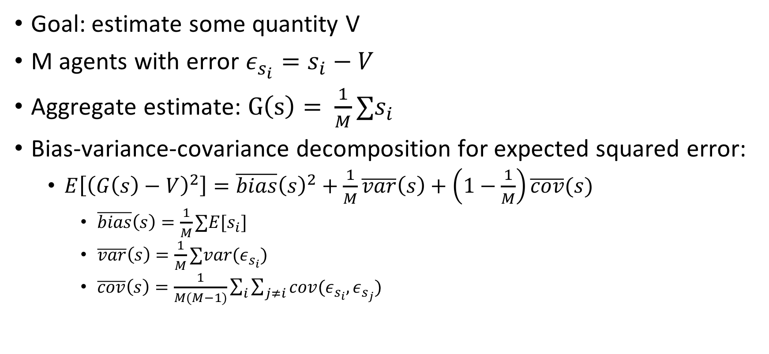
Basic Model from LP
Goal: estimate some quantity V
M agents with error $ε_{s_{i}}=s_{i}−V$
Aggregate estimate: $G\left(s\right)= \frac{1}{M}∑s_{i}$
Bias-variance-covariance decomposition for expected squared error:
$E\left[{\left(G\left(s\right)−V\right)}^{2}\right]=\overline{bias}{\left(s\right)}^{2}+\frac{1}{M}\overline{var}\left(s\right)+\left(1−\frac{1}{M}\right)\overline{cov}(s)$
$\overline{bias}\left(s\right)=\frac{1}{M}∑E[s_{i}]$
$\overline{var}\left(s\right)=\frac{1}{M}∑var(ε_{s_{i}})$
$\overline{cov}\left(s\right)=\frac{1}{M(M−1)}\sum_{i}{\sum_{j≠i}{cov(ε_{s_{i}}, ε_{s_{j}})}}$

Slide 6
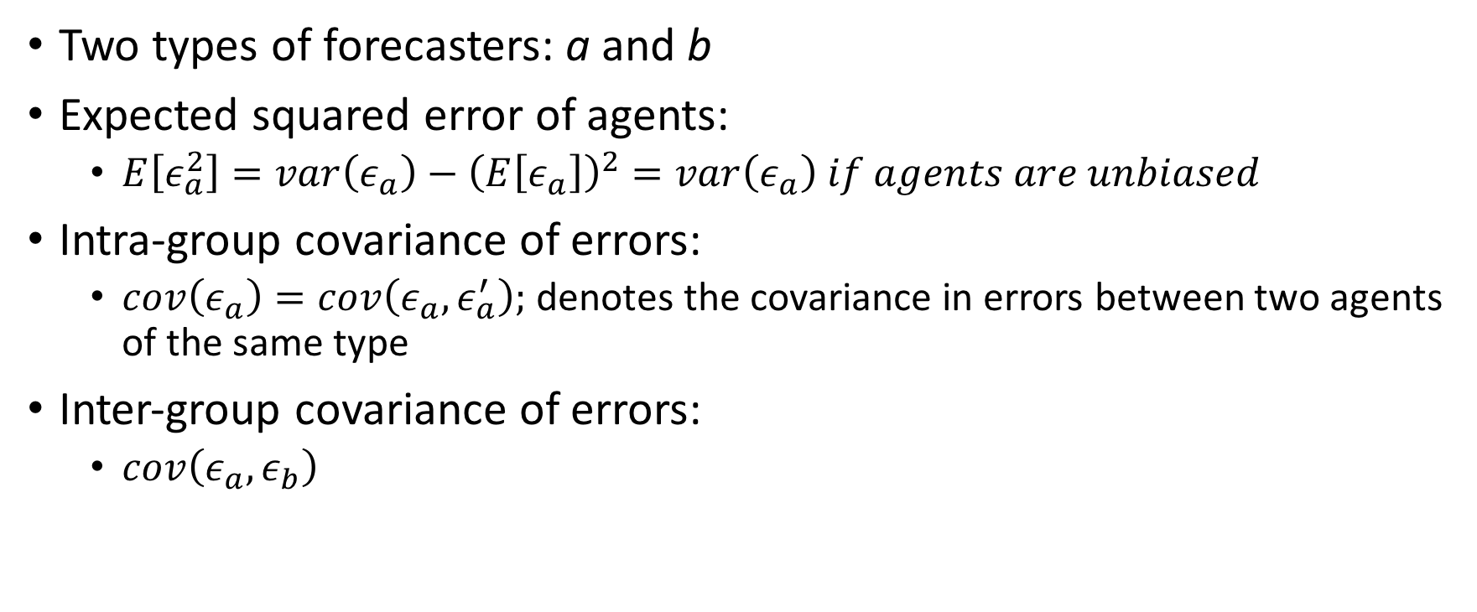
Group Composition from LP
Two types of forecasters: a and b
Expected squared error of agents:
$E\left[ε_{a}^{2}\right]=var\left(ε_{a}\right)−{\left(E\left[ε_{a}\right]\right)}^{2}=var\left(ε_{a}\right) if agents are unbiased$
Intra-group covariance of errors:
$cov\left(ε_{a}\right)=cov\left(ε_{a}, ε_{a}^{′}\right);$denotes the covariance in errors between two agents of the same type
Inter-group covariance of errors:
$cov\left(ε_{a}, ε_{b}\right)$

Slide 7
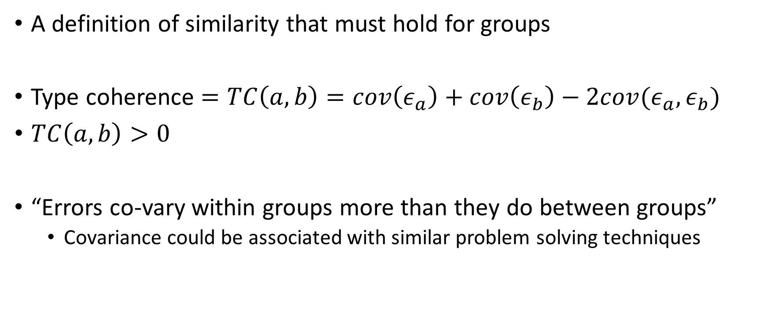
Type Coherence from LP
A definition of similarity that must hold for groups
Type coherence $=TC\left(a,b\right)=cov\left(ε_{a}\right)+cov\left(ε_{b}\right)−2cov(ε_{a},ε_{b})$
$TC\left(a,b\right)>0$
“Errors co-vary within groups more than they do between groups”
Covariance could be associated with similar problem solving techniques

Slide 8
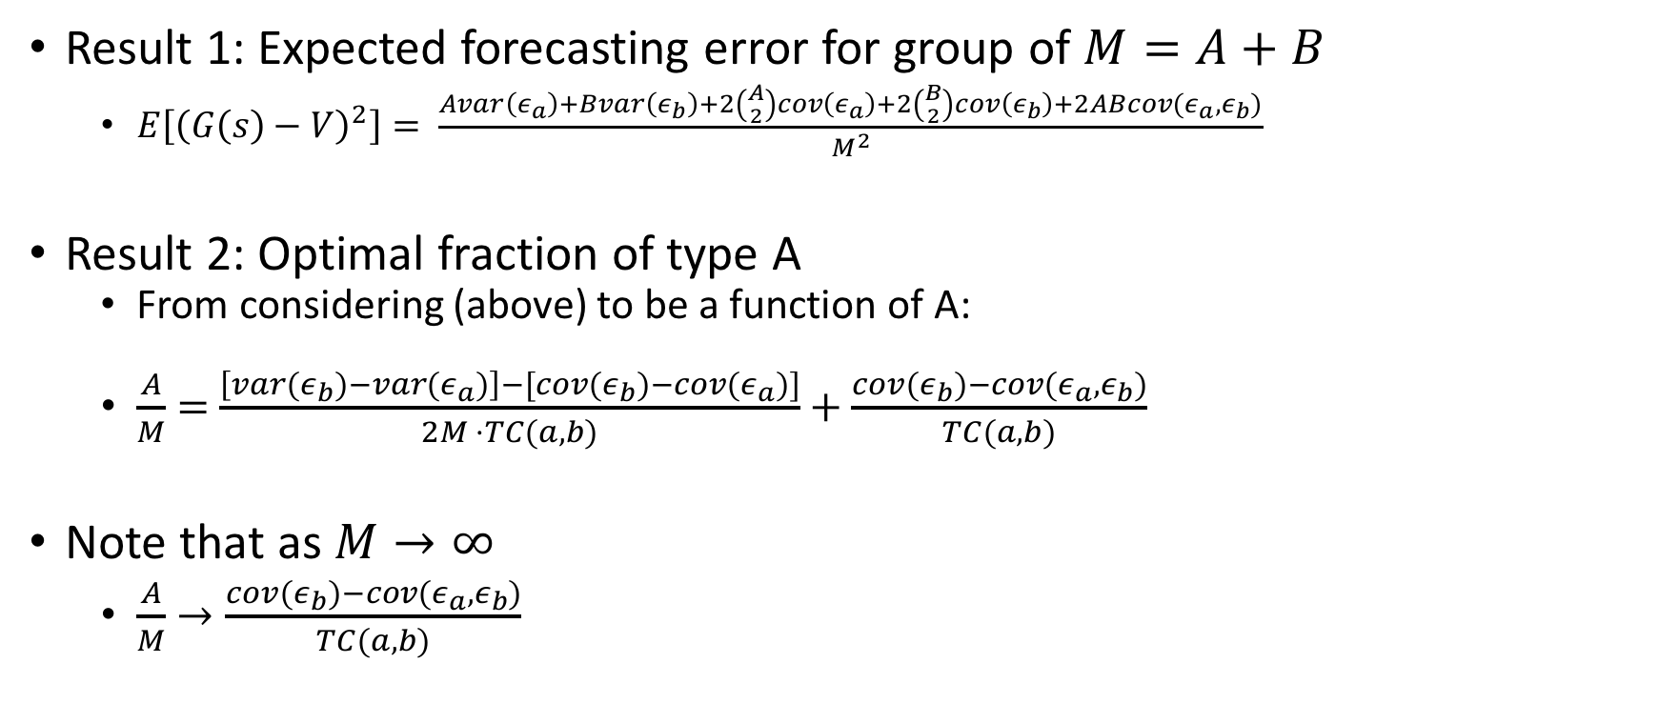
Final Results from LP
Result 1: Expected forecasting error for group of $M=A+B$
$E\left[{\left(G\left(s\right)−V\right)}^{2}\right]= \frac{Avar\left(ε_{a}\right)+Bvar\left(ε_{b}\right)+2\left({A \atop 2}\right)cov\left(ε_{a}\right)+2\left({B \atop 2}\right)cov\left(ε_{b}\right)+2ABcov(ε_{a}, ε_{b})}{M^{2}}$
Result 2: Optimal fraction of type A
From considering (above) to be a function of A:
$\frac{A}{M}=$ $\frac{\left[var\left(ε_{b}\right)−var\left(ε_{a}\right)\right]−[cov\left(ε_{b}\right)−cov(ε_{a})]}{2M ⋅TC(a,b)}+\frac{cov\left(ε_{b}\right)−cov(ε_{a},ε_{b})}{TC(a,b)}$
Note that as $M→∞$
$\frac{A}{M}→\frac{cov\left(ε_{b}\right)−cov(ε_{a},ε_{b})}{TC(a,b)}$

Slide 9
Extension to Prediction Markets
How can we use our knowledge of optimal forecast groups to help design a prediction market?
One possible solution: create participation incentives/disincentives for the different agent types to ensure optimal group composition
Assume agents are aware of their type and the current group composition

Slide 10
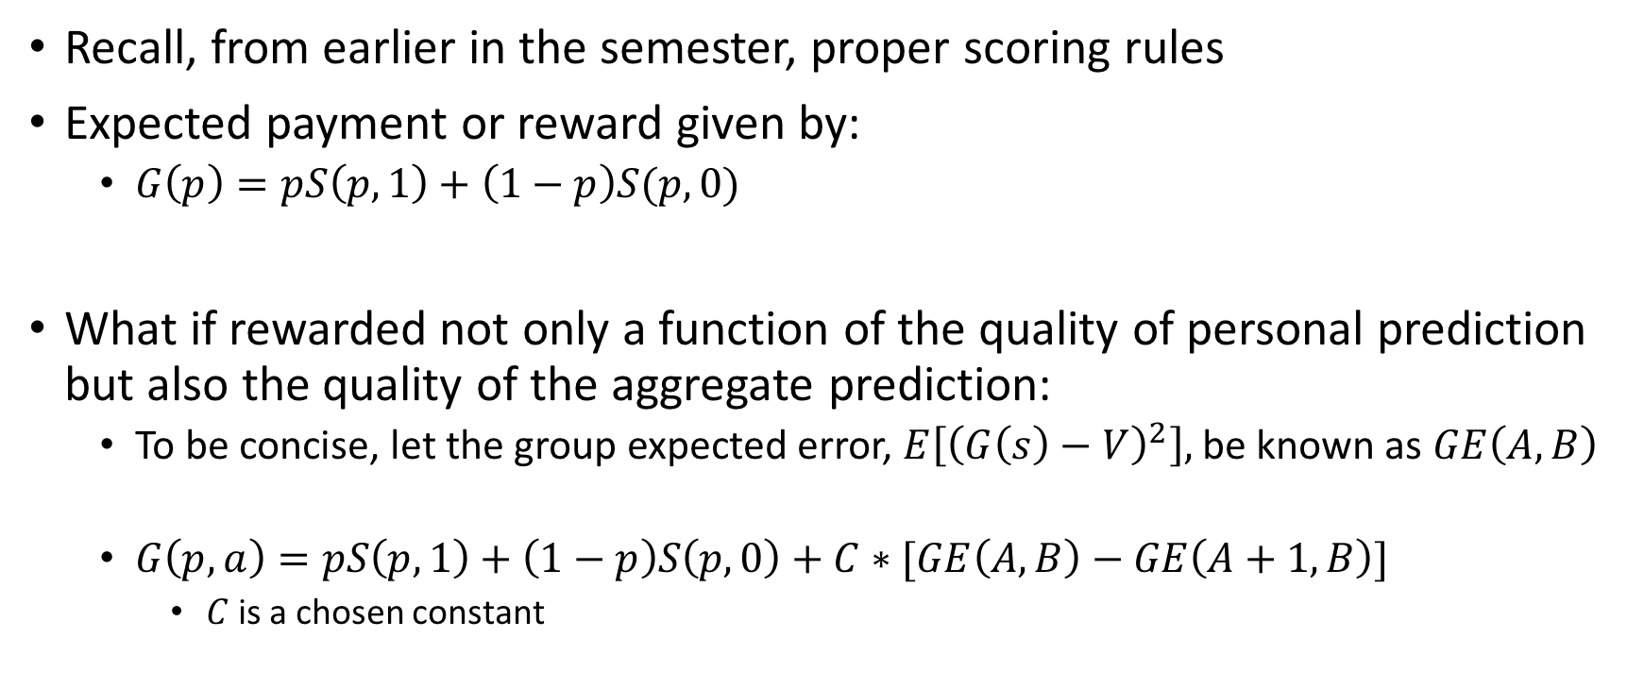
Proposed Scheme
Recall, from earlier in the semester, proper scoring rules
Expected payment or reward given by:
$G\left(p\right)=pS\left(p,1\right)+\left(1−p\right)S(p,0)$
What if rewarded not only a function of the quality of personal prediction but also the quality of the aggregate prediction:
To be concise, let the group expected error, $E\left[{\left(G\left(s\right)−V\right)}^{2}\right],$be known as $GE\left(A,B\right)$
$G\left(p,a\right)=pS\left(p,1\right)+\left(1−p\right)S\left(p,0\right)+C∗[GE\left(A,B\right)−GE\left(A+1,B\right)]$
$C$ is a chosen constant

Slide 11
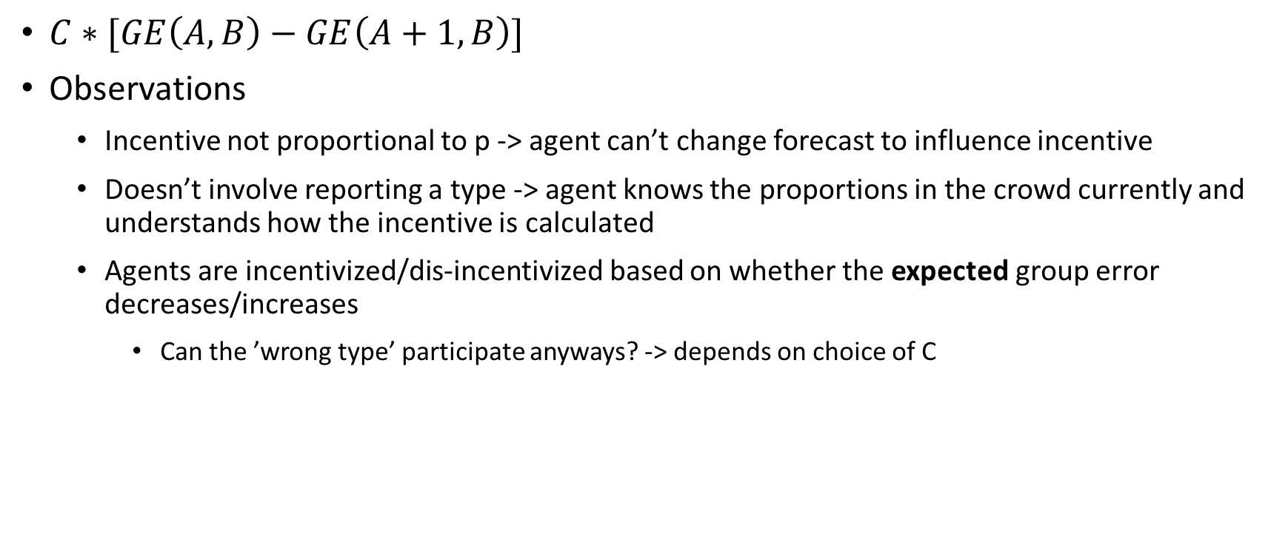
In More Detail
$C∗[GE\left(A,B\right)−GE\left(A+1,B\right)]$
Observations
Incentive not proportional to p -> agent can’t change forecast to influence incentive
Doesn’t involve reporting a type -> agent knows the proportions in the crowd currently and understands how the incentive is calculated
Agents are incentivized/dis-incentivized based on whether the expected group error decreases/increases
Can the ’wrong type’ participate anyways? -> depends on choice of C

Slide 12
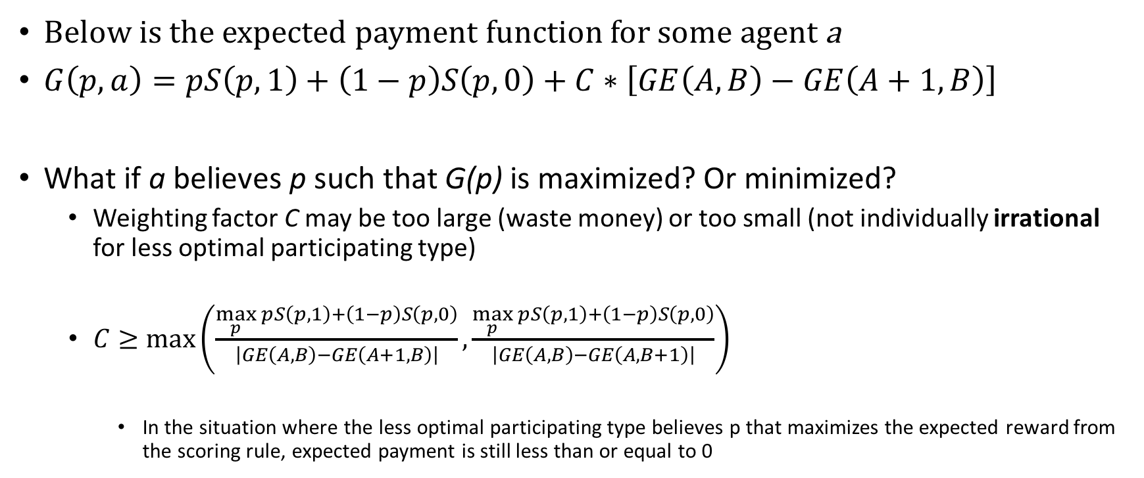
How to Weight Incentives/Disincentives
Below is the expected payment function for some agent a
$G\left(p,a\right)=pS\left(p,1\right)+\left(1−p\right)S\left(p,0\right)+C∗\left[GE\left(A,B\right)−GE\left(A+1,B\right)\right]$
What if a believes p such that G(p) is maximized? Or minimized?
Weighting factor C may be too large (waste money) or too small (not individually irrational for less optimal participating type)
$C≥max\left(\frac{\max_{p}{pS\left(p,1\right)+\left(1−p\right)S\left(p,0\right)}}{\left|GE\left(A,B\right)−GE\left(A+1,B\right)\right|},\frac{\max_{p}{pS\left(p,1\right)+\left(1−p\right)S\left(p,0\right)}}{\left|GE\left(A,B\right)−GE\left(A,B+1\right)\right|}\right)$
In the situation where the less optimal participating type believes p that maximizes the expected reward from the scoring rule, expected payment is still less than or equal to 0

Slide 13
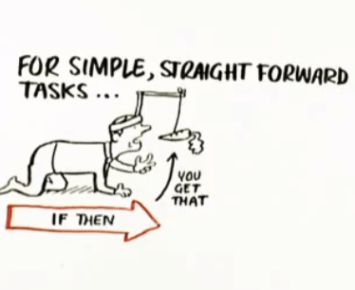
Case for the Incentive
So far we have been mostly focused on disincentives, how could this help improve participation from the desired type?
Positive activation threshold
I.e. minimum expected payment to participate
https://www.brainscape.com/blog/2012/01/what-motivates-you/

Slide 14
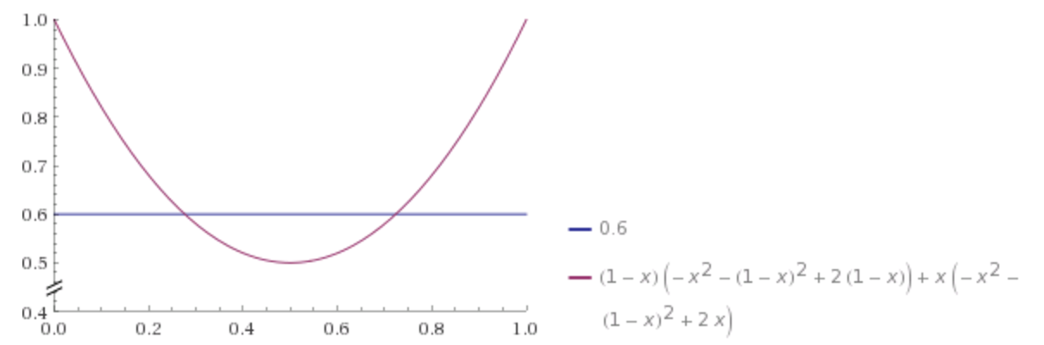
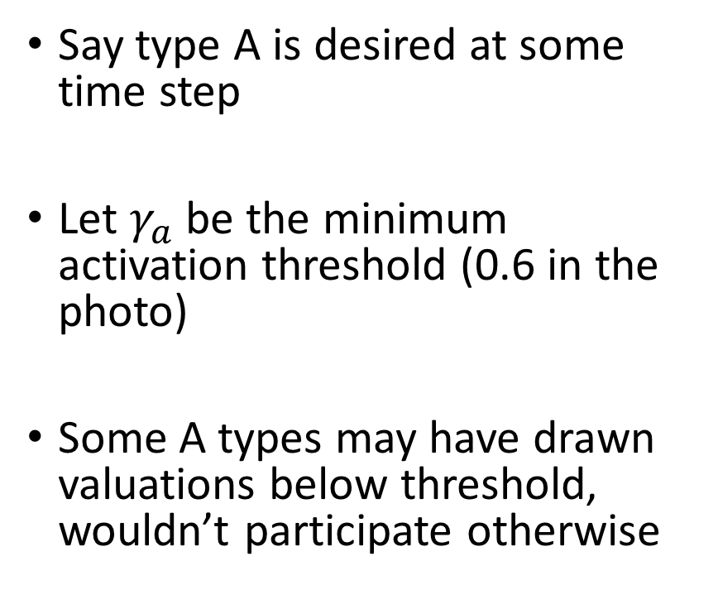
Case for the Incentive
Say type A is desired at some time step
Let $γ_{a}$ be the minimum activation threshold (0.6 in the photo)
Some A types may have drawn valuations below threshold, wouldn’t participate otherwise

Slide 15
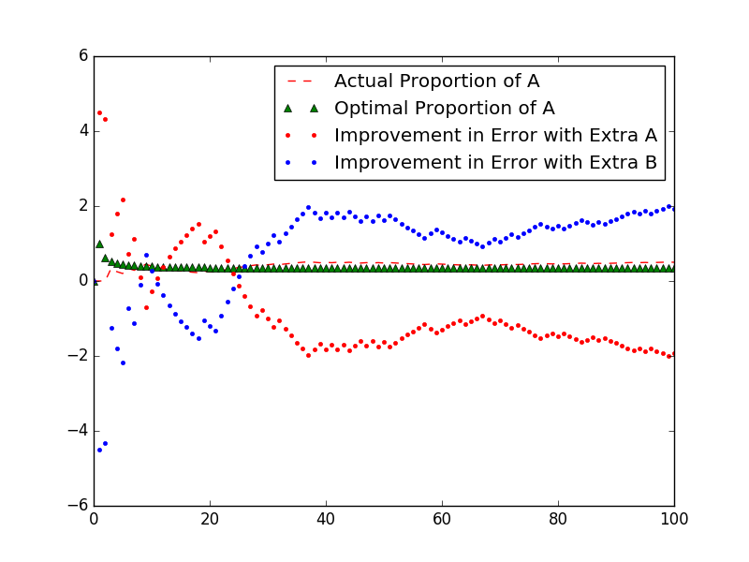
Simulation of Prediction Market

Slide 16
Limitations (Price of better accuracy in expectation)
Fragile
Market organizer trusts that agents won’t participate if not rational in order to know the current quantities of A and B
High burden on market organizer
Must be able to collect/compile data on types
Thin bidding pools
Cost
Lose the nice O(1) cost for market scoring rule

Slide 17
Future Work
Aggregation performance against a market scoring rule (MSR)
Enforcing a budget / bounds on total payout (reporting types?)

Slide 18
References
P. J. Lamberson, Scott E. Page, (2012) Optimal Forecasting Groups. Management Science 58(4):805-810

