Slide 1
t-SNE: A Technique for Dimensionality Reduction
Brody Kellish, Joe Timko, Nicholas von Turkovich
Presentation based on the work of Laurens van der Maaten and Geoffrey Hinton (https://lvdmaaten.github.io/publications/papers/JMLR_2008.pdf)

Slide 2
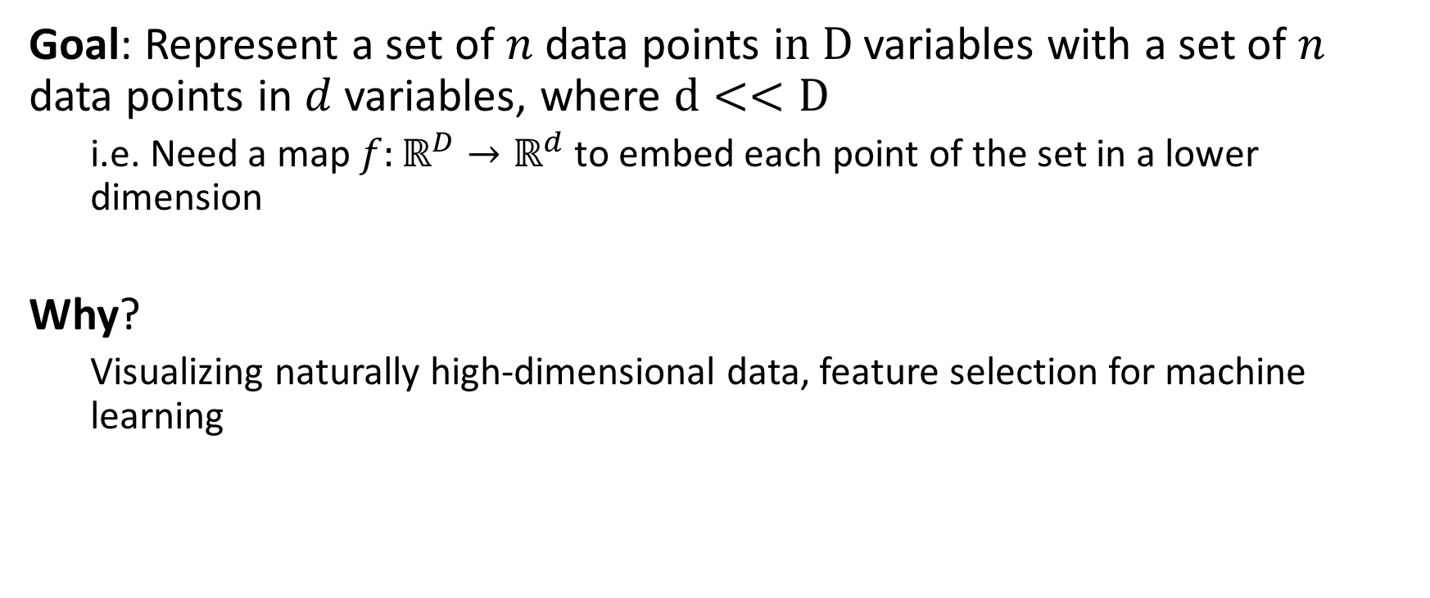
The Problem: Dimensionality Reduction
Goal: Represent a set of $n$ data points i$n D$ variables with a set of $n$ data points in $d$ variables, where $d<<D$
i.e. Need a map $f:ℝ^{D}→ℝ^{d}$ to embed each point of the set in a lower dimension
Why?
Visualizing naturally high-dimensional data, feature selection for machine learning
Notes:
Fix P and N to D and d

Slide 3
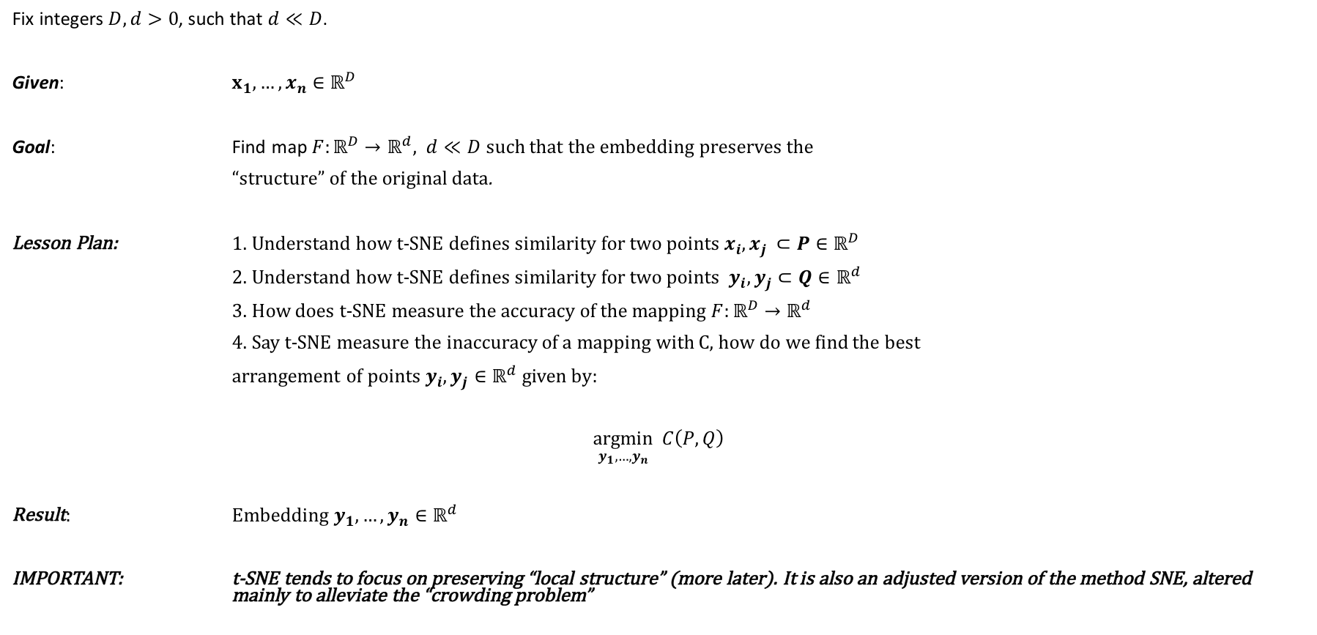
Bird’s Eye View of t-SNE
Fix integers $D, d>0$, such that $d≪D$.
Given: $x_{1},…, x_{n}∈ℝ^{D}$
Goal: Find map $F:ℝ^{D}→ℝ^{d}, d≪D$ such that the embedding preserves the
“structure” of the original data.
Lesson Plan: 1. Understand how t-SNE defines similarity for two points $x_{i}, x_{j }⊂P∈ℝ^{D}$
2. Understand how t-SNE defines similarity for two points $y_{i}, y_{j}⊂Q∈ℝ^{d}$
3. How does t-SNE measure the accuracy of the mapping $F:ℝ^{D}→ℝ^{d}$
4. Say t-SNE measure the inaccuracy of a mapping with C, how do we find the best
arrangement of points $y_{i}, y_{j}∈ℝ^{d}$given by:
$\underset{y_{1},…,y_{n}}{argmin}{ C\left(P, Q\right)}$
Result: E$mbedding y_{1},…,y_{n}∈ℝ^{d}$
IMPORTANT: t-SNE tends to focus on preserving “local structure” (more later). It is also an adjusted version of the method SNE, altered mainly to alleviate the “crowding problem”

Slide 4
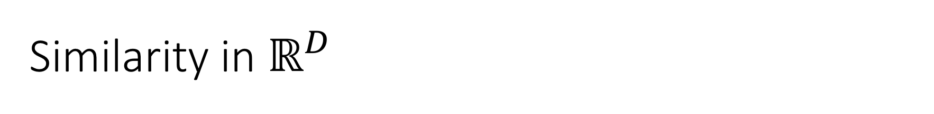
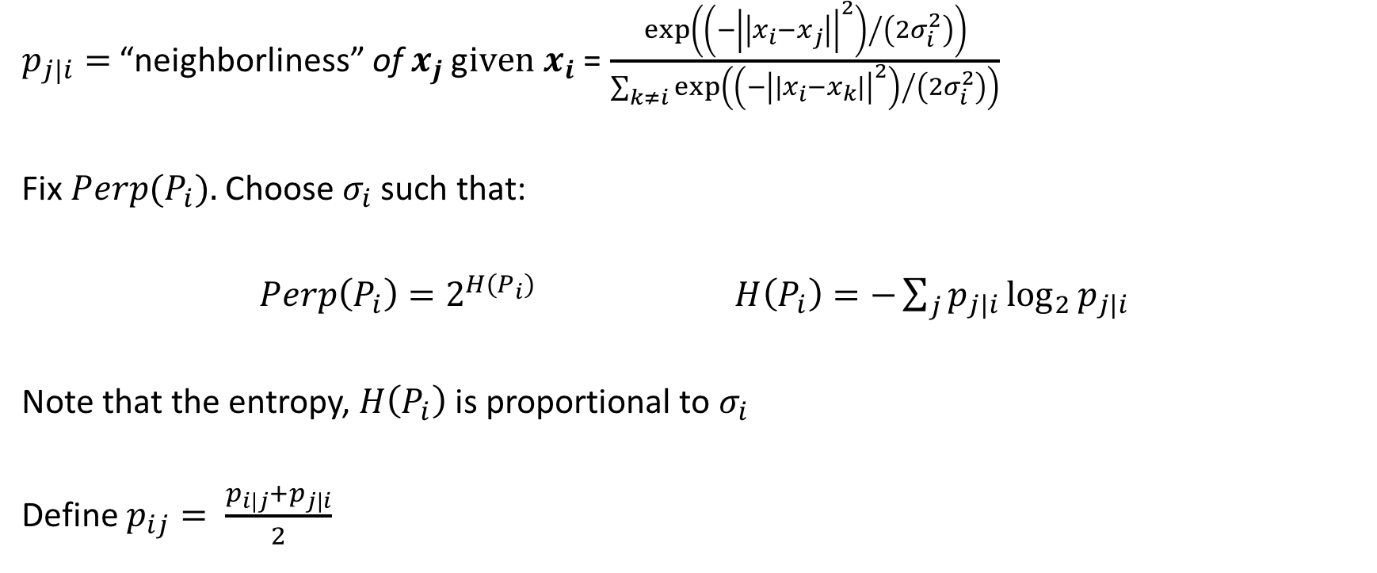
Similarity in $ℝ^{D}$
$p_{j|i}=$ “neighborliness” of $x_{j}$ g$iven x_{i}$ = $\frac{exp\left({\left(−{\left|\left|x_{i}−x_{j}\right|\right|}^{2}\right)}/{\left(2σ_{i}^{2}\right)}\right)}{\sum_{k≠i}{exp⁡\left({\left(−{\left|\left|x_{i}−x_{k}\right|\right|}^{2}\right)}/{\left(2σ_{i}^{2}\right)}\right)}}$
Fix ${Perp(P}_{i}).$Choose $σ_{i}$ such that:
$Perp\left(P_{i}\right)=2^{H\left(P_{i}\right)}$ $H\left(P_{i}\right)=−\sum_{j}{p_{j|i}\log_{2}{p_{j|i}}}$
Note that the entropy, $H\left(P_{i}\right)$ is proportional to $σ_{i}$
Define $p_{ij}= \frac{p_{i|j}+p_{j|i}}{2}$
Notes:
Use analogy to describe more intuitively what similarity means especially depending on your location within the point cloud
How this works:
Iterate over values of sigma
Sigma induces a change in the values of p_j|j
Iterate over different distributions or values for sigma until the entropy value is reached
This is a way of determining distributions that biases the algorithm to care more about preserving local structure
Symmetric pij to make the gradient easier to compute

Slide 5
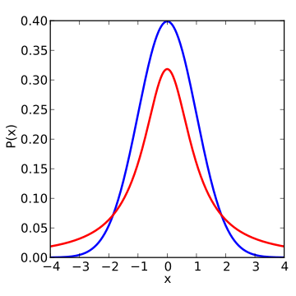
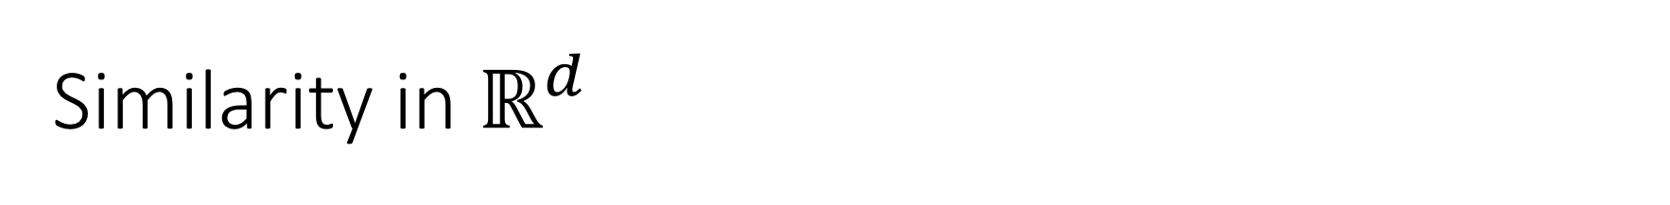
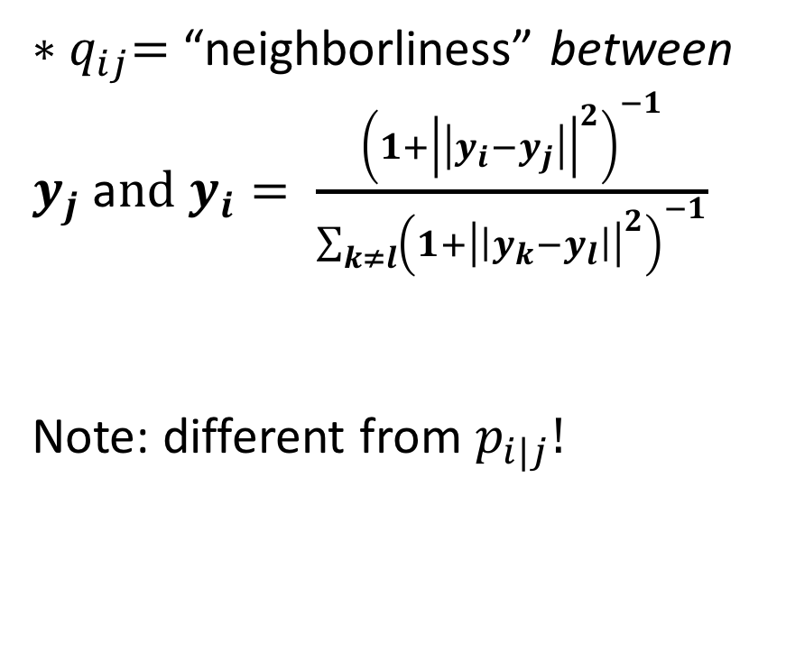
Similarity in $ℝ^{d}$
${∗q}_{ij}=$ “neighborliness” between $y_{j}$ a$nd y_{i}= \frac{{\left(1+{\left|\left|y_{i}−y_{j}\right|\right|}^{2}\right)}^{−1}}{\sum_{k≠l}{{\left(1+{\left|\left|y_{k}−y_{l}\right|\right|}^{2}\right)}^{−1}}}$
Note: different from $p_{i|j}!$
Figure 1: Student t-distribution with 1 degree of freedom (https://en.wikipedia.org/wiki/Student's_t-distribution#/media/File:T_distribution_1df_enhanced.svg)
Notes:
As you go from high dimension to low dimension, unless there were redundant variables/feature of your data points, some distances will be distorted
In the case of TSNE, since local structure is preserved and prioritized, larger distances/more global structures can be distorted, specifically enlarged
What that means is points that are not close in high dimensional space may be forced to be modeled farther from each other in low dimensions (recall the triangle of points demonstration and show that the p and q values create an attractive force on the farthest points in the mapped dimension)
To compensate for this reality, the paper writers used a student t-distribution with 1 degree of freedom to reflect/describe the increased probability of points existing far away from each other in the smaller dimension. Since the distribution has fatter tails than the gaussian, the p value (say 0.05) on the blue line represents a point moderately distant from the rest. In the mapped dimension, to get the q value that would incur no difference in the gradient, the point must be even more distant. This prevents the issue of crowding

Slide 6
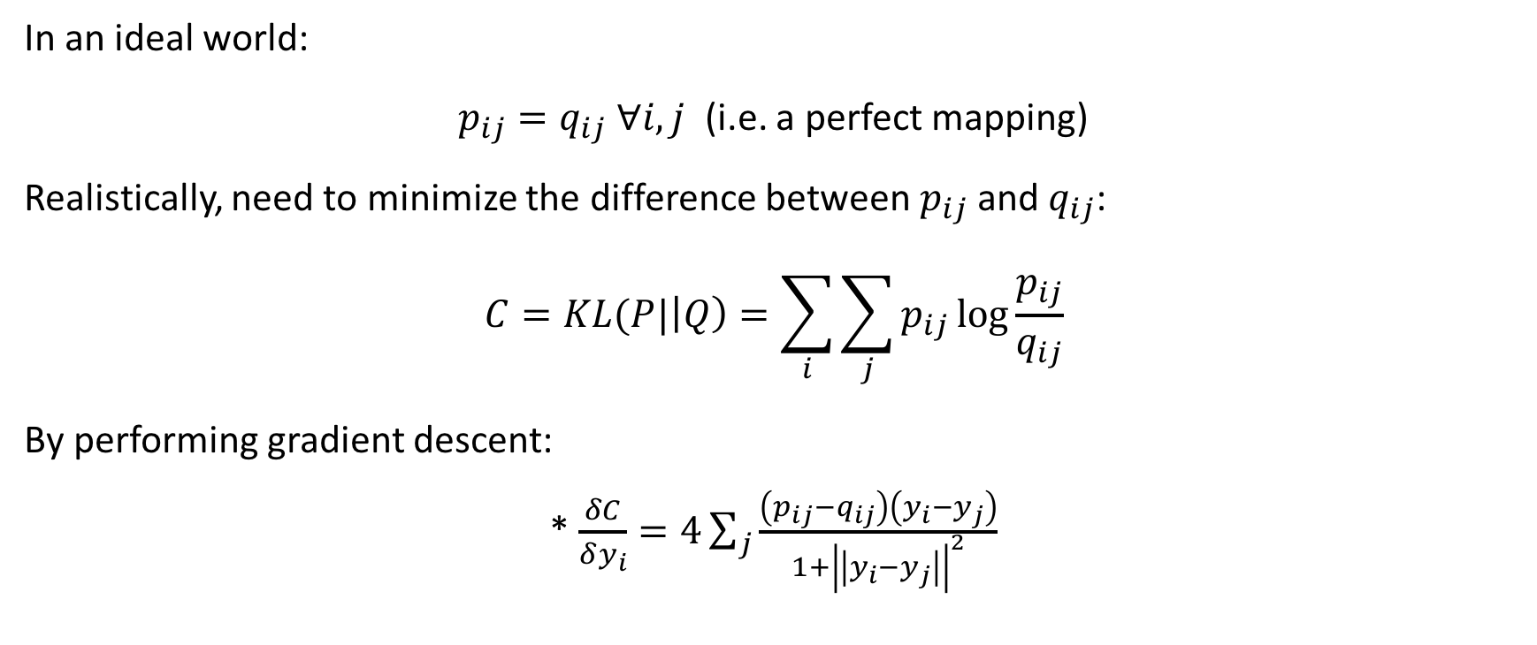
The Cost of the Mapping
In an ideal world:
$p_{ij}=q_{ij} ∀i, j$ (i.e. a perfect mapping)
Realistically, need to minimize the difference between $p_{ij}$ and $q_{ij}$:
$$C=KL(P|\left|Q\right)=\sum_{i}{\sum_{j}{p_{ij}\log{\frac{p_{ij}}{q_{ij}}}}}$$
By performing gradient descent:
* $\frac{δC}{δy_{i}}=4\sum_{j}{\frac{\left(p_{ij}−q_{ij}\right)\left(y_{i}−y_{j}\right)}{1+{\left|\left|y_{i}−y_{j}\right|\right|}^{2}}}$
Notes:
Ideally, if the probability distributions between pairs of points are the same between the high dimensional space and the low dimensional mapping, then they’re relative distances from each other are also equal. However, when embedding data, most of the time this does not happen and distances get distorted. Recall a triangle of points in the 2 plane forced onto a 1 dimensional plane.
Therefore, need to assign a metric or way of judging how bad the current embedding is. Note the C equation. This computes the sum of all mapping errors between the original data set and the mapped points. Note that the equation has a very specific idea of what constitutes an erroneous mapping of points. It assigns very high degree of error to a pair of points that are modeled as “close neighbors” in high d but are not close in low dimensions. Vice versa, being modeled as close in low dimension but far away in high dimension does not introduce much error.
Gradient descent is a computational method used to iteratively reach a system with lower value of some stated function, in this case cost. It is analagous to a ball roll down the hill to reach a state of lower potential energy. In this case, our potential energy is C (cost) or the overall mistake in our mapping. The gradient descent will wiggle each of the mapping points in the direction that specifies a negative dC/dy in order to maximally reduce the cost function with respect to that point. Doing that repeatedly for each point until the overall mapping has reached a minimum state of cost.

Slide 7
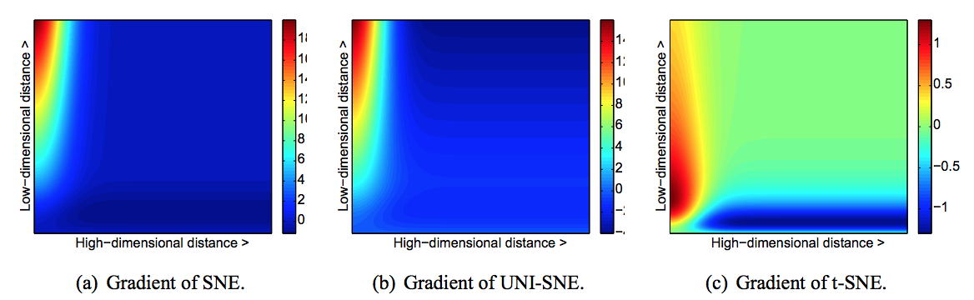

Putting the “t” in t-SNE
Recall that $q_{ij}$ modeled using a Student t-distribution:
Why? -> The Crowding Problem
Figure 2: Visualization of Cost Function Gradients for Two Points (https://lvdmaaten.github.io/publications/papers/JMLR_2008.pdf)

Slide 8
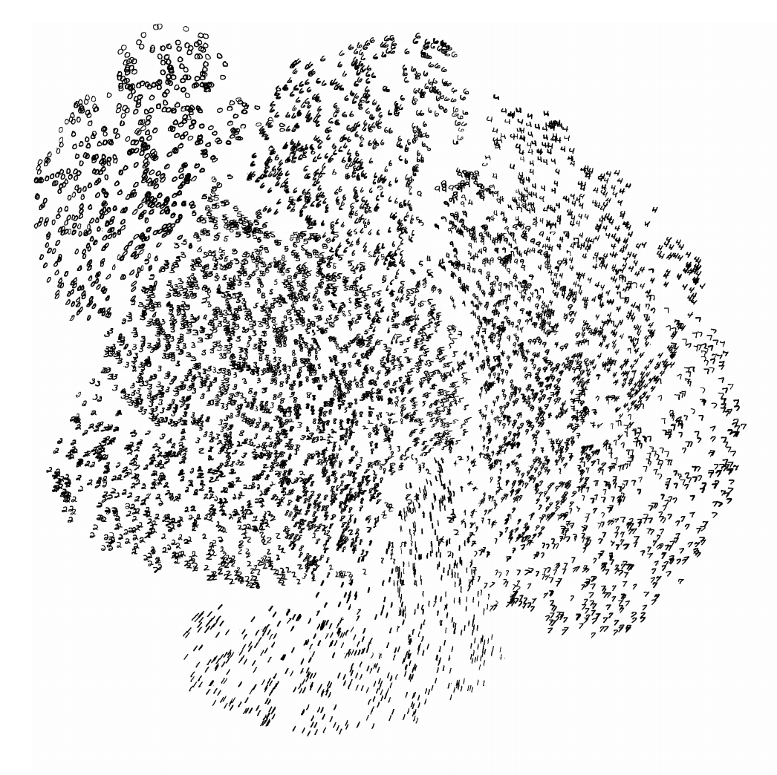
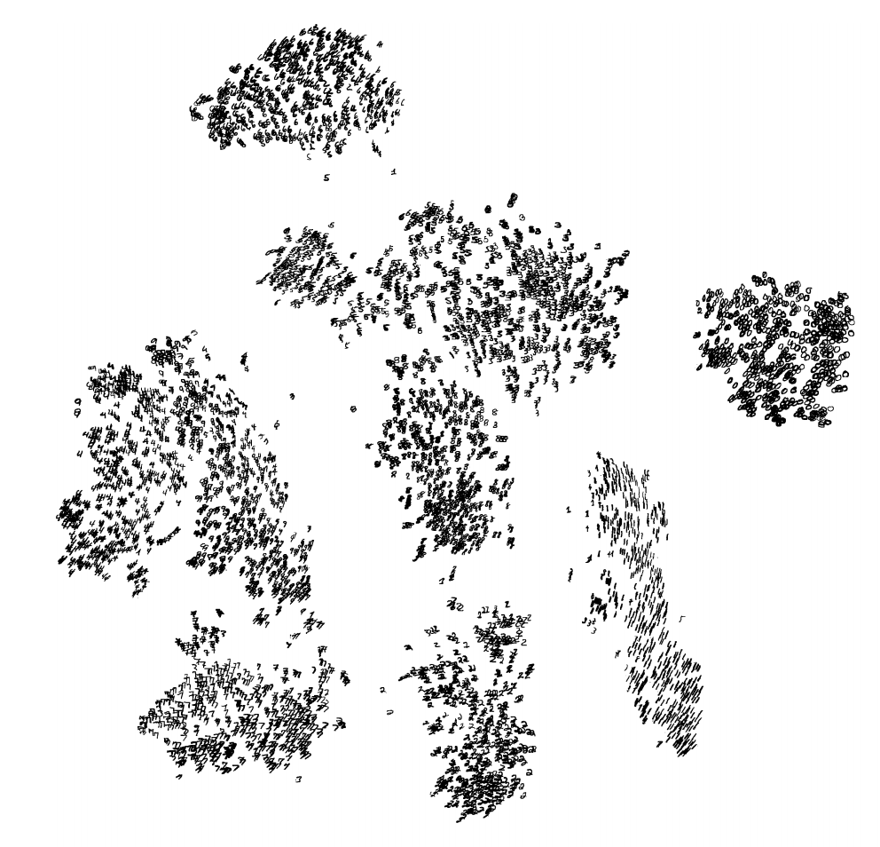
Performance on Data (MNIST)
SNE
t-SNE
Figure 3: Clusters of MNIST Images by SNE (https://lvdmaaten.github.io/publications/misc/Supplement_JMLR_2008.pdf )
Figure 4: Clusters of MNIST Images by t-SNE (https://lvdmaaten.github.io/publications/misc/Supplement_JMLR_2008.pdf )
Notes:
MNIST data set is a large number of images of handwritten digits.
Each of the images (gray scale) are composed of 764 pixels (28 by 28). Therefore we can think of each image as a data point in R^784.

Slide 9
Comparison to Other Methods

Slide 10
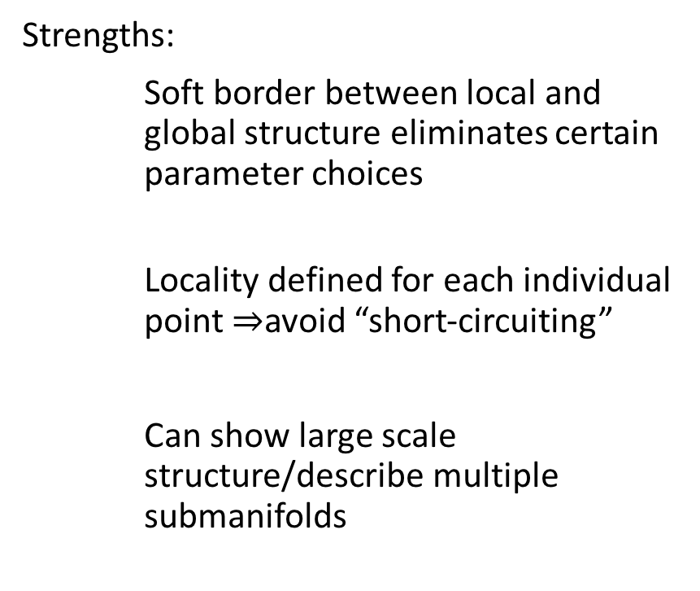
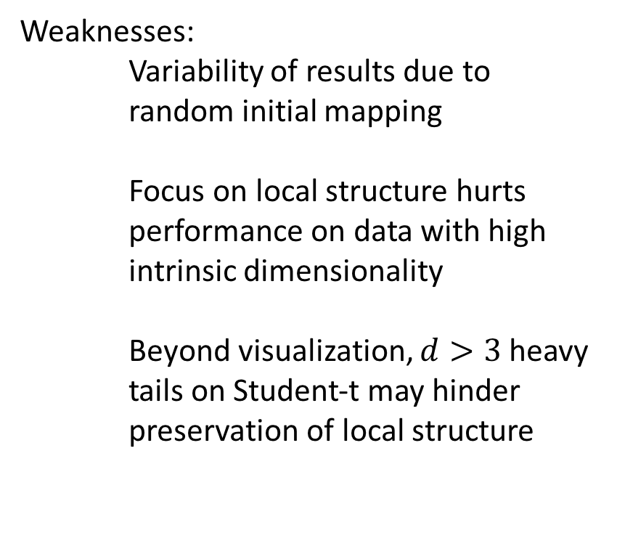
Strengths and Weaknesses
Strengths:
Soft border between local and global structure eliminates certain parameter choices
Locality defined for each individual point $⇒$avoid “short-circuiting”
Can show large scale structure/describe multiple submanifolds
Weaknesses:
Variability of results due to random initial mapping
Focus on local structure hurts performance on data with high intrinsic dimensionality
Beyond visualization, $d>3$ heavy tails on Student-t may hinder preservation of local structure

Slide 11
Conclusion and Ideas for Future Use

