Slide 1
T-SNE: A Technique for Dimensionality Reduction
Brody Kellish, Joe Timko, Nicholas von Turkovich
Presentation based on the work of Laurens van der Maaten and Geoffrey Hinton (https://lvdmaaten.github.io/publications/papers/JMLR_2008.pdf)

Slide 2
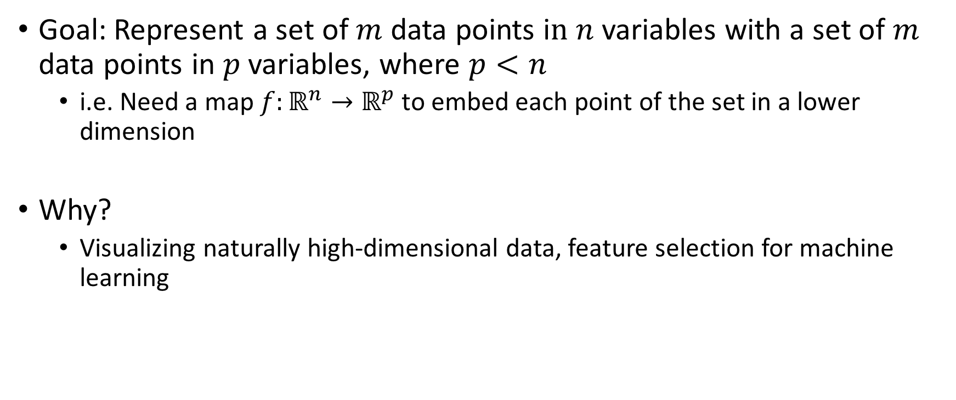
The Problem: Dimensionality Reduction
Goal: Represent a set of $m$ data points i$n n$ variables with a set of $m$ data points in $p$ variables, where $p<n$
i.e. Need a map $f:ℝ^{n}→ℝ^{p}$ to embed each point of the set in a lower dimension
Why?
Visualizing naturally high-dimensional data, feature selection for machine learning

Slide 3
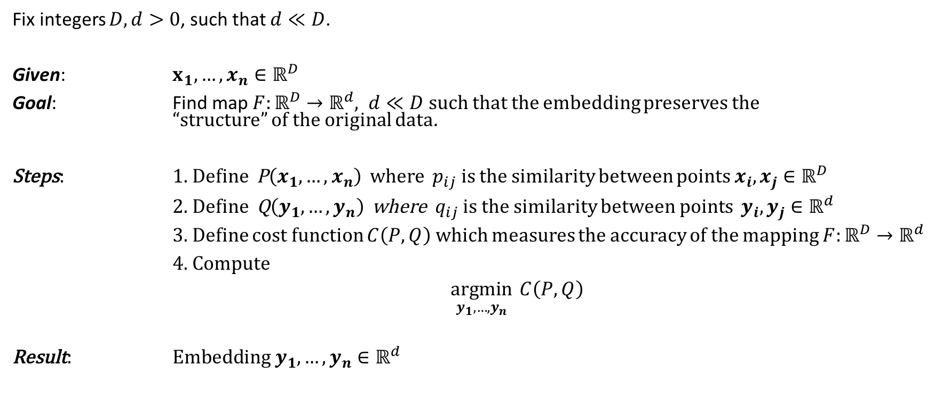
Bird’s Eye View
Fix integers $D, d>0$, such that $d≪D$.
Given: $x_{1},…, x_{n}∈ℝ^{D}$
Goal: Find map $F:ℝ^{D}→ℝ^{d}, d≪D$ such that the embedding preserves the “structure” of the original data.
Steps: 1. Define P$\left(x_{1},…,x_{n}\right)$ where $p_{ij}$ is the similarity between points $x_{i}, x_{j}∈ℝ^{D}$
2. Define Q$\left(y_{1},…,y_{n}\right)$ where $q_{ij}$ is the similarity between points $y_{i}, y_{j}∈ℝ^{d}$
3. Define cost function $C\left(P, Q\right)$ which measures the accuracy of the mapping $F:ℝ^{D}→ℝ^{d}$
4. Compute
$\underset{y_{1},…,y_{n}}{argmin}{ C\left(P, Q\right)}$
Result: E$mbedding y_{1},…,y_{n}∈ℝ^{d}$

Slide 4
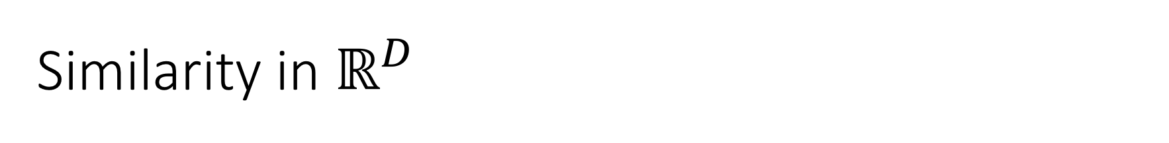
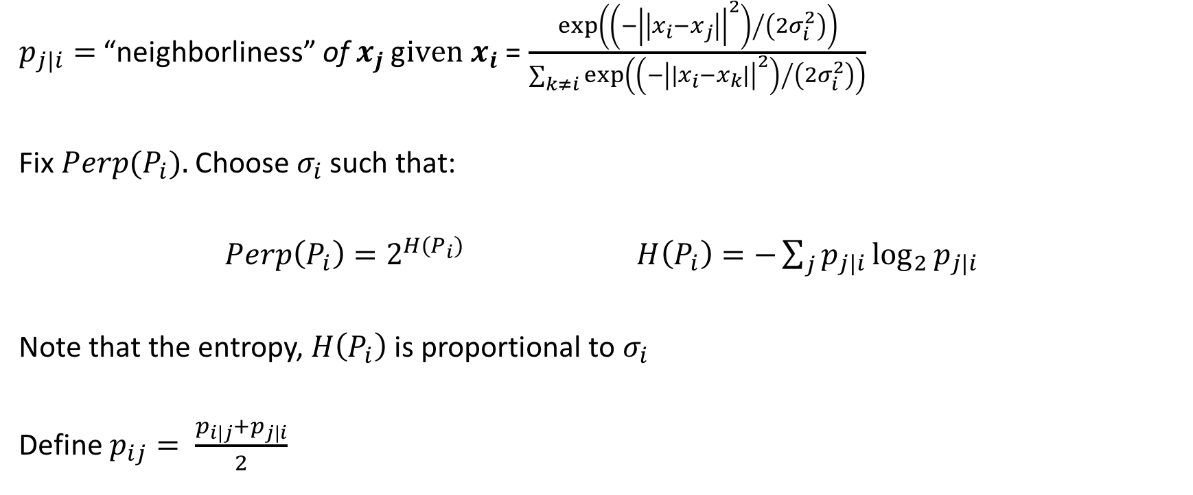
Similarity in $ℝ^{D}$
$p_{j|i}=$ “neighborliness” of $x_{j}$ g$iven x_{i}$ = $\frac{exp\left({\left(−{\left|\left|x_{i}−x_{j}\right|\right|}^{2}\right)}/{\left(2σ_{i}^{2}\right)}\right)}{\sum_{k≠i}{exp⁡\left({\left(−{\left|\left|x_{i}−x_{k}\right|\right|}^{2}\right)}/{\left(2σ_{i}^{2}\right)}\right)}}$
Fix ${Perp(P}_{i}).$Choose $σ_{i}$ such that:
$Perp\left(P_{i}\right)=2^{H\left(P_{i}\right)}$ $H\left(P_{i}\right)=−\sum_{j}{p_{j|i}\log_{2}{p_{j|i}}}$
Note that the entropy, $H\left(P_{i}\right)$ is proportional to $σ_{i}$
Define $p_{ij}= \frac{p_{i|j}+p_{j|i}}{2}$
Notes:
Use analogy to describe more intuitively what similarity means especially depending on your location within the point cloud
How this works:
Iterate over values of sigma
Sigma induces a change in the values of p_j|j
Iterate over different distributions or values for sigma until the entropy value is reached
This is a way of determining distributions that biases the algorithm to care more about preserving local structure
Symmetric pij to account for outlier data points

Slide 5
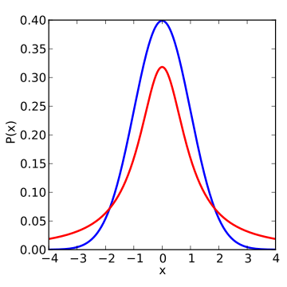
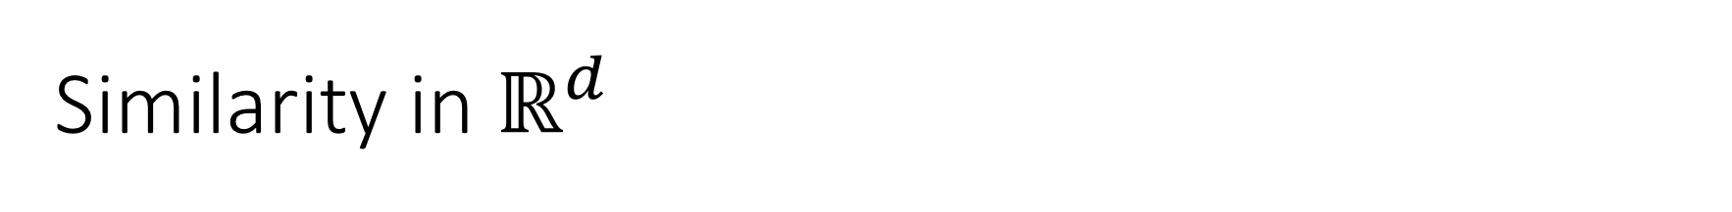

Similarity in $ℝ^{d}$
$q_{j|i}=$ “neighborliness” of $y_{j}$ g$iven y_{i}= \frac{{\left(1+{\left|\left|y_{i}−y_{j}\right|\right|}^{2}\right)}^{−1}}{\sum_{k≠l}{{\left(1+{\left|\left|y_{i}−y_{j}\right|\right|}^{2}\right)}^{−1}}}$
Figure 1: Student t-distribution with 1 degree of freedom (https://en.wikipedia.org/wiki/Student's_t-distribution#/media/File:T_distribution_1df_enhanced.svg)
Notes:
As you go from high dimension to low dimension, unless there were redundant variables/feature of your data points, some distances will be distorted
In the case of TSNE, sincelocal structure is preserved and prioritized, larger distances/more global structures can be distorted, specifically enlarged
What that means is points that are not close in high dimensional space may be forced to be modeled farther from each other in low dimensions (recall the triangle of points demonstration)
To compensate for this reality, the paper writers used a student t-distribution with 1 degree of freedom to reflect/describe the increased probability of points existing far away from each other in the smaller dimension. Since the distribution has fatter tails than the gaussian,

Slide 6
Cost function – K-L divergence
Minimize “distance” between two distributions
Choice of P and Q allows for large distances to be weighted less

Slide 7
Choice of P and Q – why important with respect to SNE?
Why student-t
Why symmetric p’s and q’s

Slide 8
What is it Actually Doing?

Slide 9
Strengths/Pitfalls

Slide 10
Comparison to Other Methods

