Slide 1
T-SNE: A Technique for Dimensionality Reduction
Brody Kellish, Joe Timko, Nicholas von Turkovich
Presentation based on the work of Laurens van der Maaten and Geoffrey Hinton (https://lvdmaaten.github.io/publications/papers/JMLR_2008.pdf)

Slide 2
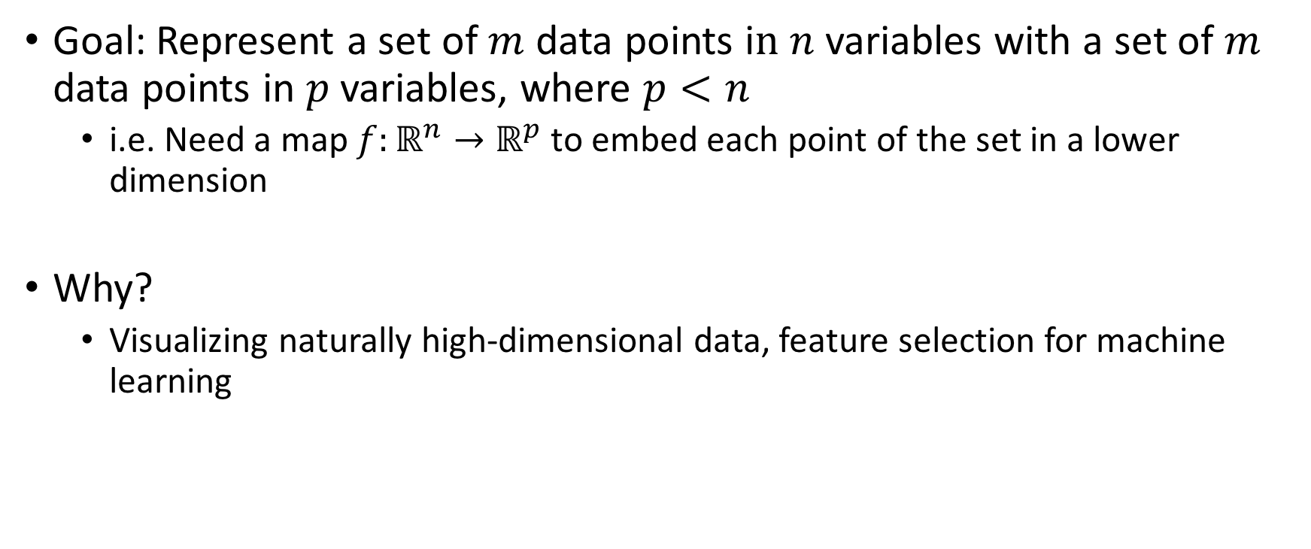
The Problem: Dimensionality Reduction
Goal: Represent a set of $m$ data points i$n n$ variables with a set of $m$ data points in $p$ variables, where $p<n$
i.e. Need a map $f:ℝ^{n}→ℝ^{p}$ to embed each point of the set in a lower dimension
Why?
Visualizing naturally high-dimensional data, feature selection for machine learning

Slide 3
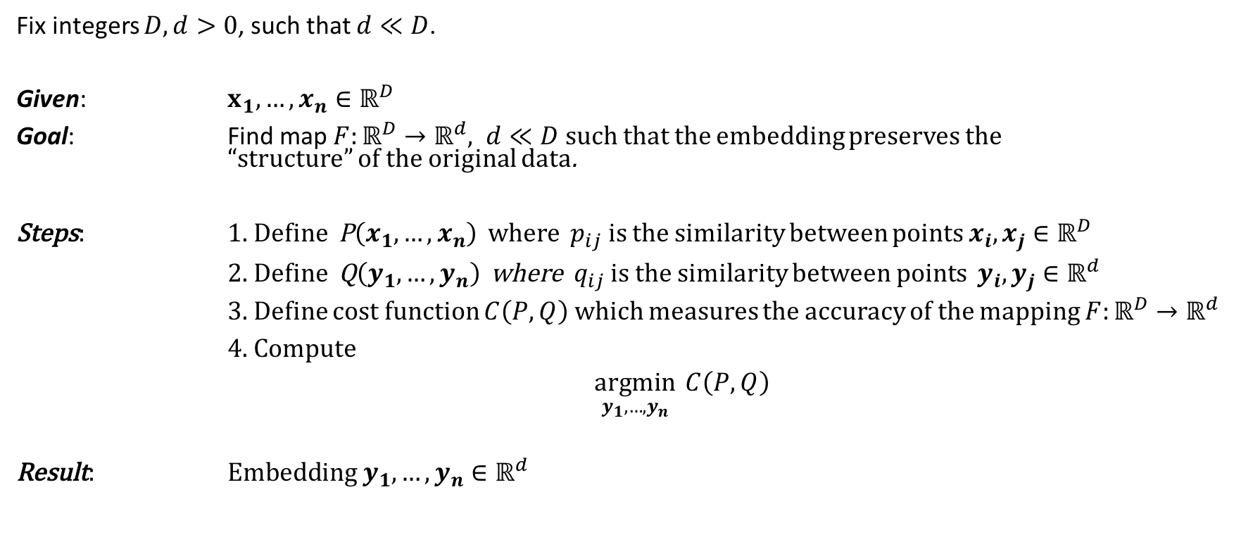
Bird’s Eye View
Fix integers $D, d>0$, such that $d≪D$.
Given: $x_{1},…, x_{n}∈ℝ^{D}$
Goal: Find map $F:ℝ^{D}→ℝ^{d}, d≪D$ such that the embedding preserves the “structure” of the original data.
Steps: 1. Define P$\left(x_{1},…,x_{n}\right)$ where $p_{ij}$ is the similarity between points $x_{i}, x_{j}∈ℝ^{D}$
2. Define Q$\left(y_{1},…,y_{n}\right)$ where $q_{ij}$ is the similarity between points $y_{i}, y_{j}∈ℝ^{d}$
3. Define cost function $C\left(P, Q\right)$ which measures the accuracy of the mapping $F:ℝ^{D}→ℝ^{d}$
4. Compute
$\underset{y_{1},…,y_{n}}{argmin}{ C\left(P, Q\right)}$
Result: E$mbedding y_{1},…,y_{n}∈ℝ^{d}$

Slide 4
Similarity P in R^D

Slide 5
Similarity Q in R^d

Slide 6
Choice of P and Q – why important?
Why student-t

Slide 7
Cost function – K-L divergence
Minimize “distance” between two distributions
Choice of P and Q allows for large distances to be weighted less

Slide 8
What is it Actually Doing?

Slide 9
Comparison to Other Methods

Slide 10
Strengths/Pitfalls

