Slide 1
T-SNE: A Technique for Dimensionality Reduction
Brody Kellish, Joe Timko, Nicholas von Turkovich
Presentation based on the work of Laurens van der Maaten and Geoffrey Hinton (https://lvdmaaten.github.io/publications/papers/JMLR_2008.pdf)

Slide 2
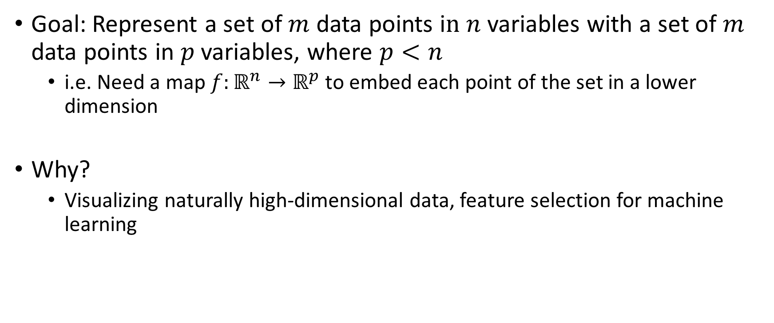
The Problem: Dimensionality Reduction
Goal: Represent a set of $m$ data points i$n n$ variables with a set of $m$ data points in $p$ variables, where $p<n$
i.e. Need a map $f:ℝ^{n}→ℝ^{p}$ to embed each point of the set in a lower dimension
Why?
Visualizing naturally high-dimensional data, feature selection for machine learning

