Slide 1
Data Warehouse Design & ETL Implementation in Informatica
Project
Ethnic Group Census Data Analysis,
ETL Processes in Informatica & Visual Analytical Reports
Reference:-
GUVI - CHUBB:
Capstone Project Submission
(Data Track) AET2025 Batch
By:
N.B.V.Sindhu
B.Tech CSE (Final Year)
VNRVJIET, Hyderabad
nbvsindhu@gmail.com
Ph: 7989971159
Date:- 08-Dec-2024

Slide 2
Index
Project Objective
Scope and Solution
Data Analysis
Datasets – Summary
Lookup Data – Mapping
Important Points
ETL Processes in Informatica
Visual Analytical Reports

Slide 3
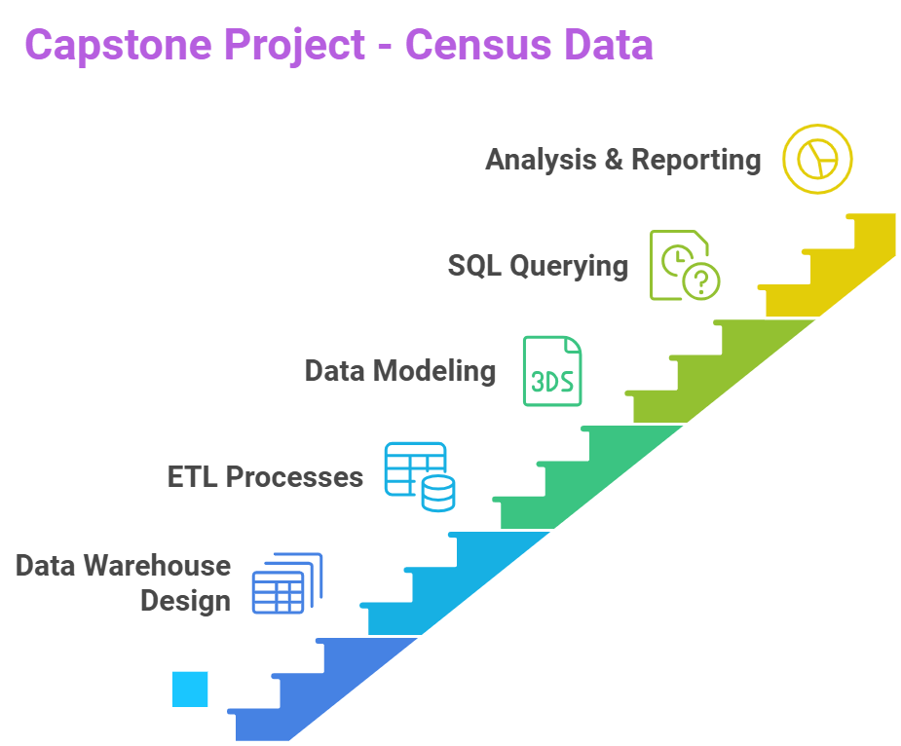
Project Objective
To design and implement a data warehouse
Extracting insights from the Census datasets provided
ETL Processes, Data Modelling, SQL querying using Informatica
Analysis & reports generation

Slide 4
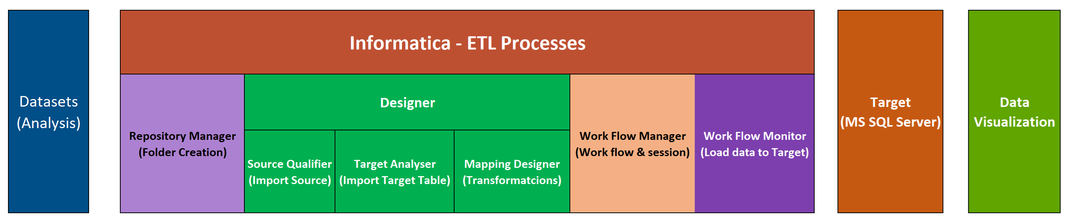
Project Scope & Solution
Data Analysis & Modelling (Analyze Datasets, identify dimensions & facts, Design the data model)
ETL Implementation (Data Loading strategy, Staging Tables, Mappings & workflows in Informatica)
Data Analysis (SQL querying and Analyzing the Data)

Slide 5
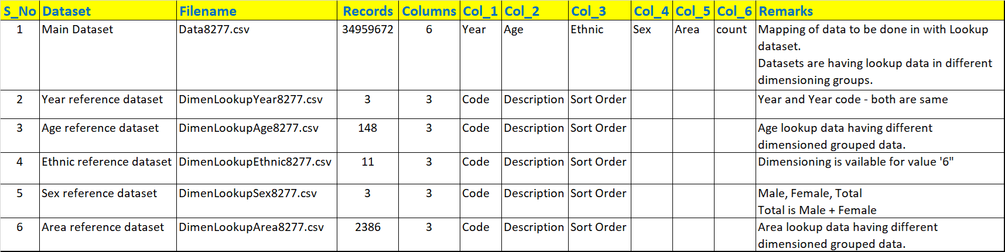
Datasets - Summary
There are 6 Data Sets (1 main dataset and 5 dimension lookup datasets for mapping)

Slide 6
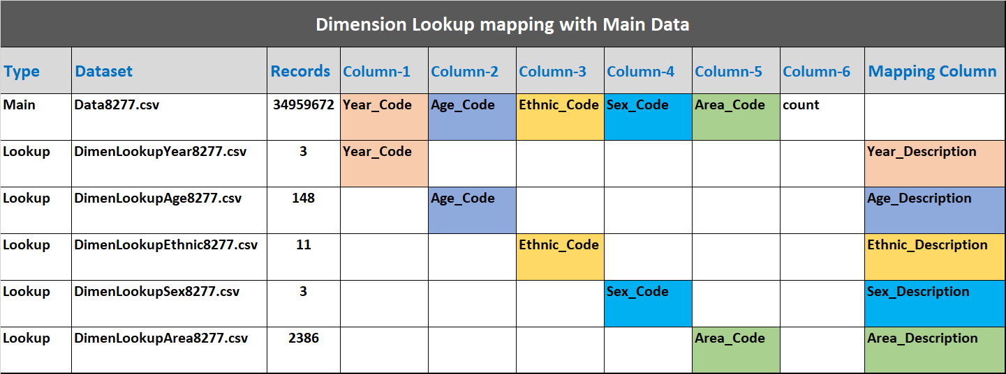
Lookup and Mapping

Slide 7
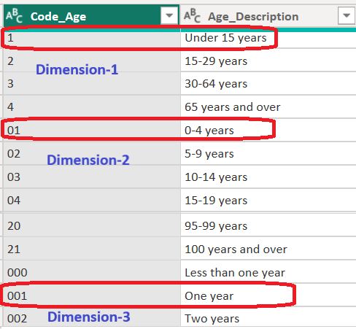
Important Points and Observations
There are few codes which are in Numerical format with different sizes. (Ex: Age Lookup dataset)
Actually, these codes are designed for mapping in different DIMENSIONS (Ex: Age Lookup dataset)
All the codes are to be considered as "Strings" to treat them as different dimensions in the lookup.

Slide 8
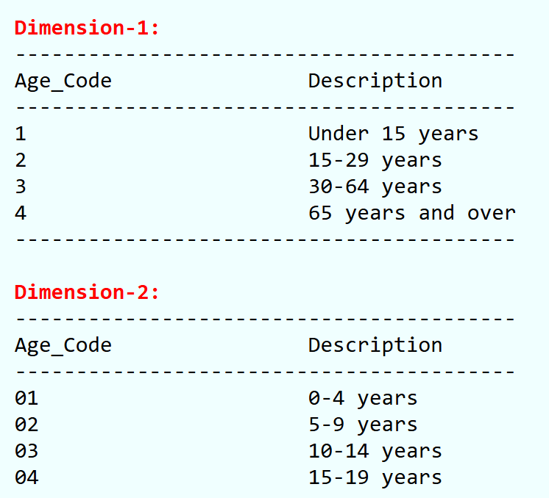
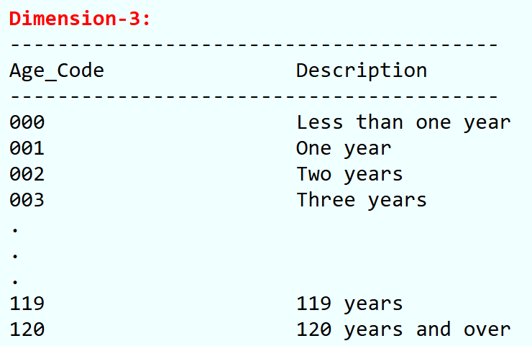
LookupDataset Analysis Ex: Age
Grouping of values (Dimensions) are present in the AGE Lookup data.
Proper mapping is to be done with necessary lookup for accurate results.
The following "AGE" Lookup values are present in different Dimensions:

Slide 9
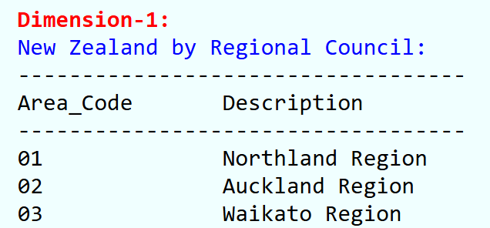
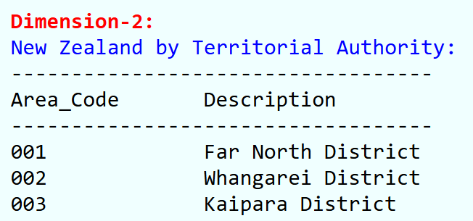
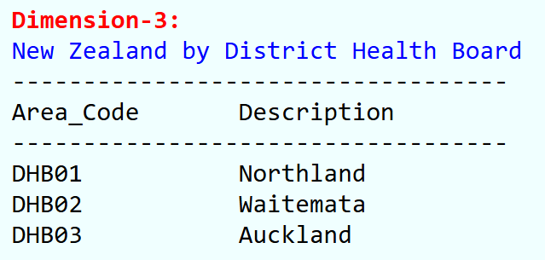
LookupDataset Analysis Ex: Area
Grouping of values (Dimensions) are present in the AREA Lookup data.
The following "AREA" Lookup values are present in different Dimensions:

Slide 10
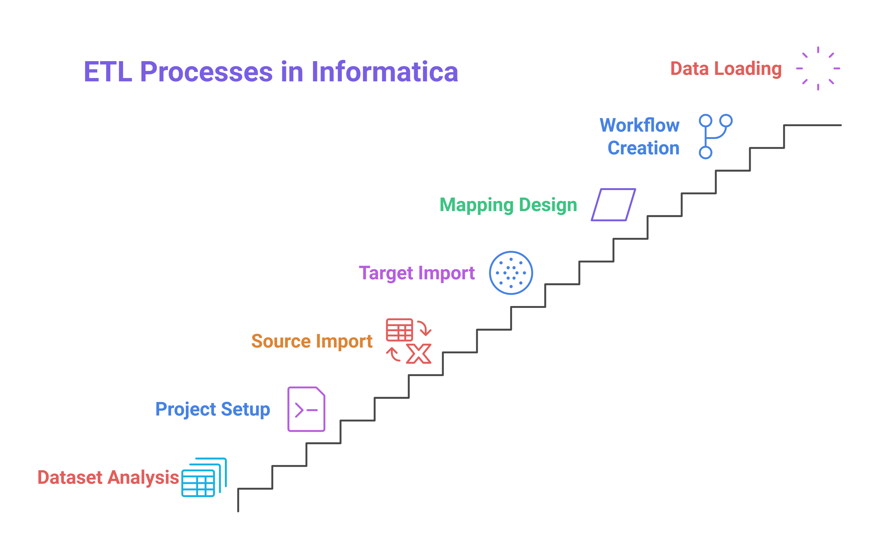
ETL Process in Informatica
Once Data Analysis is done => find out the key observations => Finalized the Solution =>
ETL Processes(Informatica)

Slide 11
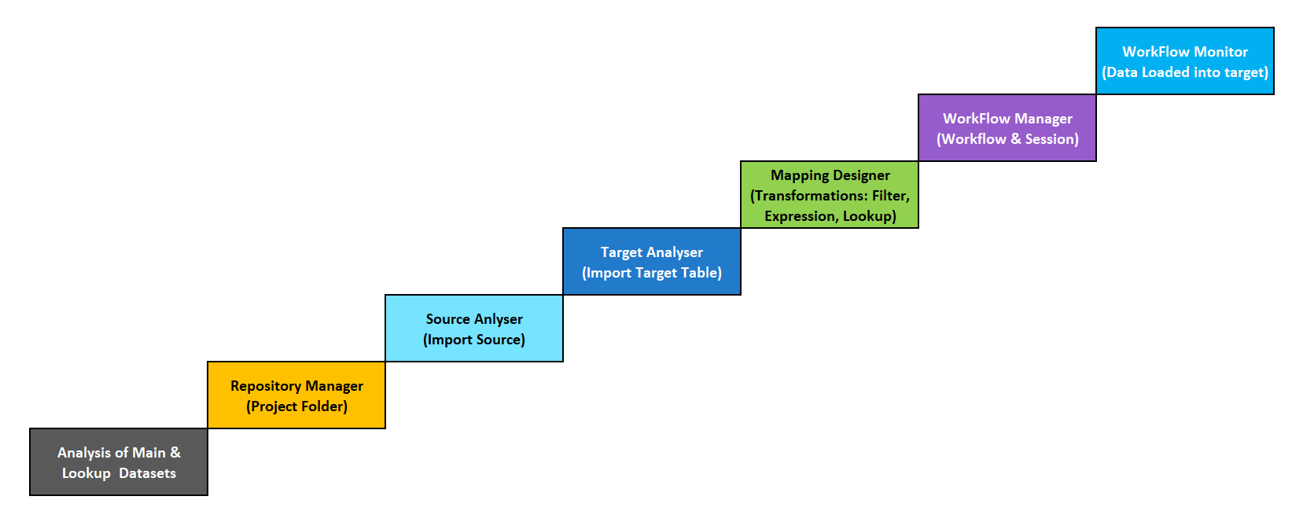
ETL Process in Informatica
Once Data Analysis is done => find out the key observations => Finalized the Solution =>
ETL Processes(Informatica)

Slide 12
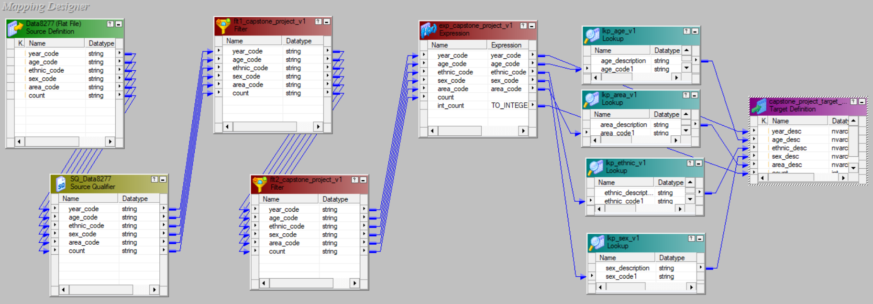
Mapping Designer

Slide 13
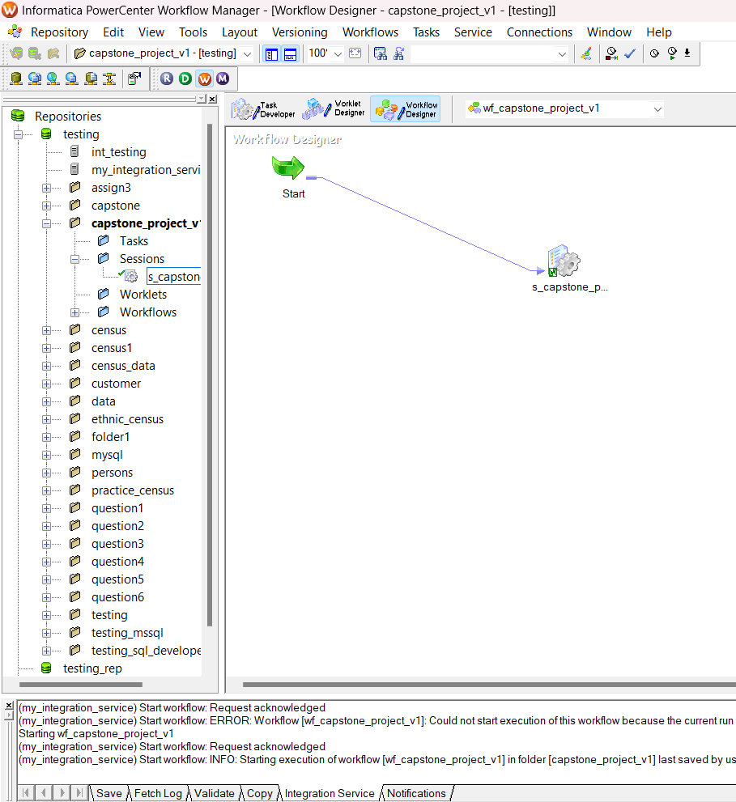
Work Flow Manager

Slide 14
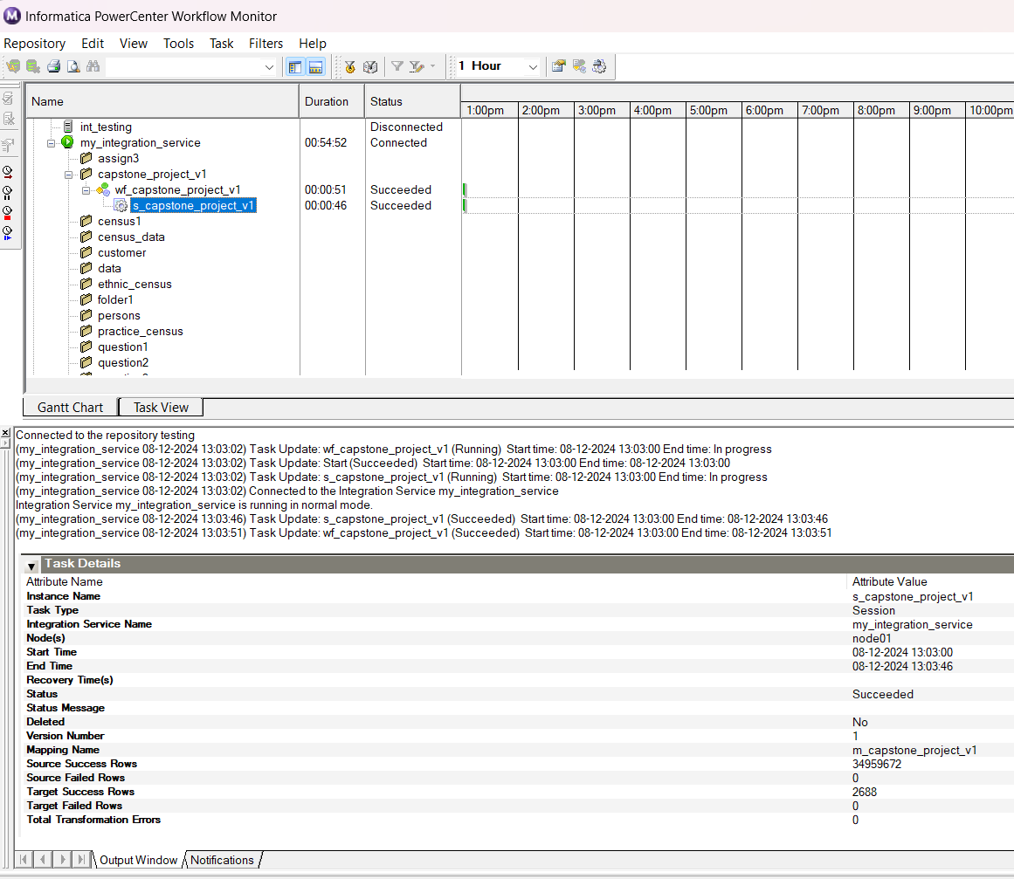
Work Flow Monitor

Slide 15


Generating Visual Analytical Reports
Analytical Bar Charts:
Year Vs Male/Female Population
Year Vs AgeGroup
Year Vs Area
Year Vs Ethnic Groups
Analytical Donut Pie Charts:
Male/Female Ratio
Age Group Ratio
Area Wise
Ethnic Group Wise

Slide 16
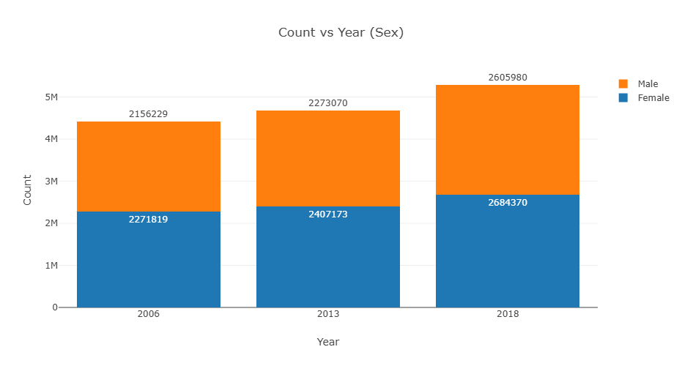
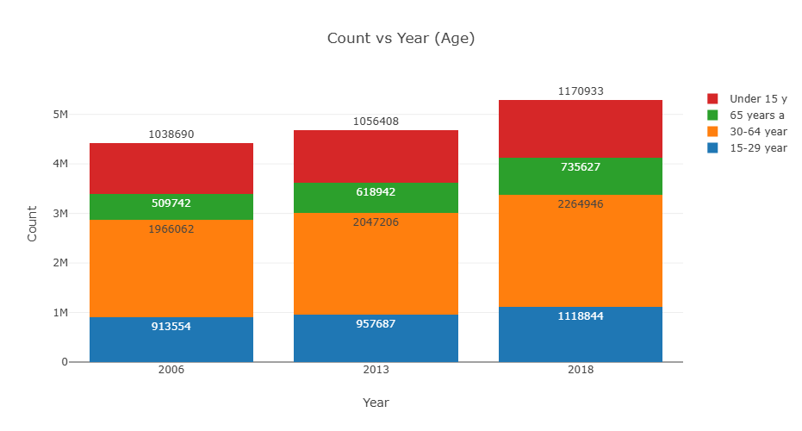
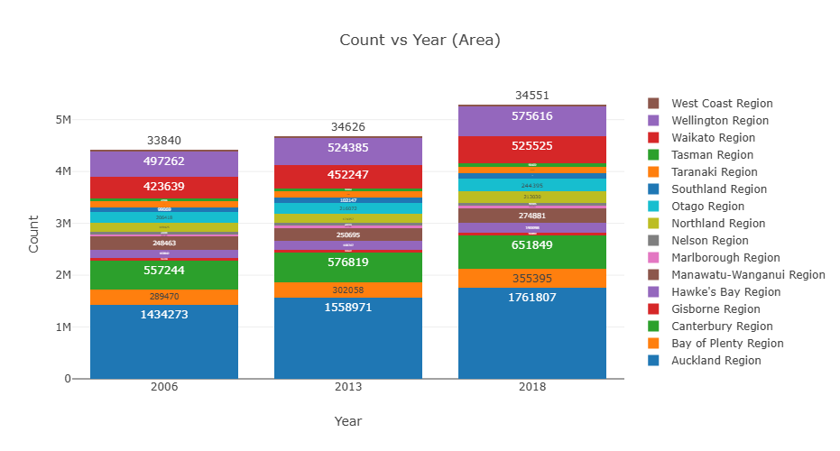
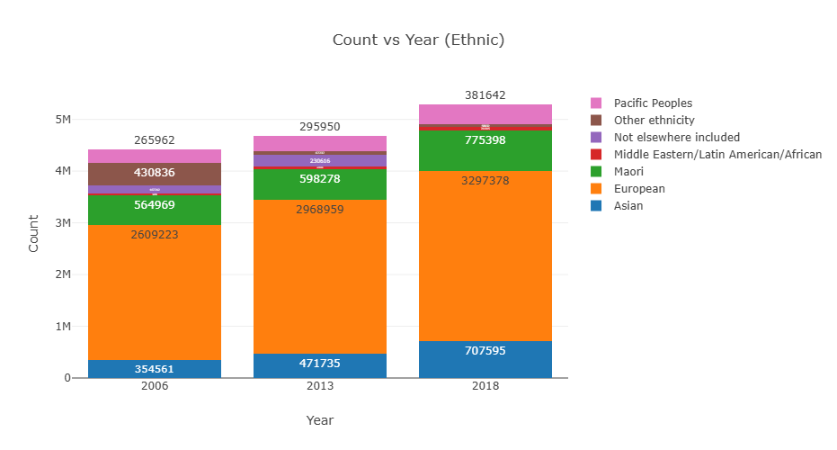
Analytical Bar Charts

Slide 17
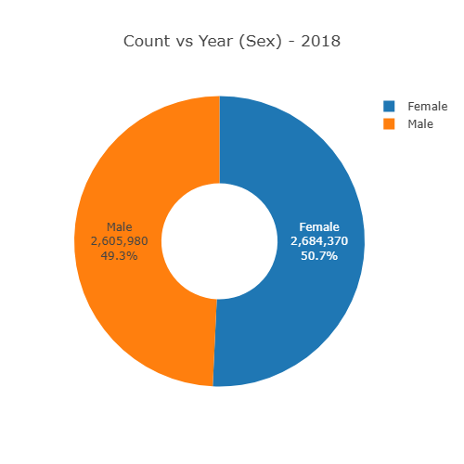
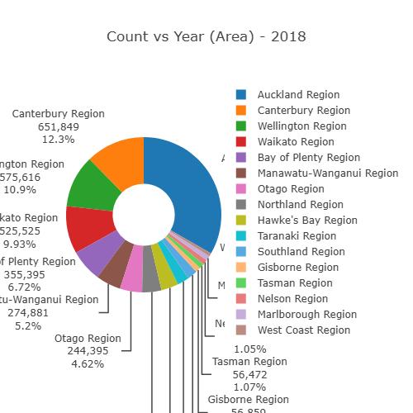
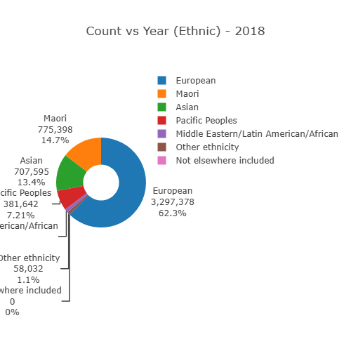
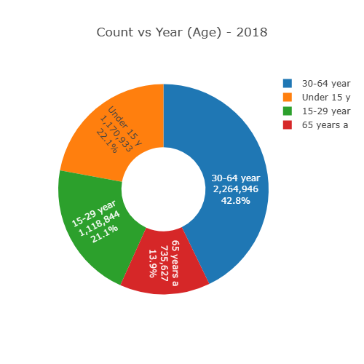
Analytical Donut Pie Charts

Slide 18
Thank You very much
N.B.V.Sindhu
B.Tech CSE (Final Year)
VNRVJIET, Hyderabad
nbvsindhu@gmail.com
Ph: 7989971159

