Slide 1
Code Colosseum
By C&E

Slide 2
Code Colosseum
Purpose
Help people develop their programming abilities through different practice problems
Improve user skills through an online competitive platform
Collaborative platform where users can share solutions and learn from others
Goal statement
Our goal is to creating a web application for real-time competitive programming, where users can either compete with others through different game modes/exercises or practice and develop their programming skills
Users will be able to log onto the platform and be pitted against other users for rank points
There will be different game modes that offer different playing styles and challenges

Slide 3
Contact Information
Aidan Sommer: sommerab@mail.uc.edu
Henock Dinberu: dinberhw@mail.uc.edu
Rukudzo Mushunje: mushunrl@mail.uc.edu
Giovanni: abuaitgi@ucmail.uc.edu

Slide 4
Abstract
Our goal is to create a platform where people with a similar goal can improve their programming skills. The platform aims to help people program across various skill levels by providing a range of different questions. Additionally, players will have a choice between competing in a timed ranked mode or a casual practice mode. In each mode, questions are based on a central topic and require solving a specific challenge. Once the question is solved, the grader will be ran on the users solution. Users will then be able to increase their ranked rating as well as practice and improve their skills by utilizing the various game modes available.

Slide 5
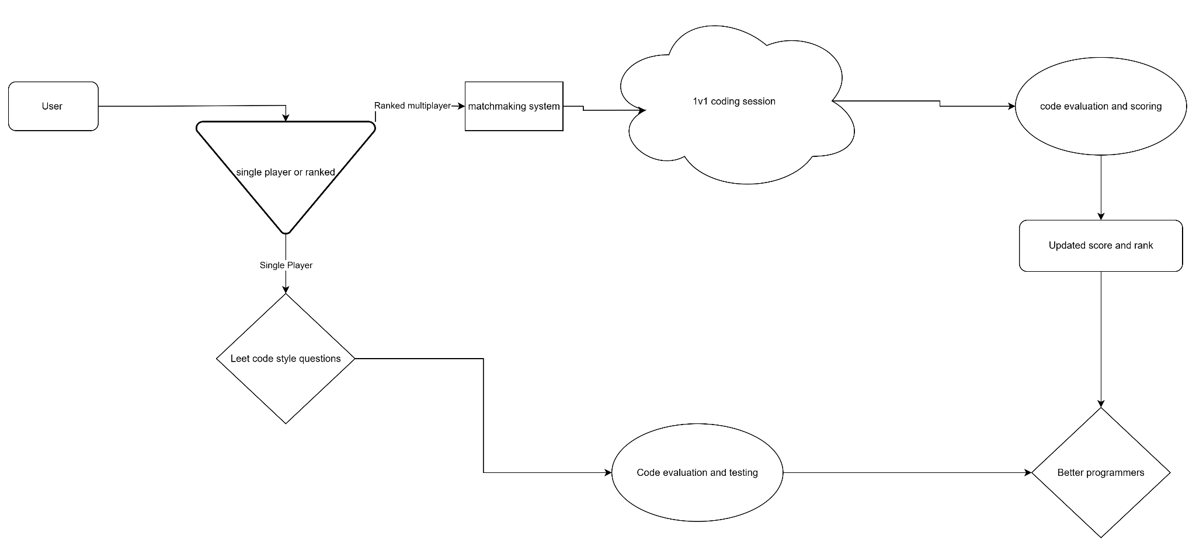
User story & design diagram
As a college student looking to get my first internship this summer, I wanted to refine my problem-solving and coding abilities. I have a very competitive nature, so being able to compete with people in a real-time scenarios would be a major plus. I want to be able to practice programming problems in both a competitive and a more relaxed environment.

Slide 6
Project Constraints
Economic:
Minimal constraints; software focus avoids high material/R&D costs.
Leverages free-tier cloud services, minimizing upfront expenses.
Professional:
Core goal: A platform for developers to sharpen skills for emerging technologies (e.g., AI) and career growth.
Supports users from beginner to advanced levels in preparing for technical interviews and.
Environmental:
No direct environmental impact (software-based).
Potential indirect impact from cloud computing energy usage if the platform scales significantly.
Cultural & Social:
Emphasizes intuitive, inclusive design to be welcoming and accessible to diverse global users.
Aims to foster a supportive community of lifelong learners.

Slide 7
Project Progress
Finished
Chosen our frontend and backend frameworks
Selected core infrastructure including database and dependencies
Finalized user workflows and overall application workflows
Todo:
Sketching out different designs and flows for our application
Deciding on logo design and website colors
Finalizing user experience and smithing problem questions

Slide 8
Expected Accomplishments
A fully functional and hosted web application
Have a range of different problems of various difficulties
An optimized and secure way to run and test code submitted by users
A working demo for users to connect to and challenge each other in real-time
Two separate modes for online head-to-head and practice

Slide 9
Division of Work
Henock Dinberu
  Full-stack Development
Aidan Sommer
  Full-Stack Development
Rukudzo Mushunje
  Database Management
  Application Design / Testing

Slide 10
Demo Expectations
A functional and published website where users can compete
Live demonstration that shows application usage in real time
Demonstrate both head-to-head and practice scenarios

