Slide 1

VERGE: AI-powered eVolution towards opEn and secuRe edGe architEctures
Grant Agreement 101096034
WP5 Demonstration 2.3:
“Smart micro-orchestration in disaggregated softwarized RAN elements”

Slide 2
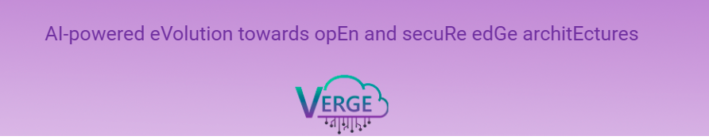
Acknowledgement
This video is based on the work conducted by the VERGE project, which has received funding from the Smart Networks and Services Joint Undertaking (SNS JU) under the European Union’s Horizon Europe research and innovation programme under Grant Agreement No 101096034.
https://www.verge-project.eu/
Views and opinions expressed are however those of the author only and do not necessarily reflect those of the European Union. Neither the European Union nor the granting authority can be held responsible for them.
UK participants in VERGE are supported by UKRI grant numbers 10071211 (Samsung Electronics (UK) Limited) and 10061781 (King’s College London).

