Slide 1
Reliability-based Seismic Design

Slide 2








The Current Approach: Hazard-based Design
Single Return Period
Reduced Inelastic Spectrum
Analyse and design
$$H(im)$$
$$S_{a}$$
$$F_{b}=S_{d}\left(T_{1}\right)∙m∙λ$$
$$q$$
$$R_{d}≥E_{d}$$
Performance Objective
$$S_{d}(T_{1})$$
$$IM$$
$$T$$
Ignores the rest of the hazard curve
Uses fixed behaviour factors within a building typology
No consideration of the variability of ground motion characteristics on the collapse capacity of the structure
Non-uniform Level of Safety

Slide 3



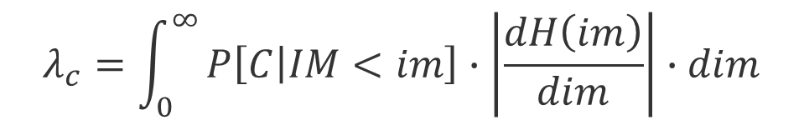





Reliability-based Verification: EC8 Annex F
$$λ_{c}=\int_{0}^{∞}{P\left[C | IM<im\right]∙\left|\frac{dH\left(im\right)}{dim}\right|∙dim}$$
$$λ_{c}≤λ_{c,t}$$
Performance Objective
Capacity / Fragility
Demand / Hazard
$$P[C]$$
$$f(θ_{c},β_{c})$$
$$H(im)$$
1st Order
Assumptions:
$$f\left(k_{0},k_{1}\right)$$
Log-normal fragility curve
Log-linear hazard curve
$$IM$$
$$IM$$
$$λ_{c}=k_{0}∙θ_{c}^{−k_{1}}∙\exp\left[0,5∙k_{1}^{2}∙β_{c}^{2}\right]$$
1st Order Approximation:
Cornell (1996)

Slide 4
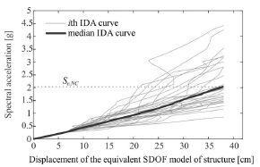
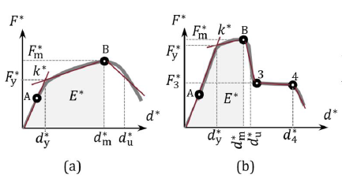
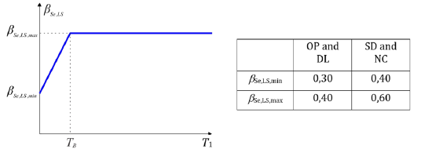




Reliability-based Verification: EC8 Annex F
Target Collapse Capacity:
Median Collapse Capacity, $θ_{c}$:
SDOF Idealisation + IDA
$$λ_{c,t}=2×{10}^{−4}$$
$$θ_{c}$$
Fragility Curve Dispersion, $β_{c}$:
A verification procedure.
SDOF simplification
Very iterative
Not „designer-friendly“
prEN 19988-1-1, 2022; Žižimond and Dolšek, 2019
Notes:
Gebäude muss bemessen worden sein

Slide 5
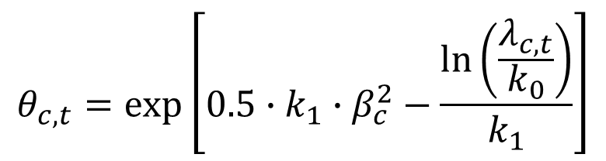

Reliability-based Design
The required collapse capacity
Target reliability
$$θ_{c,t}=\exp\left[0.5∙k_{1}∙β_{c}^{2}−\frac{\ln\left(\frac{λ_{c,t}}{k_{0}}\right)}{k_{1}}\right]$$
$$λ_{LS}=k_{0}∙θ_{LS}^{−k_{1}}∙\exp\left[0,5∙k_{1}^{2}∙β_{LS}^{2}\right]$$
Notes:
This equation forms the basis of all simplified risk-based design methods.

Slide 6

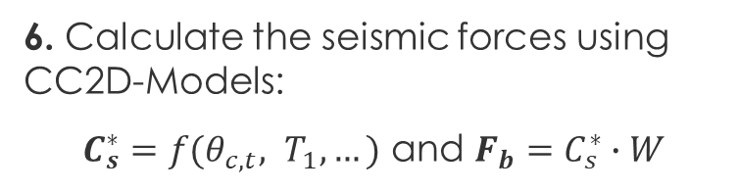

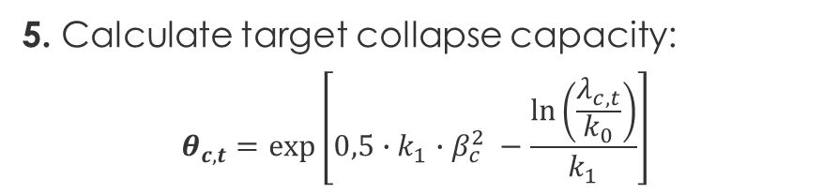


A Reliability-based Design Procedure
1. Define safety level: $λ_{c,t}$
7. Design structure and check period
END
2. Estimate period: $T_{1}$
6. Calculate the seismic forces using CC2D-Models:
$C_{s}^{∗}=f(θ_{c,t}, T_{1}, …)$ and $F_{b}=C_{s}^{∗}∙W$
3. Define hazard: $k_{0}$, $k_{1}$
5. Calculate target collapse capacity:
$$θ_{c,t}=\exp\left[0,5∙k_{1}∙β_{c}^{2} −\frac{\ln\left(\frac{λ_{c,t}}{k_{0}}\right)}{k_{1}}\right]$$
4. Estimate dispersion: $β_{c}$
based on Shahnazaryan and O‘Reilly (2021), Žižmond and Dolšek (2019)

Slide 7

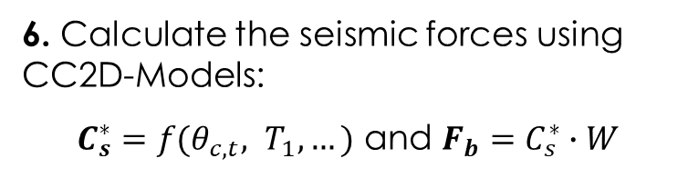



CC2D-Models in a reliability-based Design Procedure
1. Define safety level: $λ_{c,t}$
Collapse capacity to design force models (CC2D-Models): models that define the relationship between the collapse capacity and design force of a structure.
NEEDED:
7. Design structure and check period
END
2. Estimate period: $T_{1}$
6. Calculate the seismic forces using CC2D-Models:
$C_{s}^{∗}=f(θ_{c,t}, T_{1}, …)$ and $F_{b}=C_{s}^{∗}∙W$
3. Define hazard: $k_{0}$, $k_{1}$
5. Calculate target collapse capacity:
$$θ_{c,t}=\exp\left[0,5∙k_{1}∙β_{c}^{2} −\frac{\ln\left(\frac{λ_{c,t}}{k_{0}}\right)}{k_{1}}\right]$$
4. Estimate dispersion: $β_{c}$
based on Shahnazaryan and O‘Reilly (2021), Žižmond and Dolšek (2019)

Slide 8
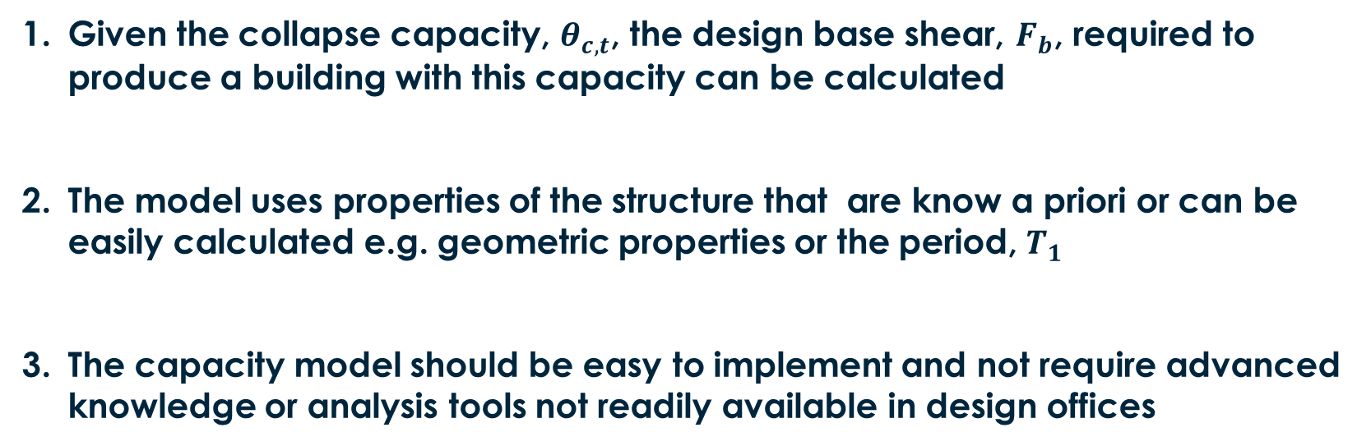
Requirements for the CC2D-Model
Given the collapse capacity, $θ_{c,t}$, the design base shear, $F_{b}$, required to produce a building with this capacity can be calculated
The model uses properties of the structure that are know a priori or can be easily calculated e.g. geometric properties or the period, $T_{1}$
The capacity model should be easy to implement and not require advanced knowledge or analysis tools not readily available in design offices
Notes:
A disadvantage of this proposed method is that it is quite dependent on the building geometries used to derive the relationships.
This is in my opinion a trade off between a method that is accurate and easy to use vs. A procedure that is more generally applicable but complexer to use

Slide 9

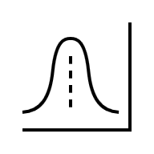


Factors Influencing CC2D-models
Structural System
Site Conditions
Soil properties, tectonic region, seismicity, …
Modelling
Components and Materials
Ground Motion Selection
Hazard consistency, scaling, …
Analysis Method
Non-linear dynamic/static,
uncertainties, …
Intensity Measure
SA(T1), PGA, AvgSA, …

Slide 10
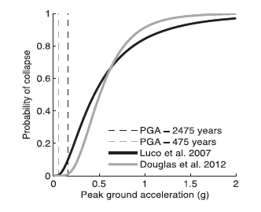






Existing CC2D-Models / Procedures
Risk-targeted seismic maps Luco et al. 2007 (USA), Douglas et al. 2012 (FRA), Silva et al 2016 (EU)
Fragility curves anchored by a defined $P_{C}$at a specific hazard level
Fixed $β_{c}$ for all buildings
$$IM_{des}$$
$$β_{c}=0.5$$
$$β_{c}=0.8$$
$$IM_{des}=θ_{c}∙exp⁡[−Φ^{−1}\left(P_{C|{IM}_{des}}\right)∙β_{c}]$$
0.1
0.00001
$$θ_{c}$$
Silva et al. 2016

Slide 11
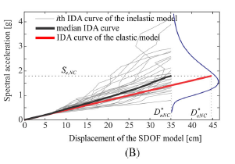
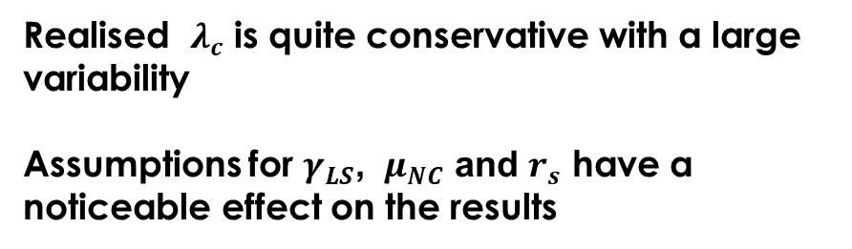





Existing CC2D-Models / Procedures
Risk-targeted seismic action Žižimond and Dolšek, 2019
A type of risk-targeted behaviour factor
Assume $γ_{LS}$, $μ_{NC}$ and $r_{s}$
$$S_{d}=\frac{θ_{C}}{γ_{LS}∙r_{NC}}$$
$$r_{NC}=\frac{μ_{NC}}{C_{1}}∙r_{s}$$
SDOF-IDA
Realised $λ_{c}$ is quite conservative with a large variability
Assumptions for $γ_{LS}$, $μ_{NC}$ and $r_{s}$ have a noticeable effect on the results
$$μ_{NC}$$
$$C_{1}$$

Slide 12
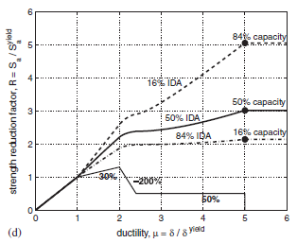








Existing CC2D-Models / Procedures
Integrated Performance-based design Shahnazaryan et al. (2021)
Uses SPO2IDA to predict $θ_{c}$ based on the pushover curve
Good estimates of collapse capacity
Only works well one-way
Iteratively change the SPO-curve until $θ_{c}=θ_{c,t}$
$$θ_{c}$$
Design the building so that it matches the idealised pushover curve
$$F_{y}$$
$$F_{c}$$
$$K_{3}$$
$$K_{1}$$
$$K_{2}$$
$$R_{R}$$
Vamvatsikos and Cornell, 2006

Slide 13
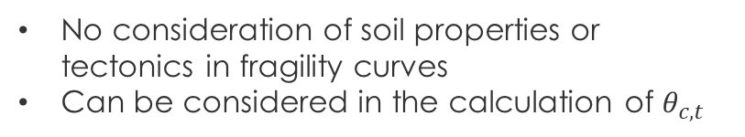
Summary of the Review
All structural typologies can be accommodated
RC structures have been used for the verification of the methods
No consideration of soil properties or tectonics in fragility curves
Can be considered in the calculation of $θ_{c,t}$
No explicit consideration of modelling or material uncertainties.
Could be incorporated in all methods
Static record sets are used (not site specific)
User must select own records
Generally, IDA is used
Nonlinear SDOF approximation
Generally, building specific
Primarily PGA or SA(T1).
More efficient predictors have not yet been considered e.g. AvgSA
Use a priori Information? No. Trial and error
No Complex techniques? SDOF-IDA, record selection, matching pushover curves
No single procedure fits the bill! → We need to derive our own

Slide 14
Research Direction:
Development of a framework for the consistent derivation of the CC2D-Models
Derivation of CC2D-Models for steel CBF structures
Characterisation of the influence of site dependence on CC2D-Models in a European Context
Evaluation of the significance of modelling and material uncertainty in the development of CC2D-Models for steel CBF structures
Verification of the effectiveness of the design procedure at achieving the desired reliability level

Slide 15
Summary
Motivation:
There is currently no CC2D-model for reliability-based design that is suitable for implementation in a design standard, easy to use and incorporates the effects of material/modelling uncertainties and site dependence.
Solution:
Characterise the influence of site properties on the fragility curve estimates using SDOF models
Derive new CC2D-Models for steel concentrically braced frames using detailed MDOF models
Investigate the importance of material and modelling uncertainties on fragility curves estimates of MDOF systems
Test the effectiveness of the proposed reliability-based design method

Slide 16
Work Packages

Slide 17
Research Direction:
Development of a framework for the consistent derivation of the CC2D-Models
Derivation of CC2D-Models for steel CBF structures
Characterisation of the influence of site dependence on CC2D-Models in a European Context
Evaluation of the significance of modelling and material uncertainty in the development of CC2D-Models for steel CBF structures
Verification of the effectiveness of the design procedure at achieving the desired reliability level

Slide 18
Work-Packages
WP 00 – Evaluation of existing fragility curve models
WP 01 – Site-dependence of fragility curve parameters
WP 02 – Development of CC2D-Models for steel CBF archetype structures + Framework
WP 03 – The influence of modelling and material uncertainty on CD-Models for steel CBFs
WP 04 – Verification of the reliability-based design procedure
WP 05 – Publications
WP 06 – Dissertation

Slide 19
WP00 – Evaluation of existing fragility curve models
Motivation:
Many collapse fragility curves for a large range of structures have been published in the literature.
Research Question:
Are there enough fragility curves of sufficient quality in the literature to enable the derivation of suitable CC2D-Models for use in reliability-based design?
Status: Completed

Slide 20
WP01 – Site-dependence of fragility curve parameters
Motivation:
It has been shown that the dispersion of fragility curves is influenced by the contribution of different tectonic source types to the site hazard. Europe contains many different tectonic source types (active shallow crust, subduction interface, subduction in-slab, …) and the hazard at many location is influenced by two or more of these source types.
Research Questions:
How are the fragility curve parameters affected by the location of the structure within Europe?
Can variations in the fragility curves be modelled in a predictable way to allow incorporation in reliability-based design?
Status: Started – active

Slide 21
WP02 – CC2D-Models for steel CBF archetype structures
Motivation:
There is currently no CC2D-model for reliability-based design that is accurate, suitable for implementation in a design standard and user friendly for engineering practitioners.
Steel structures have generally been neglected in the development of capacity model for risk-based design
Research Question:
How can the relationship between the collapse capacity and the design force of steel CBFs be quantified and modelled?
Status: Started – paused

Slide 22
WP03 – Modelling and Material Uncertainty
Motivation:
Modelling / material parameters based on statistical regression are associated with an inherent uncertainty. The variation of these parameters can have a noticeable effect on the response of the structure and therefore the fragility curve parameters
Research Questions:
To what extent do modelling and material uncertainties affect the fragility curve parameters of steel CBFs?
Is the effect significant enough to require incorporation into the reliability-based design procedure?
How can this effect be best incorporated into the design procedure?
Status: Started – paused

Slide 23
WP04 – Verification of the Design Procedure
Motivation:
To be able to promote this design method as a viable alternative to hazard-based design and other risk-based design methods we must be able to show that it produces adequate results
Research Questions:
How do the actual collapse capacities of structures designed using reliability-based design and the CD-Models compare to the target values?
What parameters or components of the design procedure influence the accuracy the most?
Status: Not Started

Slide 24
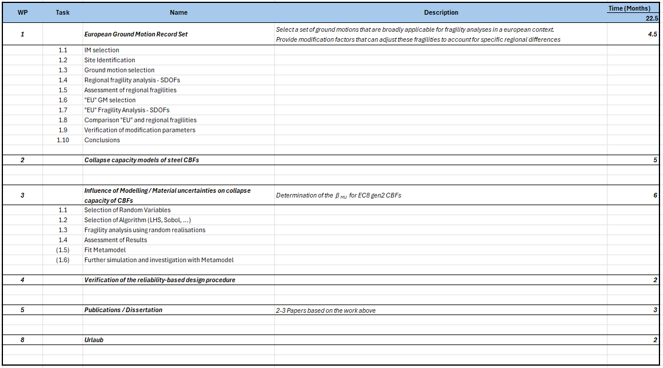
Work-Packages
2 Years
12/25 – 04/26
05/26 – 11/26
12/26 – 05/27
06/26 – 08/27
08/26 – 10/27

Slide 25
WP00 – Evaluation of existing fragility curve models
Motivation:
Many collapse fragility curves for a large range of structures have been published in the literature.
Research Question:
Are there enough fragility curves of sufficient quality in the literature to enable the derivation of suitable CC2D-Models for use in reliability-based design?
Status: Completed

Slide 26
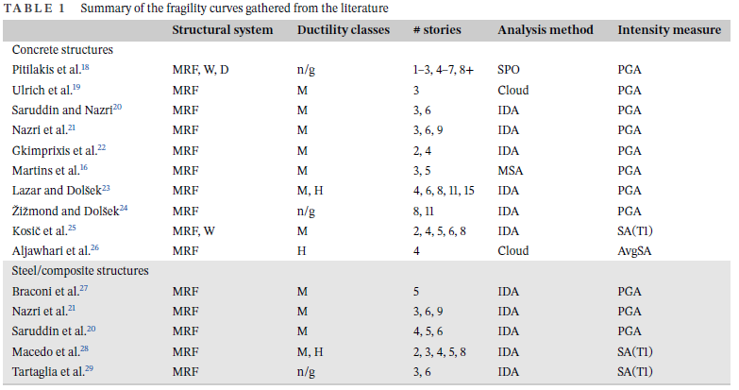
WP00 – Evaluation of existing fragility curve models
Create a database of fragility curves from the literature
  EC8 “new” structures
  Must contain information on the design parameters
The Numbers:
15 Studies
136 RC MRFs
21 RC Wall/Dual systems
33 Steel MRFS

Slide 27
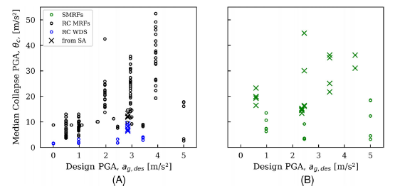
WP00 – Evaluation of existing fragility curve models
2. Inspection of the Database
Reinforced Concrete
Steel

Slide 28
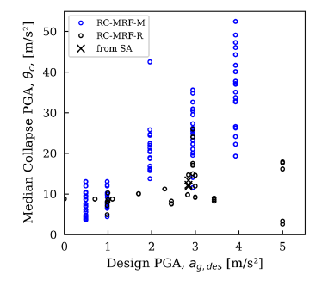
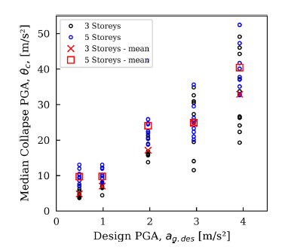
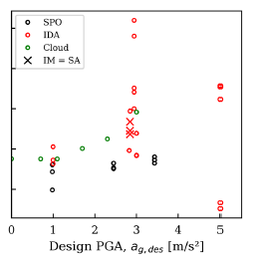
WP00 – Evaluation of existing fragility curve models
Different Studies
No. of Stories
Analysis Method

Slide 29
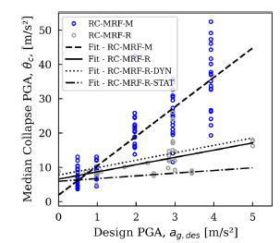
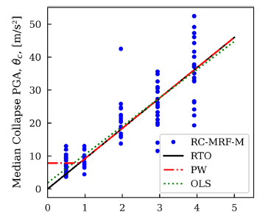
WP00 – Evaluation of existing fragility curve models
3. Regression Analysis
Inherent Capacity

Slide 30
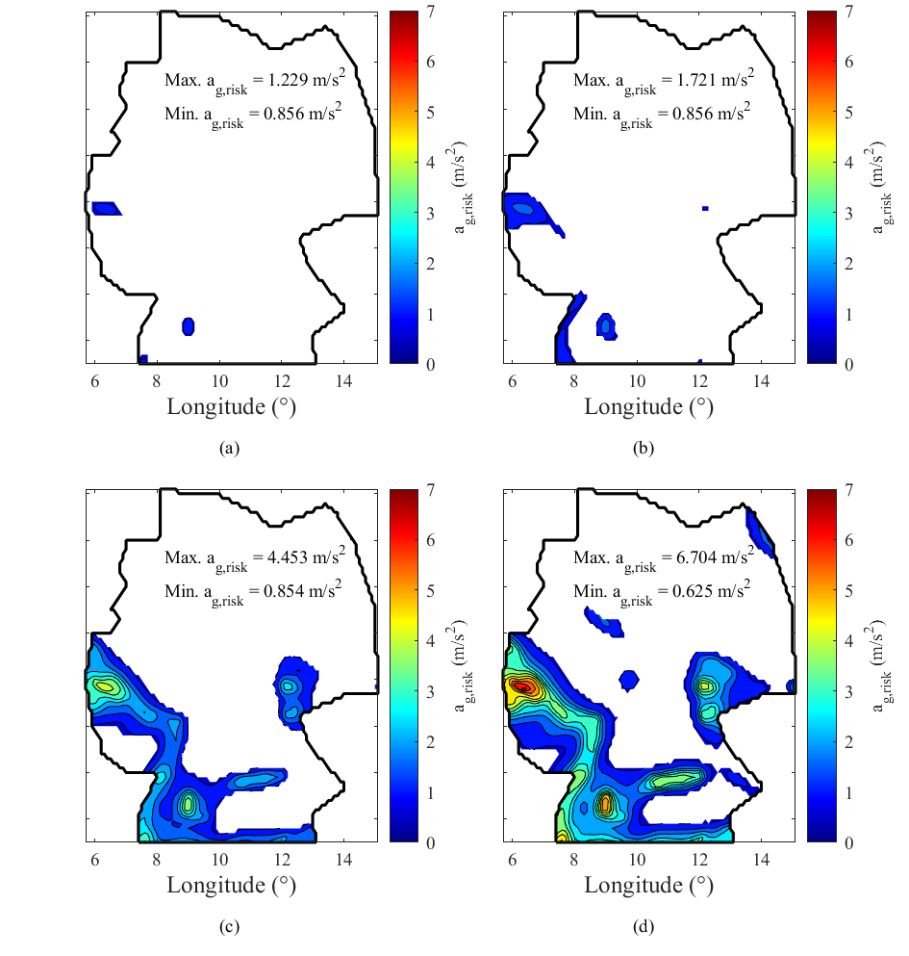





WP00 – Evaluation of existing fragility curve models
4. Application to risk-targeted seismic demand maps
  Piecewise model: $θ_{c}=\max\left(9.19∙a_{g};7,84\right)$ and $β_{c}=0,7$
$$λ_{t}=1∙{10}^{−4}$$
$$λ_{t}=5∙{10}^{−5}$$
$$λ_{t}=1∙{10}^{−5}$$
$$λ_{t}=5∙{10}^{−6}$$
White = No Seismic Design
Seismic region similar to EC8/NA
Seismic region larger than EC8/NA

Slide 31
WP00 – Evaluation of existing fragility curve models
Summary
There is significant variability in the relationship between collapse capacity and design force for EC8 structures based on data obtained from the literature
Using data from multiple studies that don’t use a consistent analysis framework leads to large variability and discrepancies
RC MRFs are well represented. RC-Wall systems and steel structures are not
No. There is not sufficient data of sufficient quality.
We must generate our own fragility curves

Slide 32
WP01 – Site-dependence of fragility curve parameters
Motivation:
It has been shown that the dispersion of fragility curves is influenced by the contribution of different tectonic source types to the site hazard. Europe contains many different tectonic source types (active shallow crust, subduction interface, subduction in-slab, …) and the hazard at many location is influenced by two or more of these source types.
Research Questions:
How are the fragility curve parameters affected by the location of the structure within Europe?
Can variations in the fragility curves be modelled in a predictable way to allow incorporation in reliability-based design?
Status: Started – active

Slide 33
WP01 – Site-dependence of fragility curve parameters
Overview of the Methodology:
For a many sites across Europe select a set of records that is consistent with the hazard and tectonic source characteristics
For each site perform IDA on a set of representative SDOF systems to derive fragility curves
Assess the results based on the hazard and tectonic characteristics as well as the SDOF oscillator properties.
Derive models for the observed differences in the fragility curve parameters relative to a “reference” model

Slide 34
WP01 – Site-dependence of fragility curve parameters
1. Intensity Measure Selection
Average spectral acceleration Avg.SA([T_{i}, T_{j}])
  An efficient predictor of Collapse and peak floor accelerations
  AvgSA(0,3): SA[0, 0.33, 0.66, 0.99, 1.33, 1.67, 2.0, 2.33, 2.66, 3.00] → T1 up to 1s
  AvgSA(0,6): SA[0, 0.66, 1.33, 2.00, 2.67, 3.34, 4.00, 4.67, 5.33, 6.00] → T1 up to 2s
Other IMs for GM-Selection
  Significant Duration (5-95%) → important for degrading systems
  Spectral acceleration → ensures compatibility with spectral shape
    30 periods from 0.01s und 10s

Slide 35
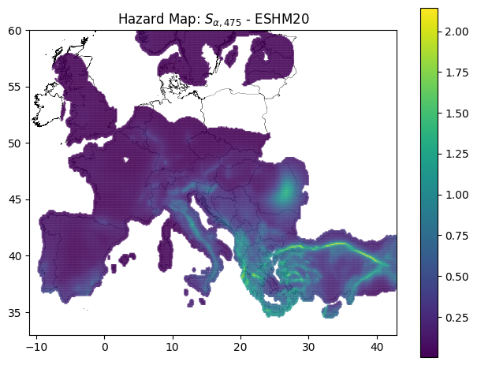
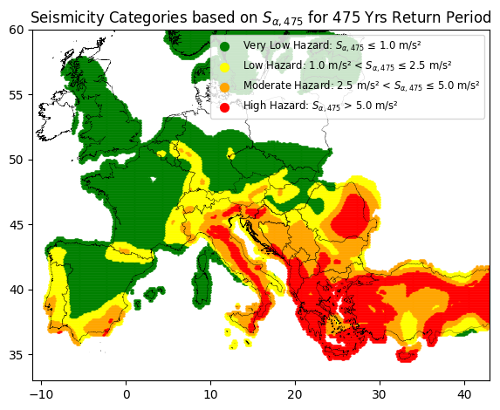
WP01 – Site-dependence of fragility curve parameters
2. Site Selection
Seismicity Level → Low/mod and High

Slide 36
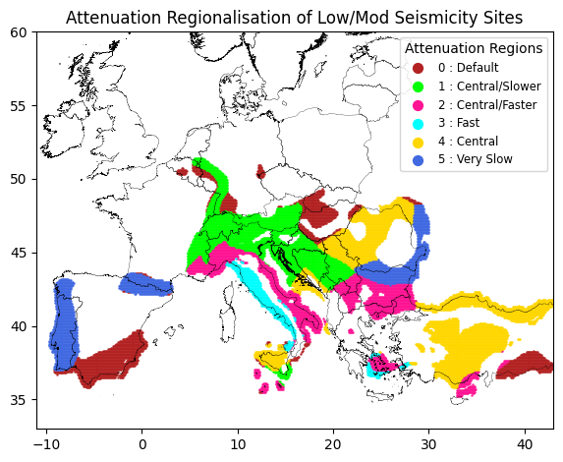
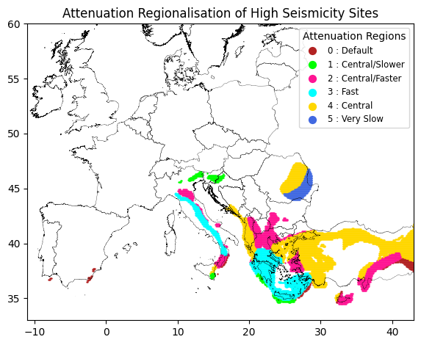
WP01 – Site-dependence of fragility curve parameters
2. Site Selection
Attenuation of ground motion (based on ESHM20)

Slide 37
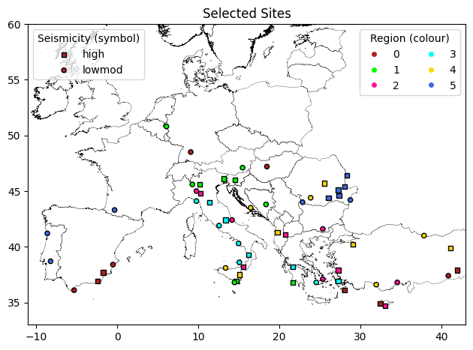
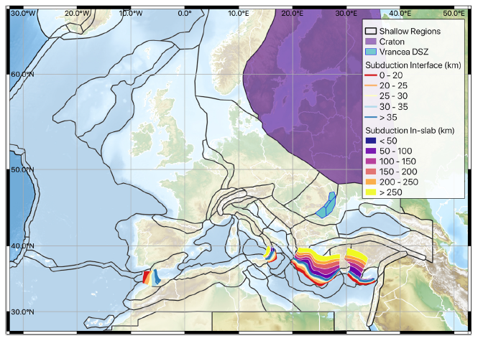
WP01 – Site-dependence of fragility curve parameters
2. Site Selection
60 Sites → 30 pro seismicity level, 5 per attenuation region
Well distributed relative to the different tectonic sources

Slide 38
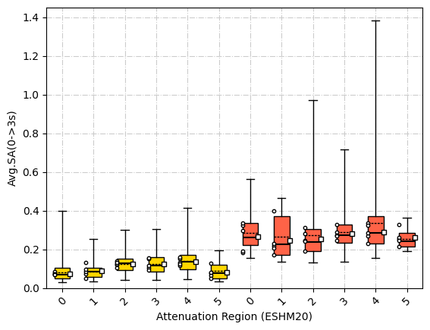
WP01 – Site-dependence of fragility curve parameters
2. Site Selection
Distribution of Avg.SA within the regions
Average of selected sites
Selected sites

Slide 39
WP01 – Site-dependence of fragility curve parameters
4. Ground Motion Selection
GMs from the ESM database + extra subduction records from Kik-Net/NGA-Subduction
Derivation of new IM-correlation relationships for the hazard assessment
Generalised conditional intensity measure selection
5. Statistical assessment of site hazard disaggregation and selected records
6. Fragility Analysis of SDOF systems
7. Statistical assessment of fragility results and model development
8. Propose a set of “reference” ground motions for the further development of CC2D-models

Slide 40
WP02 – CC2D-Models for steel CBF archetype structures
Motivation:
There is currently no CC2D-model for reliability-based design that is accurate, suitable for implementation in a design standard and user friendly for engineering practitioners.
Steel structures have generally been neglected in the development of capacity model for risk-based design
Research Question:
How can the relationship between the collapse capacity and the design force of steel CBFs be quantified and modelled?
Status: Started – paused

Slide 41
WP02 – CC2D-Models for steel CBF archetype structures
Overview of the Methodology:
Select the design and geometric parameters to be investigated
Design and model a suite of archetype structures according to gen. 2 of EC8
Perform IDA to determine the fragility parameters for each structure
Statistically analyse the results to determine the dominant design parameters and derive a CC2D-Model for steel CBF

Slide 42
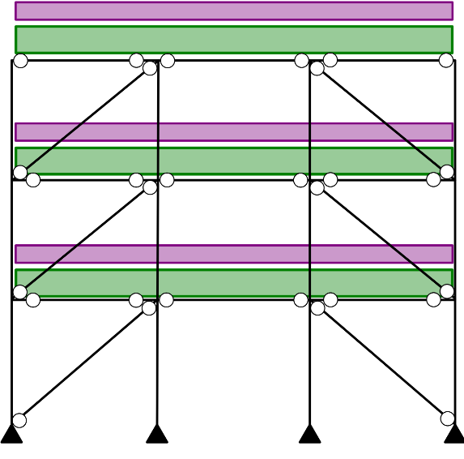

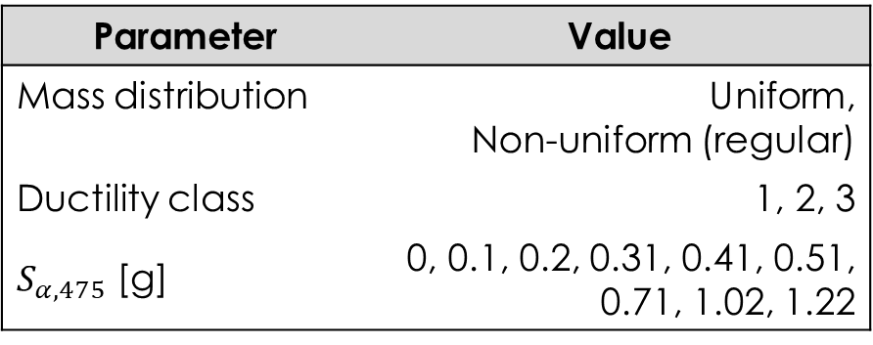



WP02 – CC2D-Models for steel CBF archetype structures
1. Design Parameters
Geometry / Material Parameters
Parameters | Value
No. of storeys | 3, 5, 7
Bay width [m] | 5, 6, 7
Steel Grade | S235, S355
Load Parameters
Parameter | Value
Mass distribution | Uniform, Non-uniform (regular)
Ductility class | 1, 2, 3
$S_{α,475}$ [g] | 0, 0.1, 0.2, 0.31, 0.41, 0.51, 0.71, 1.02, 1.22
$$G=7.5 kPa$$
$$Q=3.0 kPa$$
$S$: $<1000 m;$ $s_{k}=0.85 kPa$
$W$: Zone 1 Category 4
864 Structures!

Slide 43
WP02 – CC2D-Models for steel CBF archetype structures
2. Design Archetype Structures
Design of the structures is automated using Python-based algorithms and a user defined input file (.json format)
EC8 gen. 2 conforming design for:
  Braces
  Beams
  Columns
  Gusset Plates
Produces an output file describing the geometry of the structure (.json format)
Output file can be read by other algorithms for generating nonlinear models of the structures

Slide 44
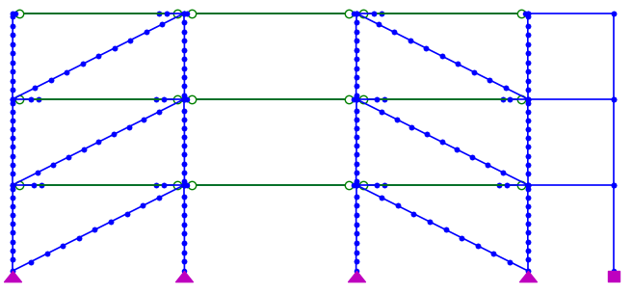
WP02 – CC2D-Models for steel CBF archetype structures
2. Nonlinear Modelling
Based on recommendations of Karamanci and Lignos (2014)
„rigid“ links used to model slab
Elastic beam elements
Mass lumped at nodes
P-Δ column
8 displacement-based fibre elements with corotational geometry and initial out-of-straightness
Pinned-base
Gusset connection

Slide 45
WP02 – CC2D-Models for steel CBF archetype structures
2. Nonlinear Modelling
Based on recommendations of Karamanci and Lignos (2014)
„rigid“ connection for gusset geometry
Rotational spring for flexibility of beam-column connection
Rotational spring for flexibility of beam-splice connection
Rotational spring for in- and out-of-plane gusset flexibility

Slide 46
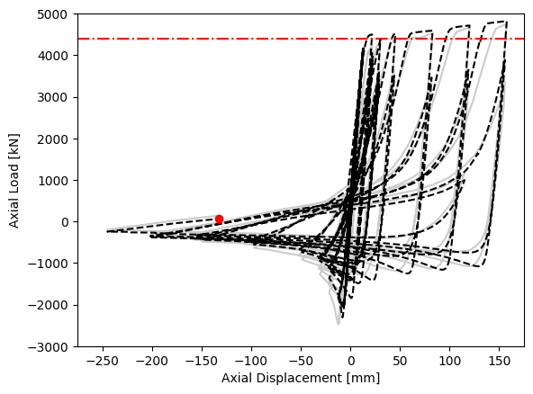
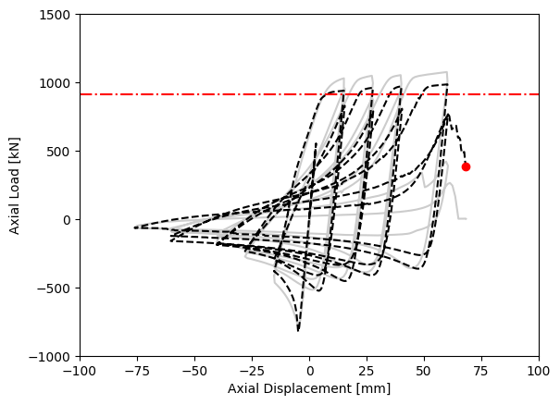
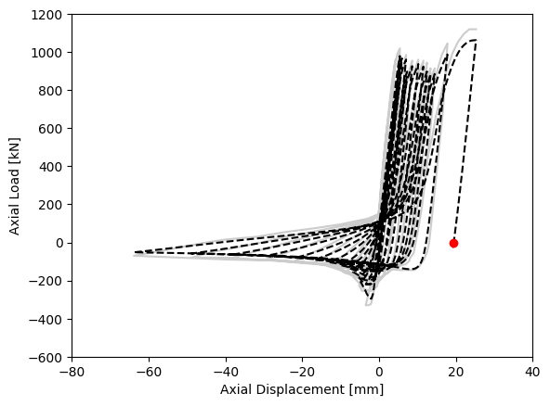
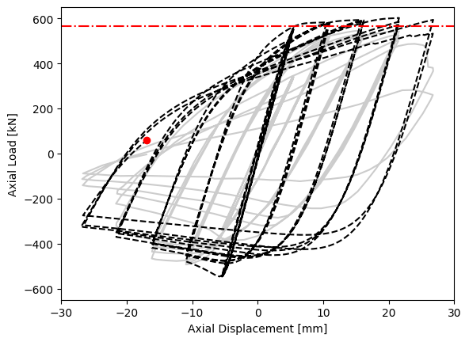




WP02 – CC2D-Models for steel CBF archetype structures
2. Nonlinear Modelling
Verification of brace modelling
$$\frac{KL}{r}=85$$
$$\frac{KL}{r}=63$$
Not so good!
$$\frac{KL}{r}=30$$
$$\frac{KL}{r}=120$$

Slide 47
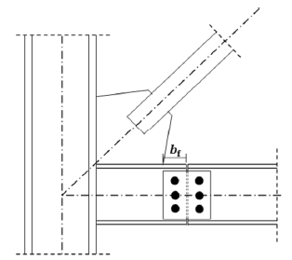
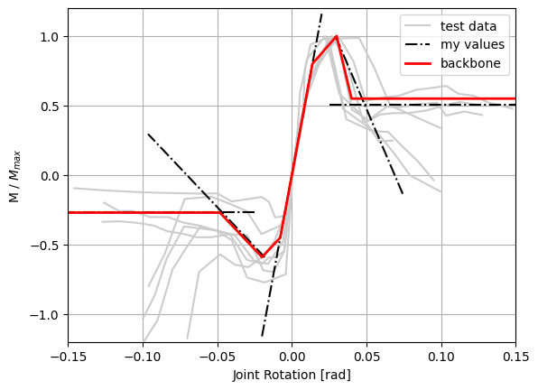

WP02 – CC2D-Models for steel CBF archetype structures
2. Nonlinear Modelling
Beam-Column-Joint Model
Backbone data from Liu und Astenah (2004)
Hysteresis parameters from Karamanci and Lignos (2014)
Function of Mpl
Mpl [kNm]:
325
275
225
125
175
75

Slide 48


WP02 – CC2D-Models for steel CBF archetype structures
2. Nonlinear Modelling
Damping Models
Rayleigh and Modal Damping lead to overdamping due to large changes in period
Solution: use a model that updates each step
Model to Use

Slide 49
WP02 – CC2D-Models for steel CBF archetype structures
3. Incremental Dynamic Analysis
Analysis using OpenseesPy and IDA Algorithms implemented in Python
Algorithms prepared and ready to go
Failure Mechanisms (explicitly modelled)
Buckling / LCF-fracture of columns + braces
Gusset connection failure (bolt shear, block tear out, bearing)
Beam-Splice / Beam-Column connection degradation
4. Calculation of Fragility Curve Parameters
Assessment of different intensity measures (SA(T1), AvgSA(0,3), AvgSA(0,6))
5. Derivation of CC2D-Model

Slide 50
WP03 – Modelling and Material Uncertainty
Motivation:
Modelling / material parameters based on statistical regression are associated with an inherent uncertainty. The variation of these parameters can have a noticeable effect on the response of the structure and therefore the fragility curve parameters
Research Questions:
To what extent do modelling and material uncertainties affect the fragility curve parameters of steel CBFs?
Is the effect significant enough to require incorporation into the reliability-based design procedure?
How can this effect be best incorporated into the design procedure?
Status: Started – paused

Slide 51
WP03 – Modelling and Material Uncertainty
Overview of the Methodology:
Identify the random variables to be considered
Select a subset of “representative” archetype structures
Use a variance reduction technique (Latin hypercube / Sobol sampling) to perform a Monte Carlo style analysis and determine the distribution of fragility parameters due to modelling / material uncertainty
Statistically analyse the results to determine the dominant sources of uncertainty
Perform bootstrap analyses to assess the confidence of the results
(Optional) Fit a meta-model to the fragility data to predict the fragility curves

Slide 52
WP03 – Modelling and Material Uncertainty
1. Random Variables
40-80 variables per model → A Lot!!

Slide 53
WP04 – Verification of the Design Procedure
Motivation:
To be able to promote this design method as a viable alternative to hazard-based design and other risk-based design methods we must be able to show that it produces adequate results
Research Questions:
How do the actual collapse capacities of structures designed using reliability-based design and the CD-Models compare to the target values?
What parameters or components of the design procedure influence the accuracy the most?
Status: Not Started

Slide 54
WP04 – Verification of the Design Procedure
Overview of Methodology:
Select several sites distributed across Europe
Use reliability-based design to design several different steel CBF structures. Consider:
  Different reliability levels
  Modelling/material uncertainty
  Site dependence
  Hazard curve simplification
Assess the collapse risk using site specific Multiple-Stripe Analysis
Compare the collapse risk results
Provide recommendations for a framework for deriving CD-Models and performing reliability-based design

Slide 55
WP05/6 – Publications/Dissertation
Papers / Publications:
Paper | Title / Topic
J1 | Evaluation of existing fragility curves
C1 | Simplified risk-based design of steel structures
J2 | A regionalised model for the site dependence of fragility curve parameters
J3 | IM correlation models for ESHM20 GMMs based on the ESM-database
J4 | Derivation of CC2D-Models for steel CBFs
J5 | The effect of modelling and material uncertainty on the fragility curves of steel CBFs
With GfZ?

Slide 56
Organisatorisches - Promotionsordnung

Slide 57


Organisatorisches – Promotionsordnung
§5 Dissertation
(5) Die Dissertation is in deutscher oder englischer Sprache abzufassen
(8) In der Regel ist die Dissertation als Monographie zu erstellen, aber …
(9) Eine Kumulative Dissertation is unter folgenden Rahmenbedingungen zulässig:

Slide 58

Organisatorisches – Promotionsordnung
§7 Gutachter und Promotionskommission
§8 Begutachtung und Annahme der Dissertation

Slide 59
Organisatorisches – zukünftige Besprechungen

Slide 60
Sonstige Fragen oder Kommentare?

