Slide 1
Final project :KDD2009
Nan Chen ,Xiao Liang

Slide 2
Introduction
based on KDD-Cup 2009, Customer relationship prediction. We chose one of the three tasks, which is to predict the propensity of customers to switch provider (churn). We used the small version of data provided by KDD-Cup, which contains a training data set and a task label file for churn. The training data set is 8.2 Mbytes large and includes 230 variables containing both continuous and discrete data. We did not use the testing data file provided by the website since there is no task label file related to that testing data.

Slide 3
Introduction
Among the 230 variables in the training set, 98 variables are numerical and 50 are discrete. The remaining are empty variables. Thus there are indeed 148 useful variables. There are 50000 objects listed. We mainly used data mining methods learned in this class and we utilized Weka to implement them. The methods that came into our mind at this time include decision tree, Neural Network and Naïve Bayes. Also we applied the principle component analysis to reduce the data dimension and we used some ensemble classifier like Adaboost method to enhance the performance. We used information gain and Chi-Square methods to rank the attributes and achieved a better classification result using the top 5 ranked features.

Slide 4
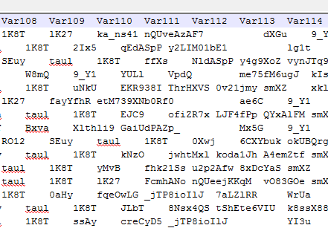
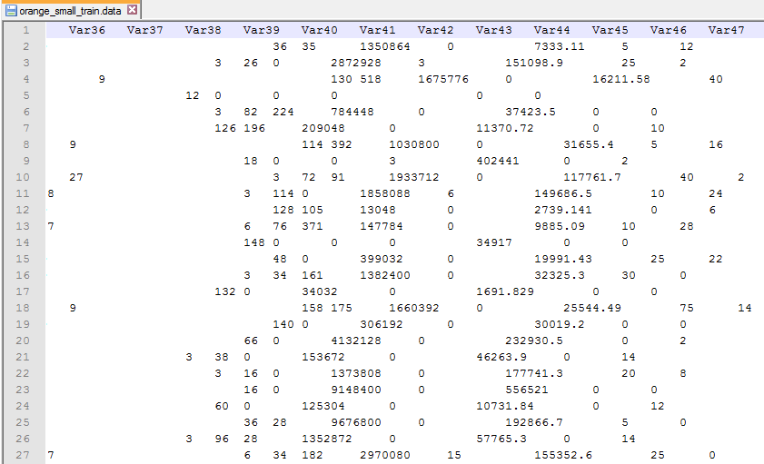
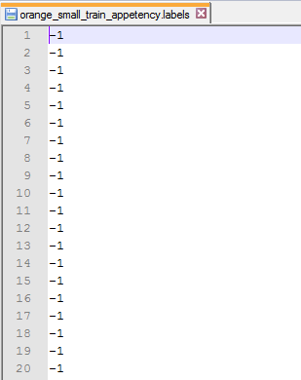
Missing values before treat
98 variables are numerical and 50 are discrete. The remaining are empty variables. We further reduce the number of attributes to 77

Slide 5
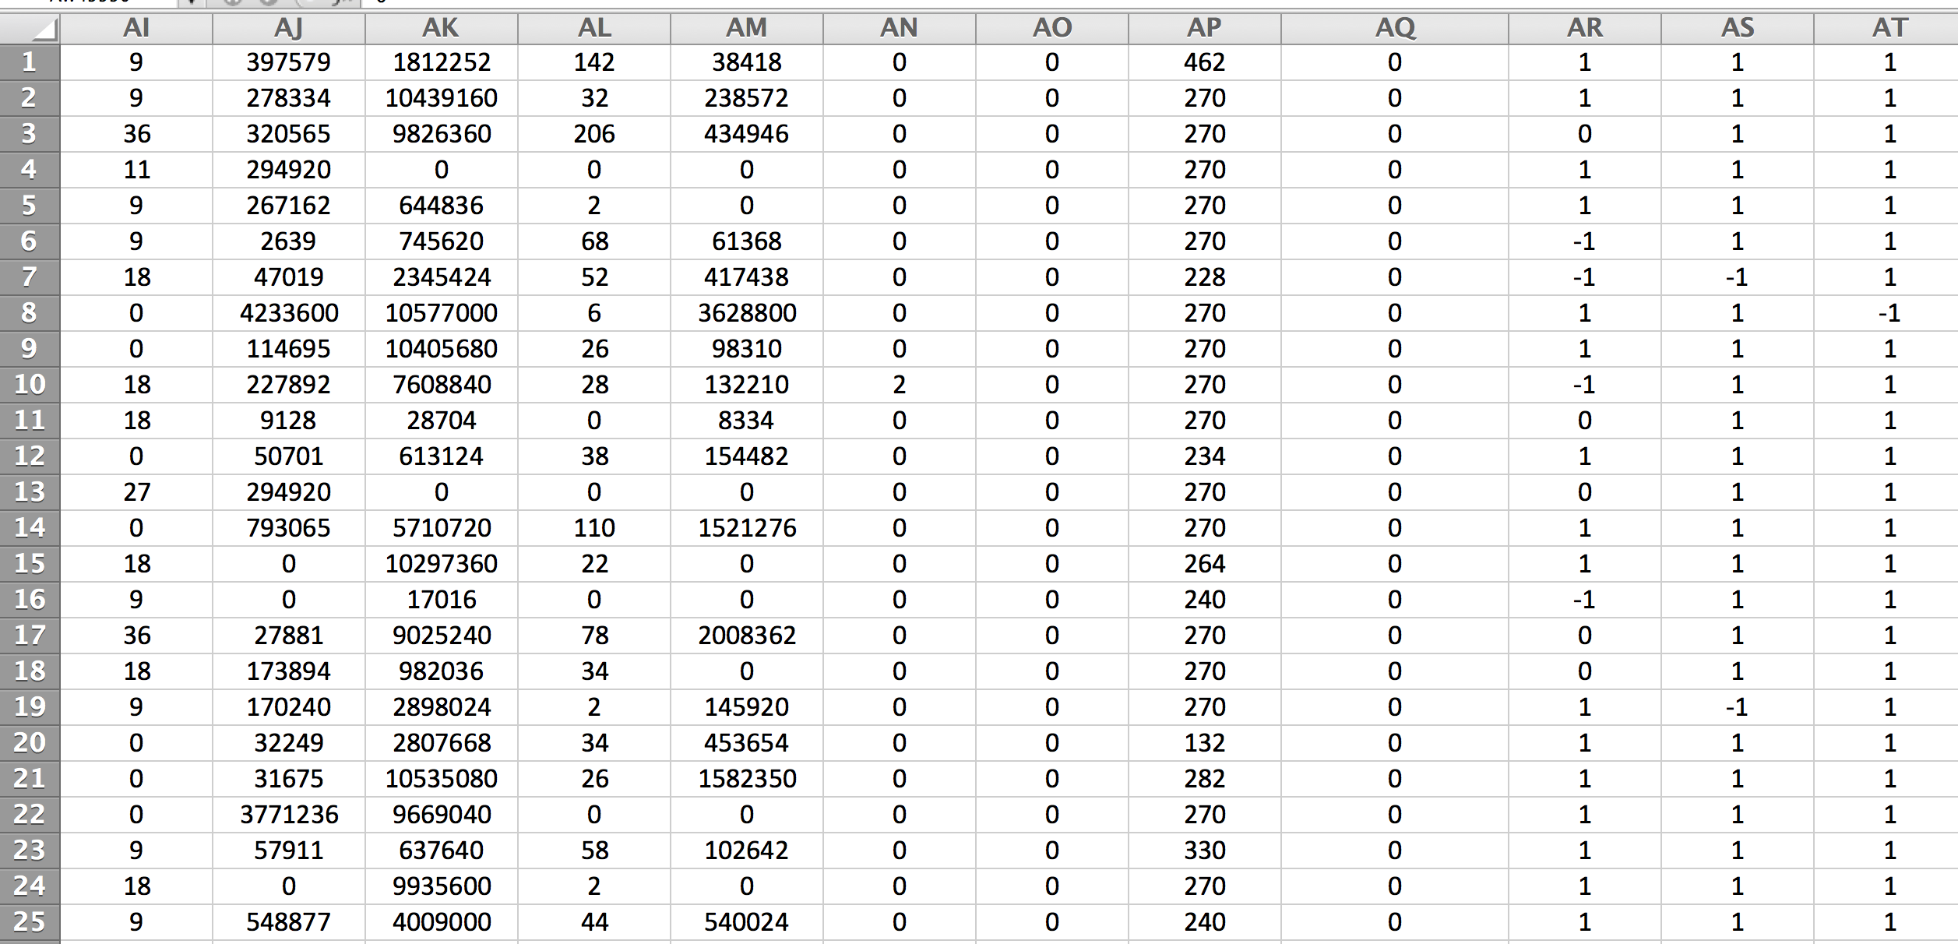
No missing values after treatment
98 variables are numerical and 50 are discrete. The remaining are empty variables. We further reduce the number of attributes to 77

Slide 6
2 ways to treat missing values
For missing numerical data attributes, we used the average numerical value to replace the missing numerical data. For missing discrete data attributes, we have tried two missing value replace value strategy.
Strategy 1: Used excel pivot table to find the most frequent discrete (non-numeric data)
Use 1 to replace the 1st most frequent discrete data
Use -1 to replace the 2nd most frequent discrete data
Use 0 to replace the 3,4,5th…n th most frequent discrete data
Therefore all the discrete (non-numeric) data are converted to frequent discrete (non-numeric data)

Slide 7
2 ways to treat missing values
Strategy 2:
Used excel filer to find and replace the distinct non-numerical value with distinct numeric value (0-99) according to alphabetical order

Slide 8
Achieved accuracy for most methods
method | Data 1 accuracy | AUC | Data 2 accuracy | AUC
Decision tree | 91.2118 % | 0.606 | 91.2882 % | 0.604
Naïve Bayes | 38.3588 % | 0.601 | 39.3588 % | 0.601
Back Propagation Neural network | 92.5471 % | 0.5 | 92.5471 % | 0.5
Ada boost Naïve Bayes | 38.3588 % | 0.601 | 39.3588 % | 0.601
principal components K=10, decision tree | 92.5471 % | 0.5 | 92.5471 % | 0.5
principal components K=10, Naïve Bayes | 92.4294 % | 0.601 | 92.2941 % | 0.6
Decision tree method gives us a best result because the Area Under Curve (AUC) value is the greatest

Slide 9
Difficulties encountered and solution
When converting non-numeric value to numeric value using strategy #1
It was impossible to use regular expression to
Use “0” to replace the 3,4,5th…n th most frequent discrete data in Microsoft Excel,
Since there is no (poor) Regular expression support in MS Excel ☹
Solution: Open Office (we did not use this ) instead we just used Excel function to solve this issue

Slide 10
What we said to do last time
Select top x features (for clustering)
X means/ Simple means/ Hierarchical Clustering (Single link and BIRCH)
Set number of clustering to 2, compare and analysis the result with other supervised classification methods (Clustering Validate)
Visualize clustering result in WEKA, MATLAB, SPSS in 2D and 3D

Slide 11
Features selection
We used
information gain and
Chi-Square methods
to rank the attributes. We used the Select attributes tuple in Weka and the search method is set to be default.

Slide 12
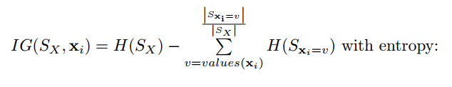

Features selection
Information Gain:
Where p(S) is the probability of a training example in the set S to be of the
positive/negative class.

Slide 13
Features selection
Information Gain:
The top 5 ranked attributes from Weka are:
0.02002 29 Var126
0.008002 15 Var73
0.005614 16 Var74
0.005338 42 Var189
0.005314 3 Var13

Slide 14
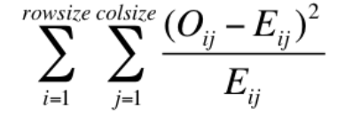
Features selection
Chi-Square methods :
We are familiar with this formula ☺

Slide 15
Features selection
Chi-Square methods :
The top 5 ranked attributes from Weka are
1553.594 29 Var126
586.9648 15 Var73
427.1662 42 Var189
387.7388 16 Var74
387.5699 3 Var13
The results from the two methods agree with each other.

Slide 16
We used the top 5 ranked attributes and applied Decision tree and Naïve Bayes to them. The results of classification are as below. We notice that the results by Naïve Bayes are better than the results using the full data set.
method | Data 1 accuracy | AUC | Data 2 accuracy | AUC
Decision tree | 92.5471 % | 0.5 | 92.5471 % | 0.5
Naïve Bayes | 92.4294 % | 0.646 | 92.4294 % | 0.646

Slide 17
Clustering Methods
Clustering in WEKA (SimpleKMeans,Xmeans)and SPSS (BIRCH)
Single Link clustering (in SPSS) in not computationally feasible for this project due to large data set(50K).

Slide 18
Binary Cluster results and Class lables
Cluster membership
Cluster0
Cluster1
Class label
Label==-1 customer stays with current wireless carrier (major)
Label==1 customer change wireless carrier (minor)

Slide 19
Visualization of clustering data
Weka Released Version 3.6 2D
Weka Developper Version 3.7.11 3D (Java 3D 1.5 is required)
Matlab 3D
SPSS 3D

Slide 20
Visualization of clustering data
Weka Released Version in 2D using 2 out of 5 feature selected variables (10 combinations)
Advantage: (Nice representation)
Fast to visualize clustering data in 2D, no need to code
Easy to control the amount of data by controlling the jitter bar
Show Cluster membership by using binary color code
Disadvantage : Lack of ability to visualize high dimensional data

Slide 21
Visualization of clustering data
Weka Developed Version in 3D (Java 3D 1.5 is required) using 3 out of 5 feature selected variables (10 combinations)
Advantage: (Nice representation)
Fast to visualize clustering data in 3D, no need to code
Easy to control the amount of data by selecting percentage of data
Disadvantage : Limited to 3D ,can be rotated, can not control zoom in/out
Rotation can be slow if 100% of large amount of data is selected , hard to orient the visualized result in a good orthogonal view ,fixed camera position, hard see cluster membership

Slide 22
Visualization of clustering data
MATLAB
Advantage:
Fast to visualize a portion of clustering data in 3D, Visualization can be rotated, can zoom in/out, color code cluster membership
Disadvantage :
Visualization and Rotation can be slow if 100% of large amount of data is selected , data preprocessing and modifying code is needed

Slide 23
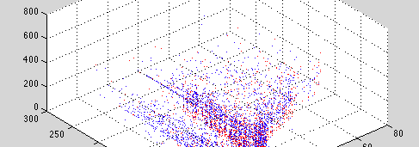
MATLAB 3D clustering Visualization

Slide 24
Visualization of clustering data
SPSS
Advantage:
Fast to visualize 100% large clustering data set in 3D, no need to code
Disadvantage :
Can not zoom in/out or rotation of the plot, camera position is fixed

Slide 25
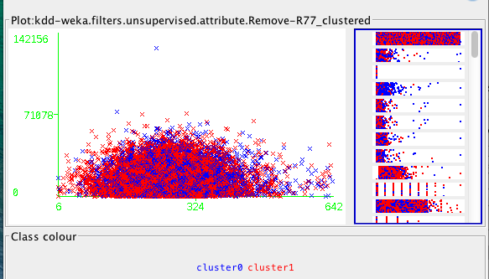
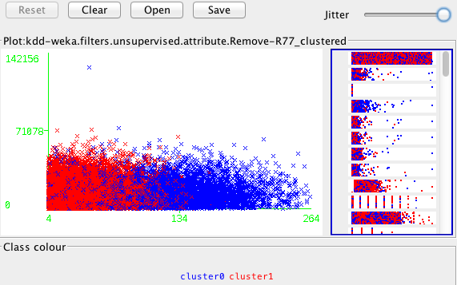
Weka 2D Clustering Visualization

Slide 26
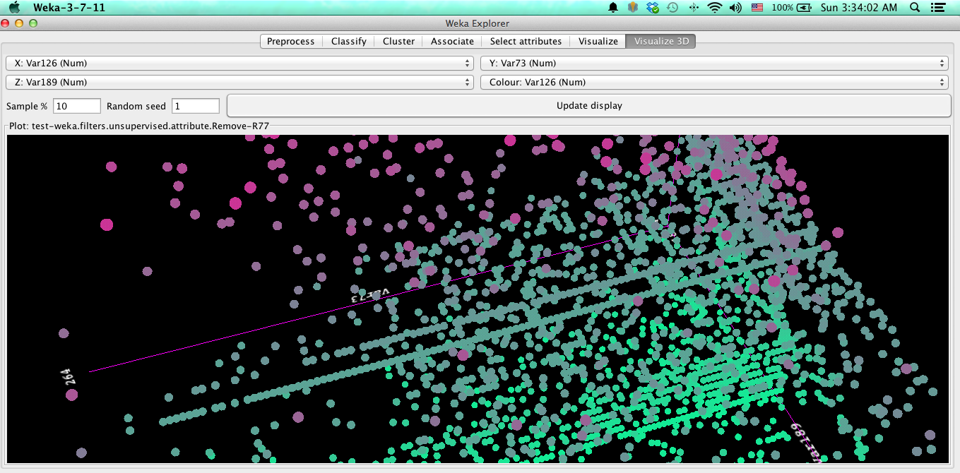
Weka 3D Clustering Visualization
(scatter plot 3D)

Slide 27
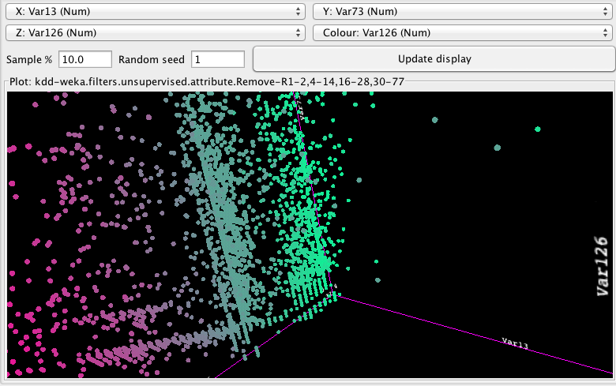
More 3D plot in WEKA

Slide 28
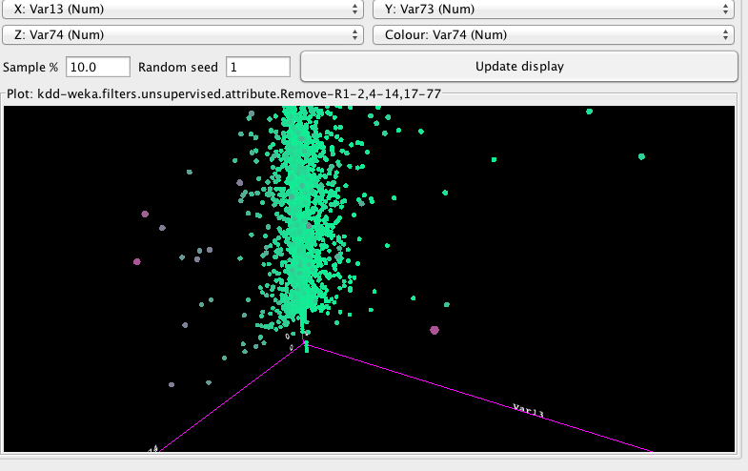

Slide 29
WEKA XMeans K=2
 |  | Accuracy (compare with class label)
Var 74 | Var 13 | 86.75%
Var 189 | Var 13 | 80.57%
Var 189 | Var 74 | 58.05%
Var 73 | Var 13 | 64.79%
Var 73 | Var 74 | 64.79%
Var 73 | Var 189 | 80.57%
Var 126 | Var 13 | 58.05%
Var 126 | Var 74 | 58.04%
Var 126 | Var 189 | 58.04%
Var 126 | Var 73 | 59.39%
 | Average Accuracy | 66.90%
 | Best Accuracy | 86.75%
 | Decision Tree Accuracy | 92.55%

Slide 30
Weka Simple Means K=2
 |  | Accuracy (compare with class label)
Var 74 | Var 13 | 86.73%
Var 189 | Var 13 | 81.40%
Var 189 | Var 74 | 81.40%
Var 73 | Var 13 | 35.21%
Var 73 | Var 74 | 35.21%
Var 73 | Var 189 | 35.10%
Var 126 | Var 13 | 64.80%
Var 126 | Var 74 | 64.80%
Var 126 | Var 189 | 64.80%
Var 126 | Var 73 | 64.60%
 | Average Accuracy | 61.41%
 | Best Accuracy | 86.73%
 | Decision Tree Accuracy | 92.55%

Slide 31
Weka Simple K Means 3D K=2
 |  |  | Accuracy (compare with class label)
Var73 | Var 126 | Var 189 | 59.43%
Var 73 | Var 74 | Var 126 | 64.60%
Var 13 | Var 73 | Var126 | 64.60%
Var 13 | Var 74 | Var 126 | 64.80%
Var 73 | Var 74 | Var 189 | 64.90%
Var 13 | Var 73 | Var 189 | 64.90%
Var 13 | Var 73 | Var 74 | 64.79%
Var 13 | Var 74 | Var 189 | 81.40%
Var 13 | Var 126 | Var 189 | 64.80%
Var 74 | Var 126 | Var 189 | 64.80%
 |  | Average Accuracy | 65.90%
 |  | Best Accuracy | 81.40%
 |  | Decision Tree Accuracy | 92.55%

Slide 32
Hierarchical Cluster Analysis
WEKA is not perfect for supporting HCA , it is rather poor tool to do HCA
(WEKA has no/poor documentation for error handling when doing HCA )
SPSS has better support for HCA
However , in SPSS default cluster method is called “between group linkage” method takes long time (>30 mins) to compute and clustering all the data sets (50000) for each run (K=2) , Since it takes so long to complete clustering all our data sets , single link clustering algorithm is not suitable for large data sets (50000)

Slide 33
“Between Group Linkage” in SPSS
Similar to Single Link Clustering Algorithm .SPSS computes the smallest average distance between all group pairs and combines the two groups that are closest. The procedure begins with as many clusters as there are cases. At step one, the two cases with the smallest distance between them are clustered. Then SPSS computes distances once more and combines the two that are next closest. The process continues until all cases are grouped into one large cluster.

Slide 34
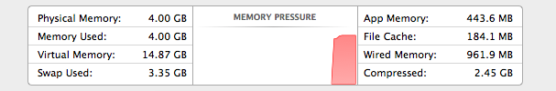
Single Link is slow for large data sets(50k) and super large memory foot print

Slide 35

After one hour ,SPSS is still not finished

Slide 36
BIRCH (aka. Two Step Clustering in SPSS )
Distance based (CF tree)
Faster than other clustering algorithms (a fraction of second)
Can process categorical or continuous data
only 1-pass of data (suitable for very large data files)

Slide 37
1st Step in SPSS BIRCH:
Preclustering: Making Little Clusters
Preclusters are just clusters of the original cases that are used in place of the raw data in the hierarchical clustering. As a case is read, the algorithm decides, based on a distance measure, if the current case should be merged with a previously formed precluster or start a new precluster. When preclustering is complete, all cases in the same precluster are treated as a single entity. The size of the distance matrix is no longer dependent on the number of cases but on the number of preclusters.

Slide 38
2nd Step in SPSS BIRCH:Hierarchical Clustering of Preclusters
SPSS uses the standard hierarchical clustering algorithm on the preclusters. you control the number of preclusters. Large numbers of preclusters give better results because the cases are more similar in a precluster; however, forming many preclusters slows the algorithm

Slide 39
BIRCH K=2 (TWO STEPS in SPSS)
 |  | Accuracy (compare with class label)
Var 74 | Var 13 | 86.75%
Var 189 | Var 13 | 81.06%
Var 189 | Var 74 | 92.65%
Var 73 | Var 13 | 66.72%
Var 73 | Var 74 | 92.65%
Var 73 | Var 189 | 91.24%
Var 126 | Var 13 | 92.65%
Var 126 | Var 74 | 92.45%
Var 126 | Var 189 | 91.62%
Var 126 | Var 73 | 56.10%
 | Average Accuracy | 84.39%
 | Best Accuracy | 92.65%
 | Decision Tree Accuracy | 92.55%

Slide 40
Cluster Validation in SPSS
Cluster Cohesion:
Measures how closely related are objects in a cluster
Cohesion is measured by the within cluster sum of squares
Cluster Separation:
Measure how distinct or well- separated a cluster is from other clusters
Separation is measured by the between cluster sum of squares

Slide 41
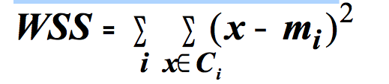
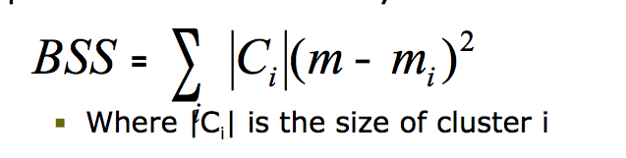
Cluster Validation in SPSS
Cluster Cohesion:
Cluster Seperation:

Slide 42
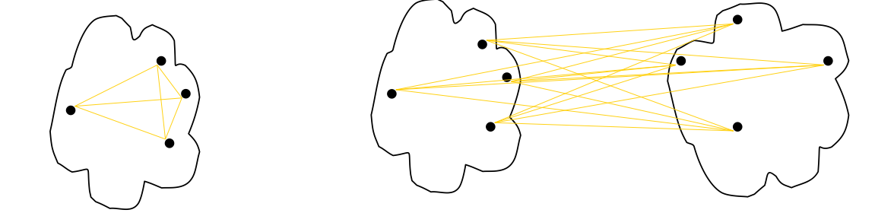
Cluster Validation in SPSS
Cluster cohesion is the sum of the weight of all links within a cluster.
Cluster separation is the sum of the weights between nodes in the cluster and nodes outside the cluster.

Slide 43
Silhouette Coefficient
Silhouette Coefficient combine ideas of both cohesion and separation, but for individual points, as well as clusters and clusterings
For an individual point, i
Calculate a = average distance of i to the points in its cluster
Calculate b = min (average distance of i to points in another cluster)
a : the smaller the better the cluster is
b: the bigger the better the cluster is
Silhouette coefficient for a point is then given by
s=1–a/b ifa<b

Slide 44
Silhouette Coefficient
Silhouette coefficient for a point is then given by
s=1–a/b ,if a<b
s=b/a-1 , if a≥b
Typically between 0 and 1
The closer to 1 the better

Slide 45
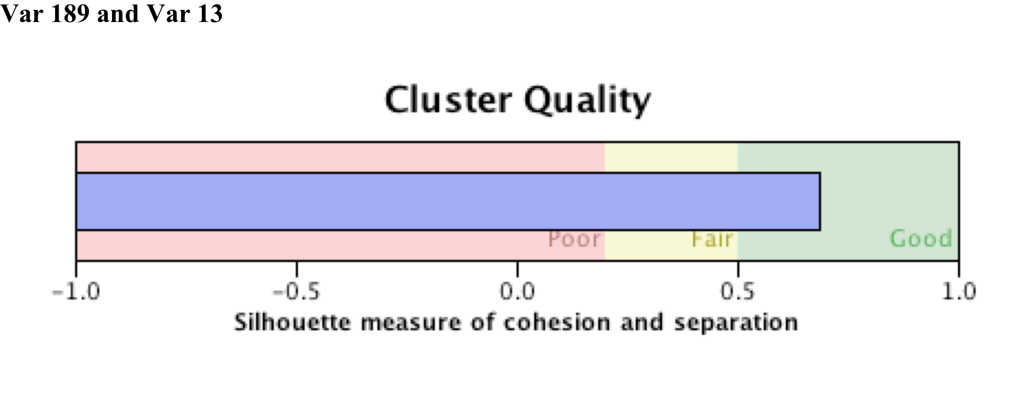
Silhouette Coefficient in SPSS

Slide 46
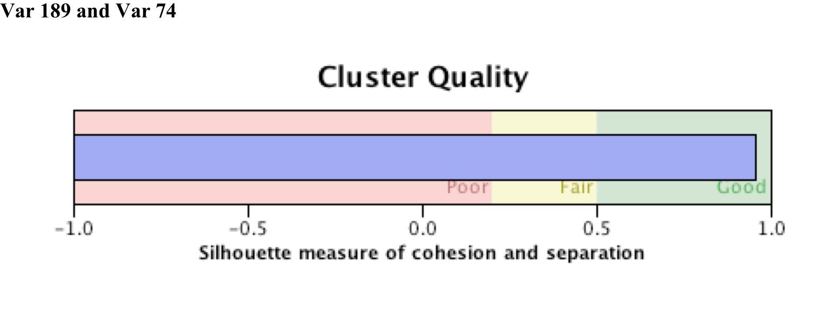
More Silhouette Coefficient in SPSS

Slide 47
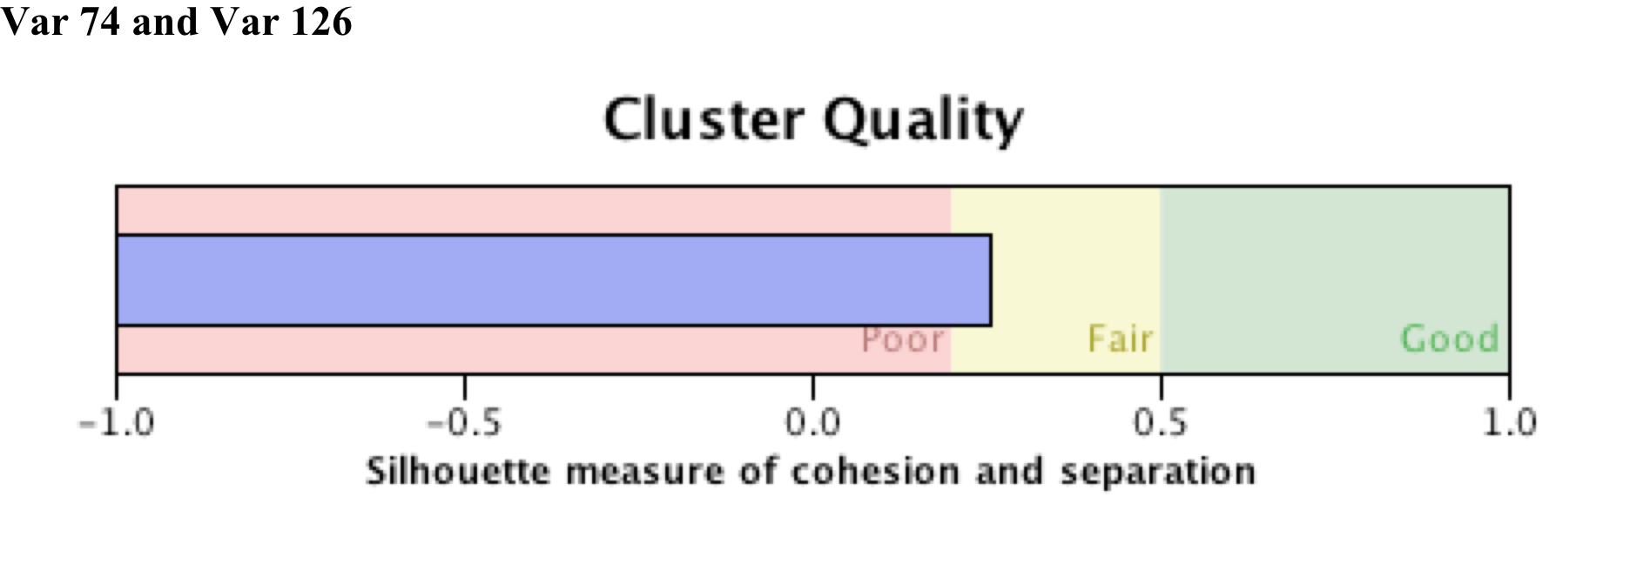
More Silhouette Coefficient in SPSS

Slide 48
Thank you, Q & A

