Slide 1
Comparative Study and Implementation of Generative AI Models
AE • VAE • DCGAN • Stable Diffusion
Assignment No. 2 | CO3 and CO4 | Fashion-MNIST experiments on Google Colab (Tesla T4)
Nilesh Chavan (202401110017) | Bhusan Bhamre (202401110078)
Notes:
Introduce the topic and the four models. We trained AE, VAE and DCGAN on Fashion-MNIST and used pretrained Stable Diffusion v1.5.

Slide 2
Reconstruction vs generation
Reconstruction
Generation
A model compresses a given image into a code and rebuilds it, so output can be compared with the input.
A model creates a new image from random noise or a text prompt; there is no single correct output.
AE, VAE (CO3)
DCGAN, Stable Diffusion (CO4)
Objectives
Run AE and VAE reconstruction and compare blur and lost detail
Train a compact DCGAN and inspect its samples
Generate images with pretrained Stable Diffusion from text prompts
Compare all outputs without overstating the results
Notes:
Explain why a reconstruction error such as MSE is meaningful for AE and VAE but not for DCGAN or Stable Diffusion.

Slide 3
Four models, four different jobs
Autoencoder
VAE
DCGAN
Stable Diffusion
Reconstruction
Reconstruction + sampling
Generation from noise
Text-to-image
How it works
Encoder compresses to a 64-value code; decoder rebuilds the image.
Strength / limit
Simple, fast. Blurs detail; not built for sampling.
How it works
Encoder predicts mean and variance; loss = reconstruction + KL divergence.
Strength / limit
Smooth latent space. Blurrier output.
How it works
Generator and discriminator trained against each other.
Strength / limit
Sharp edges. Unstable training, broken samples.
How it works
Pretrained latent diffusion removes noise step by step, guided by the prompt.
Strength / limit
Realistic and detailed. Heavy compute, prompt-sensitive.
AE, VAE and DCGAN were trained on Fashion-MNIST; Stable Diffusion is pretrained and used for inference only, so this compares capabilities, not a same-domain benchmark.
Notes:
Walk through each card. Reconstruction models are judged against an input; DCGAN and Stable Diffusion create new images.

Slide 4
Setup and architectures
Data: Fashion-MNIST, 60,000 train / 10,000 test, 28 × 28 grayscale, 10 classes
Colab, PyTorch 2.11.0, Tesla T4 GPU; batch size 128; 10 epochs each; no seed set
Stable Diffusion: runwayml/stable-diffusion-v1-5, float16, 20 steps, guidance 7.0, 512 × 512
Model | Layers | Training | Parameters
Autoencoder | 784→256→64 (latent)→256→784; ReLU, Sigmoid | Adam 1e-3, MSE | 435,536
VAE | 784→400; mean and log-variance (20 each); 20→400→784 | Adam 1e-3, BCE + KL | 652,824
DCGAN generator | Linear 100→6272; 2 transposed convs; BatchNorm, ReLU, Tanh | Adam 2e-4, BCE | 778,305
DCGAN discriminator | 2 convs + linear; LeakyReLU, Sigmoid | Adam 2e-4, BCE | 138,817
Stable Diffusion | Pretrained text encoder, U-Net, decoder | None (inference) | Not counted
Notes:
Parameter counts were calculated from the printed layer sizes. The DCGAN used Adam with beta1 = 0.5 and noise size 100.

Slide 5
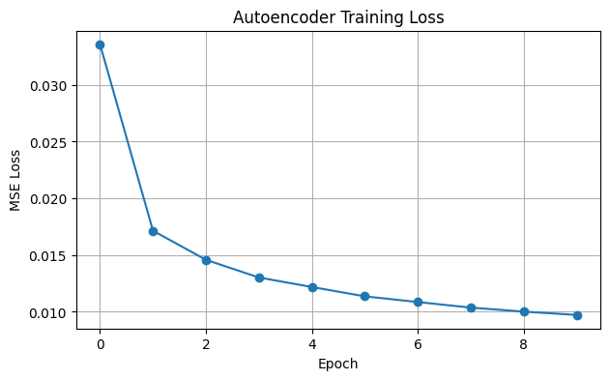
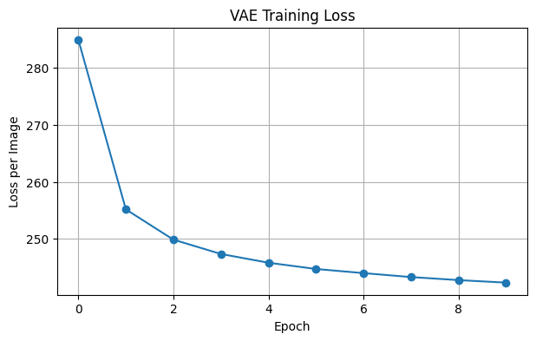
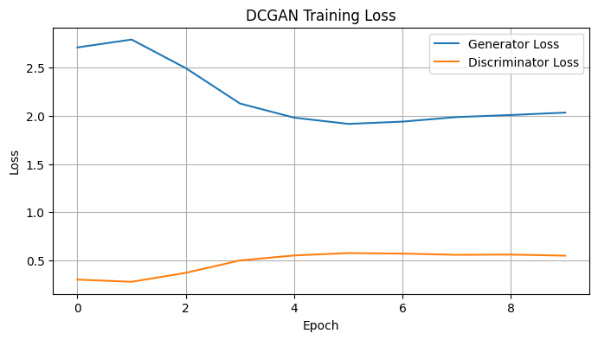
Training behaviour over 10 epochs
AE (MSE)
VAE (loss per image)
DCGAN (D and G loss)
Model | Epoch 1 | Epoch 10
AE loss (MSE) | 0.033584 | 0.009718
VAE loss | 284.9157 | 242.3201
DCGAN D / G loss | 0.3026 / 2.7064 | 0.5507 / 2.0316
AE and VAE losses fall fast, then slowly
DCGAN losses level off from about epoch 5
Losses use different scales; not comparable
GAN losses are not image-quality scores
Notes:
Epoch axis in the plots starts at 0, so index 0 is epoch 1. AE loss is batch-average MSE per pixel; VAE loss is per image (cross-entropy + KL).

Slide 6
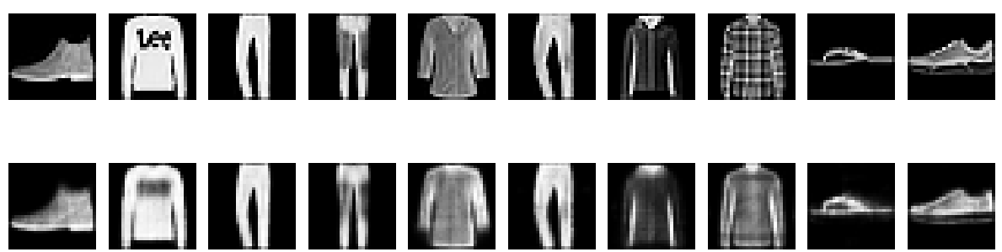
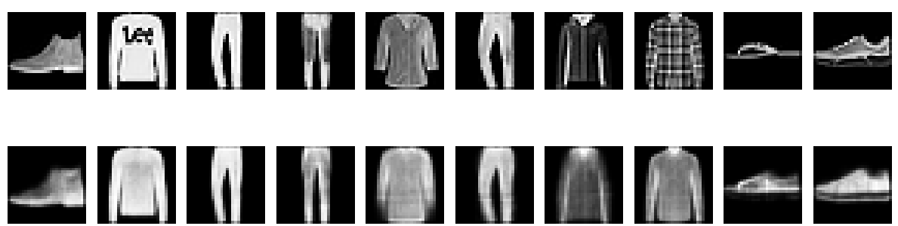
Reconstruction: the AE is more faithful than the VAE
Autoencoder
VAE
AE keeps logo and plaid faintly; VAE smooths them away
VAE blur comes from the KL term and sampled latent vector
Single run; models differ in size and loss
Top row: original. Bottom row: reconstruction (first 10 test images).
Notes:
AE test MSE 0.009628, VAE 0.015939. Both keep silhouettes; the VAE is visibly blurrier, which matches the MSE.

Slide 7
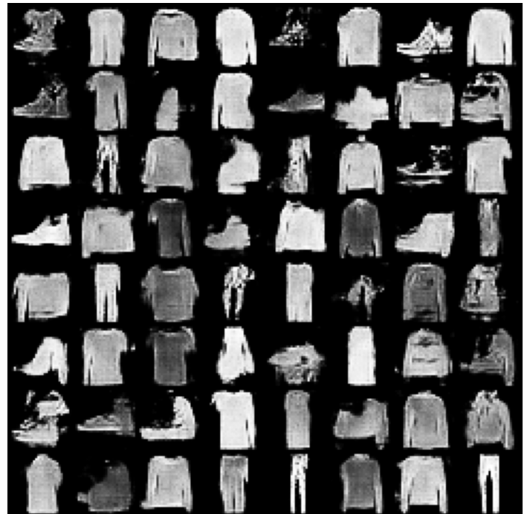
DCGAN: new images, but rough
What works
Recognisable sneakers, boots, tops, T-shirts and trousers
Sharper edges than the VAE reconstructions
What does not
Many noisy, grainy or broken samples
Several tops look alike (diversity not measured)
Needs more training for clean results
Noise size 100 | Adam lr 2e-4 | final D / G loss 0.5507 / 2.0316
64 samples generated from random noise after 10 epochs
Notes:
Samples are fast to generate once trained. No diversity or quality score was computed, so we cannot say whether mode collapse occurred.

Slide 8
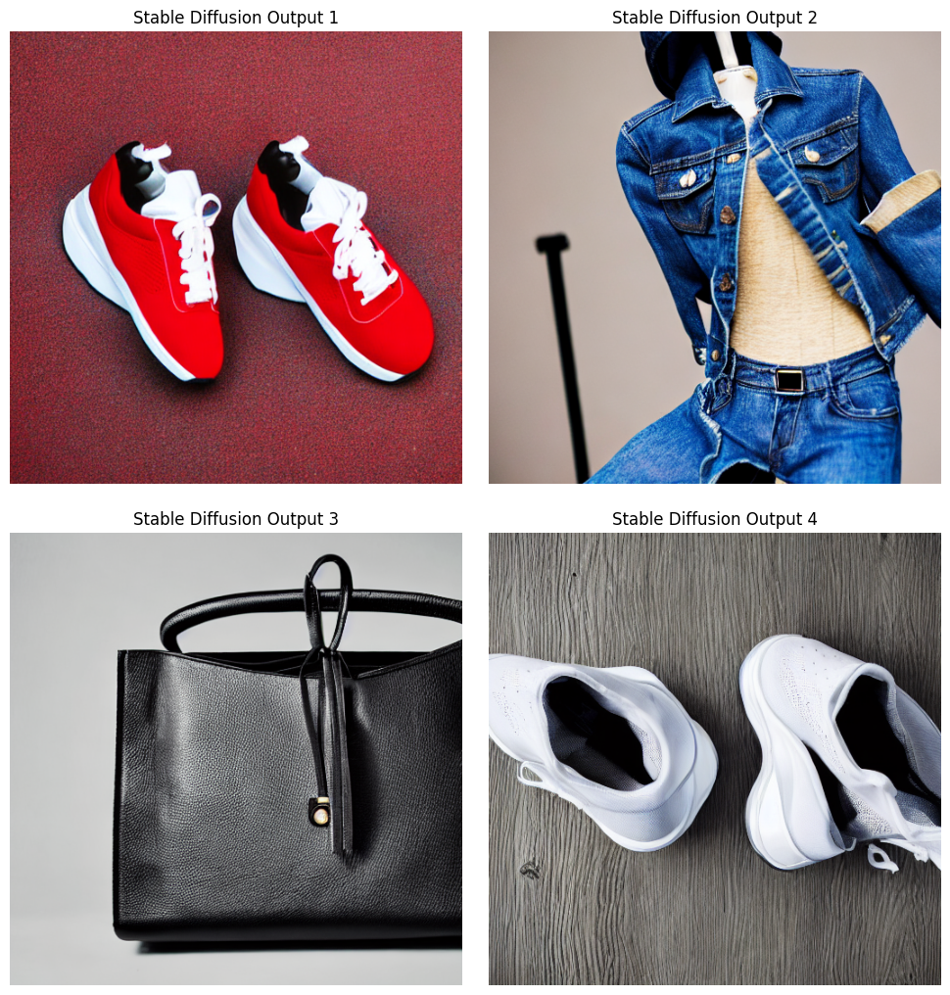
Stable Diffusion v1.5: realistic, with prompt misses
# | Observation
1 | Photo-like red sneakers, but on a red surface, not white
2 | Clear denim stitching and buttons; odd mannequin and stray pole
3 | Convincing leather grain and studio light; strap slightly tangled
4 | Realistic mesh texture; shoes overlap, grey floor not white
20 steps | guidance 7.0 | 512 × 512 | safety checker disabled
No numerical quality score was recorded for DCGAN or Stable Diffusion.
Red sneakers, denim jacket, leather handbag, white running shoes
Notes:
All four images are colour and photo-like. Weaknesses: missing white backgrounds in prompts 1 and 4, and structural oddities in images 2 and 4.

Slide 9
Side-by-side comparison from our results
Criterion | AE | VAE | DCGAN | Stable Diffusion
How judged | Match to input (MSE 0.009628) | Match to input (MSE 0.015939) | Visual inspection | Realism and prompt match
Sharpness seen | Soft | Softest | Fairly sharp edges | Sharp and detailed
Creates new images | Not designed to | By sampling (not run here) | From noise | From text
Training effort | 10 epochs | 10 epochs | 10 epochs, two networks | None (pretrained)
Control | Input image | Input or latent | Almost none | Text prompt
Main weakness | Blur | Stronger blur | Noisy, broken samples | Prompt misses, GPU need
Qualitative comparison based on this study; models use different data, so it is not a benchmark.
Notes:
Choose the model by goal: faithful reconstruction, sampling, or controllable generation.

Slide 10
Conclusion
No single best model: choose by goal (reconstruction, sampling or controllable generation)
AE and VAE blur detail; the VAE blurred more (MSE 0.015939 vs 0.009628)
DCGAN makes new images but needs more training for clean results
Stable Diffusion gave the most realistic output, at higher compute cost and with prompt mismatches
Limits: 10-epoch training, single run, different data across models
AI tools: ChatGPT and Claude. ChatGPT prompts covered Colab code for all four models, AE/VAE training and reconstruction plots, and debugging DCGAN, Stable Diffusion and MSE.
Verification: numbers and figures checked against the notebook output.
Nilesh: dataset, AE, VAE, MSE. Bhusan: DCGAN, Stable Diffusion, report and slides.
Notes:
Summarise the findings, AI usage, verification and each member's contribution. Both members should be ready for Q&A on all four models.

