Slide 1
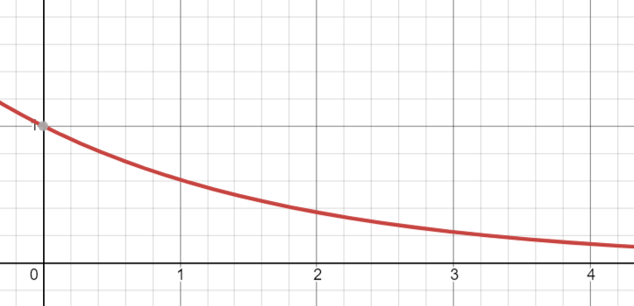

DEBUT
#1 - #136
#137 - #455
#455 - #731
#731 - #898
#898 - #999
FRESHMEN
SOPHOMORE
JUNIOR
SENIOR

