Slide 1
Continuous Training
Framework
MLOps pipeline

Slide 2
Continuous Training : MLOps Pipeline

Slide 3
Introduction to Continuous Training (CT)
Continuous training : The practice of regularly retraining ML models with new data to maintain or improve performance over time
Fetch Data
Monitor
Collect new data
Evaluate
Model drift
Data drift
Concept drift
Bias drift
Clean Data
Continuous training
Deploy to production
Prepare Data
Evalutate Model
Train Model

Slide 4
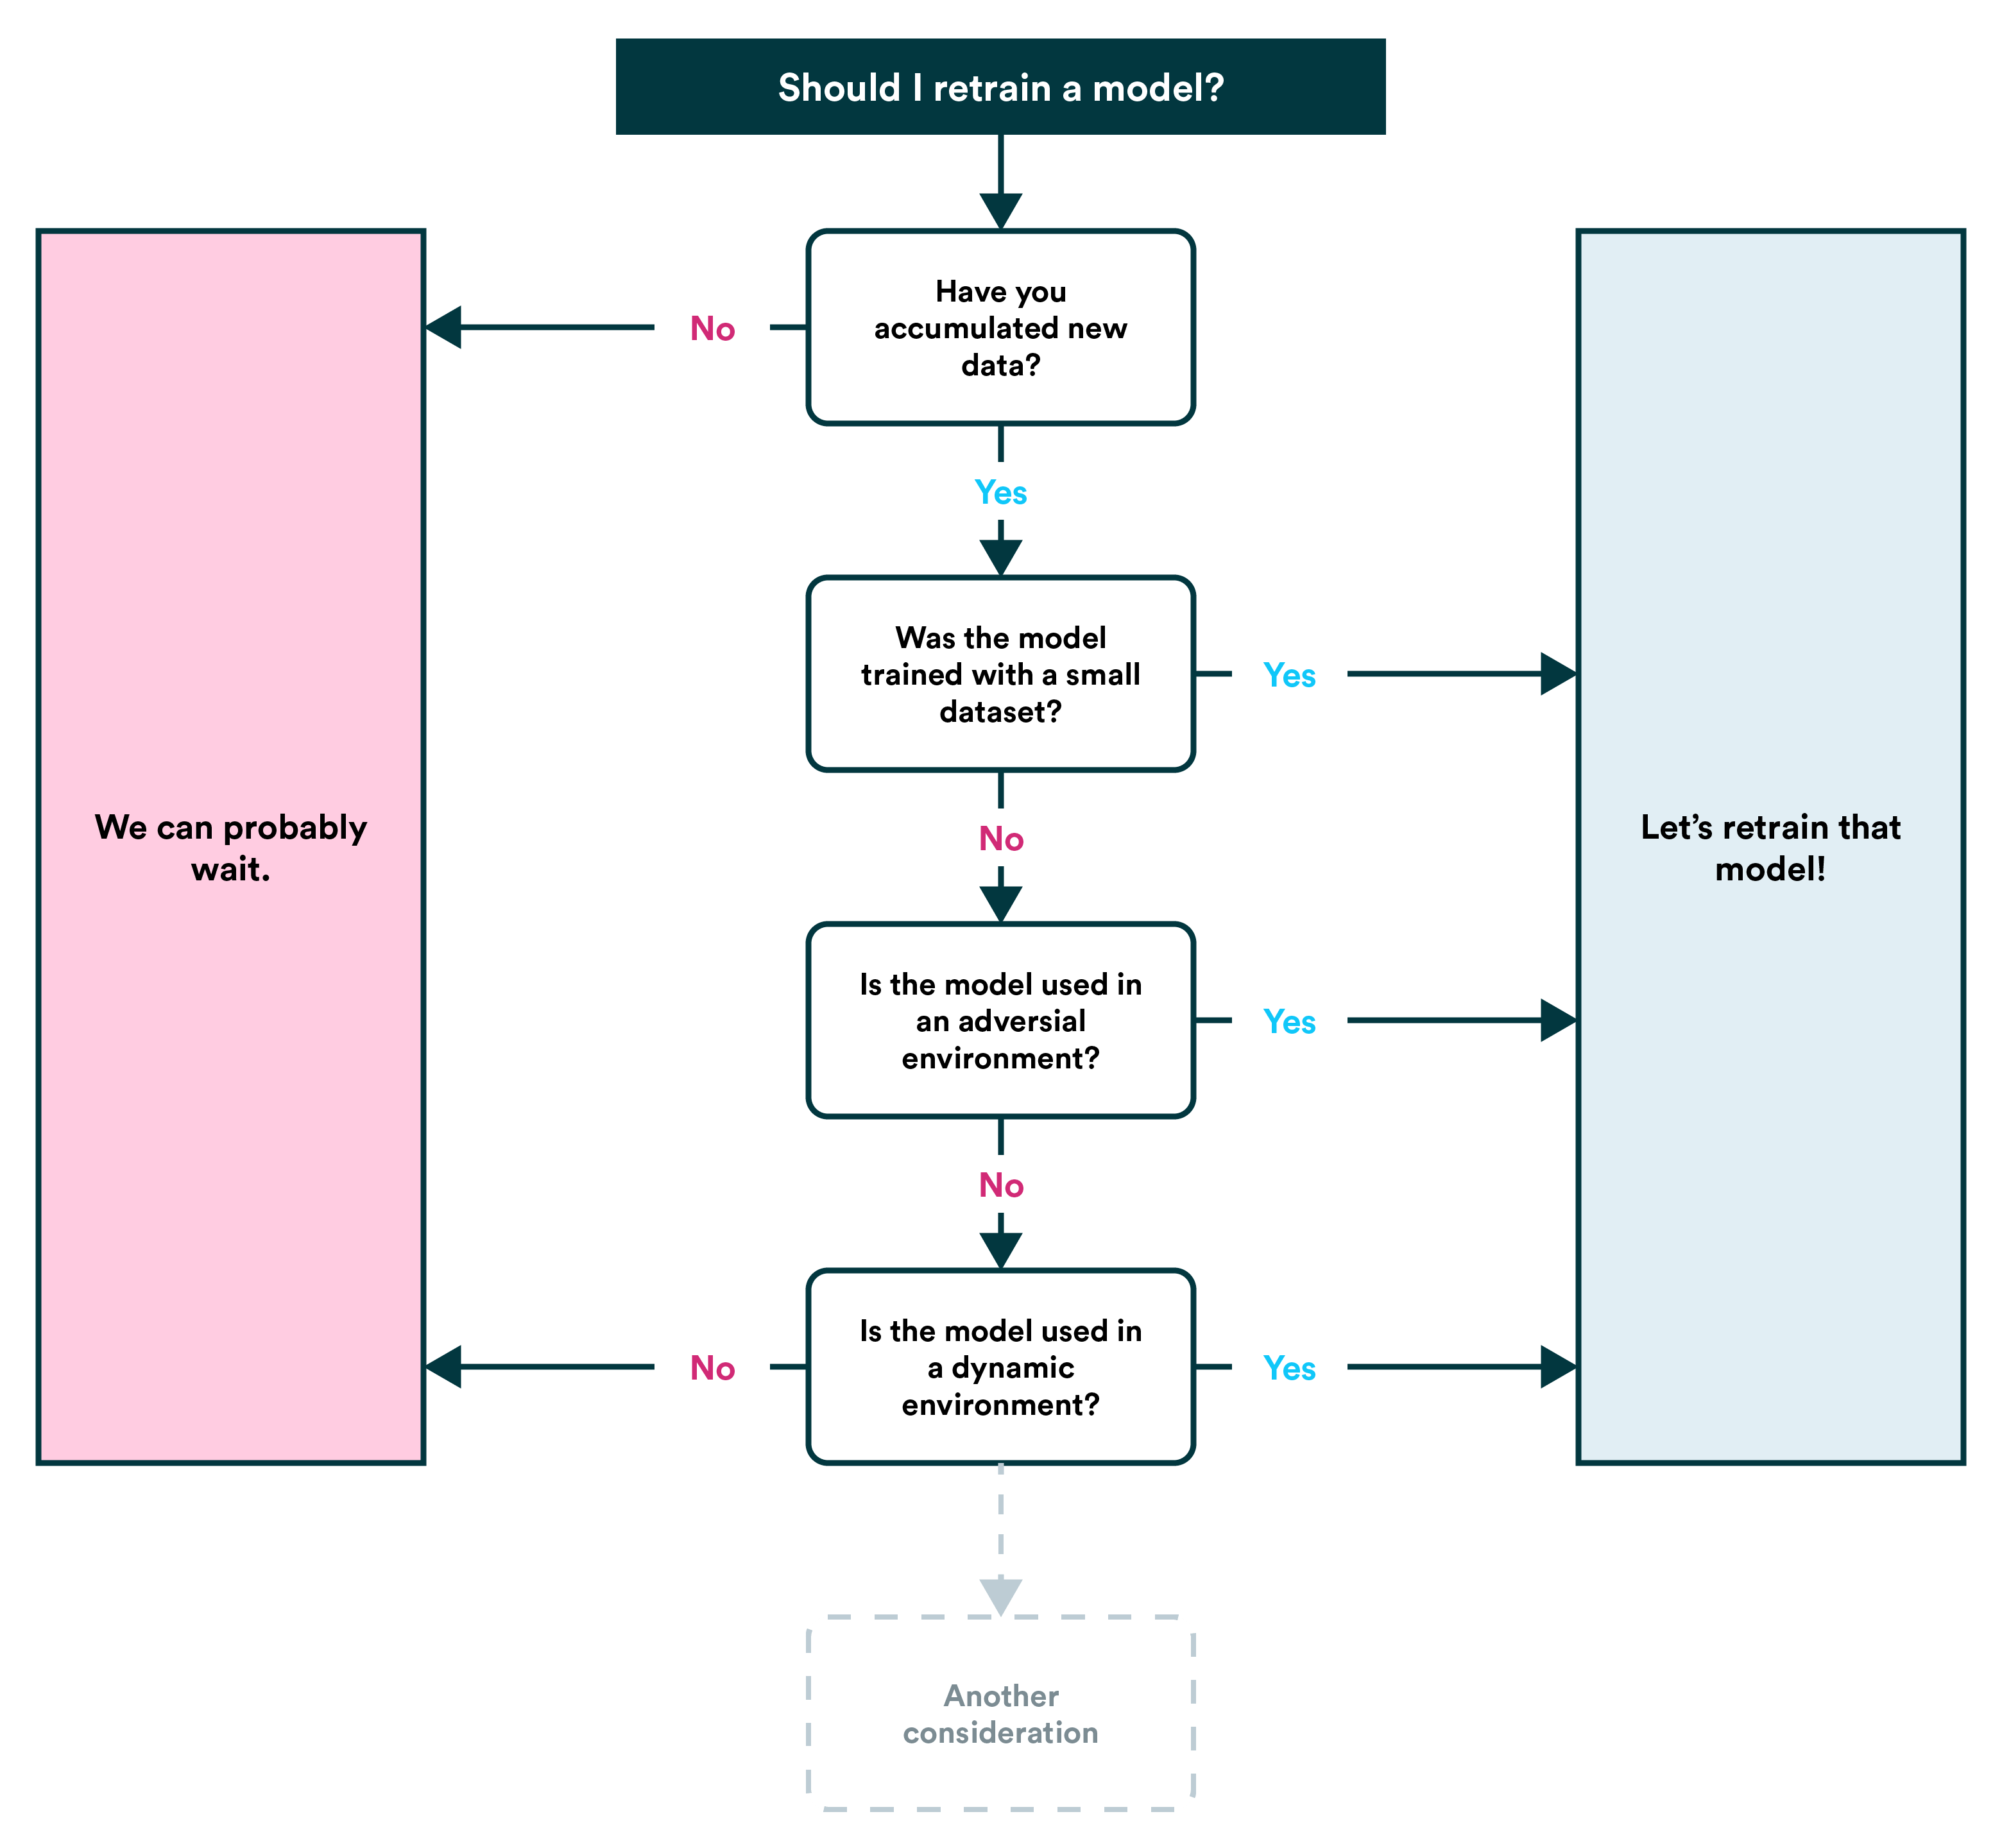
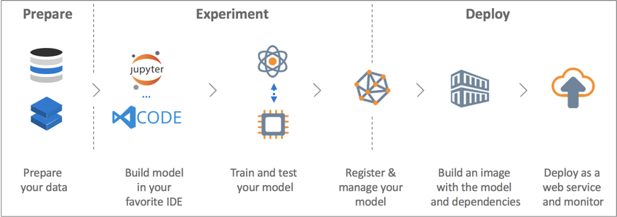
Introduction to Continuous Training
Introduced by Google in 2021 : MLOps: Continuous delivery and automation pipelines in machine learning

Slide 5
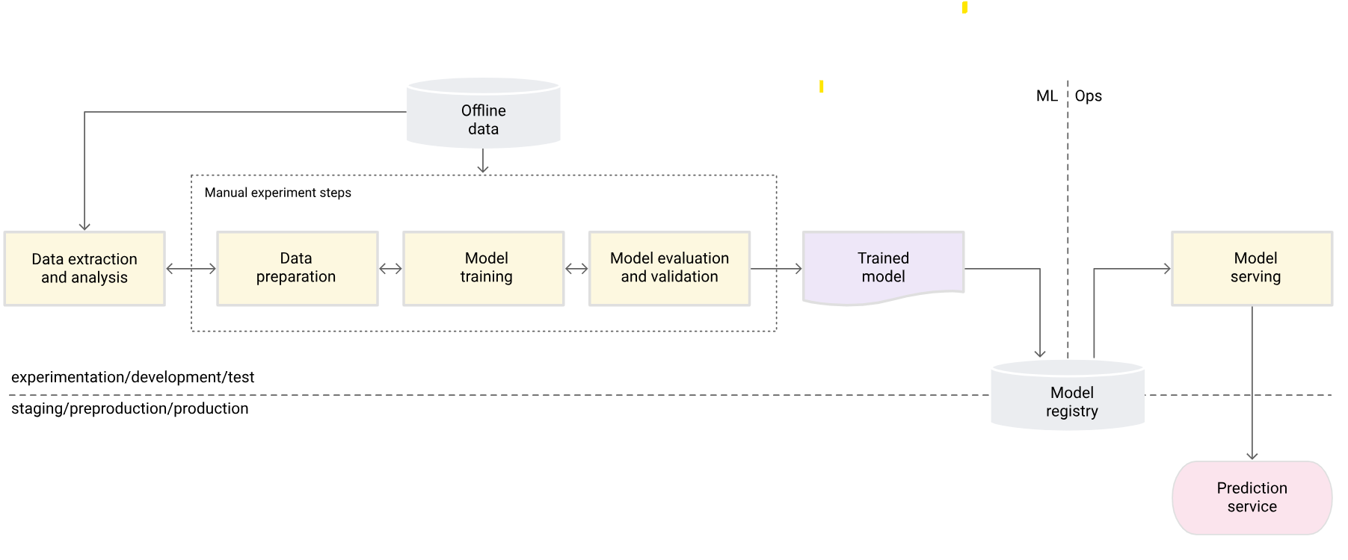
MLOps level 0 : No Continuous training
Manual, Script driven, Interactive
Disconnection between ML and Ops
Infrequent Release
Only deploying an enpoint
Lack of Performance monitoring

Slide 6
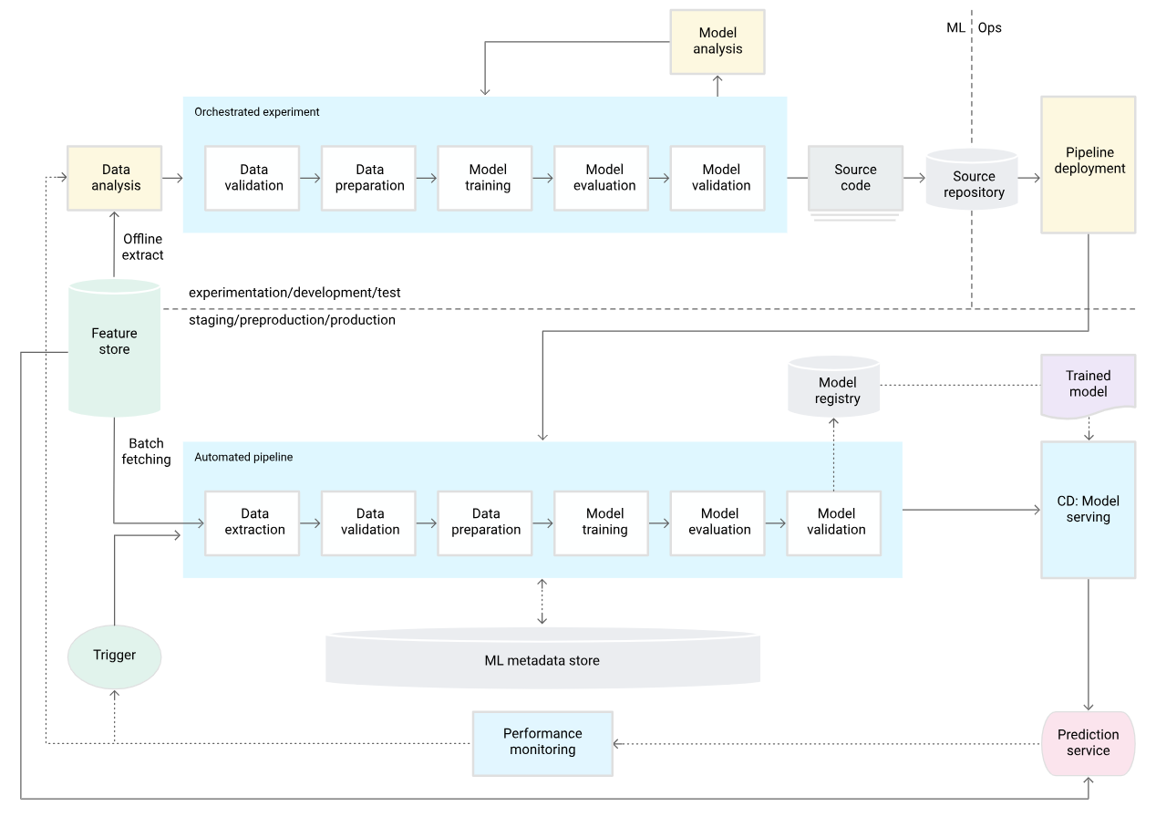
MLOps level 1: ML pipeline automation
Integrate triggers on data and model validation steps
Continuously trains (CT) the model in production
Code must be modularized : Experimental / Production share the same pipeline
Deploying a whole model training pipeline, not only an endpoint
Training code is not deployed automatically (no CI/CD)

Slide 7
MLOps level 1: Additionnal components
Data Validation (Pre-Training):
Check for schema skews (unexpected features/values) → Stop pipeline if anomalies.
Detect data value skews (statistical changes) → Trigger retraining.
Model Validation (Post-Training):
Evaluate metrics (e.g., accuracy) vs. current model/baseline.
Test consistency across data segments (e.g., regional performance).
Validate deployment compatibility (API, infrastructure).

Slide 8
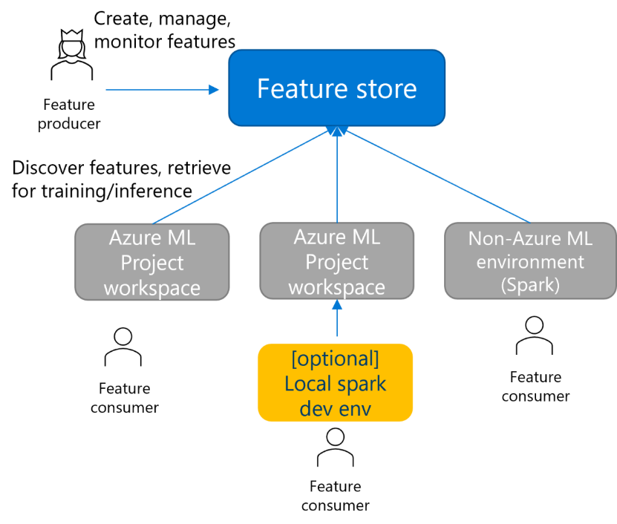
MLOps level 1: Additionnal components
Feature Store (Optional)
Features are the attributes of your dataset (ex. : age, height, eye color …)
Data consistency : Centralized feature repository for training/serving
Use other members’ EDA created features : No data replication

Slide 9
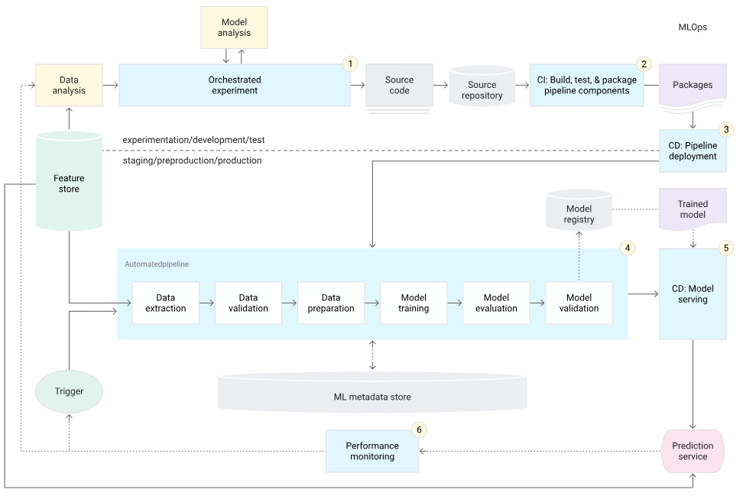
MLOps level 2: CI/CD pipeline automation
The pipeline is now deployed automatically :
Source control
Test and build services
Deployment services
Model registry
Feature store
ML metadata store
ML pipeline orchestrator
The code itself is now automatically deployed
6 main steps in the pipeline

Slide 10
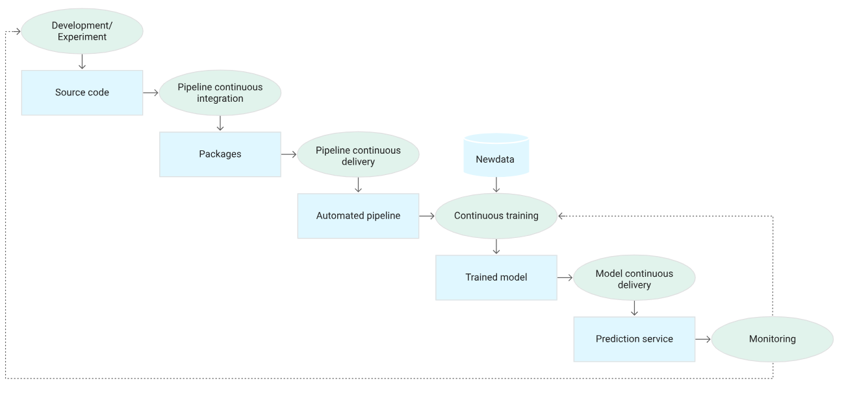
MLOps level 2: The 6 stages of automation
Iteratively try algorithms
Compile source code and running tests
Deploy pipeline to target environment
Trigger the training pipeline automatically
Model endpoint serves requests
Collect & Analyse metrics

Slide 11
Continuous Training : Framework

Slide 12
Continuous Training Framework : 3 steps
When to retrain ? (CT pipeline triggers)
Which data to use ?
What part of the pipeline should be retrained ?
Retraining
Model Quality
Historical data
Time
Time
Retraining data : What window size ?

Slide 13
Continuous Training Framework : When to retrain ?
ML Pipeline Triggers
Automate retraining based on:
Schedule (e.g., daily/weekly)
Easiest to implement
May not adapt to real-time changes
Maintains model freshness in stable environments
Performance decay (If not broken why fix it ?)
Feedback could take time
Businesss may be impacted already
Requires monitoring tools & metrics
Can lead to delayed action if performance degradation is gradual
Concept drift (data distribution shifts)
Independent of feedback delay
Requires continuous monitoring of input data distributions
Can trigger retraining proactively to maintain model relevance
Model Quality
Retraining
Time

Slide 14
Continuous Training Framework : Which data to use ?
Fix window size
Easy
Too wide : may miss seasonnal trends
Too narrow : may overfit on noisy data
Dynamic window size
Window size is an hyperparamater -> Can be optimized
Data driven
Harder to implement
Intensive computing
Dynamic data selection
Measure data similarity
Try to train a model that tries to differenciate 2 datasets.
Drift = Mean(AUC)
Historical data
Time
Retraining data : What window size ?

Slide 15
CT Framework : What parts of the pipeline should be retrained ?
Automate model and HyperParameter search
Use Azure Auto ML to explore models, losses, and hyperparameters.
Keep track of top-performing configs in Azure ML Model Registry.
Retrain only when better configurations are found (Azure ML Pipelines)
Modular and versioned code
Decouple preprocessing, features, and models in code (Azure ML Components)
Track experiments with MLOps tools (Azure ML Experiments & Runs)
Allow easy swapping of components like loss functions (Azure DevOps or GitHub/GitLab)
Adaptive training with feedback
Adjust loss functions based on new data patterns. (Azure ML Data Drift Monitor)
Include user feedback in training for faster adaptation. (Azure App Insights)
Trigger retraining based on business or performance metrics. (Azure ML Pipeline Triggers)

Slide 16
Continuous Training Framework : Final notes
CT Can create damage
Retraining can sometimes exacerbate issues if the root cause is not addressed.
Overfitting to new data might lead to worse generalization.
The cause of bad performance can be elsewhere
Data quality → Fix upstream data source
Data/Concept drift may require classification thresholds update
Refit preprocessing parameters
Update classification threshold
Always diagnose the root cause of performance degradation before retraining.
Prioritize fixing upstream issues and optimizing existing components.
Retraining should be a last resort, not the default solution.

