Slide 1

MLFlow

Slide 2



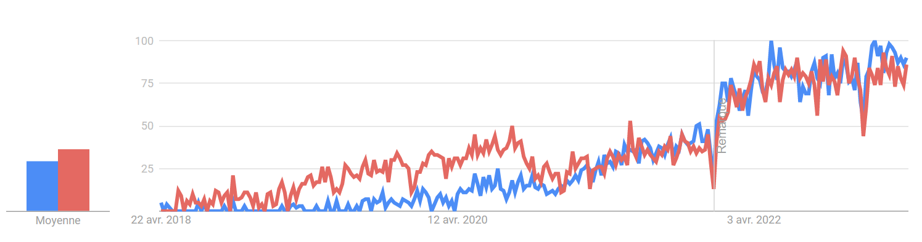
MLFlow follows the trend of increasing interest for MLOps
Source : Google Trends

Slide 3
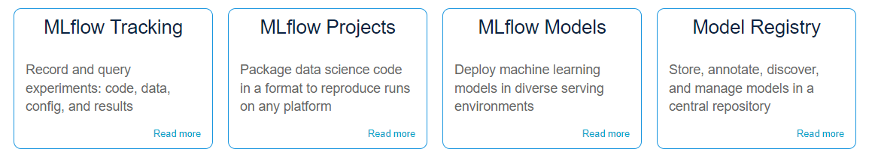
What is MLFlow ?
Open source platform developed by Databricks to manage ML models lifecycles. It’s a comprehensive solution that’s used from the experimentations to the deployment of a model.
The 4 main components of MLFlow:
Source : mlflow.org

Slide 4
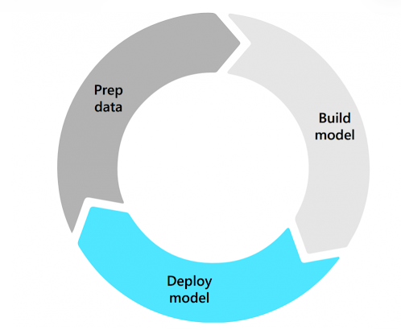
ML Lifecycle?
Data preparation :
Data cleaning
Data labelling
Data augmentation
…
Build model :
Model development
Model training
Model evaluation
Deployment

Slide 5
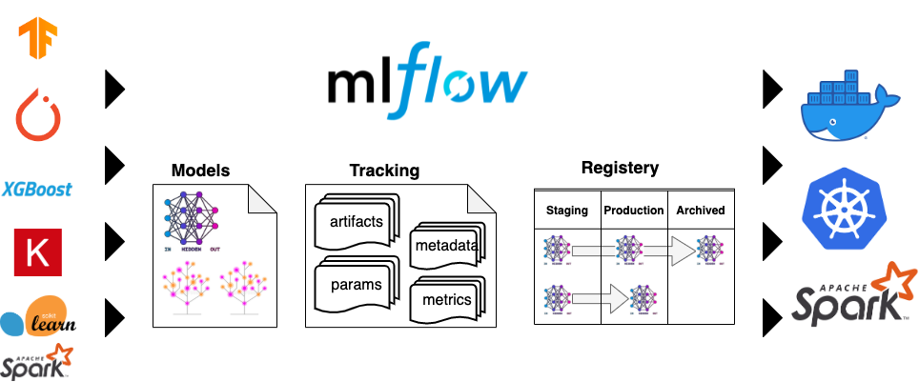

A universal solution
High compatibility with ML frameworks
High compatibility with deployment platforms

Slide 6
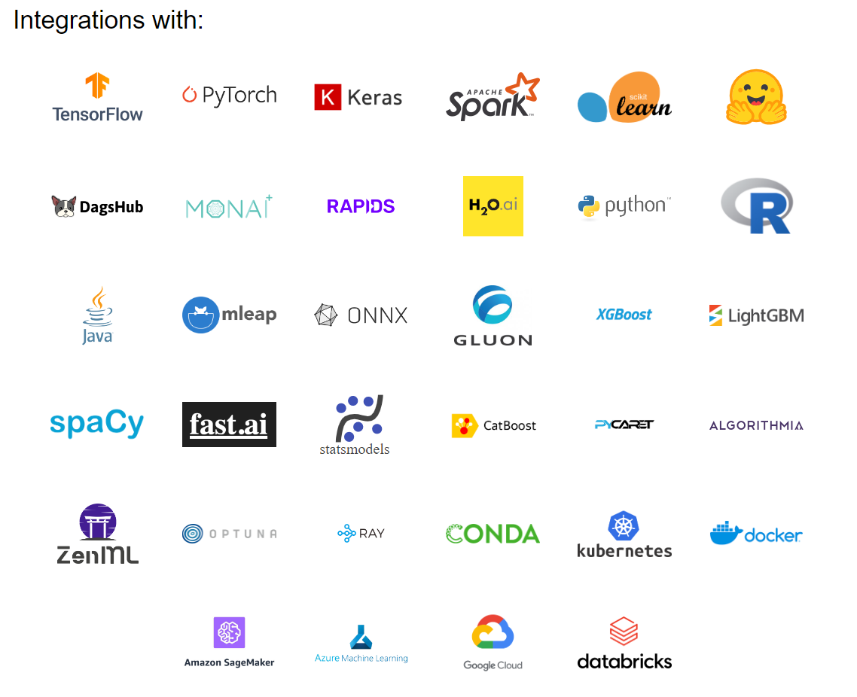
Other examples
Source : mlflow.org

Slide 7
When to use MLFlow ?
Locally, on solo projects that require to train one or more ML models. MLFlow is a useful tool to track experiments results, without adding a lot of extra libraries/dependencies.
For group projects, to share hyperparameters and KPIs on the same model instance.
On cloud or on-premise servers, using MLOPs pipelines. MLFlow is able to host the models and deploy them. By separating the pipelines used to train the model and the pipelines used to deploy it, the process can be improved in multiple aspects (maintenance, security, reliability)

Slide 8
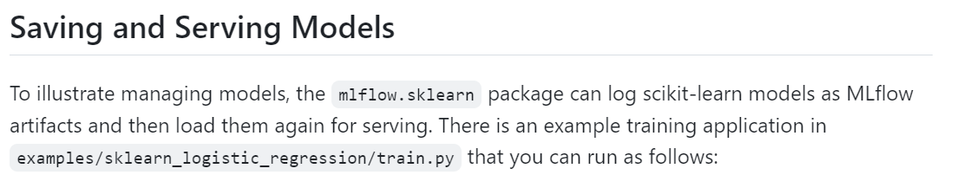
As a ML Engineer/ML Ops …
Model versioning
Data Quality & Data Drift
Serve a model

Slide 9



As a ML Engineer/ML Ops …
Pipeline example for real-time inference
VM
Real time data flow
Data Drift
Cockpit
Data Prep
Data Quality

