Slide 1
Continuous Training and Model Drift

Slide 2
Sommaire
01
04
02
05
03
06
Notes:
Présentation pas technique. Bcp d’informations glanées au fil de l’eau. Ordres de grandeur, exemples, typologies de fraude, prévention

Slide 3
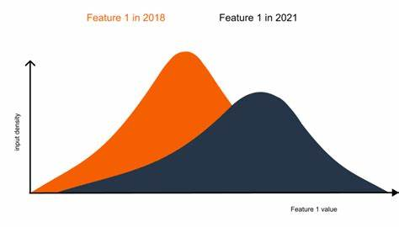
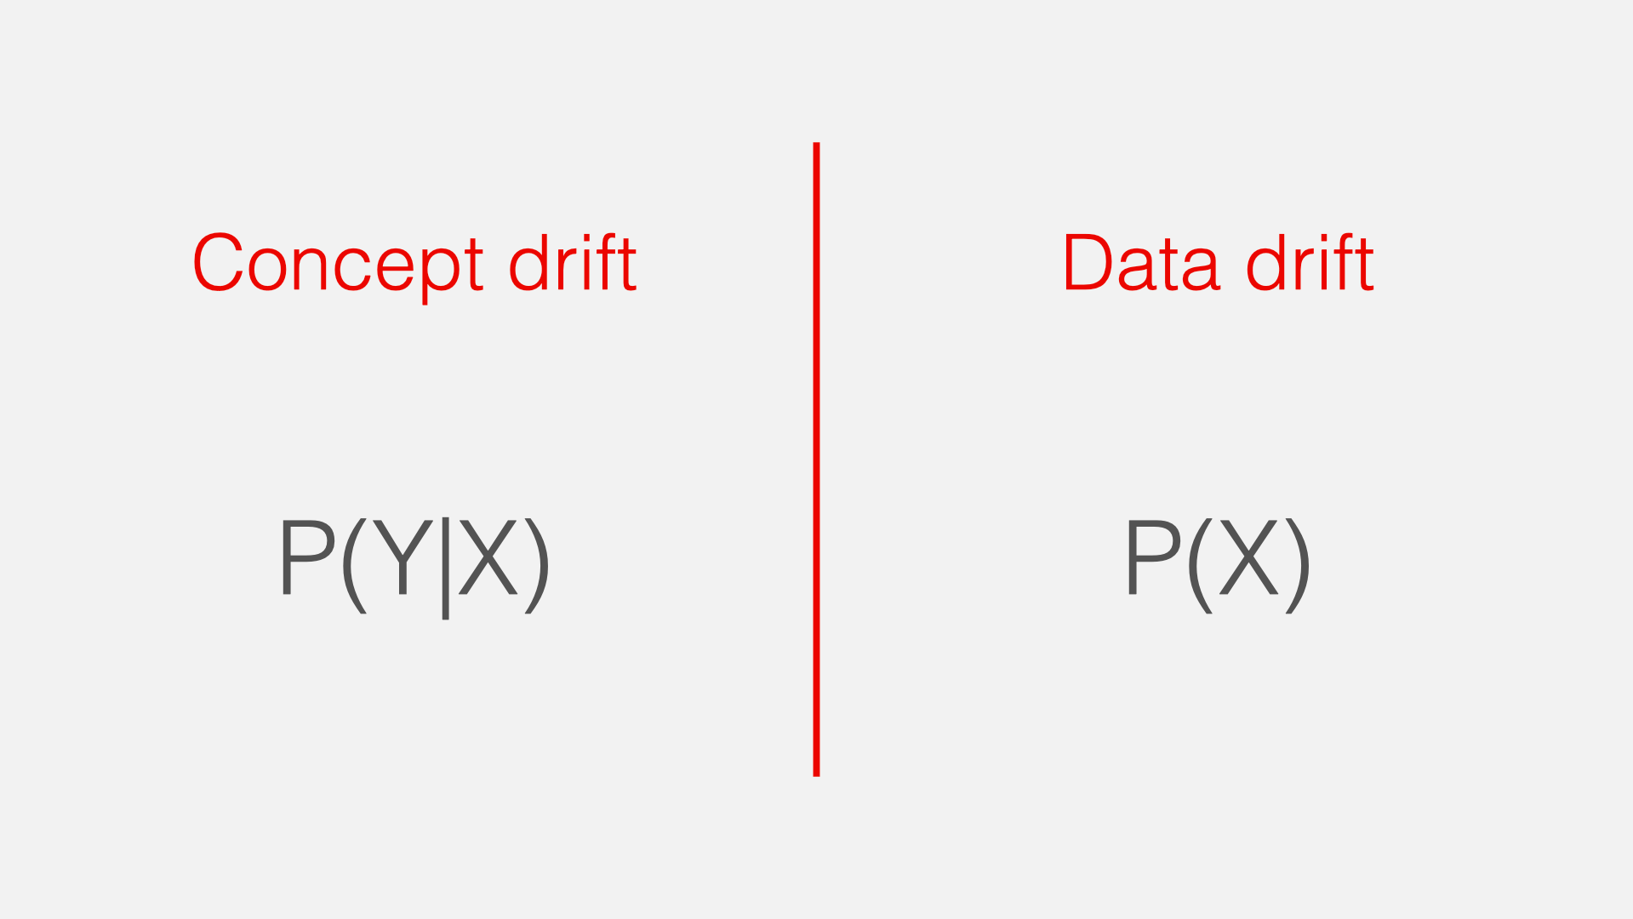
What is Drift
Model drift describes the drop in performance of a model over time. There are two types of drift, concept drift and data drift.
Data drift
Concept drift
The distribution of the input data is changing
A fundamental paradigm change in what the model is measuring.

Slide 4
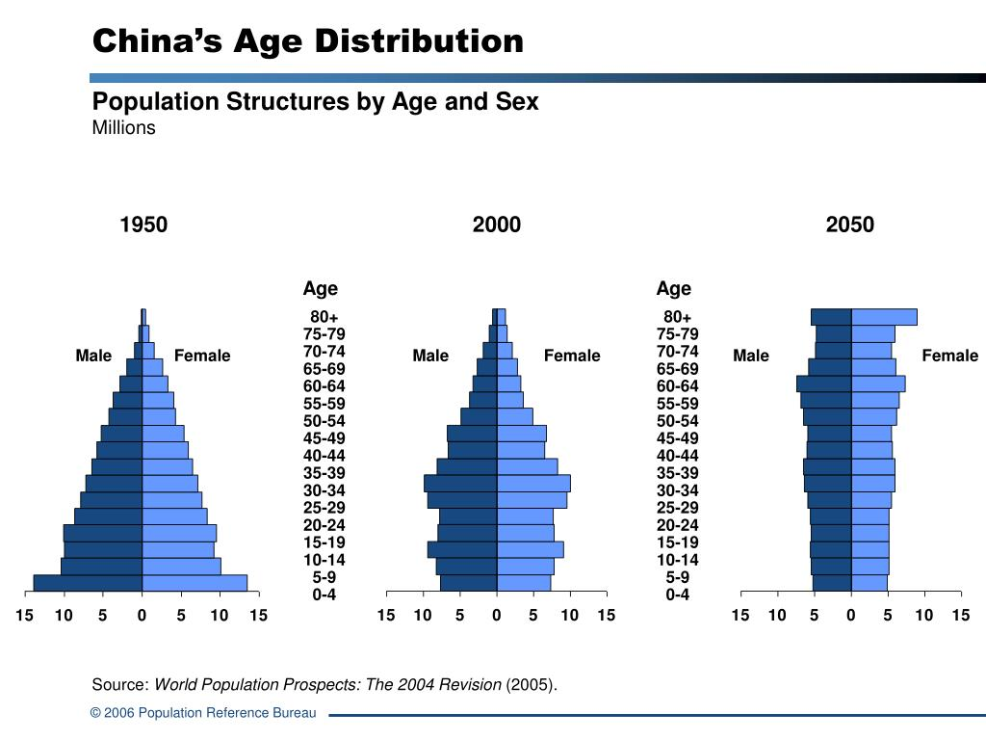
Data Drift
Data drift occurs when the distribution of the input variable changes over time
Example : prediction of average health spending per person in China based on age distribution and other factors.
A model trained on 2000 data will be obsolete by 2050 (or much earlier…)

Slide 5
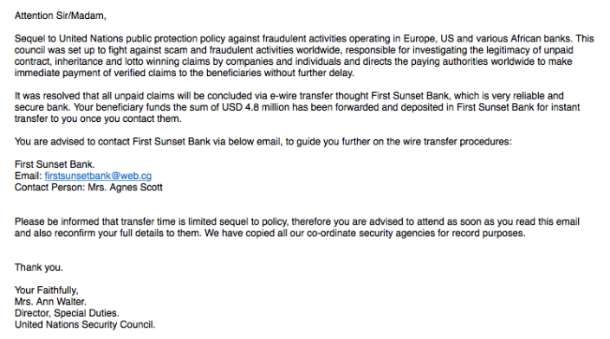
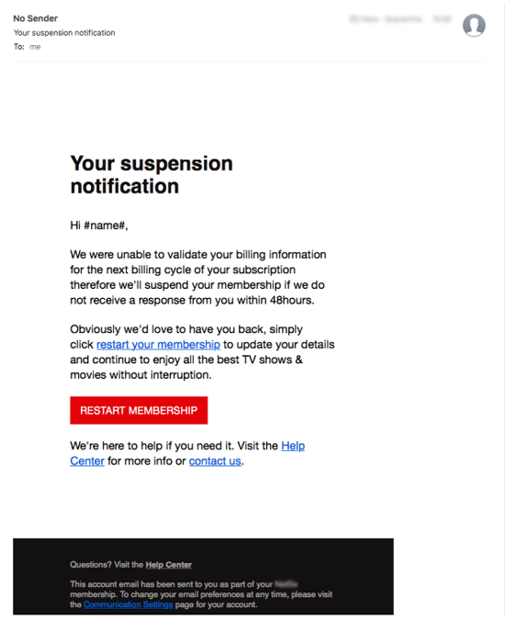
Concept Drift
Phishing e-mail 10 years ago
Phishing e-mail today
Looks official
Does not have a phishy e-mail or huge sum of money
Link should be thoroughly checked to detect phishing
Spam detected
Not detected
Phishy email
Large amount of money
The key markers of a phishing e-mail have changed, so an old model would not have the same performance as before. The overall distribution of the input has maybe not changed, but the target subgroup within the input variables has changed

Slide 6

How to detect, prevent and treat drift
A non-predictive approach
A predictive approach
Use Machine Learnig algorithms on the loss to predict drift
Predicting drift is quite difficult but very important for model performance
Domain knowledge (knowledge that phishing emails change rapidly and drastically)
Statistical test comparing 2 distributions (K-S test, PSI…) -> data drift
Set thresholds for accuracy or loss and alerts when thresholds are reached
Continuous Training

