Slide 1
4- Building an End to End ML pipeline

Slide 2
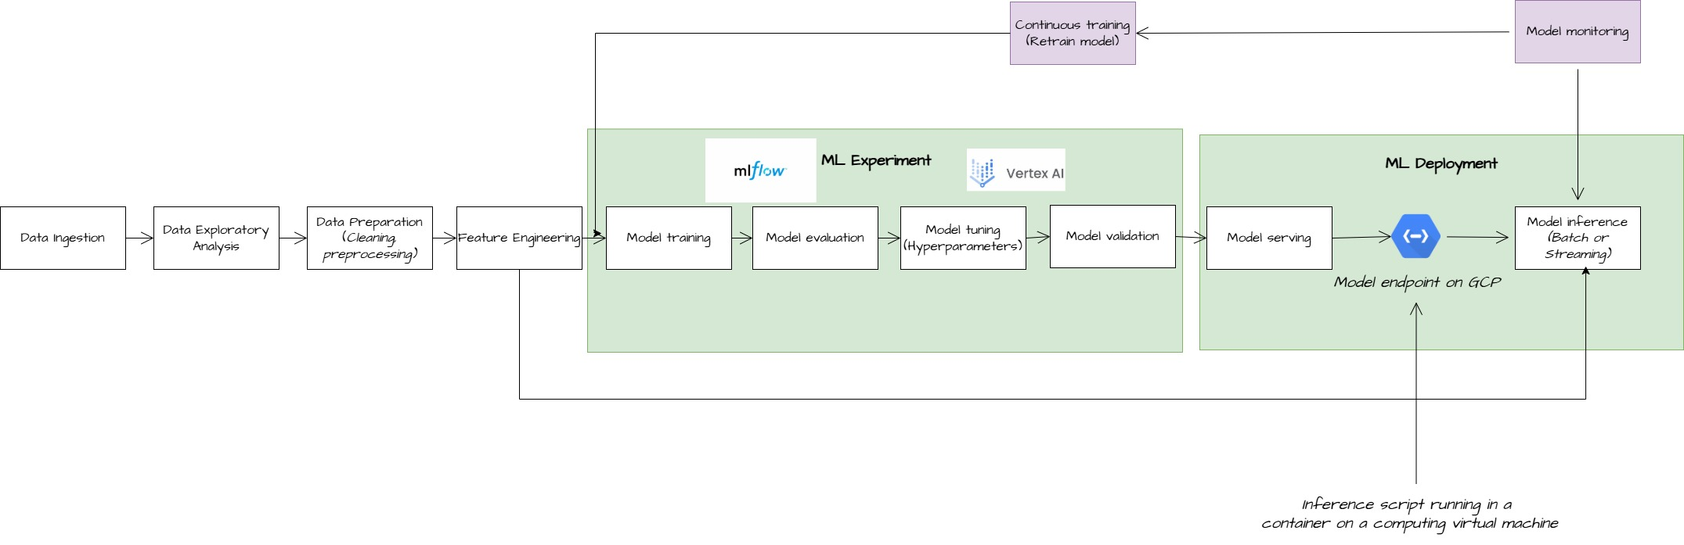
Reminder of what is a ML pipeline
Definition: A ML pipeline is a series of steps in order to serve a machine learning model for inference. It encompasses data acquisition, preprocessing, training, evaluation, and deployment.
In green the concepts seen in classes #1-2-3 /5
In purple the concept for today class

Slide 3


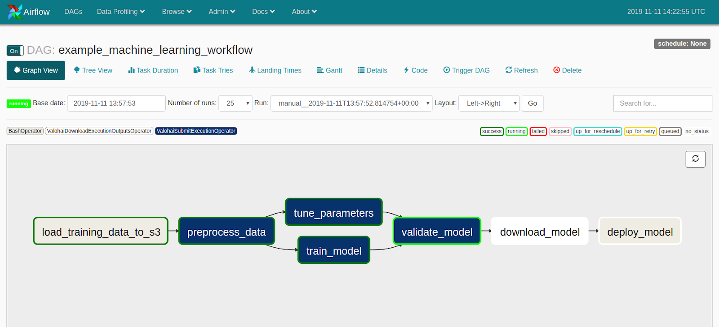
Orchestrate a full ML pipeline
Pipeline
running
Scripts finished successfuly
Running script
Scripts waiting to run

Slide 4
Google (TFX) for building full End-to-End ML pipeline
What is TFX?
An end-to-end (E2E) platform from Google for deploying machine learning workflows in production
Compatible infrastructures : For GCP and on-premise
Completely opensourced in 2019 : used at Alphabet of course but also at Spotify, Twitter, Airbus
Components of TFX:
TensorFlow Data Validation (TFDV): Data analysis.
TensorFlow Transform (TFT): Data preprocessing.
TensorFlow Model Analysis (TFMA): Model evaluation.
TensorFlow Serving: Model deployment.
TensorFlow Metadata (TFMD): Metadata management.
Pipeline Orchestrator: (e.g., Apache Beam, Kubeflow).

Slide 5
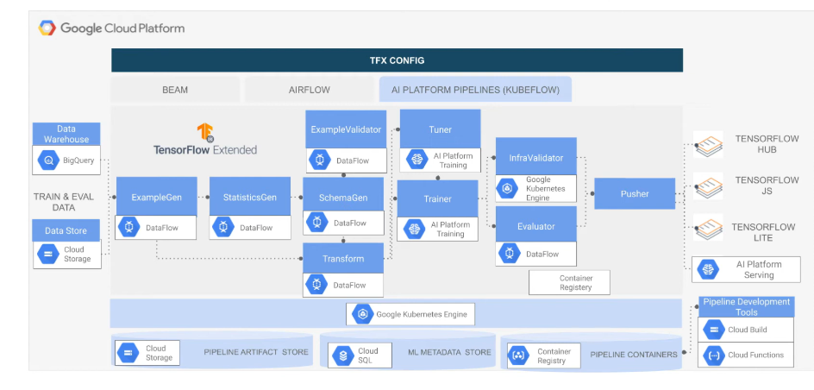
Google (TFX) for building full End-to-End ML pipeline
Modules (Components) inside tfx python library
Orchestrator

Slide 6
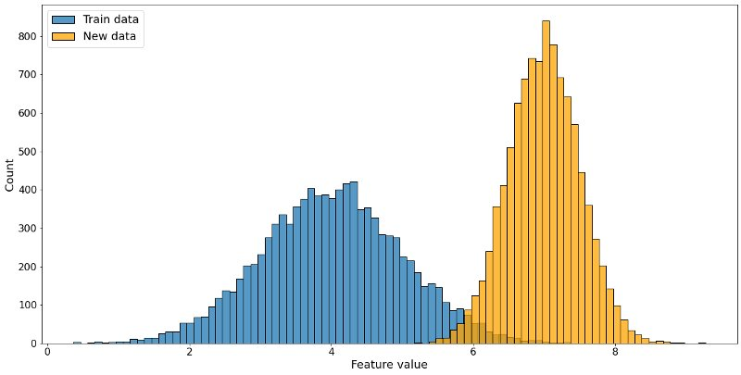
Data drift

Slide 7
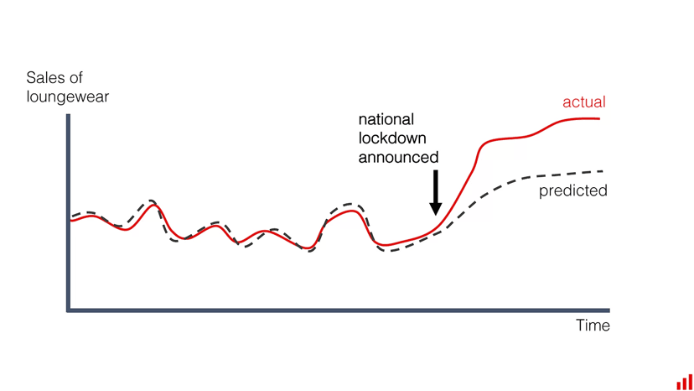
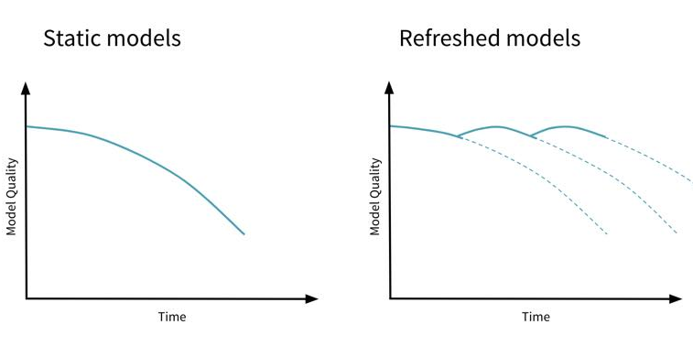
Model drift
Decrease in the model performance over time
Training

Slide 8
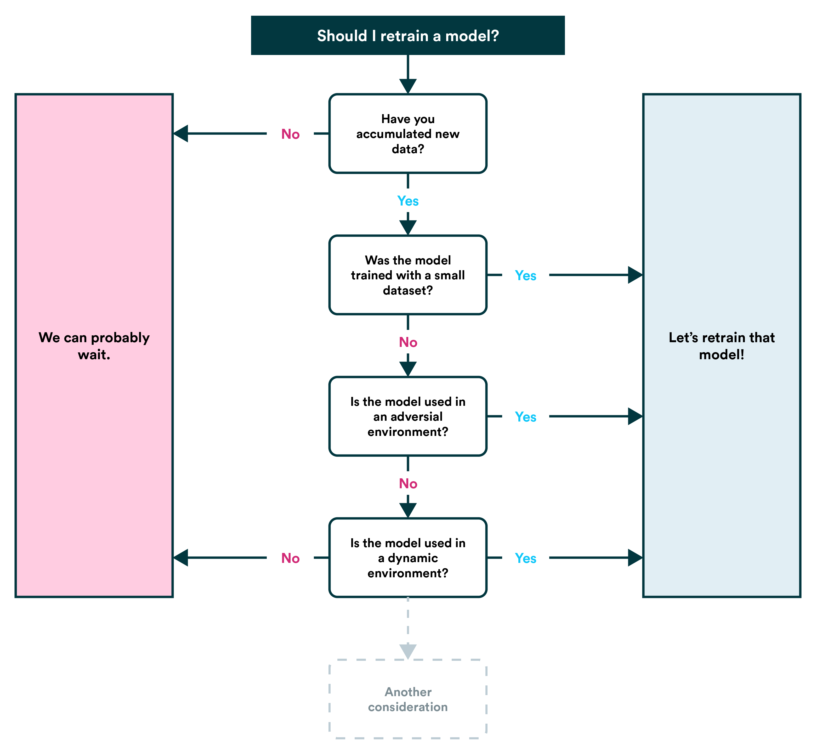
Continuous training (CT)

Slide 9
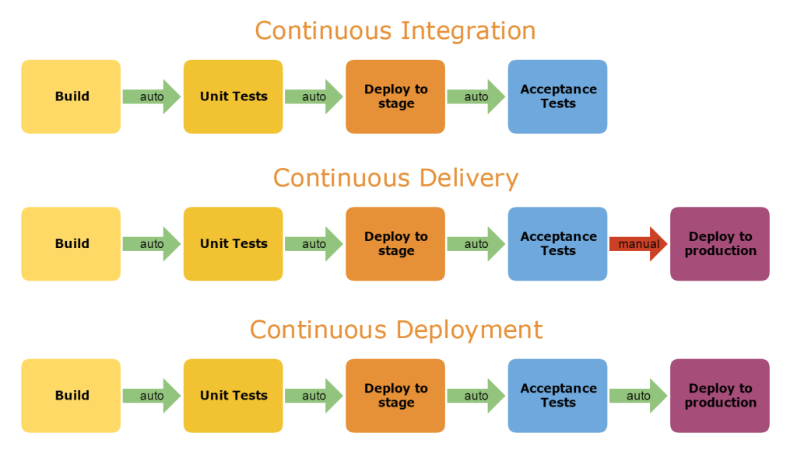
Continuous Integration (CI) and continuous Deployment / Delivery (CD)

Slide 10
Resources
iusztinpaul/energy-forecasting: 🌀 𝗧𝗵𝗲 𝗙𝘂𝗹𝗹 𝗦𝘁𝗮𝗰𝗸 𝟳-𝗦𝘁𝗲𝗽𝘀 𝗠𝗟𝗢𝗽𝘀 𝗙𝗿𝗮𝗺𝗲𝘄𝗼𝗿𝗸 | 𝗟𝗲𝗮𝗿𝗻 𝗠𝗟𝗘 & 𝗠𝗟𝗢𝗽𝘀 for free by designing, building and deploying an end-to-end ML batch system ~ 𝘴𝘰𝘶𝘳𝘤𝘦 𝘤𝘰𝘥𝘦 + 2.5 𝘩𝘰𝘶𝘳𝘴 𝘰𝘧 𝘳𝘦𝘢𝘥𝘪𝘯𝘨 & 𝘷𝘪𝘥𝘦𝘰 𝘮𝘢𝘵𝘦𝘳𝘪𝘢𝘭𝘴

Slide 11
Today’s objectives
1
Implement TFX
2
Continuous training
Extra
Continuous Integration / Continuous Deployment (CI/CD)

