Slide 1
Logo

Slide 2
Money, Institutions, and Markets
ECON 3320 · Money and Banking
Nicolas Cachanosky · UTEP · Center for Free Enterprise

Slide 3
CHAPTER 1
The Nature and Price of Money

Slide 5
Definition
Function 1
Means of payment
Function 2
Unit of account
Function 3
Store of value
Functions

Slide 6
A short history of money
Stage 1
Free banking
Stage 3
Commodity money
Stage 2
Classic gold standard
Stage 4
Bretton Woods System
Stage 5
Fiat money
Stage 6
The future of money?

Slide 8
Person 1
apples
Person 2
bananas
Person 3
salt

Slide 9
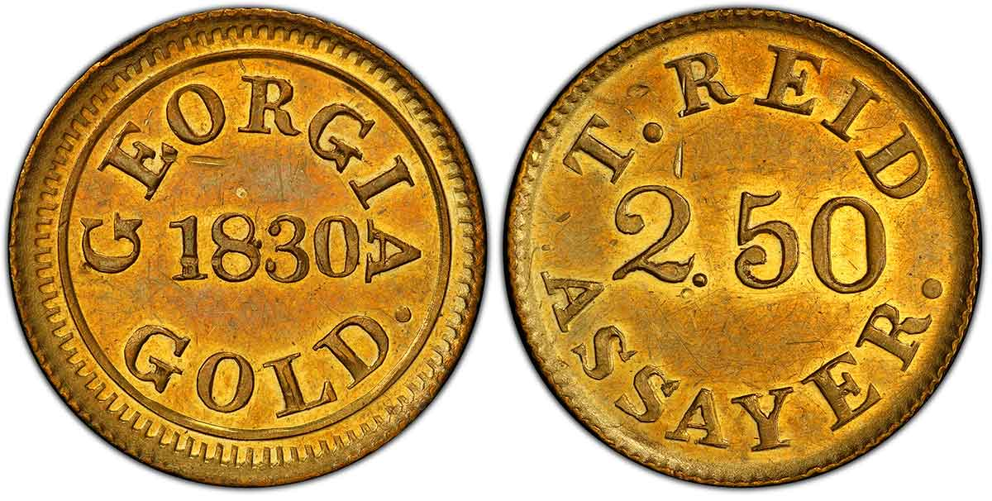
A short history of money

Slide 10
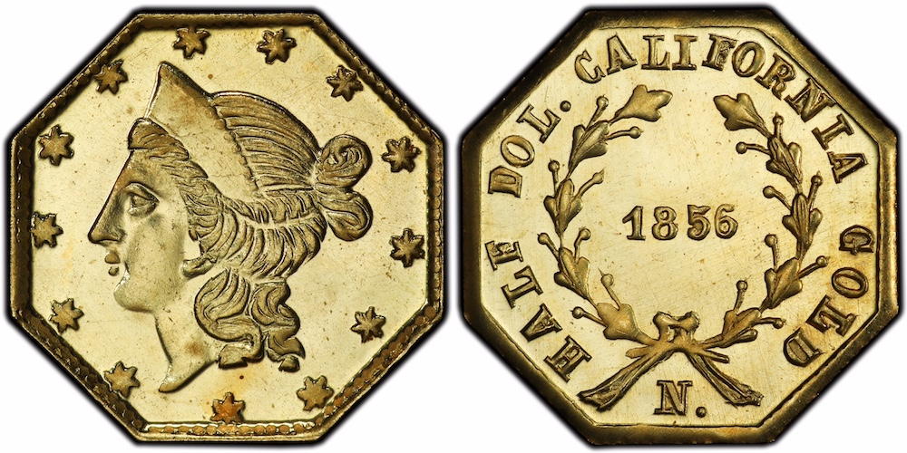
A short history of money

Slide 11
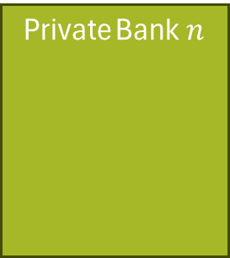

Miner 1
Miner 2
Miner 3
Miner $n$
Gold
Private Bank 1
Private Bank 2
Private Bank 3
Private Bank$n$

Slide 12
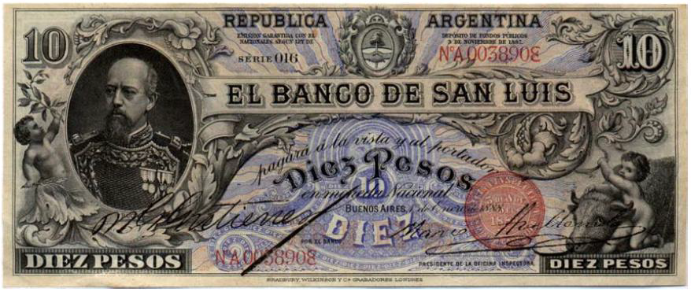
A short history of money

Slide 13

Miner 1
Miner 2
Miner 3
Miner $n$
Gold
National central bank

Slide 14
A short history of money
National central bank
Fiat money

Slide 15
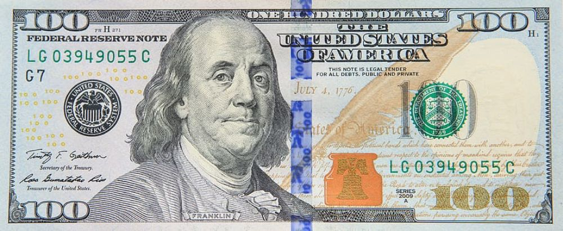
A short history of money

Slide 16
Money in the broader sense
Money in the narrower sense
Commodity money
Fiat money
Money-substitutes
Checks
Digital money
(Bitcoin)
Money certificates
Bank deposits

Slide 17
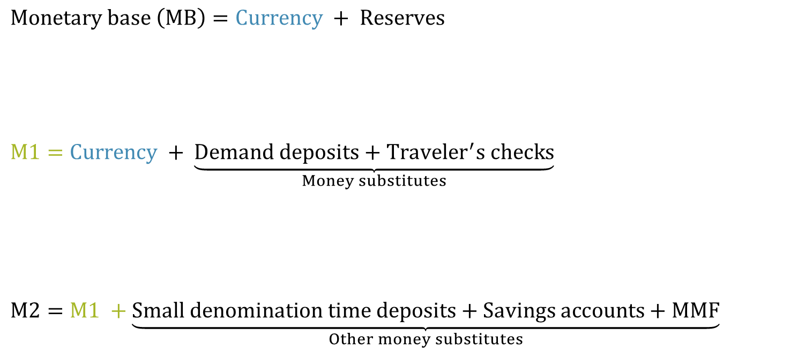
Most liquid
$$Monetary base \left(MB\right)=Currency + Reserves$$
$$M1=Currency + \underset{Money substitutes}{\underbrace{Demand deposits+Traveler^{′}s checks}}$$
$$M2=M1 +\underset{Other money substitutes}{\underbrace{Small denomination time deposits+Savings accounts+MMF}}$$
Less liquid

Slide 18




This IS inflation
Constantly increasing $P$ (price level doesn’t matter)
P
High constant $P$
This is NOT inflation
One time change in $P$
Low constant $P$
time

Slide 19
CHAPTER 2
How Banking Developed Before Central Banks

Slide 20










$$\frac{1}{P}$$
$${\dot{G}}^{S}$$
$$\frac{1}{P}$$
$$G^{S}$$
$${\dot{G}}^{D}$$
$$G^{D}$$
$${\dot{G}}^{∗}$$
$$\dot{G}$$
$$G^{∗}$$
$$G$$
Gold for non-monetary uses

Slide 21










$$\frac{1}{P}$$
$${\dot{G}}^{S}$$
$$\frac{1}{P}$$
$$G_{0}^{S}$$
$$ΔG$$
$$G_{1}^{S}$$
$$\frac{1}{P^{∗}}$$
$$\frac{1}{P^{∗}}$$
$$G_{1}^{D}$$
$${\dot{G}}^{D}$$
$$G_{0}^{D}$$
$${\dot{G}}_{0}^{∗}$$
$$\dot{G}$$
$$G_{0}^{∗}$$
$$G_{1}^{∗}$$
$$G$$

Slide 22








$$\frac{1}{P}$$
$${\dot{G}}_{0}^{S}$$
$$\frac{1}{P}$$
$$G_{0}^{S}$$
$${\dot{G}}_{1}^{S}$$
$$G_{1}^{S}$$
$$\frac{1}{P_{0}^{∗}}$$
$$\frac{1}{P_{0}^{∗}}$$
$$\frac{1}{P_{1}^{∗}}$$
$$\frac{1}{P_{1}^{∗}}$$
$${\dot{G}}^{D}$$
$$G^{D}$$
$${\dot{G}}_{0}^{∗}$$
$$\dot{G}$$
$$\dot{G}$$
$$G^{∗}$$
$$G$$

Slide 23
Blacksmiths
Miners
Gold
Coins
Rest of the market
Mints

Slide 24
Step 1
Initial $100 deposit
Step 2
Bank keeps $20 and buys bonds
Step 3
Bank issues loan for $30
ASSETS
LIABILITIES
ASSETS
LIABILITIES
ASSETS
LIABILITIES
Reserves
$120
Deposits
$100
Reserves
$20
Securities
$100
Deposits
$100
Reserves
$20
Securities
$100
Loans
$30
Deposits
$100
Notes
$30
EQUITY
$20
EQUITY
$20
EQUITY
$20

Slide 25
Reserves
10g
Reserves
9g
Reserves
8.1g
100 oz of gold
100g
90g
90g
81g
81g
Primary creation of money
Secondary creation of money (continues ad infinitum)

Slide 27
Miners
Gold
Reserves
Reserves
Reserves
CLEARING HOUSE
Bank A
Bank B
Bank C

Slide 28
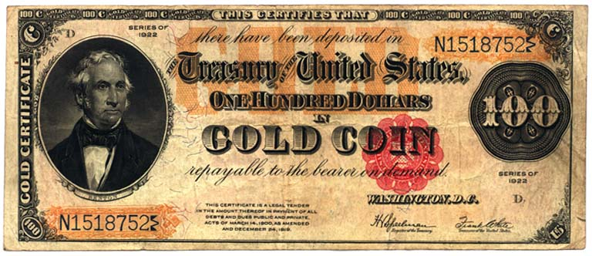

Slide 30
CHAPTER 3
Central Banks

Slide 31
Typical central bank
balance sheet
Federal Reserve
balance sheet
ASSETS
LIABILITIES
ASSETS
LIABILITIES
Foreign ccy.
Securities
Other assets
Base money
Gov. deposits
Bank deposits
Other liabilities
Gold
US Treasury Bonds
MBS
Other assets
Federal reserves
Repos
Gov. deposits
Bank deposits
Other liabilities
EQUITY
EQUITY

Slide 32
FEDERAL RESERVE BALANCE SHEET (MARCH 31, 2023) | MILLIONS OF DOLLARS
ASSETS |  | LIABILITIES
Gold | $11,037 | Federal Reserve notes (net of F.R. Bank holdings) | $2,387,471
SDR | $15,200 | Reserve repurchase agreement | $321,539
Coin | $1,480 | Deposits | $4,057,961
Securities | $6,492,768 | Term deposits held by depository institutions | $0
U.S. Treasury securities | $4,227,581 | Other deposits held by depository institutions | $2,980,514
MBS | $2,050,575 | U.S. Treasury general account | $801,537
Others | $214,612 | Foreign official accounts | $9,439
Net portfolio holdings of MS Facilities 2020 | 2,089 | Other deposits | $266,470
Items in the process of collection | $87 | Deferred availability cash items | $465
Banks premises | $642 | Treasury contributions to credit facilities | $821
Central bank liquidity swaps | $481 | Other liabilities and accrued dividends | -$232,950
Foreign currency denominated assets | $19,416 | Total liabilities | $6,535,307
Other assets | $38,031 | Capital | $45,923
Total assets | $6,581,231 | Liabilities + Capital | $6,581,231

Slide 34
The Federal Reserve
The 12 Federal Reserve banks
Boston | Chicago
New York | St. Louis
Philadelphia | Minneapolis
Cleveland | Kansas City
Richmond | Dallas
Atlanta | San Francisco

Slide 35
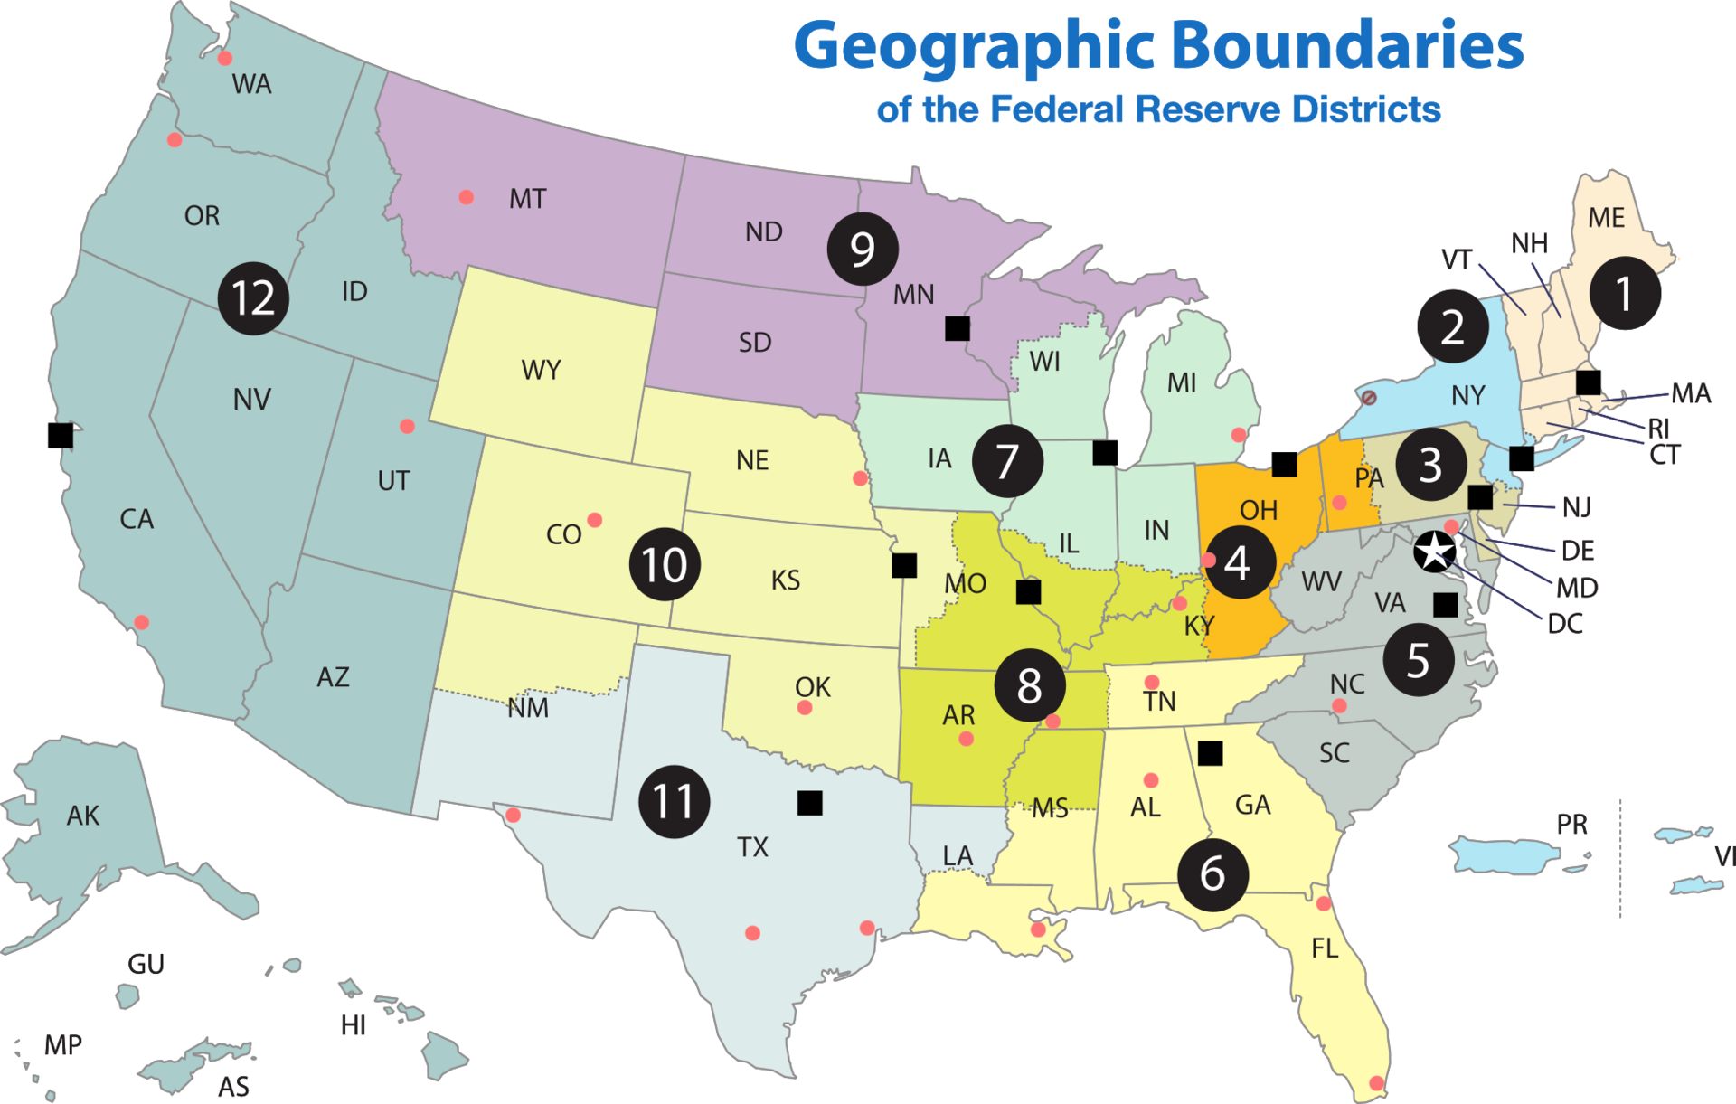
Geographic Boundaries
Federal Reserve Districts

Slide 36
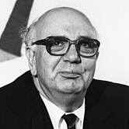
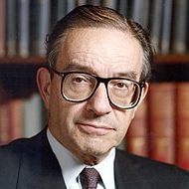
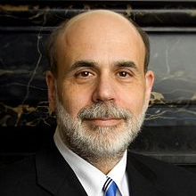
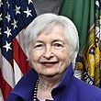
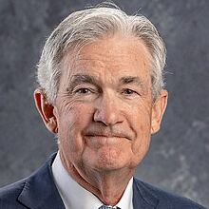
Paul Volcker
1979 – 1987 | 8 years
Alan Greenspan
1987 – 2006 | 19 years
Ben Bernanke
2006 – 2014 | 8 years
Janet Yellen
2014 – 2018 | 4 years
Jerome Powell
2014– incumbent

Slide 37
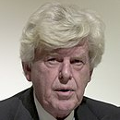
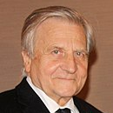
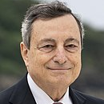
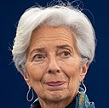
Wim Duisenberg
1998 – 2003 | 5 years
Jean-Claude Trichet
2003 – 2011 | 8 years
Mario Draghi
2011 – 2019 | 8 years
Christine Lagarde
2019 – incumbent

Slide 38
The European Central Bank
The Federal Reserve System | The European Central Bank
The Board of Governors | The Executive Board
12 Regional Federal Reserve Banks | 20 National Central Banks
Federal Open Market Committee | Governing Council

Slide 39
CHAPTER 4
How Central Banks Operate — and Why It Matters

Slide 40

$$y$$
GDP trend
Good monetary policy
Time

Slide 41

The 2008 crisis
COVID inflation
The $r^{∗}$ debate

Slide 42
Policy targets
Immediate targets
Intermediate targets
Final objective
Interest rates
Monetary aggregate
Stable GDP growth
Price level stability
Tools
Monetary regime

Slide 43
Policy targets
Because the final objectives are too “far to reach” for monetary policy, a CB must work with intermediate targets
Most CBs in developed countries target a short-term (i.e., overnight) interest rate
The CB has control over the short-term interest rate but looses control over the final objective variables
Short-term interest rate
Long-term interest rate
Lending
Economic activity
Output and unemployment
Long and variable lags

Slide 44
Monetary policy
Term
Conventional (short-term)
Unconventional (long-term)
Systems
Corridor
Floor

Slide 45
FFR is too high
Before monetary policy
After monetary policy
Bank A
Bank B
Bank A
Bank B
Reserves
Reserves
Desired reserves
Reserves
Reserves

Slide 46
FFR is too low
Before monetary policy
After monetary policy
Bank A
Bank B
Bank A
Bank B
Reserves
Reserves
Desired reserves
Reserves
Reserves

Slide 47



Financial Sector
Rest of the market
Primary dealers
Central Bank
US dollars $→$
More loans $→$
$←$ securities

Slide 48



Financial Sector
Rest of the market
Primary dealers
Central Bank
securities $→$
$←$ Less loans
$←$ US dollars

Slide 49
Policy tools
Interest on reserves (IOR)
Reserves: US dollars that commercial banks hold as a deposit at the Fed
Why pay IOR
Required reserves are a cost to banks, as they cannot lend those US dollars
Because this is a legal requirement, there is a case that the government should compensate the banks by paying IORR
Short history of IOR in the US
Oct-2008: Interest on excess reserves (IOER)
Aug-2016: Interest on required reserves
Jul-2021: IOER and IORR are combined into interest on reserve balances (IORB)
Excess reserves
IOER
IORB
Required reserves
IORR

Slide 50






The corridor system
Assume there is an increase in the demand for reserves
Step 1: Reserves demand shifts
Step 2: The Fed increases the supply of reserves
$$S_{0}^{R}$$
$$i_{FFR}$$
$$i_{FFR}^{T}$$
$$D_{0}^{R}$$
$$R_{0}$$
$$R$$

Slide 51





The floor system
Floor
IOR
No bank will lend reserves to another one if they pay less than the IOR
Ceiling
Discount rate
No bank will borrow from another bank if they can get a discount loan at a lower rate
$$i_{FFR}$$
$$i^{D}$$
$$S_{0}^{R}$$
$$i^{R}$$
$$D_{0}^{R}$$
$$R_{0}$$
$$R$$

Slide 52
CHAPTER 5
How Financial Markets Work

Slide 53
The financial system
1 Money and payment technologies
To pay for purchases and store wealth
2 Financial instruments
To transfer resources and risk from savers to investors
3 Financial markets
Where financial instruments are exchanged
4 Financial institutions
Provide access to financial markets, collect information, and provide services
5 Financial regulators
Oversights the financial system
6 Central banks
Monitor financial institutions and stabilize the economy

Slide 54

























Financial instruments
What is a cash-flow?
A cash-flow is a combination of dates $\left(t\right)$and payments $\left(p\right)$: $CF=f\left(t, p\right)$
$$\$5$$
$$\$5$$
$$\$5$$
$$\$5$$
$$\$5$$
$$\$105$$
$$2025$$
$$2026$$
$$2027$$
$$2028$$
$$2029$$
$$2055$$
$$p_{1}$$
$$p_{2}$$
$$p_{3}$$
$$p_{4}$$
$$p_{5}$$
$$p_{T}$$
$$t=1$$
$$t=2$$
$$t=3$$
$$t=4$$
$$t=5$$
$$t=6$$

Slide 55
The basic balance sheet of a financial institutions
ASSETS
LIABILITIES
More liquid
Cash
Stocks
Bonds
Loans
Real estate
Other assets
Deposits
Insurance policies
EQUITY
Less liquid

Slide 56

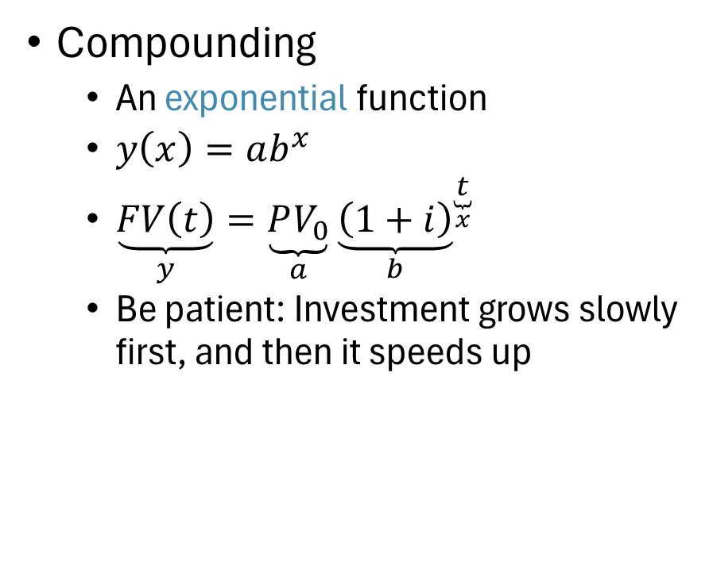

Future value
Compounding
An exponential function
$y\left(x\right)=ab^{x}$
$\underset{y}{\underbrace{FV\left(t\right)}}=\underset{a}{\underbrace{PV_{0}}}{\underset{b}{\underbrace{\left(1+i\right)}}}^{\underset{x}{\underbrace{t}}}$
Be patient: Investment grows slowly first, and then it speeds up
$$FV_{t}$$
$$PV_{0}$$
Time

Slide 57


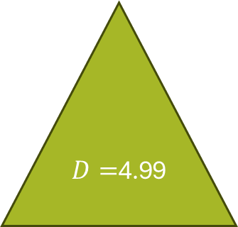



$103
$3
$3
$3
$3
$D=$4.99
$$t=1$$
$$t=2$$
$$t=3$$
$$t=4$$
$$t=5$$

Slide 58
CHAPTER 6
Pricing Financial Assets

Slide 59
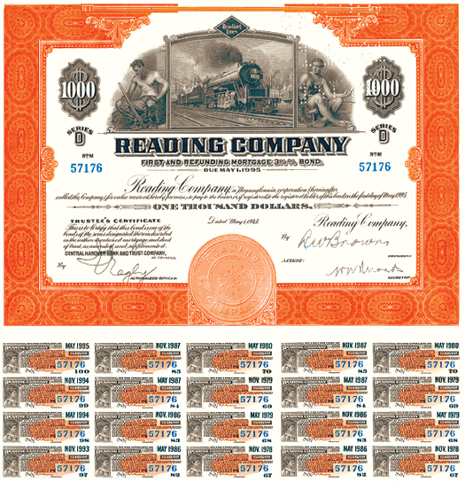

Slide 63

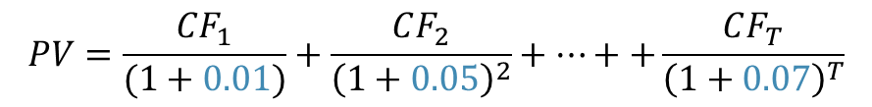



The yield curve
Discount rate
Proper cash flow valuation: Use zero-coupon discount rates for each payment date
7%
5%
1%
$$t$$
$$1$$
$$2$$
$$3$$
$$PV=\frac{CF_{1}}{(1+0.01)}+\frac{CF_{2}}{{\left(1+0.05\right)}^{2}}+…++\frac{CF_{T}}{{\left(1+0.07\right)}^{T}}$$

Slide 64
Bond from riskier country Orange
Bond from risky country Green
Country risk
Country risk

Slide 65
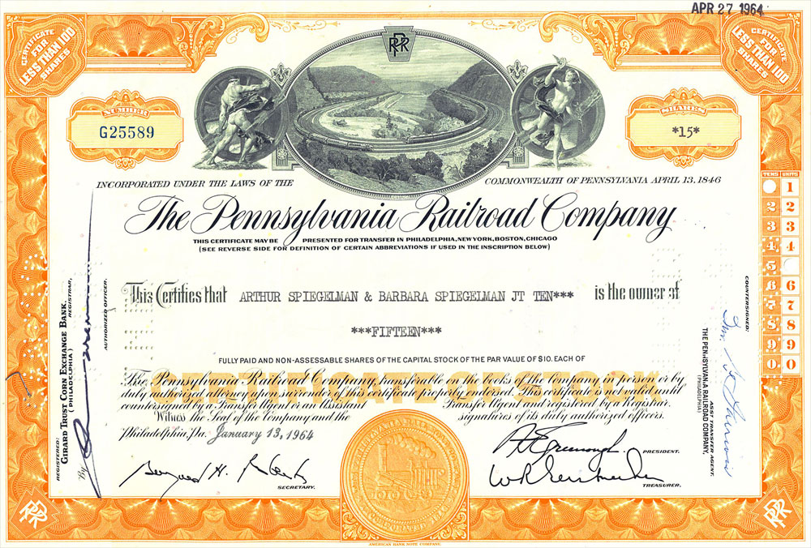

Slide 66
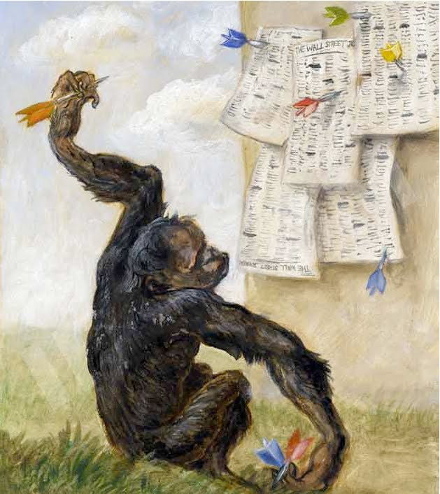

Slide 67
CHAPTER 6
Pricing Financial Assets

Slide 68

Risk premium
$$E[r]$$
Risk premium
$$β$$
Risk-free return
$$σ$$

Slide 69


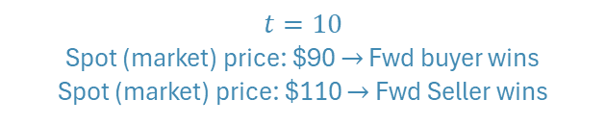
Forwards and futures
$$t=0$$
Agree to sell/buy at $t=10$ at $p=\$100$
$$t=10$$
Sell/buy at $t=10$ at $p=\$100$
$$t=10$$
Spot (market) price: $90 $→$ Fwd buyer wins
Spot (market) price: $110 $→$ Fwd Seller wins

Slide 70
Swaps
Interest rate swaps (cont…)
Interest rate swaps are agreements between two counterparties to exchange periodic interest rate payments over some future period, based on an agree-upon amount of principal (the notional principal)
Commercial bank
Business
Swap dealer
$1 million loan (5 years)
Fixed rate (5 years)
LIBOR + 1%
LIBOR + 1%
Loan
Interest rate swap

Slide 71
Exchange rate policy
How should CBs manage the exchange rate
Should there be any capital controls (restrictions to the inflow and outflow of money)?
What’s a free-floating exchange rate
When ORA = 0
Be careful!
Moving the interest rate affects the exchange rate even if ORA = 0
Free-floating exchange rate
Dirty (or managed) float
Crawling peg
Fixed (or soft) peg
Currency board
Monetary union
Hard pegs
Dollarization

Slide 72
Exchange rate policy
Capital controls and the policymakers’ choice
The trilemma (impossible trinity) of monetary policy: Pick only 2
United States
Open to international flows
Control the interest rate
Free exchange rate
Argentina
Manage the exchange rate
Control the interest rate
Capital controls
Free capital flows
Control interest rates
Fix the exchange rate

Slide 73
Exchange rate policy
Fixed exchange rate (peso depreciated)
Fixed exchange rate (peso appreciated)
$$e_{EUR}$$
$$e_{EUR}$$
$$S_{EUR}$$
$$S_{EUR}$$
Central bank accumulates reserves
$$D_{EUR}$$
Central bank loses reserves
$$D_{EUR}$$
EUR
EUR

