Slide 1
CHAPTER 1
Section 1

Slide 3
Definition
Function 1
Means of payment
Function 2
Unit of account
Function 3
Store of value
Functions

Slide 4
A short history of money
Stage 1
Free banking
Stage 3
Commodity money
Stage 2
Classic gold standard
Stage 4
Bretton Woods System
Stage 5
Fiat money
Stage 6
The future of money?

Slide 6
Person 1
apples
Person 2
bananas
Person 3
salt

Slide 7
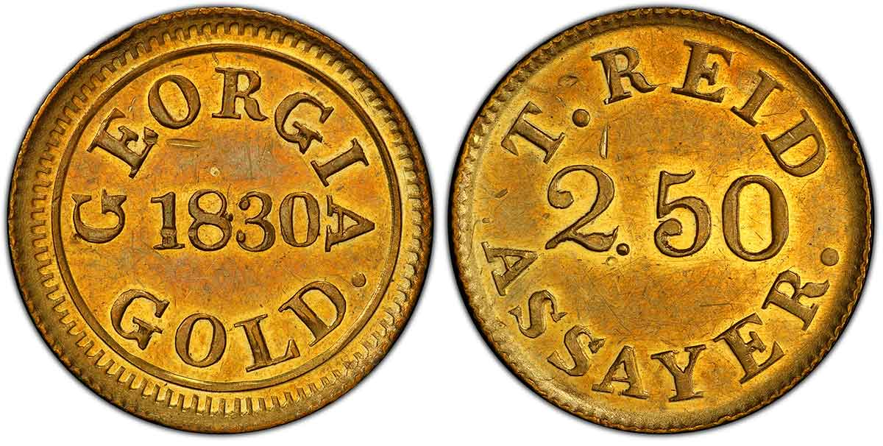
A short history of money

Slide 8
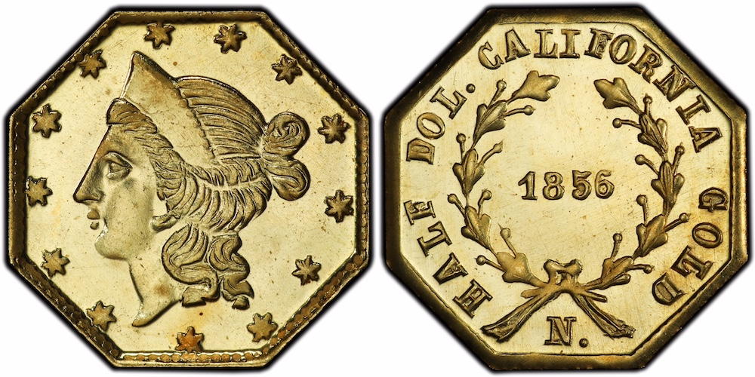
A short history of money

Slide 9


Miner 1
Miner 2
Miner 3
Miner $n$
Gold
Private Bank 1
Private Bank 2
Private Bank 3
Private Bank$n$

Slide 10
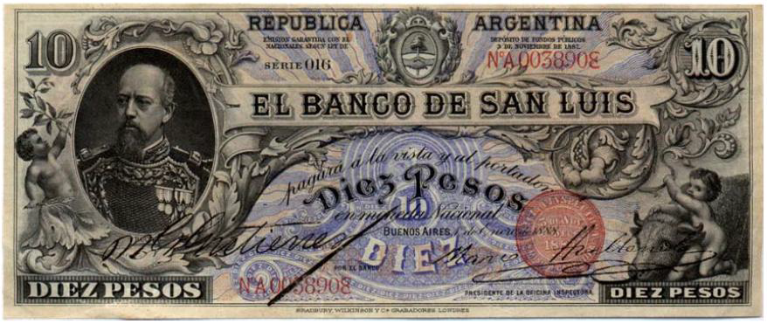
A short history of money

Slide 11

Miner 1
Miner 2
Miner 3
Miner $n$
Gold
National central bank

Slide 12
A short history of money
National central bank
Fiat money

Slide 13
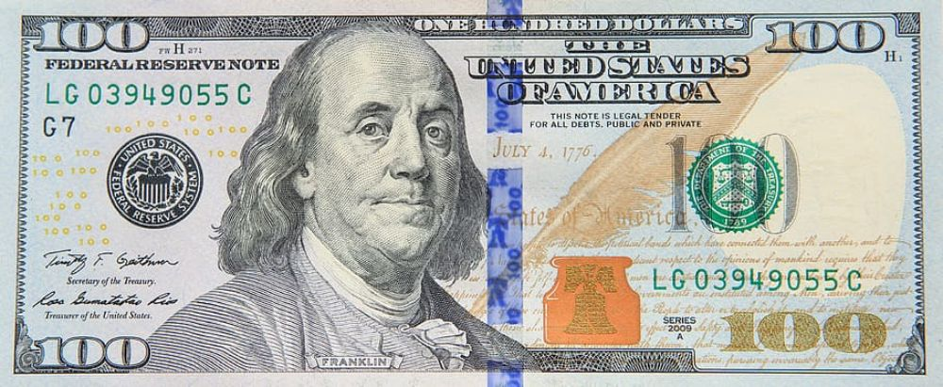
A short history of money

Slide 14
Money in the broader sense
Money in the narrower sense
Commodity money
Fiat money
Money-substitutes
Checks
Digital money
(Bitcoin)
Money certificates
Bank deposits

Slide 15
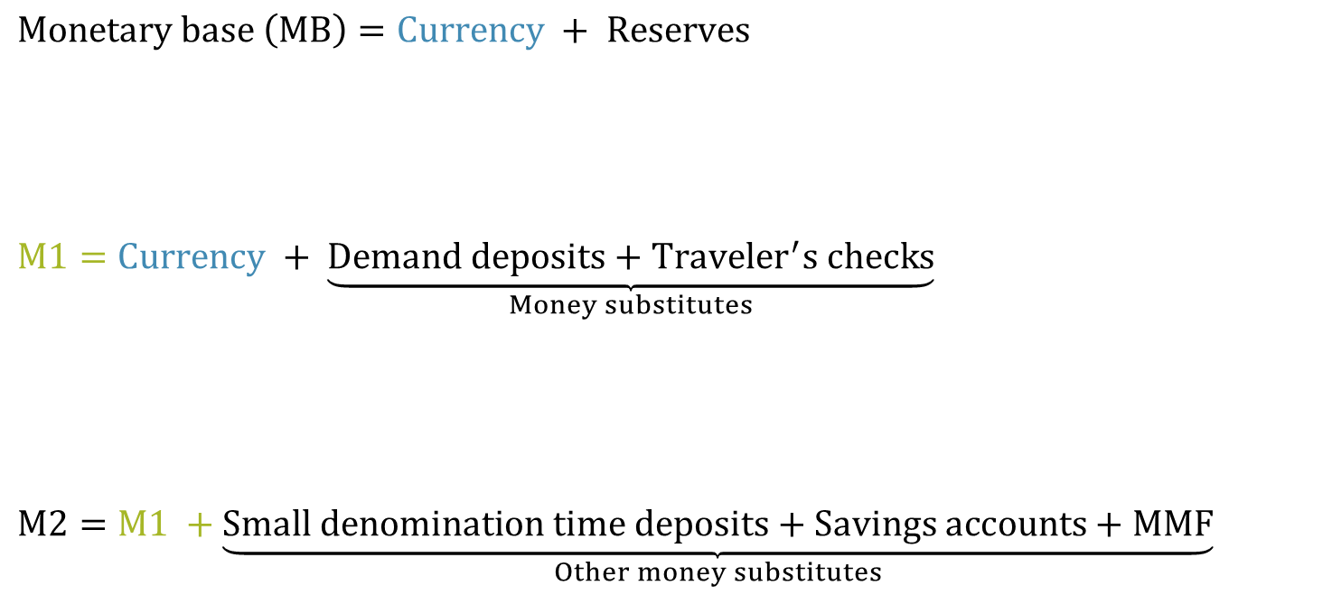
Most liquid
$$Monetary base \left(MB\right)=Currency + Reserves$$
$$M1=Currency + \underset{Money substitutes}{\underbrace{Demand deposits+Traveler^{′}s checks}}$$
$$M2=M1 +\underset{Other money substitutes}{\underbrace{Small denomination time deposits+Savings accounts+MMF}}$$
Less liquid

Slide 16




This IS inflation
Constantly increasing $P$ (price level doesn’t matter)
P
High constant $P$
This is NOT inflation
One time change in $P$
Low constant $P$
time

Slide 17

MONEY AND BANKING
LECTURE 1
WHAT IS MONEY?
Nicolas Cachanosky | ncachanosky@utep.edu

